Slide 1
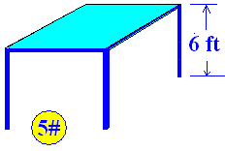
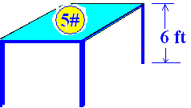
Work = Force * Distance
Work = 5 * 6 = 30 Foot Pounds

Slide 2
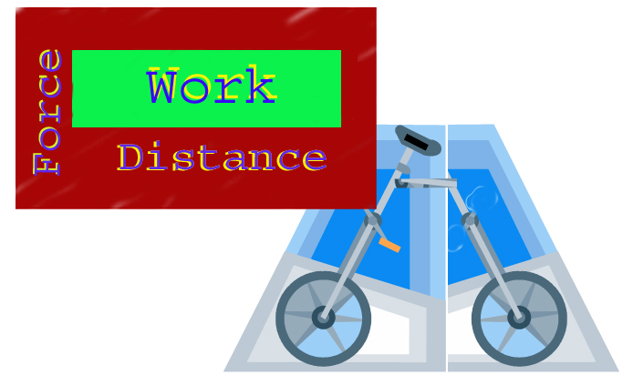
Work = Force * Distance

Slide 3
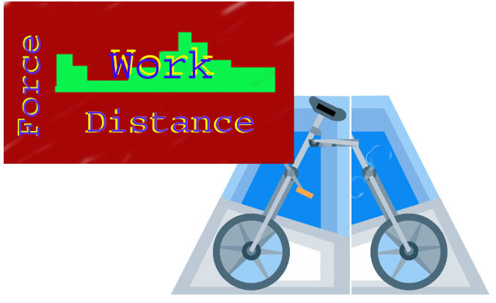
Work = Force * Distance

Slide 4
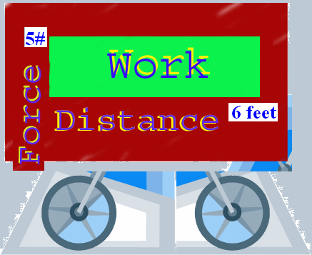
Work = Force * Distance

Slide 5


How much work in ft-pounds is done lifting a 25 pound ball 8 feet?
200.0
0.1

Slide 6
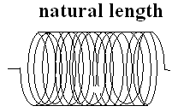
A spring of natural length
Hooke’s Law F(x) = kx

Slide 7
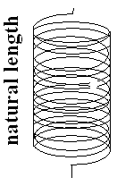
Tom McLean hung his 54# back pack on the scale at the Appalachin Trail and the spring stretched ¾ of an inch.
F(x) = kx
54 = 0.75k
216/3 = k #/in
F(x) = 72 x

Slide 8
It takes Bruce McLean a force of 40 pounds to compress his garage door spring ¼ inch.
F(x) = kx
40 = 0.25 k
160 = k #/in
F(x) = 160x

Slide 9

If it takes 3 # to hold the spring two feet beyond its natural length
F(x) = kx
F(2) = k2 = 3
K = 3/2 thus F(x) = 3/2 x
The spring constant is 1.5.

Slide 10
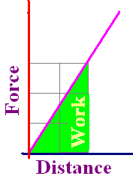
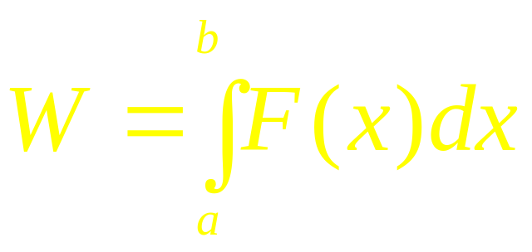
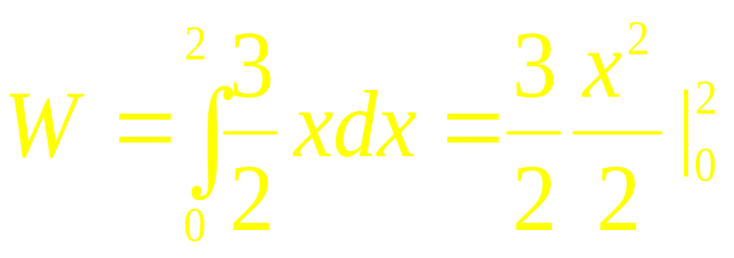
How much work was done in pulling the first spring to two feet beyond its natural length?
Work is the area of the green region.

Slide 11
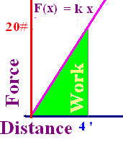
F=20 # keeps a spring 4 feet beyond its natural length. Find k if F(x) = kx
5.0
0.1

Slide 12

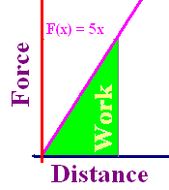
With k=5, how much work if stretched from natural length to 6 feet beyond natural length?
30 ft-lbs
60 ft-lbs
90 ft-lbs

Slide 13
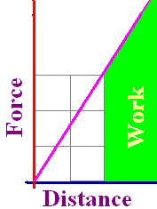

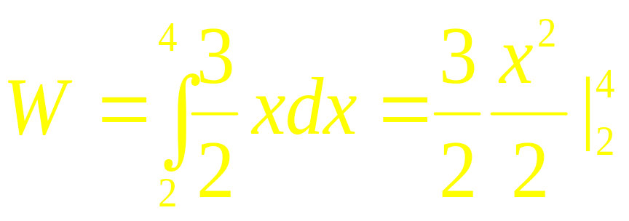
How much work is done in pulling the first spring two additional feet?
Work is the green area.

Slide 14
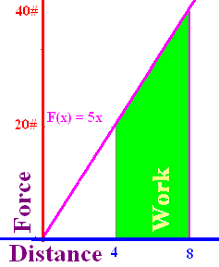
20# needed to stretch 4 ft. How much work to pull it another 4 ft?
120.0
0.1

Slide 15
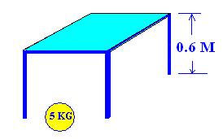
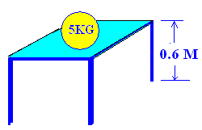
Work = Force * Distance
Force = 9.8 * 5 = 49 Newtons
Work = 9.8 * 5 * 0.6 = 29.4 Newton-Meters (Joules)

Slide 16
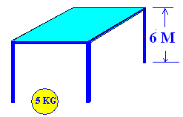
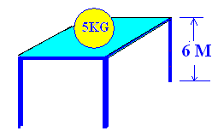
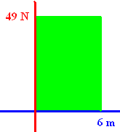
Work = Force * Distance
How much work is done if a force of 49 N is lifted 6 meters?
W = 49 * 6 = 294 Joules

Slide 17

If it takes 3 N to hold the spring 1.8 meters beyond its natural length
F(x) = kx
F(1.8) = 1.8k = 3
K = 5/3 thus F(x) = 5/3 x
The spring constant is 5/3.

Slide 18
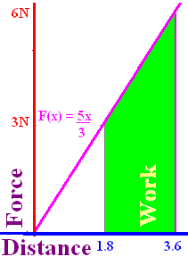

How much work is done in pulling that spring 1.8 additional meters?
Work is the area that is green.

Slide 19
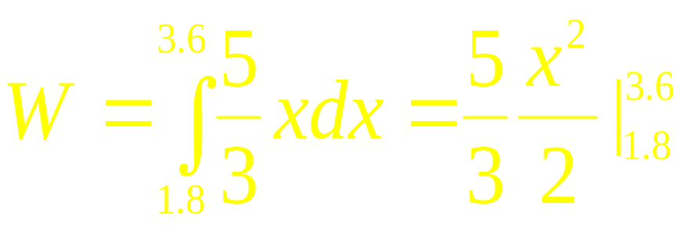
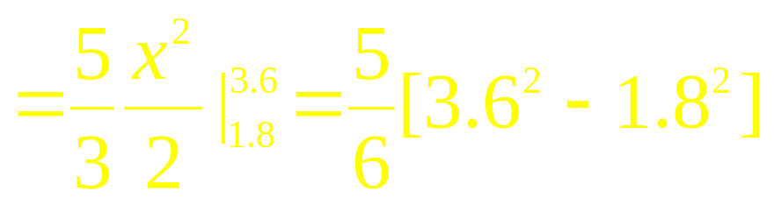

How much work is done in pulling that spring 1.8 additional meters?

Slide 20
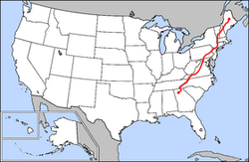
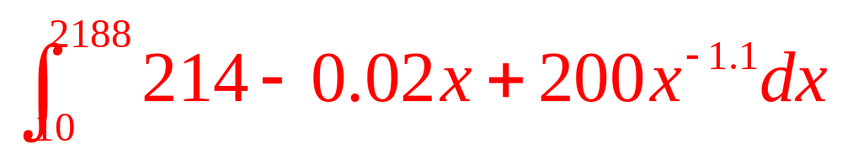
If Tom’s pack weighed 54 – 0.01x and Tom weighed 160 – 0.01x + 200/x^{1.1}, how much work did he do in walking the 2178 miles?
Trip starts at x=10 and finishes when x = 2188 miles.

Slide 21
Mile Pounds

Slide 22
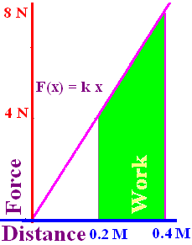
4 N holds a spring 0.2 meters beyond its natural length. Find k in F = kx.
20.0
0.1

Slide 23

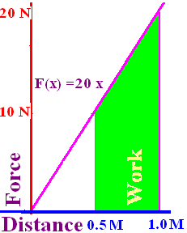
Find the work in stretching that same spring from ½ meter to 1 meter.
7.5
0.1

Slide 24
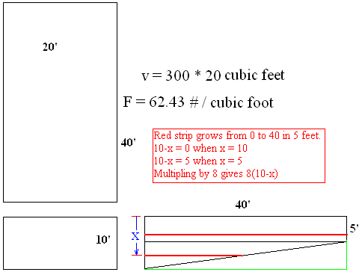
Find the work in emptying a swimming pool filled with water.
Thin slabs of water
must be lifted x feet.
Each slab weighs
62.43*20*40 Δx for 5’
62.43*20*8*(10-x) Δx
(y-0)/(x-10)=40/-5

Slide 25
The weight of one cubic foot of water is 7.48052 gallons per cubic foot times 8.3453 pounds per gallon, which equals 62.42718356 pounds of water per cubic foot.

Slide 26
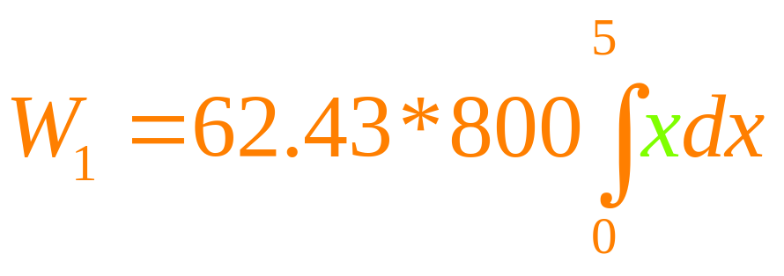
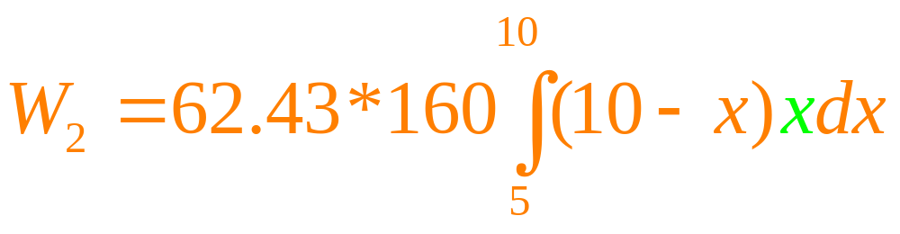
Find the work in emptying a swimming pool filled with water.
Thin slabs of water
must be lifted x feet
Each slab weighs
62.43*20*40 Δx for 5’
62.43*20*8*(10-x) Δx

