Slide 1
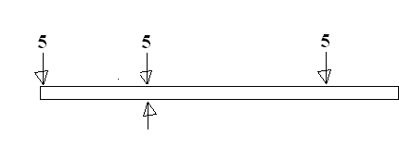
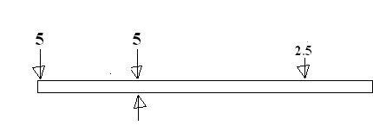
Would this balance?
How about this?

Slide 2
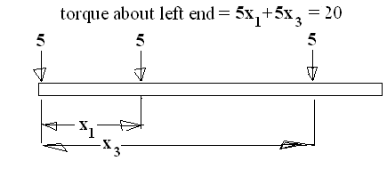
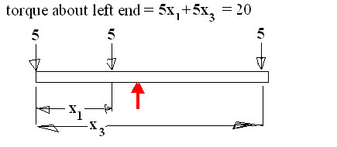
Moment
Mass
Centroid =
Centroid =

Slide 3
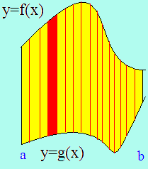
Centroid of the red rectangle
Moment about x-axis
= Area * (f(x)+g(x))/2 * density

Slide 4
Centroid of the red rectangle
Moment about y-axis
= Area * x * density

Slide 5
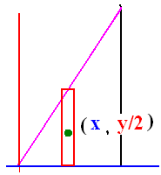
Centroid
Moment about y
Mass
x center of mass

Slide 6
Centroid
Moment about x
Mass
y center of mass

Slide 7
Find the center of mass
A metal plate weighing 3 gm/cm² bounded
by y=2x, x=1 and the x-axis.

Slide 8
Find the center of mass
A metal plate weighing 3 gm/cm² bounded
by y=2x, x=1 and the x-axis.

Slide 9


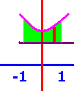
The area over y=2 and under y=x²+3 between x=-1 and x=1

Slide 10
Find M_{x} =
3.6 δ [
6.2 δ [
7.2 δ [

Slide 11
Find the center of mass
A metal plate weighing 3 gm/cm² bounded
by y=2x, x=1 and the x-axis.

Slide 12
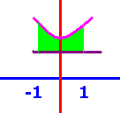
The area over y=2 and under y=x²+3 between x=-1 and x=1
[
[
[

Slide 13
Find M_{y} =
1.5 δ [
0.75 δ [
0.0 δ [

Slide 14
Find the center of mass
A metal plate weighing 3 gm/cm² bounded
by y=2x, x=1 and the x-axis.

Slide 15
The area over y=2 and under y=x²+3 between x=-1 and x=1

Slide 16
Find Mass =
1.333 δ
2.667 δ
0.0 δ

Slide 17
Find the center of mass
A metal plate weighing 3 gm/cm² bounded
by y=2x, x=1 and the x-axis.

Slide 18
Find the center of mass given M = 2.6667 δ, M_{x} = 7.2 δ, M_{y} = 0 δ.
(0, 2.7)
(2.7, 0)
(0, 2.8)

Slide 19
Centroid
Moment about x
Moment about y
Mass
Center of mass

