Slide 1



Capstone project on music recommendation systems
MIT Applied Data Science
Presentation Slides by Sean McLean

Slide 2


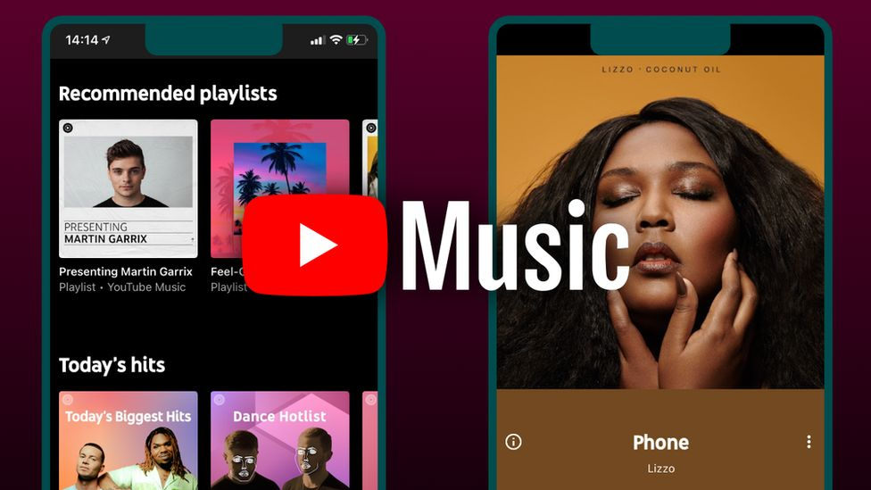
Overview Of The Problem
Creation and implementation of a recommendation system that finds the 10 best songs for a user.
Constructing a streaming dataset that has the most variety of songs and artists.

Slide 3
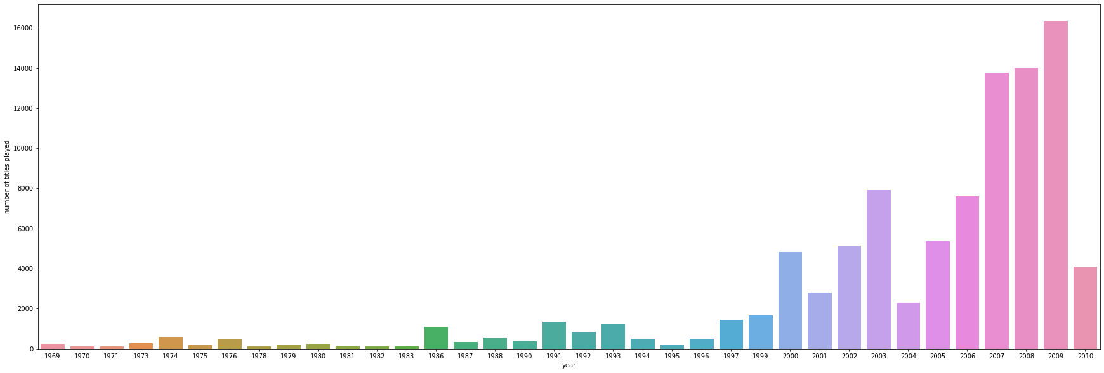
Identifying Demographics
Filtering Dataset
Interactions by year.
Approach For The Solution

Slide 4



Approach for the solution(cont.)
Usage of multiple algorithms.
Fine tuning and optimizing the model.
Text Features

Slide 5
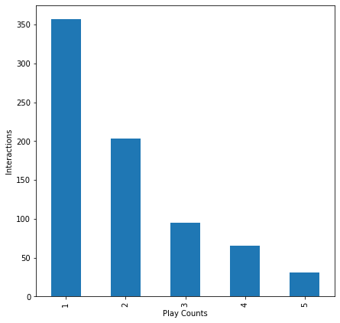
Key Findings & Insights
Filtering Helps
New music rules.
Minimal repeat user/song interactions.

Slide 6



Key Findings And Insights (cont.)
Algorithms Variance
Missing Values
The Metrics

Slide 7
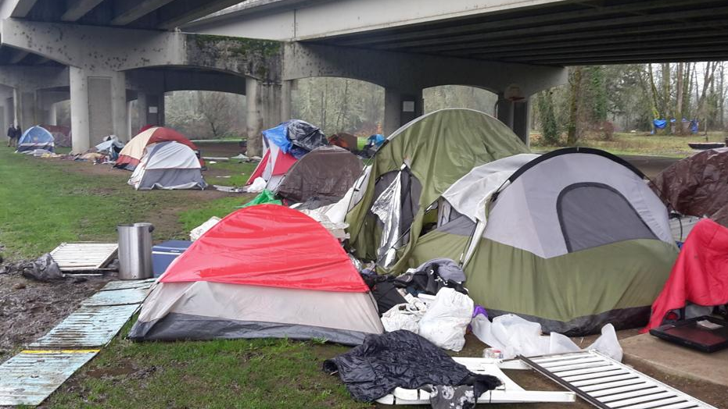
Benefits Of Implementing The Solutions
Condensed dataset, better results.
Seeing trends and patterns in data.
Establishes trust and reliability for users.

Slide 8

Benefits of implementing the solutions (cont.)
Increased popularity of the recommendation system and higher profits.
Benefits all parties involved.
See over time how the final model evolves.

Slide 9
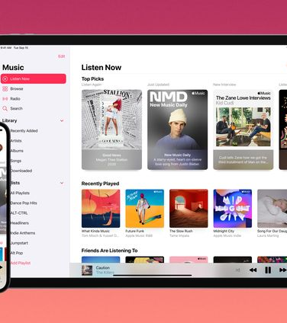
Recommendations & Next Steps
Further testing of final model.
Best algorithm?
Trial period of final model to add more data.
Content information revisions (ex. Model bias?).

Slide 10
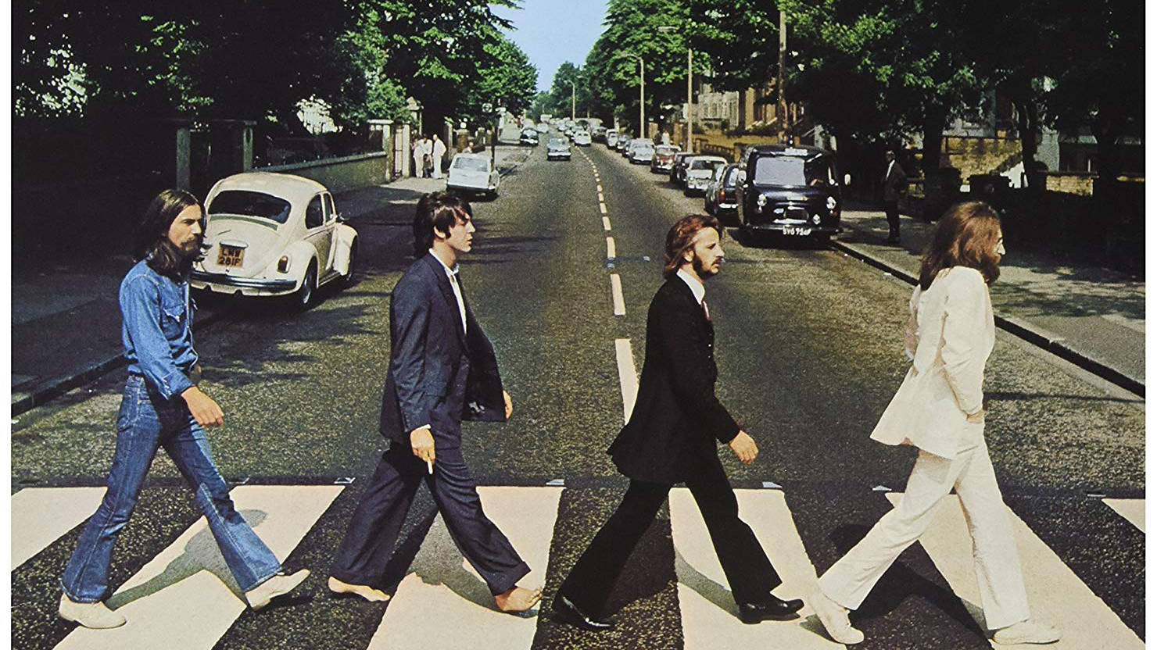
Conclusion
Thanks For A Great Class Everyone And Good Luck With All Future Endeavors!

