Slide 1
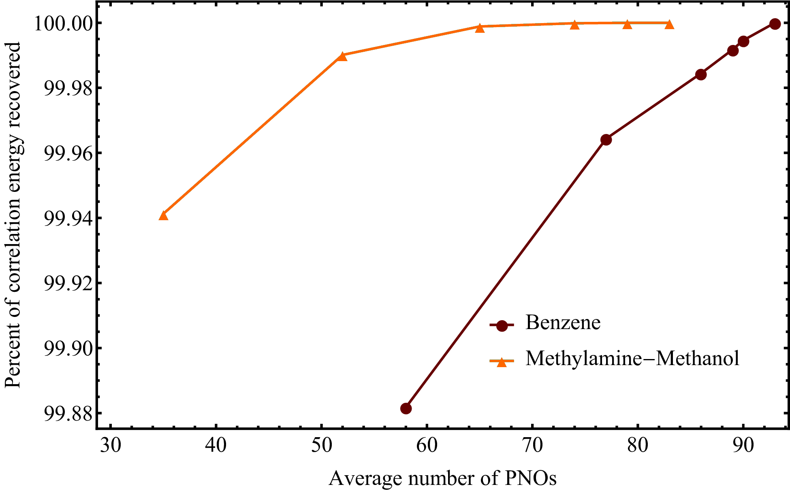
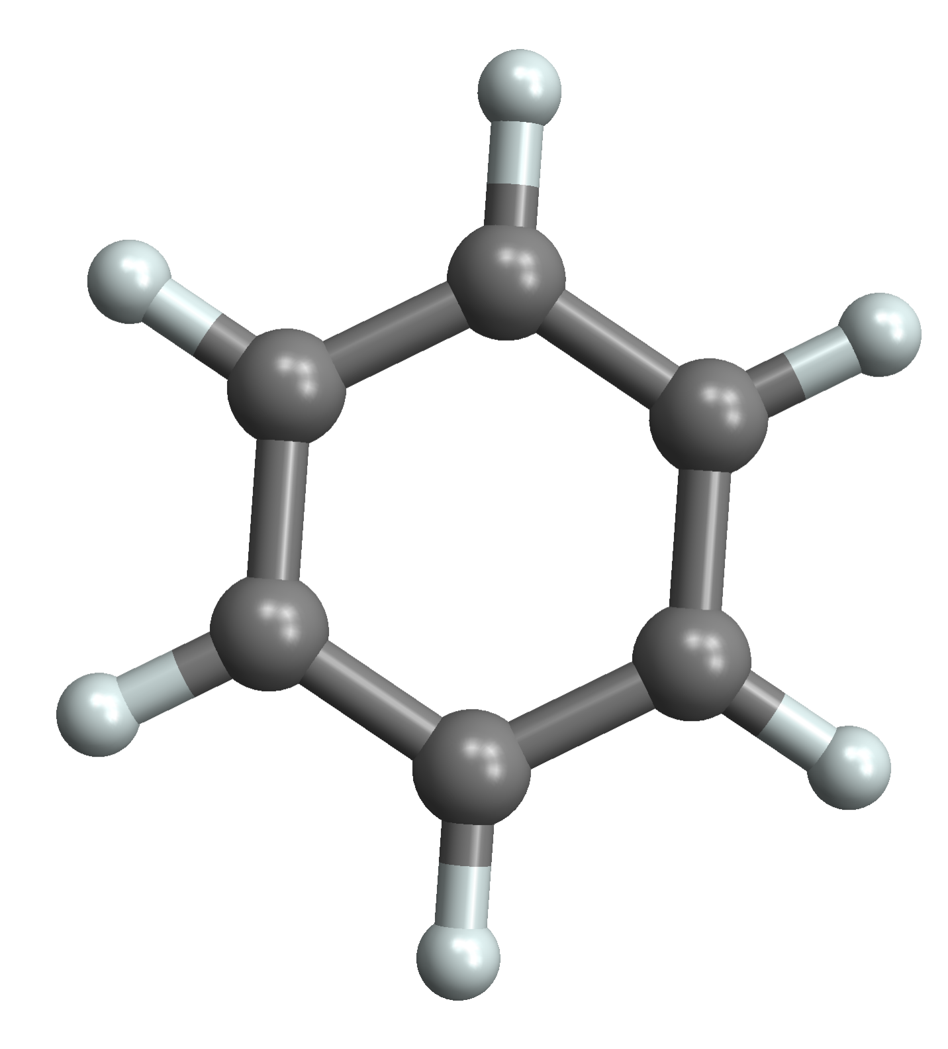
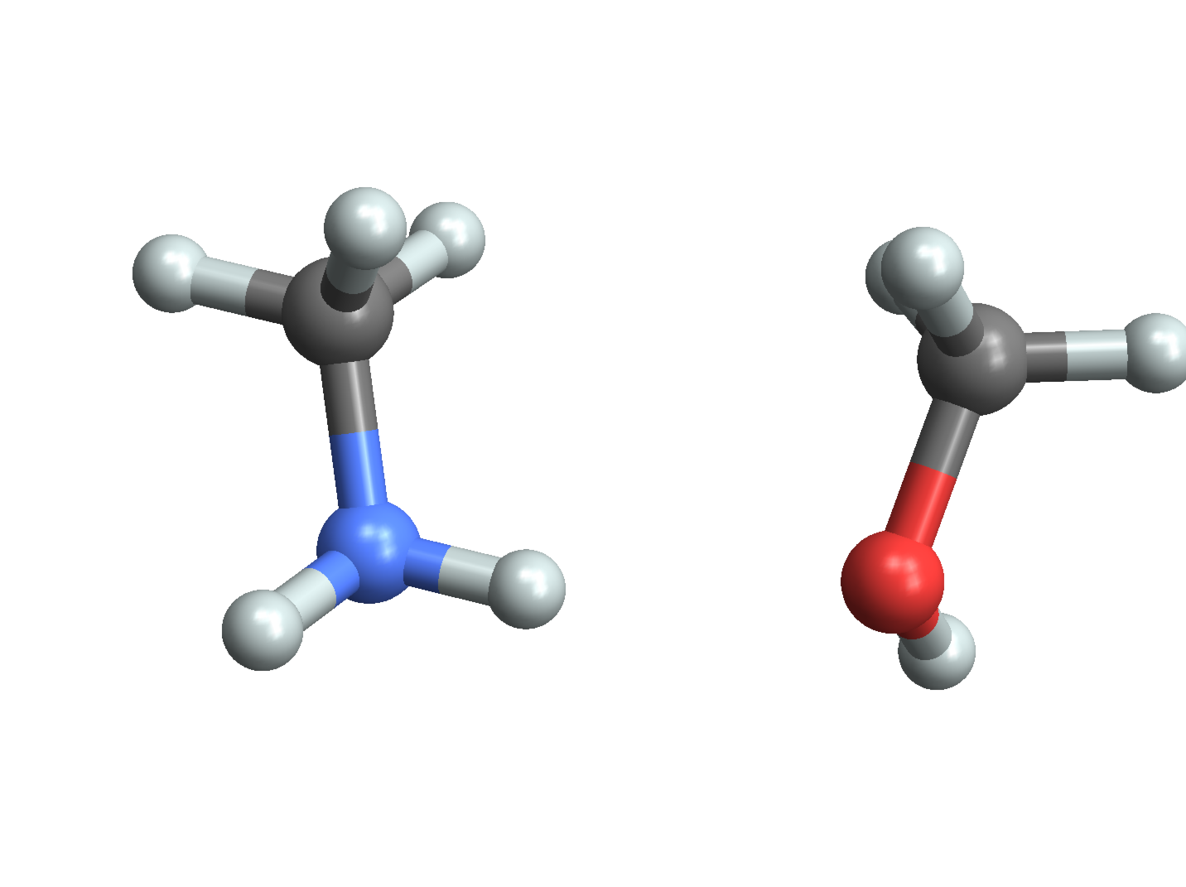
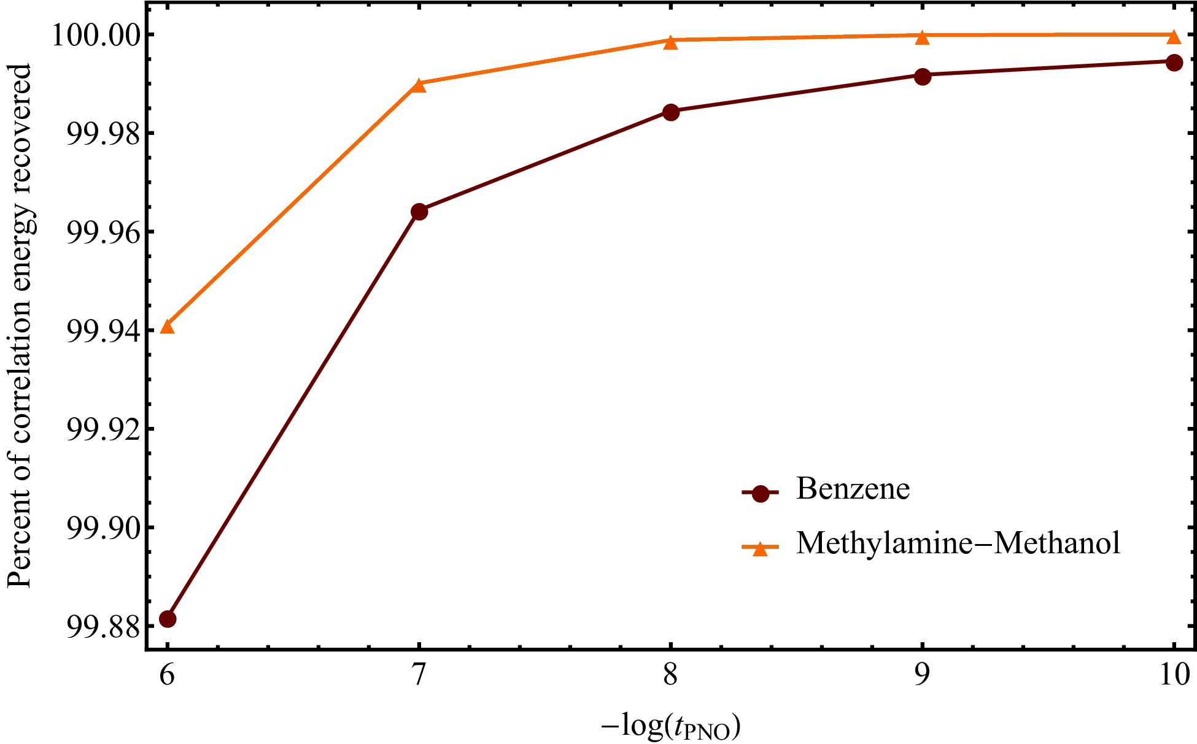
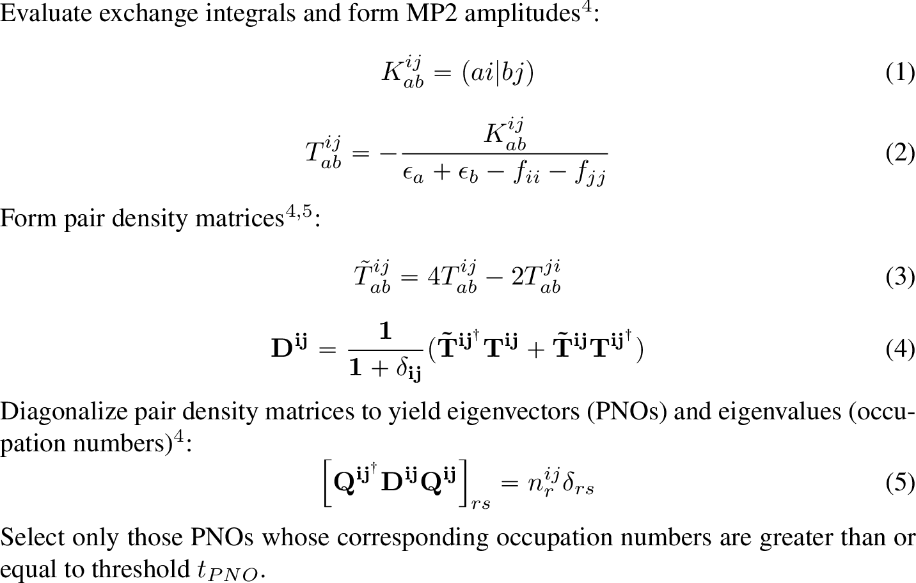


Massively-parallel simulation of reduced-scaling coupled-cluster methods
M arjory C. Clement and Edward F. Valeev
Department of Chemistry, Virginia Tech Blacksburg, VA
Introduction
Computational Details
Results, cont.
To greatly increase the reach of conventional many-body techniques like coupled-cluster (CC) we must employ numerical approximations that reduce the prohibitive high-order computational complexity as well as deploy our reduced-scaling CC algorithms on the largest machines
available. With these complementary ideas in mind we have implemented a simulation framework for reduced-scaling CC methods based on the massively-parallel implementation
of ground- and excited-state CC methods in the re-engineered Massively Parallel Quantum Chemistry (MPQC) package¹. Although the current implementation retains the high complexity of the conventional CC methods, it allows for rapid exploration of reduced-scaling ansatz and provides a production-quality solver component for reduced-scaling massively parallel coupled-cluster currently under development.
Single-point energy calculations were performed on benzene and the weakly-bound methylamine-methanol dimer. Geometries for both systems were taken from the S66 benchmark set⁶. All calculations were performed in the quantum chemistry package MPQC. The orbital basis set was cc-pVDZ, while the density fitting basis set was cc-pVDZ-RI. The Hartree Fock energy was computed using RI-RHF and orbitals were not localized. The energy precision was set to 1.0e-11. The frozen core approximation was employed. A canonical CCSD calculation was performed on each system in order to provide an energy value for comparison. Single-point energy calculations were then performed employing PNOs; the energy of each system was computed six times so that six different values of t_{PNO} could be explored. In the case of single excitations, the PNOs were replaced with OSVs, and in each case, t_{OSV} = t_{PNO} /100.
Percent of Correlation Energy Recovered vs. Average Number of PNOs
Background
Results
References
Both the ground and excited state approaches can utilize arbitrary compressions of the cluster amplitudes, including those based on pair-natural orbitals (PNOs)^{2,3} . The idea behind PNOs
is quite simple: for each pair of electrons in a system, only a few orbital products ontribute substantially to the pair-correlation wave function and pair energy, with the number of PNOs per pair essentially independent of the system size. Furthermore, the PNOs determined using an approximate first-order guess provide a useful subspace for solving the coupled-cluster equations. In the case of single excitations, PNOs are replaced by orbital-specific virtuals (OSVs), which are the PNOs corresponding to i = j. The selection threshold for PNOs and OSVs is generally different.
“MPQC4: Massively Parallel Quantum Chemistry”, Edward F. Valeev, Cannada A. Lewis, Chong Peng, Justus A. Calvin, Jinmei Zhang, https://github.com/valeevgroup/mpqc4.
2. C. Edmiston, M. Krauss, “Configuration-Interaction Calculation of H₃ and H₂”, J. Chem. Phys., 1965, 42, 1119-1120.
Frank Neese, Frank Wennmohs, Andreas Hansen, “Efficient and accurate local approximations to coupled-electron pair approaches: An attempt to revive the pair natural orbital method”, J. Chem. Phys., 2009, 130, 114108.
Jun Yang, Garnet Kin-Lic Chan, Frederick R. Manby, Martin Schutz, Hans-Joachim Werner, “The orbital-specific-virtual local coupled cluster singles and doubles method”, J. Chem. Phys., 2012, 136, 144105.
Christoph Riplinger, Frank Neese, “An efficient and near linear scaling pair natural orbital based local coupled cluster method”, J. Chem. Phys., 2013, 138, 034106.
Jan Rezac, Kevin E. Riley, Pavel Hobza, “S66: A well-balanced database of benchmark interaction energies relevant to biomolecular structures”, J. Chem. Theory Compute., 2011, 7, 2427-2438.
Figure 1: Structure of benzene
Figure 2: Structure of the weakly-bound methylamine-methanol dimer
Methodology
Percent of Correlation Energy Recovered vs. –log(t_{PNO})
Acknowledgements
This project was funded in part by the Virginia Tech Institute for Critical Technology and Applied Science (ICTAS).
Special thanks to Fabijan Pavosevic for helpful discussions.

