Slide 1

Robotic Merit Badge Session #4
Merit Badge Counselor: Maurice Ling
August 17, 2015
http://github.com/mcli/RoboticsMB

Slide 2
Agenda
Programming Accelerometer inputs
Review Competition Rules
Testing Checklist

Slide 3
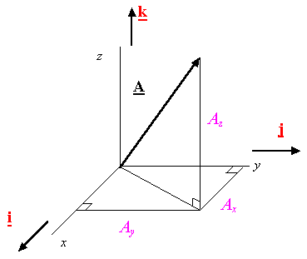

Force Vector
Force is a vector with components in the x, y, and z directions

Slide 4
Accelerometer Principles
The accelerometer measures acceleration along the x, y, and z axes of the microMagician board.
When at rest, the accelerometer measures gravitational force.
What is the relationship between force and acceleration?
Newton's 2nd Law
F = ma
Force = Mass * Acceleration
On Earth, a = g ~ 9.8 m /sec²

Slide 5
Accelerometer Measurements
Measurements from the accelerometer are taken from analog pins 0, 1, and 2 and stored in microM.xaxis, microM.yaxis, and microM.zaxis.
Raw measurements are from 0 through 1024
When at rest, these measurements correspond to the gravitational force exerted on the board.
We can convert these measurements into numbers that we can understand and easily process.

Slide 6
Normalizing the Accelerometer Measurements
Find the “zero” value of the x, y and z axes by aligning the axes of interest perpendicular to gravity. This is your zero offset.
Find the measurement value from the zero value corresponding to the gravitational force. This is your scale factor.
Your normalized measurements will be in units of gravitational force
gForce(i) = (measurement(i) -offset(i))/scaleFactor;

Slide 7
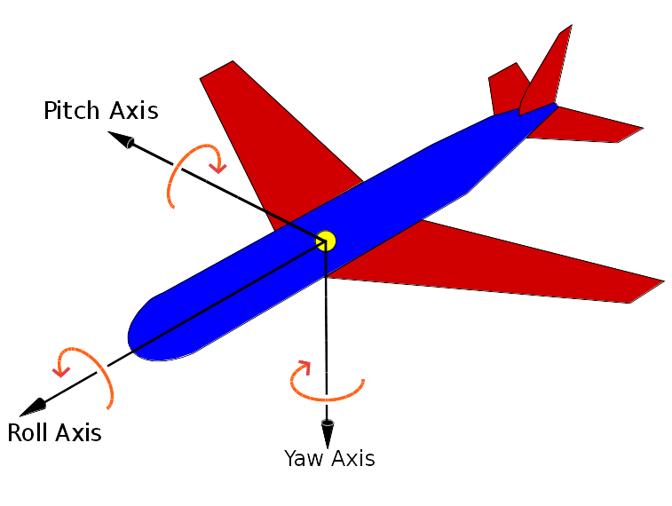
What about direction?
How do you represent the direction of the your robot?

Slide 8
Computing the Orientation
Use trigonometric approximation to get pitch and roll angles.
// apply trigonometry to get the pitch and roll:
float pitch = atan(xAxis/sqrt(pow(yAxis,2) + pow(zAxis,2)));
float roll = atan(yAxis/sqrt(pow(xAxis,2) + pow(zAxis,2)));
//convert radians into degrees
float pitchInDegrees = pitch * (180.0/PI);
float rollInDegrees = roll * (180.0/PI) ;
Run the Accelerometer program. Do the output numbers match what you expect?

Slide 9
Robotic Competition Rules
5 minute time limit
4 Components
  Design in Engineering Notebook
    Programming Logic
    Mechanical design
    Circuit diagram
    Testing Checklist & results
  Loading – manual control
  Transport Course – automatic navigation
  Unloading – manual control
Complete rules on GitHub

Slide 10
Competition Scoring
+20 Points scored for each segment completed
+25 Points for Design
Bonus points:
  Time completed within 3 minutes
  Innovative/elegant design (Up to +20)
Penalty points for:
  Handling payload
  Manual intervention
  Contact with barriers/objects
Robot must not be moved, turned, or otherwise transported physically by a human.
Judge panel consisting of industry professionals.

Slide 11
Creating a Test Checklist
A Test Checklist will help you assess your robot and identify areas you need to change or improve .
What scenarios can you think of for the competition?

Slide 12
Example Test Checklist
Scenario | Expected Behavior
Manual Naviation | Left turn Right turn Forward Reverse In-place turn
Loading | Manually navigate to payload holder Load payload onto Robot
Unloading | Manually navigate to target Unload payload onto receptacle
Auto/Manual transition | Automatic to Manual control. Manual to Automatic control
Auto navigation | U turn Left turn Right turn Go around Island object

Slide 13
Testing Your Robot
Test your robot on the different test stations
Record your results in your engineering notebook
Write down any improvements and adjustments you need to make.

Slide 14
Homework
Continue testing and programming your robot for the competition.
Come up with a name for your robot.
Create a sign with your name and your robot's name for the quarantine table.

