Slide 1

Robotic Merit Badge Session #1
July 11, 2015
Maurice Ling
949-777-5641 – robotics@linglink.com

Slide 2
Agenda
Class Overview
  Schedule
  Materials for the Class
  Robotics Merit Badge Requirements
  Robotics Showcase
The Four D’s of Robotics
Safety Working in Robotics
Introduction to Your Robot Platform - Edison
  Development Tips
  Exercises
Assignment to work on before Session #2

Slide 3
Schedule
Class Dates | Descriptoin | Special Topics
7/11 | Introduction, Material Distribution, Safety | Programming
7/25 | Sensors and Mechanical Design | Gears and Mechanics
8/8 | Design Review | Robotics in Space
8/22 | Robotics in Industry | Open Source and Robotics
8/29 | Robotics Showcase

Slide 4
Expectations
Be prepared - Review Class Reference Guide.
Be on time
Participate
Write down ideas, designs, concepts in your notebook
Be creative
Ask questions

Slide 5
Material Inventory
Carrying Case
Edison Robot
4 AAA NiMH batteries
Engineering notebook

Slide 6
Scout-Provided Materials and Preparation
Blue Card signed by Scoutmaster
Printed Workbook
Computer/laptop with Edware account
Sony compatible Remote Control
AAA NiMH battery charger
Pen/Pencil for taking notes
Legos

Slide 7
Merit Badge Requirements
All Requirements are listed in the Workbook:
Safety
Robotics in industry
General Knowledge
Design/Demonstration – Engineering Notebook
Competitions
Careers
Complete the workbook on your own for Merit Badge Counselor review/check-off

Slide 8
Robotics Showcase
Start thinking about your robot design
Be creative and have fun.
More details will be announced at the 2nd Session
If you design a robot with two Edisons, I will give you another Edison robot!

Slide 9
The Four D’s of Robotics

Slide 10
The Four D’s of Robotics
Dangerous
Dirty
Dull
Difficult

Slide 11
Safety Working with Robotics

Slide 12
Safety Working with Robotics
Have a clean work area
Keep small pieces away from young children and babies
Electro-static discharge
Protective gear

Slide 13
Programming Tips
A robot will do exactly what you tell it to do, but not always what you want it to do
Write a little, test a little
Write lots of small programs to understand how things work before attempting a large program.
Save programs often.
Create different versions of the program at stable development points.
Look at example programs to see how they work

Slide 14
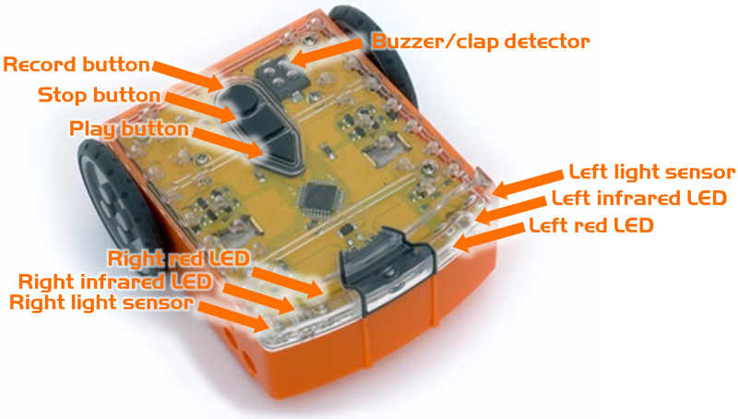
Introduction to Your Robot Platform - Edison
Play Button – Start Program
Stop Button – Stop Program
Record Button – 1 press to download, 3 to read barcode

Slide 15
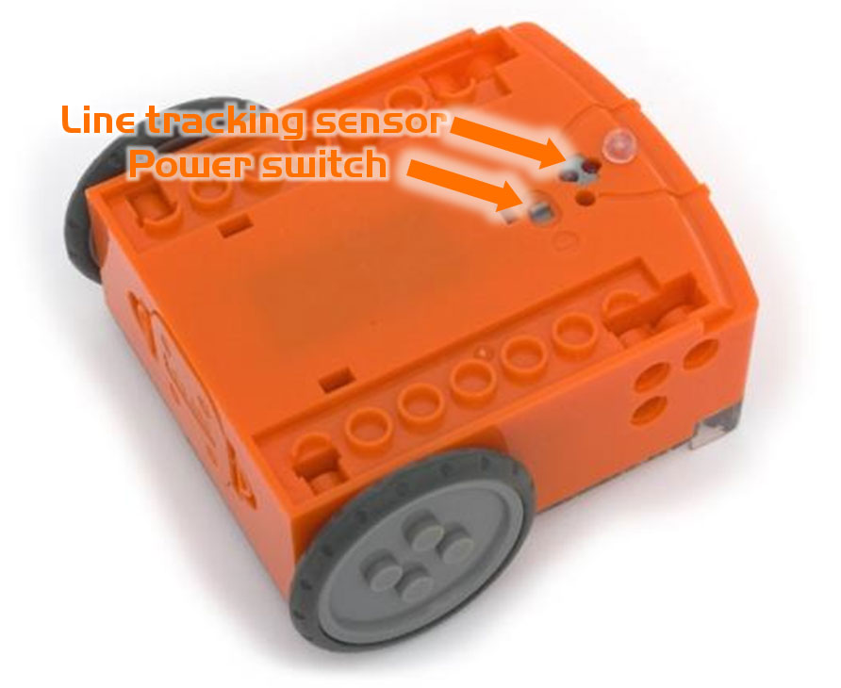
Introduction to Your Robot Platform - Edison
Power Switch
Programming cable port

Slide 16
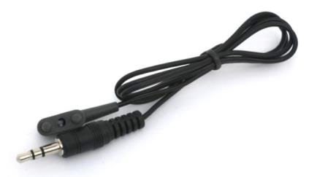
Introduction to Your Robot Platform - Edison
Programming Cable plugs into audio jack

Slide 17
Introduction to Programming Edison
Edware Programming Environment
  Color Coded Icons
    Red - Control
    Blue - Read Sensor/button
    Green - Data Operations
    Yellow – Control
  Graphical programming Advantages
    Easy to learn and visualize
  Disadvantages
    Hard to manage large programs

Slide 18
Analyzing The Test Program
Load the Test Program
Follow the logic of the the program. What does it do?
Program your Edison using the “Program Edison” button

Slide 19

Programming Exercises – Generating an SOS Signal
Create a program to generate the SOS Morse Code signal with one LED
  3 short blinks,
  3 long blinks,
  3 short blinks
  Pause
  Repeat.
A short blink is 0.25 seconds on
A long blink is 0.75 seconds on
Each blink is separated by 0.75 seconds of “off”
Pause between each SOS word is 1.75 seconds
Save Program as BlinkSOS

Slide 20
Programming Exercises – Using Sensors
Modify the BlinkSOS program to start blinking when an object is detected and stop blinking when no object is detected.
Save the program as BlinkSOSDetect

Slide 21
Assignment
Finish Class Exercises
Work through EdBook 2 Exercises
Think of three possible robot designs and write down your ideas in the engineering notebook.

