Slide 1

Robotic Merit Badge Session #2
July 25, 2015
Maurice Ling
949-777-5641 – robotics@linglink.com

Slide 2
Agenda
Engineering Notebook
Mechanical Design
  Center of Gravity
  Gears
Programming
  Development Tips
  Exercises
Assignment to work on before Session #3

Slide 3
Engineering Notebook
Put your name on your notebook
Design
  Ideas – What tasks will your robot perform?
  Review with counselor for approval (Deadline August 8th)
Tests
  How will you test your robot?
  How did your tests help refine your design?
Logic and software
    What is the logic that your control software will follow?
Description and sketch/picture of robot
Potential for Improvements – What could be better?

Slide 4
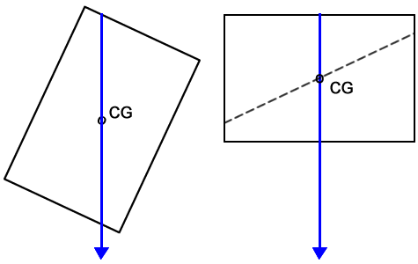
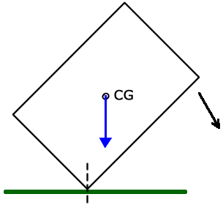
Mechanical Design – Center of Gravity
Center of Gravity- Indicator of stability

Slide 5
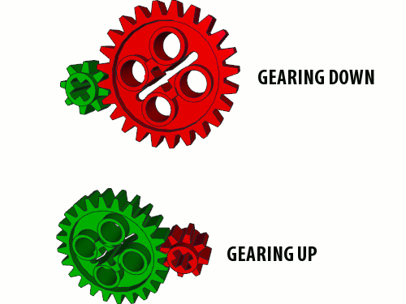
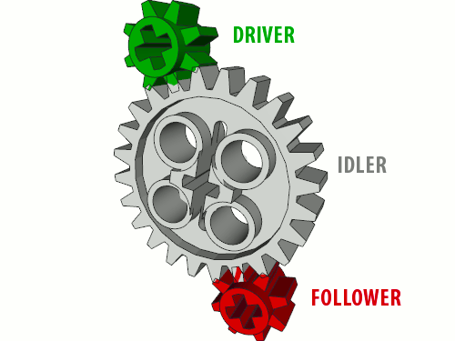
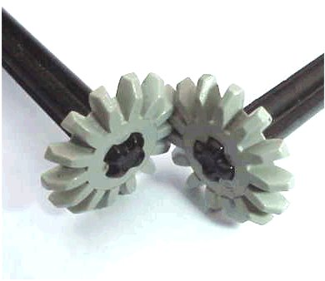
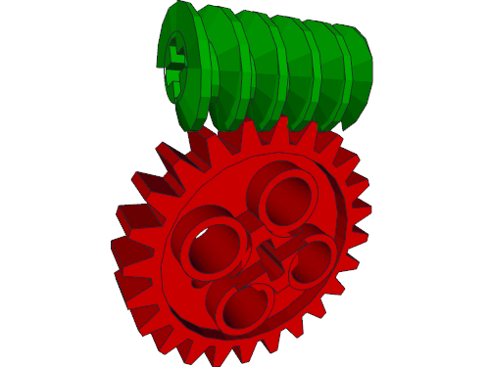
Mechanical Design – Gears
Gear Ratio =
Driver teeth/Follower teeth
Beveled Gears

Slide 6
Programming Tips
A robot will do exactly what you tell it to do, but not always what you want it to do
Write a little, test a little
Write lots of small programs to understand how things work before attempting a large program.
Save programs often.
Create different versions of the program at stable development points.
Look at example programs to see how they work

Slide 7
Analyzing The Test Program
Load the Test Program
Follow the logic of the the program. What does it do?
Program your Edison using the “Program Edison” button

Slide 8

Programming Exercises – Generating an SOS Signal
Create a program to generate the SOS Morse Code signal with one LED
  3 short blinks,
  3 long blinks,
  3 short blinks
  Pause
  Repeat.
A short blink is 0.25 seconds on
A long blink is 0.75 seconds on
Each blink is separated by 0.75 seconds of “off”
Pause between each SOS word is 1.75 seconds
Save Program as BlinkSOS

Slide 9
Programming Exercises – Using Sensors
Modify the BlinkSOS program to start blinking when an object is detected and stop blinking when no object is detected.
Save the program as BlinkSOSDetect

Slide 10
Homework
Continue thinking about your robot design and write your ideas in the Engineering Notebook.
Be creative and have fun.
If you design a robot with two Edisons, I will give you another Edison robot!
Design due on or before August 8th.
Finish any incomplete programming exercises from EdBook 2 and class.

