Slide 1

Robotic Merit Badge
Robotics Competition
Merit Badge Counselor: Maurice Ling
August 29, 2016

Slide 2
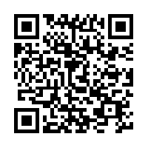
Competition Rules
Competition Rules may be found at https://github.com/mcli/RoboticsMB/blob/2016/doc/2016RoboticsCompetition.org

Slide 3
Competition Teams/Score Board
 | Relay Segment | Give Us Two More Minutes (GUTMM) | Design Points | Time | Caps Lock Crusaders (CLC) | Design Points | Time
1 | Light Navigation | Tin |  |  | Yannik
2 | Line Maze | Caleb |  |  | Matthew
3 | Ping Pong Collection | Spencer |  |  | Praneet
4 | Speedway | Brennan |  |  | Connor
5 | Push the Cans | Tyson |  |  | Logan
6 | Clap Control | Ryan |  |  | Mateo
7 | Search and Rescue | Xian Lun |  |  | David

Slide 4

Judge Panel
Mr. Mark Winters
  Senior Program Manager at Western Digital
  20 years experience as a Mechanical and Industrial Engineer.
  Eagle Scout Troop 20 Oklahoma City
Mr. Lawrence Voelz
  Electrical Engineer at Raytheon Corporation
  40 years experience working in Defense industry
  Integration and testing of the ATLFIR (Advanced Targeting Forward Looking Infrared) sensor on board the F/A-18 fighter jet.

Slide 5
Relay Segments
 | Segment | Description
1 | Light Navigation | Autonomous navigation to the light while avoiding obstacles.
2 | Line Maze | Autonomous line maze navigation while avoiding dead-end obstacles.
3 | Ping Pong Collection | Remote controlled ping pong collection into a tray.
4 | Speedway | Remote controlled driving through a race course
5 | Push the Cans | Push three 6 oz cans into a designated area.
6 | Clap-Controlled Driving | Control a robot to navigate through a course by clapping.
7 | Search and Rescue | Search for a target (Big black dot) and then head to the light.
* Autonomous hand-off between segments

Slide 6
Hand-Off Handshake
Hand-off between robots should consist of the following components:
  Receiving Robot should beep 3 times
  Sending Robot should blink LED 3 times.

Slide 7
Scoring Summary
+30 Points for Design
+20 Points scored for each segment completed
+10 Points for best time per segment
Penalty points for each occurrence:
  -5 Physical Intervention
  -5 Exceeded 5 minute time limit per segment
  -5 Excessive barrier/boundary movement
  -5 Improper hand-off

Slide 8
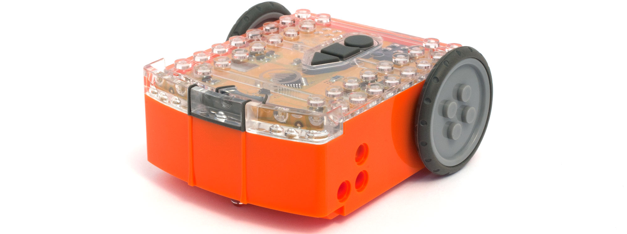
Edison Platform Features
The Edison Robot Platform provides the following capabilities and features:
Light Sensors
Obstacle Sensors
IR Remote Control
Line Tracking Sensor
Inter-Robot Communication
Web-based Graphical Programming
Simple computer to robot interface

Slide 9

Competition Course
Start
Finish
6
1
3
7
5
4
2
Drawing not to scale. Actual locations of objects and tracks will be different.

