Slide 1

Robotic Merit Badge Session #3
August 8, 2015
Maurice Ling
949-777-5641 – robotics@linglink.com

Slide 2
Agenda
Schedule
Robotics in Space
Elements of Design
Advanced Edison programming
Robotics Showcase Competition
Team Exercise

Slide 3
Schedule
Class Dates | Description | Special Topics
7/11 | Introduction, Material Distribution, Safety | Programming
7/25 | Sensors and Mechanical Design | Gears and Mechanics
8/8 | Design Review | Robotics in Space
8/22 | Robotics in Industry | Open Source and Robotics
8/29 | Robotics Showcase

Slide 4
Robots in Space
What aspects of outer space environment make it a good application of robotics?
Videos
  Using Robots to repair Satellites https://www.youtube.com/watch?v=bSyii3vluUU
  Cubesats https://youtu.be/7RrWZJHkREI

Slide 5
Elements of Design (Engineering Notebook)
Overview – Describe the task(s) for the robot.
Ideas – Possible approaches to accomplish the task, highlight the approach you have chosen.
Mechanical – How will the parts fit together? Diagrams and sketches are useful
Electrical – How will the robot be powered? What sensors does it utilize?
Programming logic – Flow chart of what the program does.
Tests – Different scenarios you will use to test your robot functionality. After building the robot, record the results of your tests.
Improvements – How would you improve your robot for the next version?

Slide 6
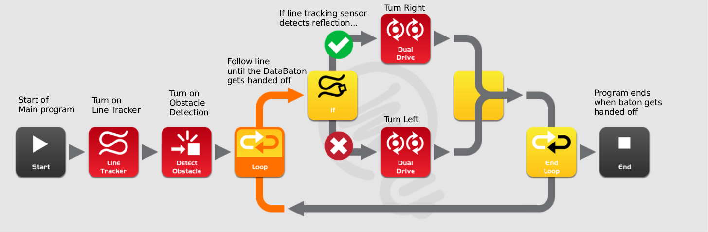
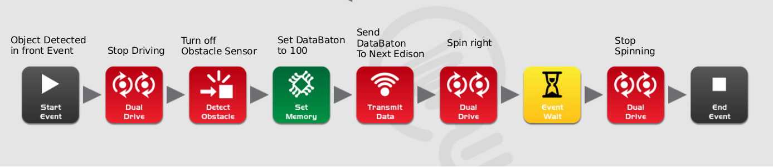
Example Line Tracking/Hand-off Logic
The main event tracks a line until
The DataBaton (value 100) gets sent
to the Other Edison
Assume that an object detected
Is an Edison and send the DataBaton

Slide 7
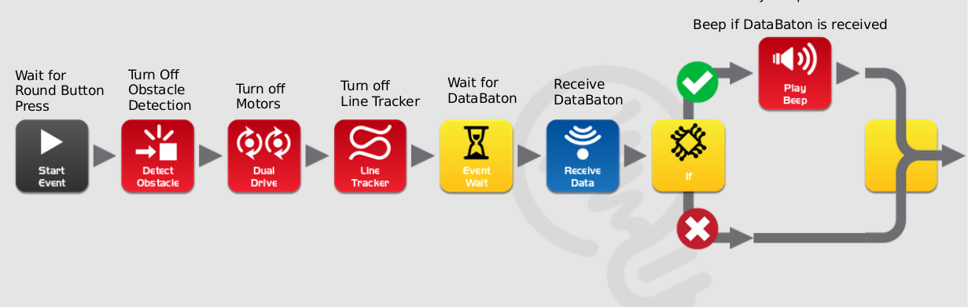
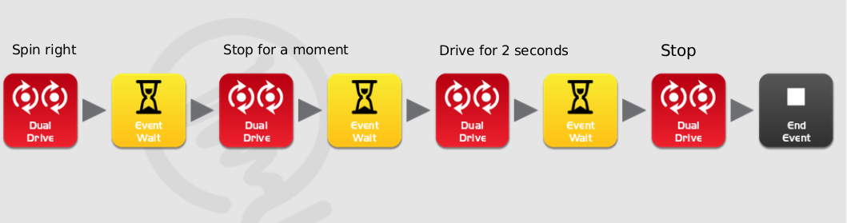
Example Receiver Logic
Edison goes into receiver mode when the Round button is pressed
After receiving the DataBaton, turn around, drive forwards and stop
For one
second

Slide 8
Robotics Showcase
Demonstrate individual robots
Bot Relay competition with 2 teams
X Team
Brennan
Tin
*Ryan
Caleb
Tyson
Xian Lun
Spencer
Y Team
Mateo
*Matthew
David
Praneet
Yannik
Logan
Connor
* Team Captain
Represents the team
Coordinates with team members to develop a strategy.
Ensures that
  Hand offs are smooth between robots
  Design & development is on schedule
  The over-all design and implementation
achieve the objectives

Slide 9
Competition Details
One competition course with 7 segments
Each segment exercises one or more sensors of the Edison
Points awarded for each event
Penalties for breaking rules
Team that wins the most points wins the over-all competition.
Hand offs are autonomous (no human control)

Slide 10
Competition Details
One competition course with 7 segments
Each segment exercises one or more sensors of the Edison
Points awarded for each event
Penalties for breaking rules
Team that wins the most points wins the over-all competition.
Hand offs should be autonomous (no human control).

Slide 11
Competition Course Segments
Segment | Description
1 | Autonomously head toward the light and avoid obstacles, find the line to the hand-off area
2 | Autonomously follow a Line Maze. Next robot is waiting at the exit!
3 | Get 3 ping pong balls into a container
4 | Speedway. Who can go the fastest? Need to stay in bounds!
5 | Push three 6 oz cans into a target area.
6 | Get through a maze by controlling your robot with clapping.
7 | Autonomously find a target using line sensor and head to the finish line where the light is.

Slide 12
Team Exercise
Choose a name for your team
Assign each scout one segment of the course.
Program your robots to cause a chain reaction. i.e. have the first robot activate the 2nd which activates the 3rd, etc. All robots need to be stationary to start with.

Slide 13
Assignment
Review preliminary design with counselor before implementing
Write up more detailed design for your personal robot
Design for competition segment
  Competition robot may be same as your personal robot
Develop a personal demo course to exercise/test your robot
Finish any remaining Workbook sections

