Slide 1
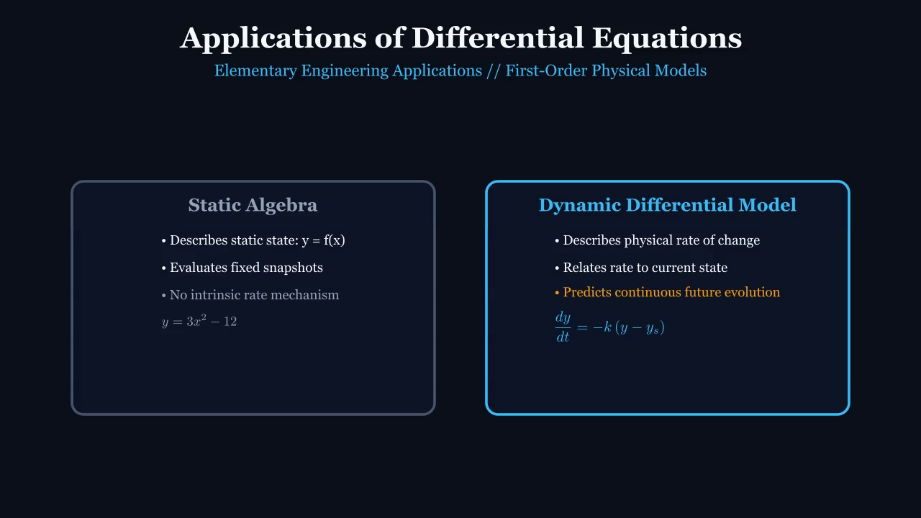
SLIDE 01 / 21 // DIFFERENTIAL EQUATIONS
Applications of Differential Equations
Elementary Applications of First-Order ODEs // Mathematical Modeling in Motion
KEY MATHEMATICAL TAKEAWAYS
• Dynamic Differential Modeling vs Static Snapshot Algebra
• Rates of change define future physical trajectories
• Primary source: MATHalino Engineering Mathematics Review
 Apple Pencil Annotation Zone
(Generous writing area for live derivations and class questions)
Notes:
TEACHER NOTES & GUIDED QUESTIONS (Slide 01 / 21):
Introduce the lecture scope. Contrast static functions y = f(x) with dynamic differential equations dy/dt = f(t, y). Explain how rates of change define physical laws.

Slide 2
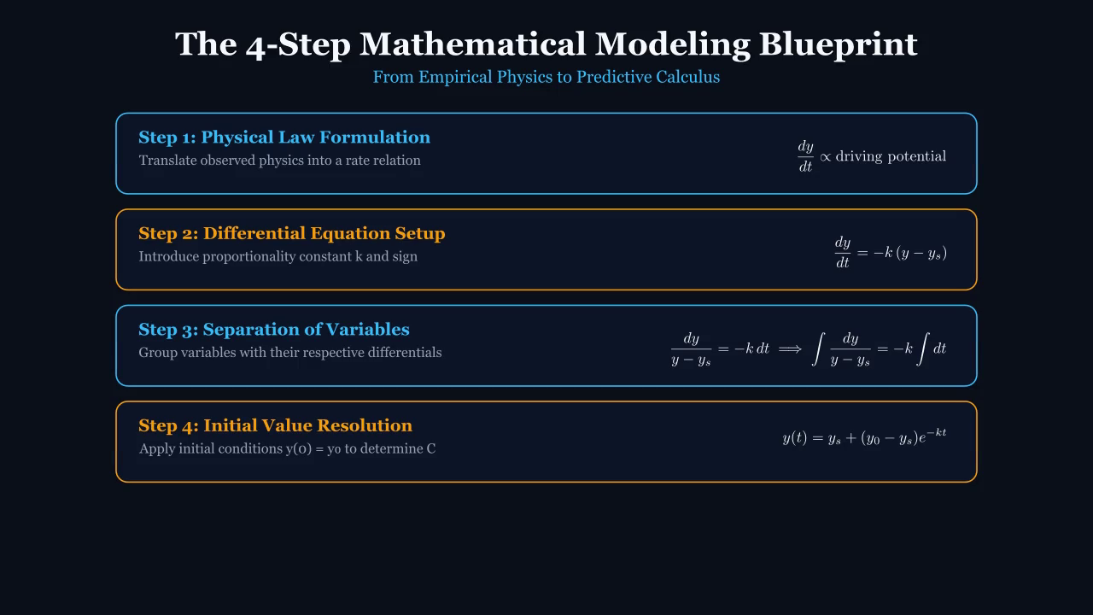
SLIDE 02 / 21 // DIFFERENTIAL EQUATIONS
The 4-Step Mathematical Modeling Blueprint
From Empirical Observation to Analytical Prediction
KEY MATHEMATICAL TAKEAWAYS
• Step 1: State the physical proportionality law
• Step 2: Formulate the differential equation with constant k
• Step 3: Separate variables and integrate analytically
• Step 4: Apply boundary/initial conditions to evaluate C
 Apple Pencil Annotation Zone
(Generous writing area for live derivations and class questions)
Notes:
TEACHER NOTES & GUIDED QUESTIONS (Slide 02 / 21):
Walk through the universal 4-step framework. Emphasize that all rate-driven physical processes (thermal, nuclear, mechanical) follow this identical workflow.

Slide 3
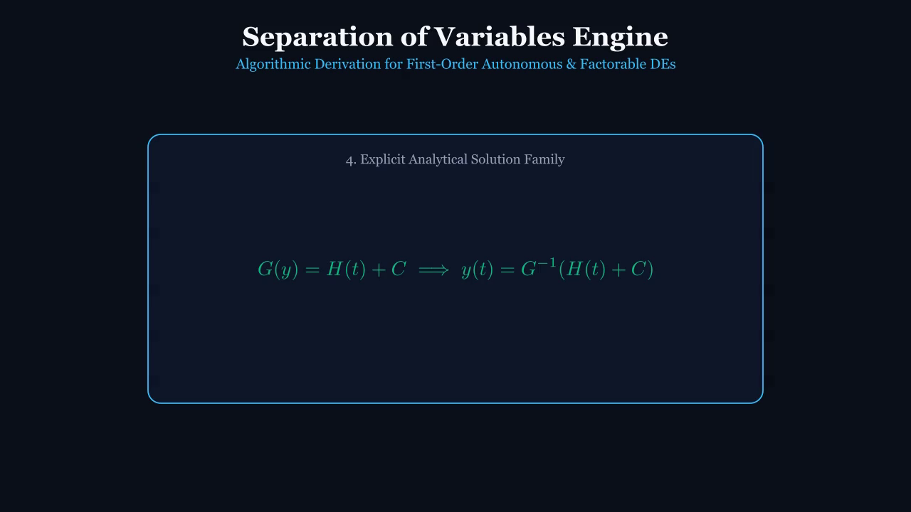
SLIDE 03 / 21 // DIFFERENTIAL EQUATIONS
Separation of Variables Mathematical Engine
Transforming Differential Statements into Integrated Solution Families
KEY MATHEMATICAL TAKEAWAYS
• Standard separable form: dy/dt = g(y) h(t)
• Group dependent terms on left: dy / g(y) = h(t) dt
• Integrate both sides: ∫ dy/g(y) = ∫ h(t) dt + C
• Solve explicitly for y(t) using inversion/logarithms
 Apple Pencil Annotation Zone
(Generous writing area for live derivations and class questions)
Notes:
TEACHER NOTES & GUIDED QUESTIONS (Slide 03 / 21):
Demonstrate the algebraic mechanics of separation. Highlight how Leibniz differentials dy and dt are separated across the equality sign.

Slide 4
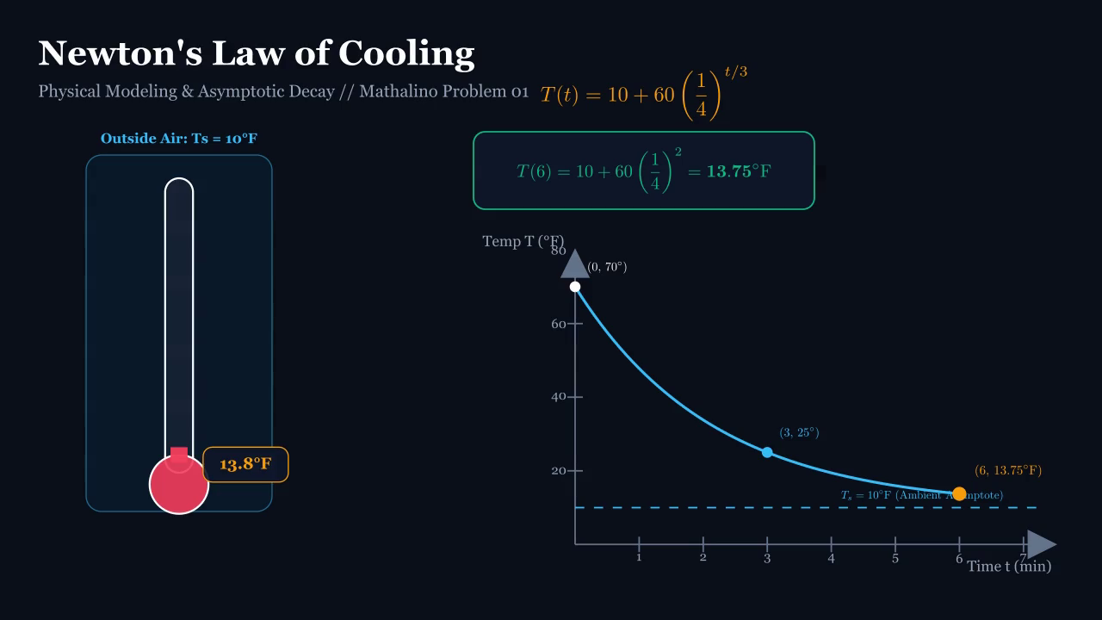
SLIDE 04 / 21 // DIFFERENTIAL EQUATIONS
Newton's Law of Cooling: Physical Intuition
Thermal Driving Potential & Asymptotic Decay Toward Ambient Temperature
KEY MATHEMATICAL TAKEAWAYS
• Governing law: dT/dt = -k(T - Ts)
• Driving force is the temperature difference (T - Ts)
• Rate is fastest initially and decreases asymptotically
• Ambient temperature Ts serves as a horizontal asymptote
 Apple Pencil Annotation Zone
(Generous writing area for live derivations and class questions)
Notes:
TEACHER NOTES & GUIDED QUESTIONS (Slide 04 / 21):
Explain why dT/dt is proportional to (T - Ts). When T > Ts, the body cools (dT/dt < 0). Point out that the curve never crosses Ts under pure convective cooling.

Slide 5
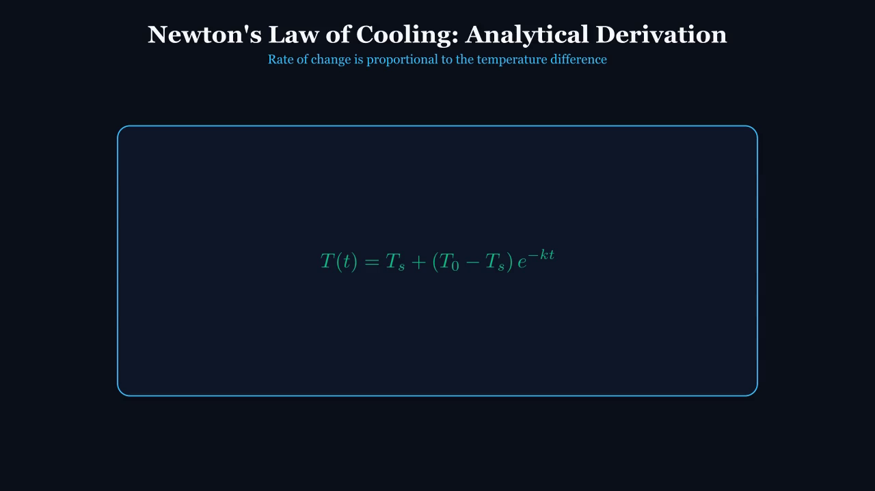
SLIDE 05 / 21 // DIFFERENTIAL EQUATIONS
Newton's Law of Cooling: Analytical Derivation
Continuous Equation Morphing from Rate Law to Explicit Solution
KEY MATHEMATICAL TAKEAWAYS
• Separated form: dT / (T - Ts) = -k dt
• Integrating: ln(T - Ts) = -kt + ln C1
• Exponentiating: T - Ts = C1 e^(-kt)
• Initial condition: T(0) = T0 ⟹ C1 = T0 - Ts
• Particular model: T(t) = Ts + (T0 - Ts) e^(-kt)
 Apple Pencil Annotation Zone
(Generous writing area for live derivations and class questions)
Notes:
TEACHER NOTES & GUIDED QUESTIONS (Slide 05 / 21):
Step through each line of the derivation. Emphasize how the initial condition evaluates the constant C1 as the initial temperature excess.

Slide 6
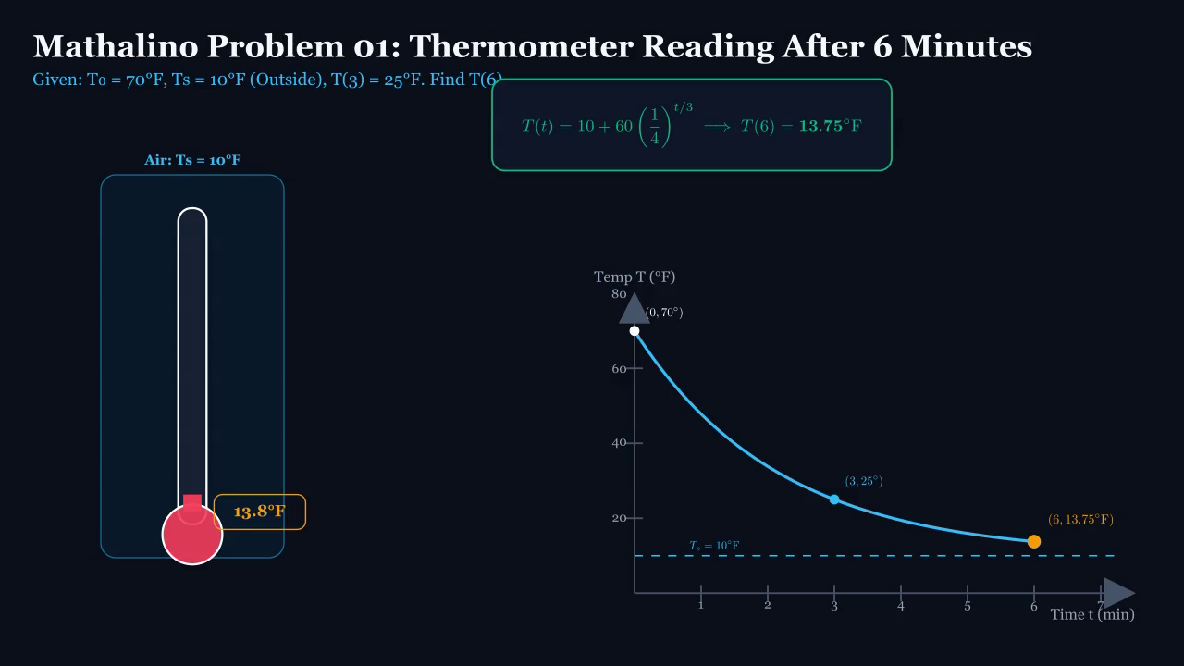
SLIDE 06 / 21 // DIFFERENTIAL EQUATIONS
Mathalino Problem 01: Thermometer Reading After 6 Minutes
Given: Inside T₀ = 70°F, Outside Ts = 10°F, T(3) = 25°F. Find T(6).
KEY MATHEMATICAL TAKEAWAYS
• Model: T(t) = 10 + 60 e^(-kt)
• At t = 3: 25 = 10 + 60 e^(-3k) ⟹ e^(-3k) = 1/4
• Base model: T(t) = 10 + 60 (1/4)^(t/3)
• Evaluation at t = 6: T(6) = 10 + 60(1/16) = 13.75°F
 Apple Pencil Annotation Zone
(Generous writing area for live derivations and class questions)
Notes:
TEACHER NOTES & GUIDED QUESTIONS (Slide 06 / 21):
State MATHalino Problem 01 data. Ask students to deduce e^(-3k) = 1/4 before moving to the resolution. Highlight the constant ratio drop over equal 3-minute intervals.

Slide 7
SLIDE 07 / 21 // DIFFERENTIAL EQUATIONS
Problem 01 Resolution & Ratio Invariance
Constant Interval Scaling Principle in First-Order Linear Systems
KEY MATHEMATICAL TAKEAWAYS
• Interval 0 to 3 min: ΔT drops from 60°F to 15°F (ratio = 1/4)
• Interval 3 to 6 min: ΔT drops from 15°F to 3.75°F (ratio = 1/4)
• Final Temperature: T(6) = 10 + 3.75 = 13.75°F exactly
• Verified against MATHalino official engineering solution
 Apple Pencil Annotation Zone
(Generous writing area for live derivations and class questions)
Notes:
TEACHER NOTES & GUIDED QUESTIONS (Slide 07 / 21):
Use Apple Pencil on iPad to annotate the ratio arrows 60 -> 15 -> 3.75 on the temperature axis.

Slide 8
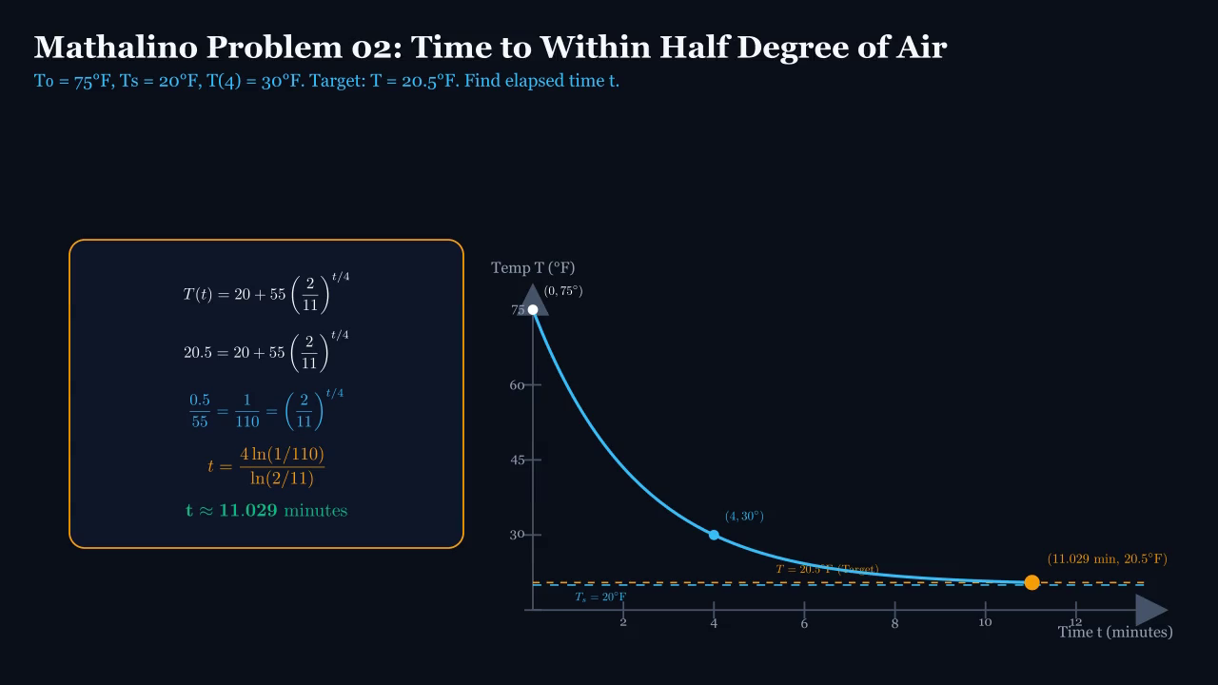
SLIDE 08 / 21 // DIFFERENTIAL EQUATIONS
Mathalino Problem 02: Time to Within Half Degree of Air
T₀ = 75°F, Ts = 20°F, T(4) = 30°F. Target: T = 20.5°F. Find elapsed time t.
KEY MATHEMATICAL TAKEAWAYS
• Model: T(t) = 20 + 55 e^(-kt)
• At t = 4: 30 = 20 + 55 e^(-4k) ⟹ e^(-4k) = 10/55 = 2/11
• Target condition: T(t) - 20 = 0.5°F ⟹ T = 20.5°F
• Equation: 0.5 = 55 (2/11)^(t/4) ⟹ 1/110 = (2/11)^(t/4)
 Apple Pencil Annotation Zone
(Generous writing area for live derivations and class questions)
Notes:
TEACHER NOTES & GUIDED QUESTIONS (Slide 08 / 21):
Explain why the target is 20.5°F (within half a degree of 20°F). Emphasize that reaching 20°F exactly would take infinite time.

Slide 9
SLIDE 09 / 21 // DIFFERENTIAL EQUATIONS
Problem 02 Logarithmic Resolution
Isolating Unknown Time Exponent via Natural Logarithms
KEY MATHEMATICAL TAKEAWAYS
• Logarithmic form: ln(1/110) = (t/4) ln(2/11)
• Exact solution: t = 4 ln(1/110) / ln(2/11)
• Numerical value: t ≈ 11.029 minutes
• Independently verified against MATHalino records
 Apple Pencil Annotation Zone
(Generous writing area for live derivations and class questions)
Notes:
TEACHER NOTES & GUIDED QUESTIONS (Slide 09 / 21):
Show how ln(1/110) = -ln 110 and ln(2/11) = ln 2 - ln 11 are both negative, giving a positive elapsed time of 11.029 minutes.

Slide 10
SLIDE 10 / 21 // DIFFERENTIAL EQUATIONS
Thermal Modeling Live Derivation Board
Instructor Apple Pencil Inking Space // Parameter Variations
LECTURE FOCUS & CORE TAKEAWAYS
• Explore heating scenarios where T0 < Ts (dT/dt > 0)
• Examine how convection coefficients alter cooling rate k
• Practice problem: Predict reading at t = 9 minutes
Notes:
TEACHER NOTES & GUIDED QUESTIONS (Slide 10 / 21):
Use this slide as a live whiteboard. Pose a question to students: What if the object was brought inside from the cold into a warm room?

Slide 11
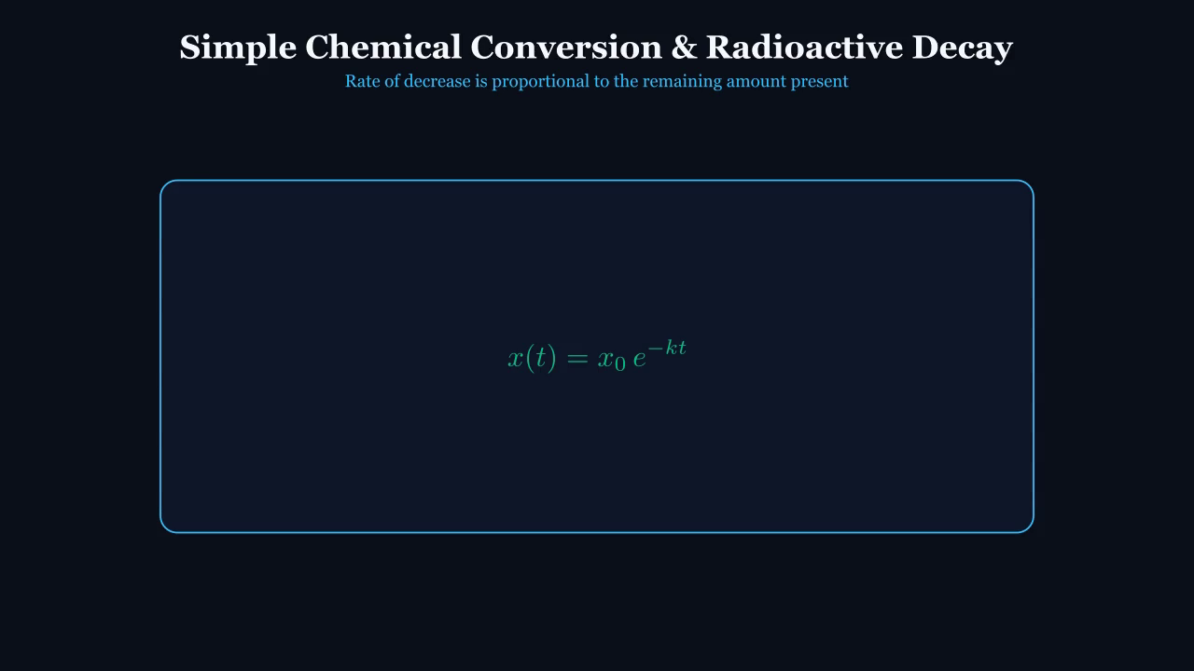
SLIDE 11 / 21 // DIFFERENTIAL EQUATIONS
Simple Chemical Conversion & Radioactive Decay
First-Order Dissipation Kinetics & Unconverted Substance Remaining
KEY MATHEMATICAL TAKEAWAYS
• Governing law: dx/dt = -kx (k > 0)
• x(t) represents remaining unconverted/undecayed substance
• Separation: dx / x = -k dt ⟹ ln x = -kt + C
• General solution: x(t) = x0 e^(-kt)
 Apple Pencil Annotation Zone
(Generous writing area for live derivations and class questions)
Notes:
TEACHER NOTES & GUIDED QUESTIONS (Slide 11 / 21):
Introduce chemical conversion and nuclear decay. Clarify that the negative sign indicates loss of reactant or parent isotope.

Slide 12
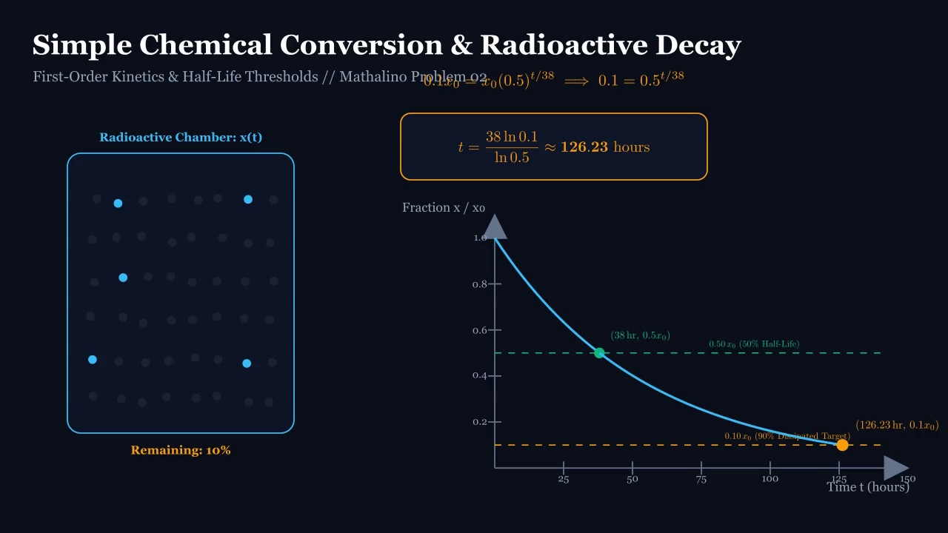
SLIDE 12 / 21 // DIFFERENTIAL EQUATIONS
Stochastic Atoms vs Continuum Calculus
Bridging Quantum Indeterminacy and Macroscopic Exponential Decay
KEY MATHEMATICAL TAKEAWAYS
• Individual decay events are quantum and probabilistic
• Avogadro-scale ensemble (10²³ atoms) yields smooth deterministic ODE
• Remaining fraction x(t)/x0 follows strict exponential decay
• Half-life t1/2 is independent of initial sample mass x0
 Apple Pencil Annotation Zone
(Generous writing area for live derivations and class questions)
Notes:
TEACHER NOTES & GUIDED QUESTIONS (Slide 12 / 21):
Discuss why we can use a smooth continuous differential equation for discrete atomic decay. Explain the Law of Large Numbers.

Slide 13
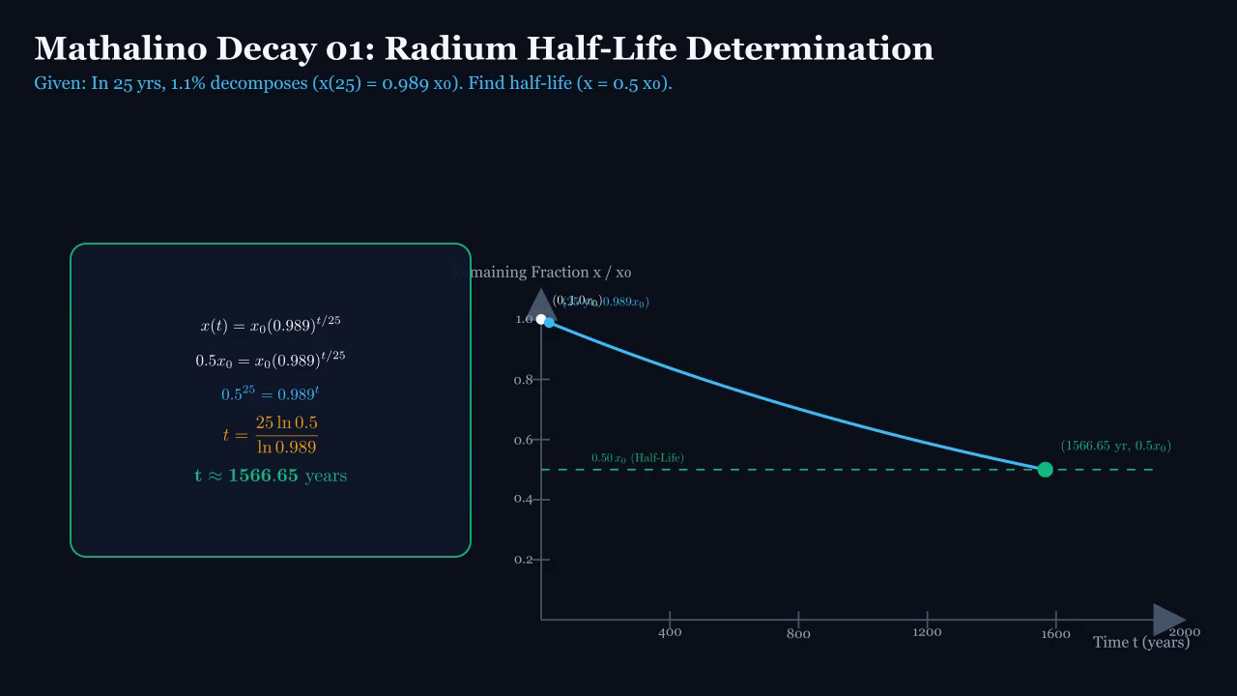
SLIDE 13 / 21 // DIFFERENTIAL EQUATIONS
Mathalino Decay Problem 01: Radium Half-Life
Given: 1.1% Decomposes in 25 Years (x(25) = 0.989 x₀). Find Half-Life.
KEY MATHEMATICAL TAKEAWAYS
• Decomposed fraction: 1.1% ⟹ Remaining fraction: 98.9% (0.989)
• Condition at t = 25: 0.989 x0 = x0 e^(-25k) ⟹ e^(-k) = (0.989)^(1/25)
• Decay model: x(t) = x0 (0.989)^(t/25)
• Half-life definition: x(t) = 0.50 x0
 Apple Pencil Annotation Zone
(Generous writing area for live derivations and class questions)
Notes:
TEACHER NOTES & GUIDED QUESTIONS (Slide 13 / 21):
Highlight MATHalino Radium Problem 01. Warn students not to confuse 1.1% decomposed with 1.1% remaining.

Slide 14
SLIDE 14 / 21 // DIFFERENTIAL EQUATIONS
Radium Half-Life Century-Scale Resolution
Calibrating a Multi-Millennium Geological Clock from a 25-Year Sample
KEY MATHEMATICAL TAKEAWAYS
• Setting x = 0.5 x0: 0.5 = (0.989)^(t/25)
• Taking logarithms: 25 ln(0.5) = t ln(0.989)
• Analytical solution: t = 25 ln(0.5) / ln(0.989)
• Calculated half-life: t ≈ 1,566.65 years
• Matches MATHalino reference solution exactly
 Apple Pencil Annotation Zone
(Generous writing area for live derivations and class questions)
Notes:
TEACHER NOTES & GUIDED QUESTIONS (Slide 14 / 21):
Demonstrate the calculation. Explain that Radium-226 has a known half-life of ~1600 years, showing the high physical accuracy of MATHalino's data.

Slide 15
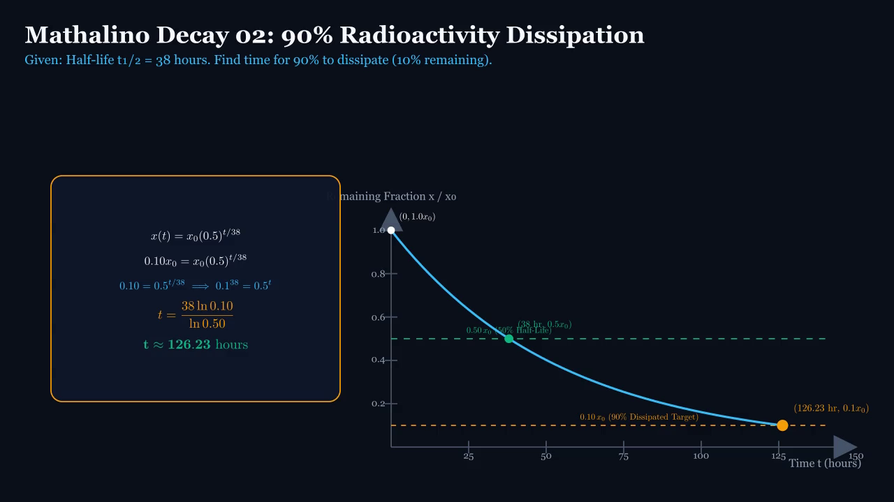
SLIDE 15 / 21 // DIFFERENTIAL EQUATIONS
Mathalino Decay Problem 02: 90% Radioactivity Dissipation
Given: Half-Life t₁/₂ = 38 Hours. Find Time for 90% to Dissipate.
KEY MATHEMATICAL TAKEAWAYS
• Base model using half-life: x(t) = x0 (0.5)^(t/38)
• Critical terminology: 90% dissipated ⟹ 10% remaining (x = 0.10 x0)
• Equation: 0.10 x0 = x0 (0.5)^(t/38) ⟹ 0.10 = 0.5^(t/38)
• Target time: t = 38 ln(0.10) / ln(0.5) ≈ 126.23 hours
 Apple Pencil Annotation Zone
(Generous writing area for live derivations and class questions)
Notes:
TEACHER NOTES & GUIDED QUESTIONS (Slide 15 / 21):
Present MATHalino Problem 02. Emphasize: 90% dissipated means exactly 10% remaining! Ask students to estimate how many half-lives this requires.

Slide 16
SLIDE 16 / 21 // DIFFERENTIAL EQUATIONS
Problem 02 Threshold Resolution & Milestone Check
Verification Against Consecutive Half-Life Milestones
KEY MATHEMATICAL TAKEAWAYS
• t = 38 hr (1 half-life): 50% remaining
• t = 76 hr (2 half-lives): 25% remaining
• t = 114 hr (3 half-lives): 12.5% remaining
• t ≈ 126.23 hr (3.32 half-lives): 10.0% remaining
• Verified against MATHalino official engineering solution
 Apple Pencil Annotation Zone
(Generous writing area for live derivations and class questions)
Notes:
TEACHER NOTES & GUIDED QUESTIONS (Slide 16 / 21):
Annotate the half-life milestones on the slide. Showing that 126.23 hr lies between 3 and 4 half-lives gives students immediate physical confidence in the result.

Slide 17
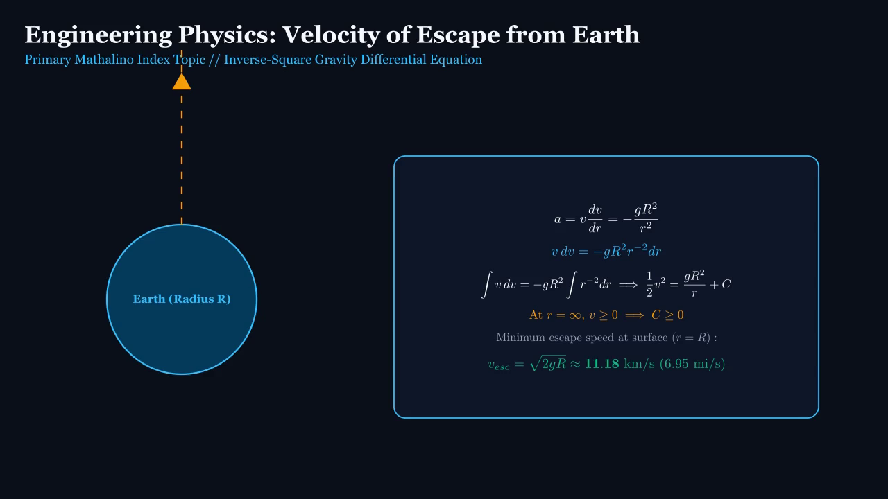
SLIDE 17 / 21 // DIFFERENTIAL EQUATIONS
Engineering Physics Extension: Velocity of Escape from Earth
Primary MATHalino Index Topic // Vertical Motion Under Variable Gravity
KEY MATHEMATICAL TAKEAWAYS
• Newton's Gravitation: F = -m g R² / r²
• Kinematic Chain Rule: a = dv/dt = v (dv/dr)
• Governing DE: v (dv/dr) = -g R² / r²
• Separation of variables: v dv = -g R² r^(-2) dr
 Apple Pencil Annotation Zone
(Generous writing area for live derivations and class questions)
Notes:
TEACHER NOTES & GUIDED QUESTIONS (Slide 17 / 21):
Transition to the engineering extension topic from MATHalino. Explain why acceleration a is written as v dv/dr rather than dv/dt.

Slide 18
SLIDE 18 / 21 // DIFFERENTIAL EQUATIONS
Escape Velocity Analytical Resolution
Integrating to Infinity to Overcome the Planetary Gravitational Well
KEY MATHEMATICAL TAKEAWAYS
• Integrating: ∫ v dv = -g R² ∫ r^(-2) dr ⟹ (1/2)v² = g R² / r + C
• Boundary condition at infinity: r ➔ ∞, v ≥ 0 ⟹ C ≥ 0
• Surface launch (r = R): (1/2) v_esc² = g R ⟹ v_esc = √(2gR)
• Numerical value: v_esc ≈ 11.18 km/s (6.95 mi/s ≈ 25,000 mph)
 Apple Pencil Annotation Zone
(Generous writing area for live derivations and class questions)
Notes:
TEACHER NOTES & GUIDED QUESTIONS (Slide 18 / 21):
Derive v_esc = sqrt(2gR). Show how energy conservation and differential separation yield the identical escape formula.

Slide 19
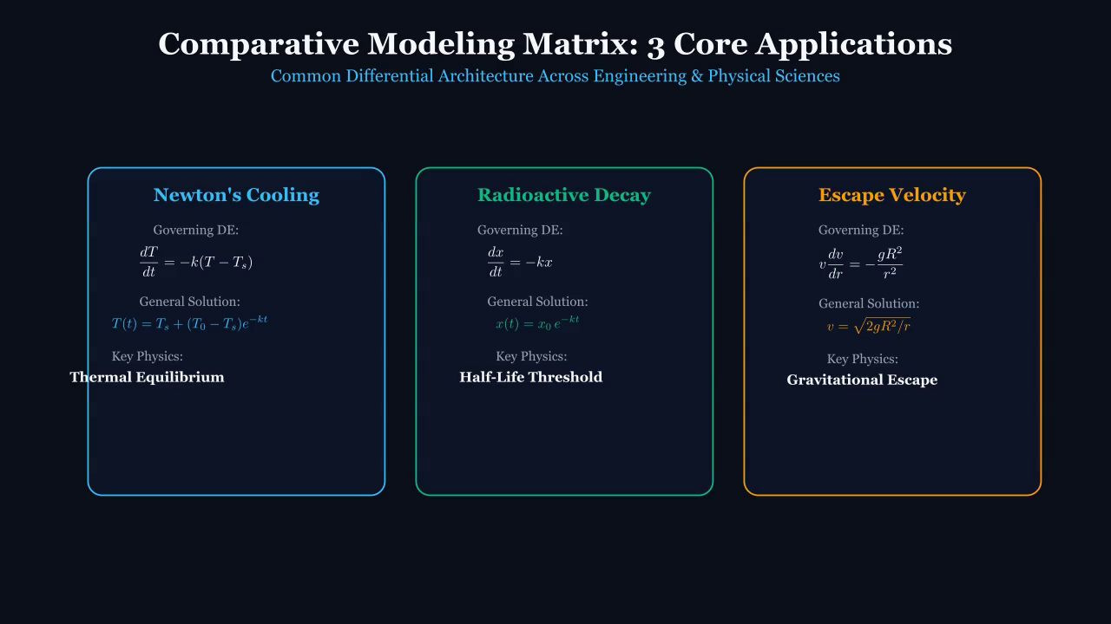
SLIDE 19 / 21 // DIFFERENTIAL EQUATIONS
Master Comparative Modeling Matrix
Unified Differential Architecture Across Engineering Applications
KEY MATHEMATICAL TAKEAWAYS
• Cooling: dT/dt = -k(T - Ts) ⟹ Asymptotic thermal balance
• Decay: dx/dt = -kx ⟹ Invariant half-life dissipation
• Escape: v dv/dr = -gR²/r² ⟹ Gravitational potential escape
• All 3 solve cleanly via separation of variables
 Apple Pencil Annotation Zone
(Generous writing area for live derivations and class questions)
Notes:
TEACHER NOTES & GUIDED QUESTIONS (Slide 19 / 21):
Summarize the 3 models side-by-side. Highlight the unity of first-order differential equations across physical systems.

Slide 20
SLIDE 20 / 21 // DIFFERENTIAL EQUATIONS
Lecture Summary & Live Apple Pencil Q&A
Core Engineering Takeaways & Examination Review
LECTURE FOCUS & CORE TAKEAWAYS
• Always check units and physical domain constraints
• Distinguish remaining fraction from dissipated fraction
• Identify physical asymptotes before solving transcendental equations
Notes:
TEACHER NOTES & GUIDED QUESTIONS (Slide 20 / 21):
Open the floor for questions. Provide live derivations for any requested steps.

Slide 21
SLIDE 21 / 21 // DIFFERENTIAL EQUATIONS
Curriculum References & Academic Acknowledgements
Primary Sources, Literature References & Animation Framework
LECTURE FOCUS & CORE TAKEAWAYS
• MATHalino Engineering Math Review (mathalino.com)
• James Stewart, Calculus: Early Transcendentals (9th Ed.)
• Boyce & DiPrima, Elementary Differential Equations
• 3Blue1Brown (Grant Sanderson), Essence of Calculus style
Notes:
TEACHER NOTES & GUIDED QUESTIONS (Slide 21 / 21):
Credit MATHalino for all authentic source problems and numerical data.

