Slide 1
DIFFERENTIAL CALCULUS FOR ENGINEERS
Maxima & Minima: Dynamic Motion, Extrema Tests & Optimization
A Motion-Graphics Interactive Lecture Designed for Live iPad & Apple Pencil Annotation
Core Function: f(x) = x³ - 3x | Applied Engineering & Geometric Optimization
Notes:
OPENING REMARKS:
Welcome students. Today we connect the geometry of motion with rigorous calculus.
We will discover how derivatives act as velocity detectors for curves, why horizontal tangents can deceive us, and how engineering systems achieve peak efficiency through extremum principles.

Slide 2
DIFFERENTIAL CALCULUS // ENGINEERING LECTURE
Lecture Trajectory: From Kinetic Intuition to Optimization
01
Visual Motion & Critical Intuition
Moving tangent vectors, slope zero conditions, and singularities (corners/cusps).
02
First Derivative Test & Sign Charts
Factorization morphing, interval sign sampling, and direction transitions.
03
Second Derivative & Concavity Bending
Differential curvature f''(x), concavity bowls, and inflection terraces.
04
Applied Engineering Optimization
Boundary constraints, revenue models, hydraulic channels, and impedance matching.

Slide 3
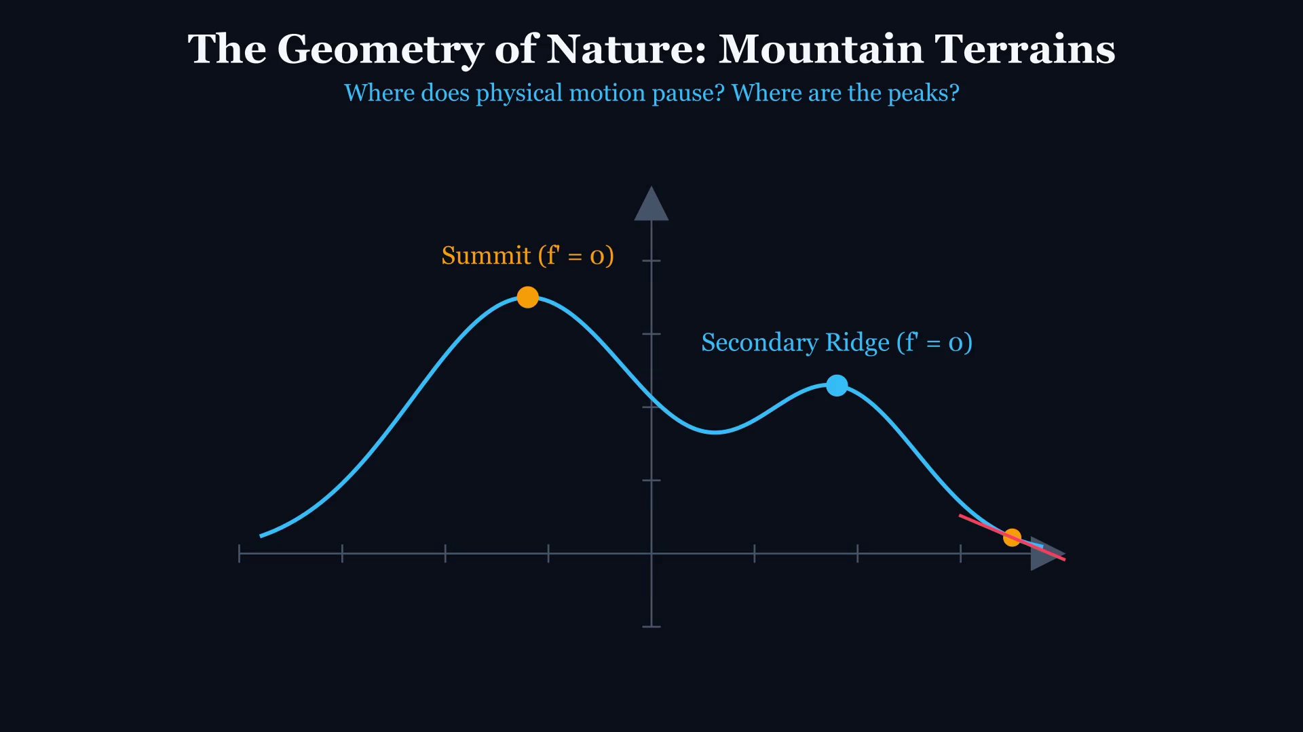
DIFFERENTIAL CALCULUS // ENGINEERING LECTURE
Terrain Exploration: The Geometry of Peaks & Valleys
KEY TEACHING OBJECTIVE
Identifying Extrema along an Elevation Profile
LECTURE FOCUS & CUES
Ask the lecture hall: 'As our exploration probe traverses this mountain range, what exact instantaneous property characterizes the true summits and lowest valleys?'
[Annotate freely in Keynote with Apple Pencil]
Notes:
Play the animation. Note how the probe ascends and descends. Highlight that slope is positive on ascent, zero at crests, negative on descent.

Slide 4
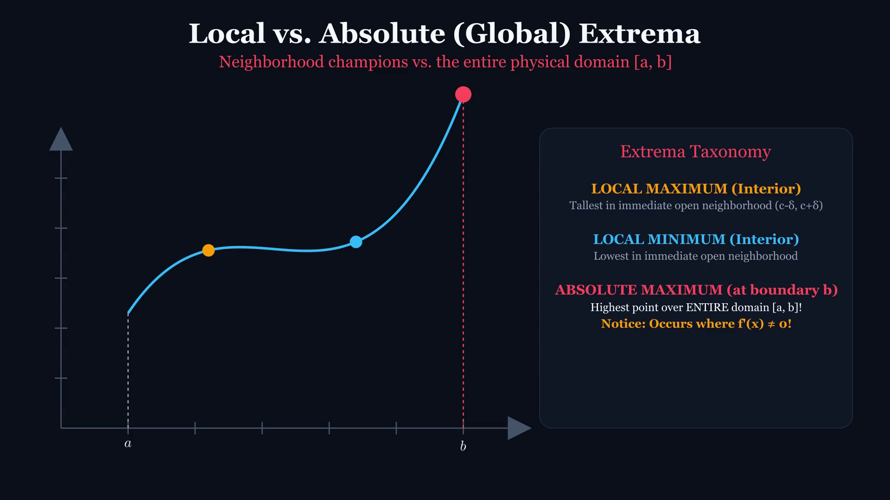
DIFFERENTIAL CALCULUS // ENGINEERING LECTURE
Topological Definitions: Local vs. Absolute Extrema
KEY TEACHING OBJECTIVE
Open Neighborhoods vs. Entire Domain Supremum
LECTURE FOCUS & CUES
Key Conceptual Question: 'Can a local maximum have a lower numerical value than a local minimum in the same function?'
[Annotate freely in Keynote with Apple Pencil]
Notes:
Play clip. Clarify that 'Local' requires an open ball (c-delta, c+delta), whereas 'Absolute' compares against all x in domain D.

Slide 5
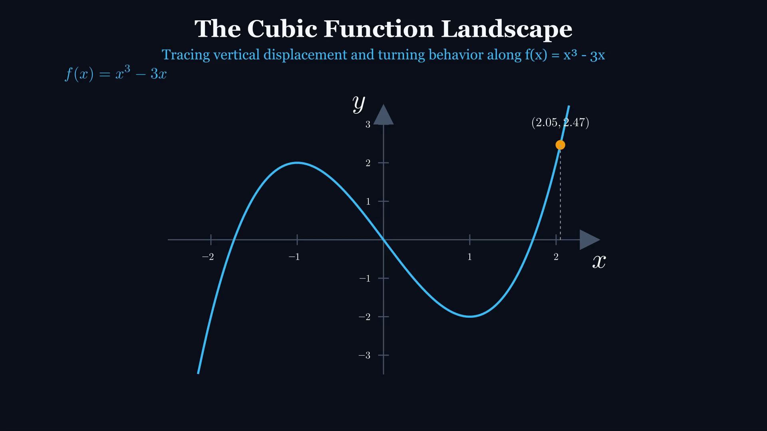
DIFFERENTIAL CALCULUS // ENGINEERING LECTURE
The Cubic Landscape: Trajectory of f(x) = x³ - 3x
KEY TEACHING OBJECTIVE
Tracking the Coordinate State of an Odd Cubic Curve
LECTURE FOCUS & CUES
Observe the symmetry: f(-x) = -f(x). What does odd symmetry tell us about the relationship between maxima and minima?
[Annotate freely in Keynote with Apple Pencil]
Notes:
Introduce f(x) = x^3 - 3x as the primary worked model. Point travels from x = -2.2 to x = 2.2, traversing a crest and a trough.

Slide 6
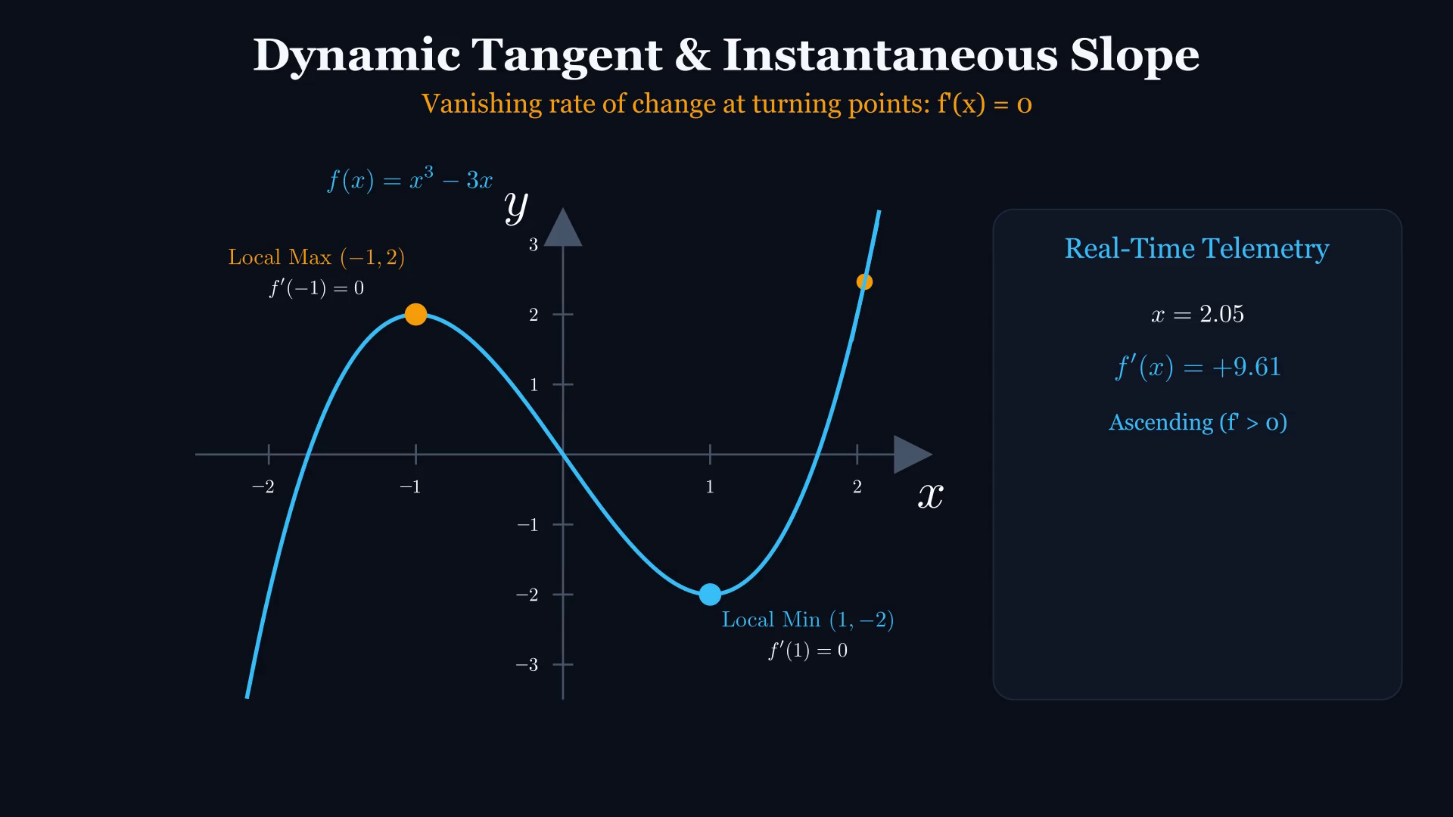
DIFFERENTIAL CALCULUS // ENGINEERING LECTURE
Dynamic Tangent Telemetry & Derivative f'(x)
KEY TEACHING OBJECTIVE
Visualizing the Derivative as an Instantaneous Rotating Vector
LECTURE FOCUS & CUES
Notice the real-time slope readout: as the point passes x = -1, the slope m collapses precisely from positive to zero to negative.
[Annotate freely in Keynote with Apple Pencil]
Notes:
Play the clip. Point out the color change of the tangent line: Cyan (positive slope) to Amber (zero slope) to Coral (negative slope).

Slide 7
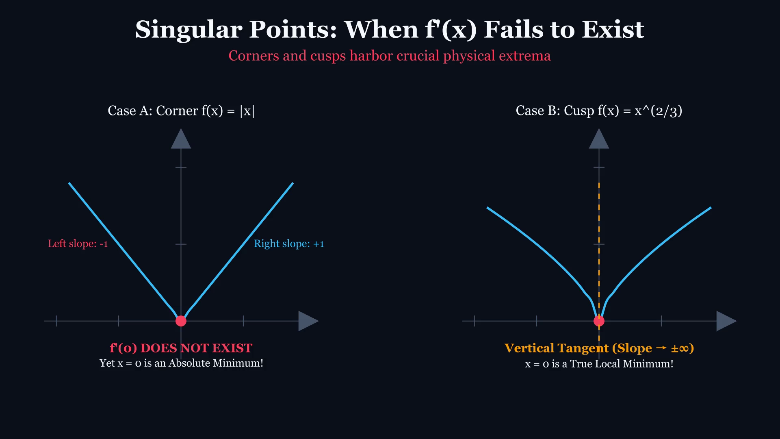
DIFFERENTIAL CALCULUS // ENGINEERING LECTURE
Singularities: When Derivatives Fail to Exist
KEY TEACHING OBJECTIVE
Critical Points Beyond Smooth Tangents: Corners & Cusps
LECTURE FOCUS & CUES
Critical Challenge: 'Does a curve need a smooth horizontal tangent to have an absolute minimum? Look at |x| and x^(2/3).'
[Annotate freely in Keynote with Apple Pencil]
Notes:
Play clip. Critical numbers occur where f'(c) = 0 OR where f'(c) does not exist (DNE), provided c is in the domain!

Slide 8
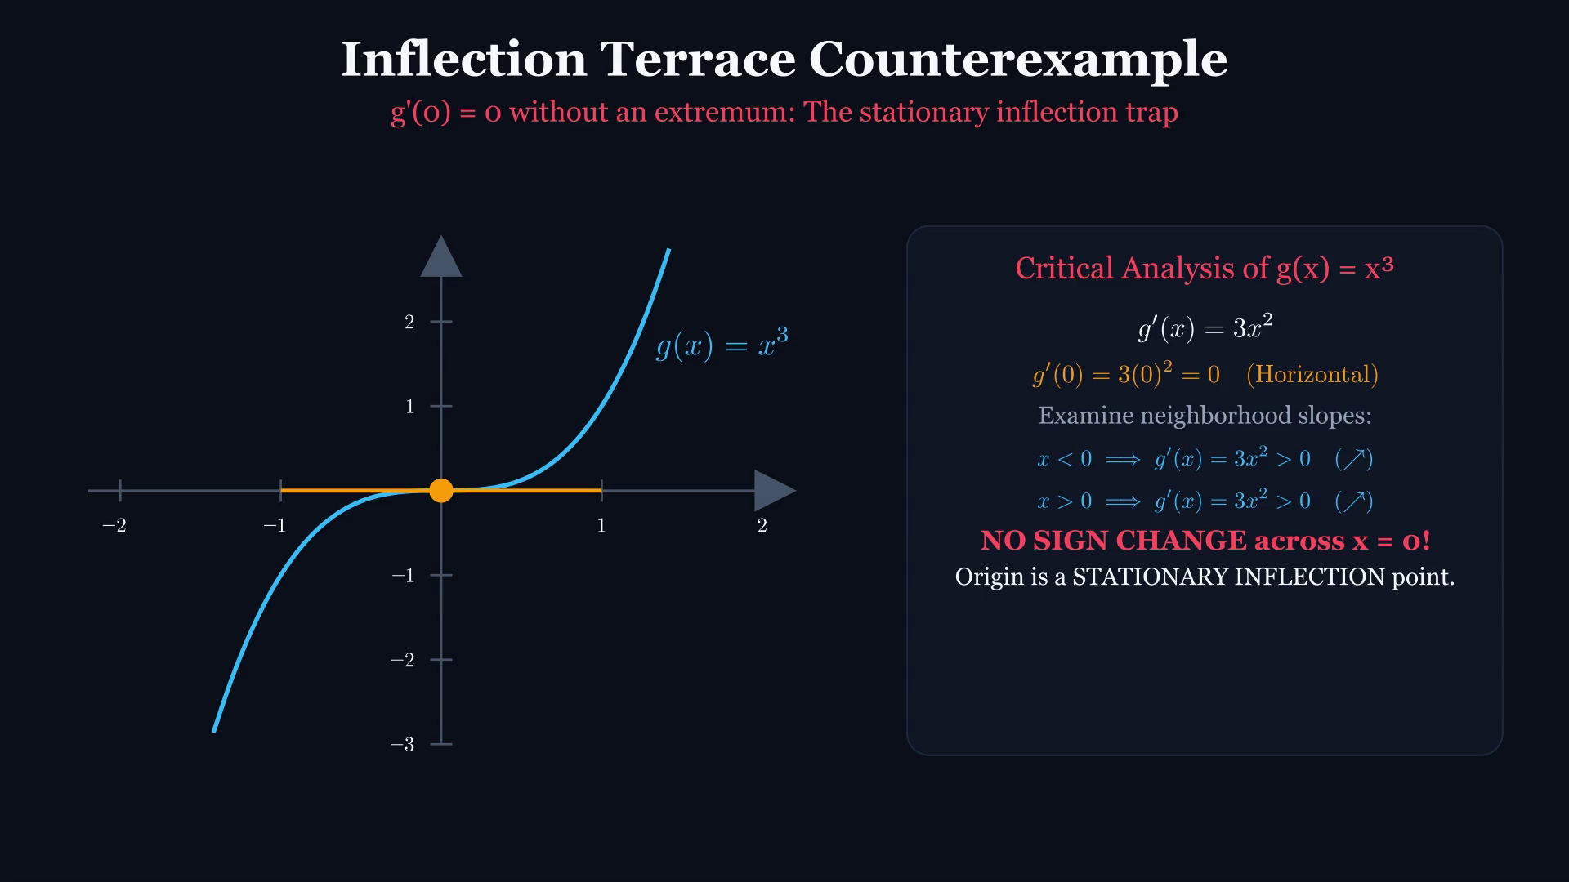
DIFFERENTIAL CALCULUS // ENGINEERING LECTURE
The Critical Trap: When f'(c) = 0 Yields NO Extremum
KEY TEACHING OBJECTIVE
Stationary Inflection Point on g(x) = x³
LECTURE FOCUS & CUES
Examine g(x) = x³: g'(0) = 0. The tangent is perfectly horizontal. Is (0, 0) a maximum or a minimum?
[Annotate freely in Keynote with Apple Pencil]
Notes:
Play clip. Tangent line goes horizontal at x=0, but the curve continues climbing. Zero derivative is NECESSARY, not SUFFICIENT.

Slide 9
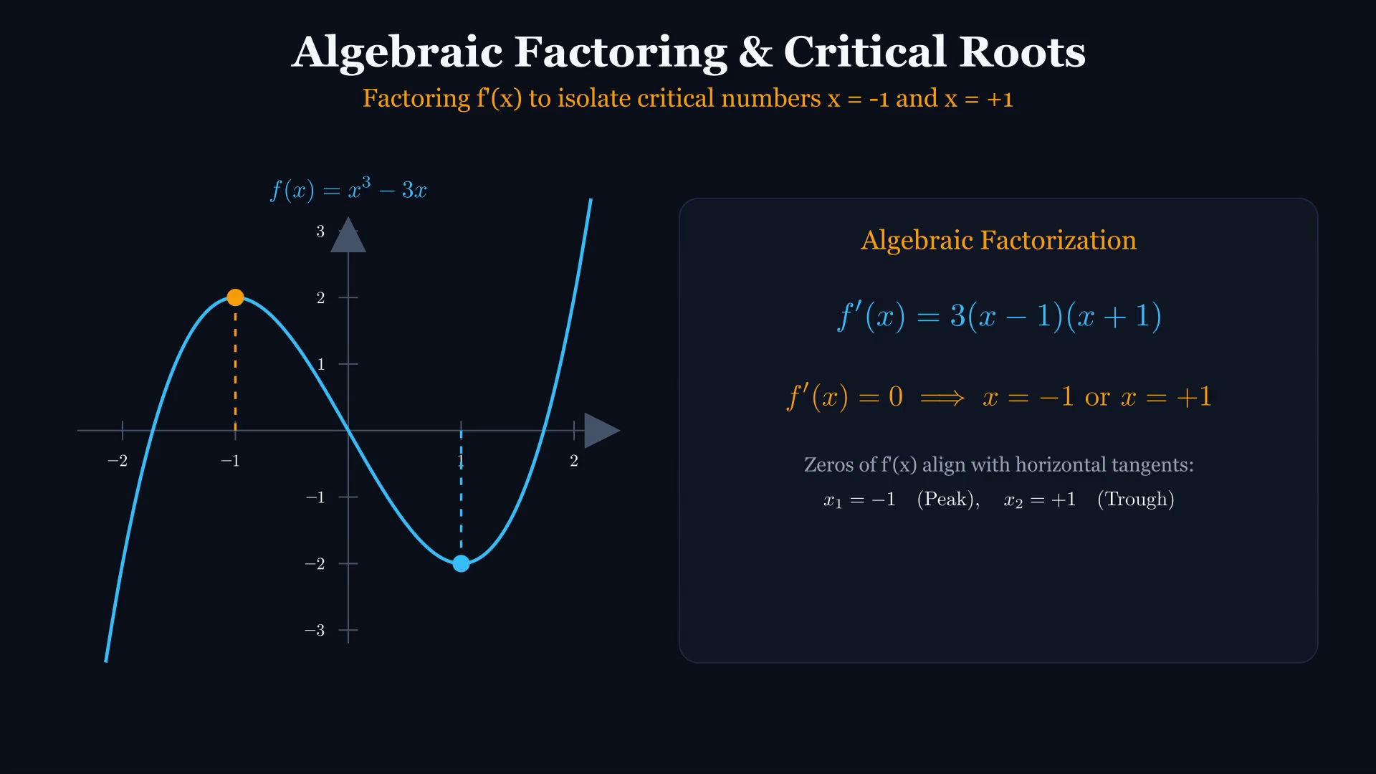
DIFFERENTIAL CALCULUS // ENGINEERING LECTURE
Algebraic Factoring: Zeroes of the Derivative
KEY TEACHING OBJECTIVE
3x² - 3 ==> 3(x² - 1) ==> 3(x - 1)(x + 1) = 0
LECTURE FOCUS & CUES
Notice how the algebraic zeros x = -1 and x = +1 project vertically into physical coordinates on the function curve.
[Annotate freely in Keynote with Apple Pencil]
Notes:
Play clip. Point out how factoring reveals the exact roots where the velocity of the curve momentarily freezes.

Slide 10
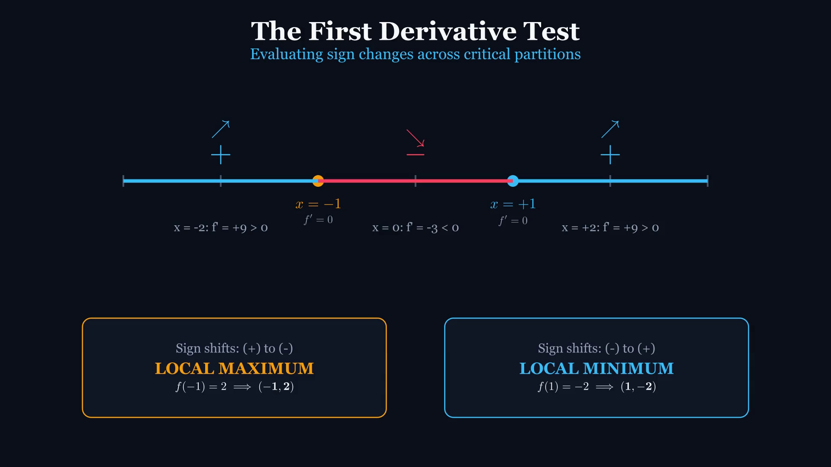
DIFFERENTIAL CALCULUS // ENGINEERING LECTURE
First Derivative Test: Dynamic Sign Partitioning
KEY TEACHING OBJECTIVE
Number Line Sampling & Directional Transitions
LECTURE FOCUS & CUES
Watch the sign chart reveal: positive slopes push the curve up, zero halts it, negative slopes pull it down.
[Annotate freely in Keynote with Apple Pencil]
Notes:
Play clip. The number line is partitioned by critical numbers into (-inf, -1), (-1, 1), and (1, inf).

Slide 11
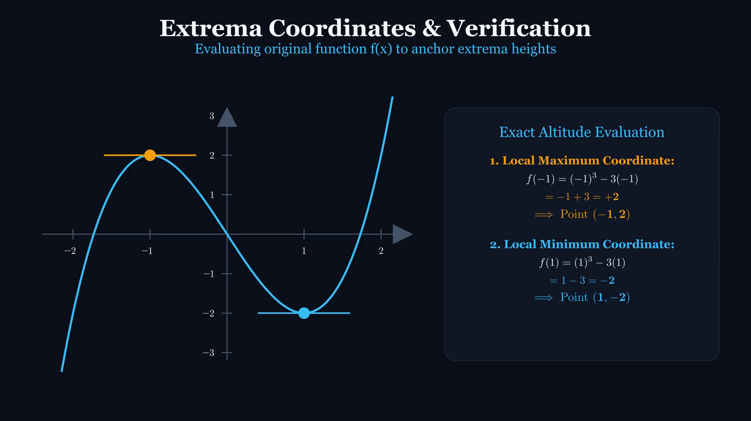
DIFFERENTIAL CALCULUS // ENGINEERING LECTURE
Coordinate Verification: Locating Exact Extrema
KEY TEACHING OBJECTIVE
Evaluating Critical Numbers in the ORIGINAL Function f(x)
LECTURE FOCUS & CUES
Common blunder alert: Students plug x = -1 into f'(x) and get 0! Where must we substitute to find the height of the curve?
[Annotate freely in Keynote with Apple Pencil]
Notes:
Play clip. Emphasize: f(-1) = (-1)^3 - 3(-1) = -1 + 3 = +2 -> Local Max (-1, 2). f(1) = (1)^3 - 3(1) = -2 -> Local Min (1, -2).

Slide 12
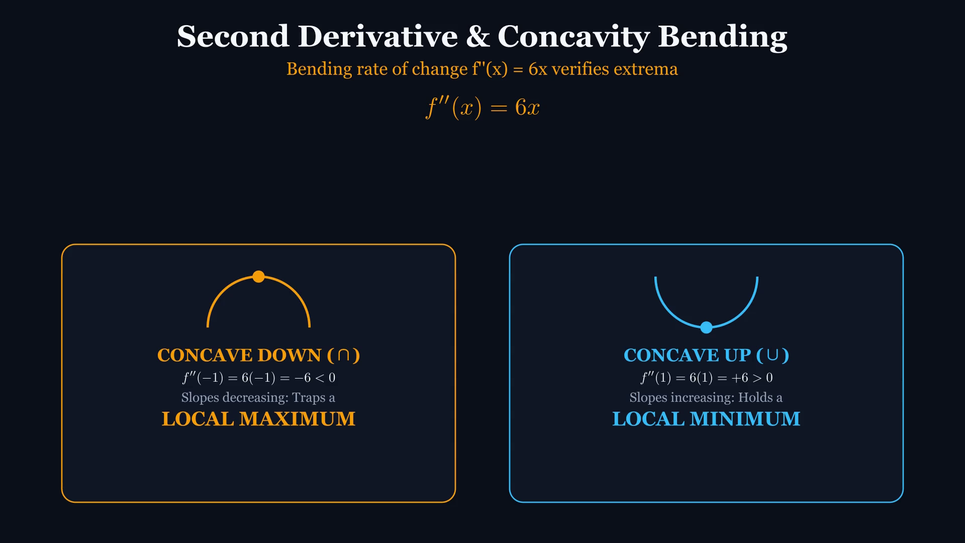
DIFFERENTIAL CALCULUS // ENGINEERING LECTURE
Second Derivative Test: Curvature & Concavity Bending
KEY TEACHING OBJECTIVE
f''(x) = 6x Measures the Rate of Change of Slope
LECTURE FOCUS & CUES
Physical Intuition: If f'(x) = 0 and f''(x) < 0, slopes are decreasing (positive -> 0 -> negative). The curve MUST be concave down (trapping a peak).
[Annotate freely in Keynote with Apple Pencil]
Notes:
Play clip. Note the two visual bowls: Concave Down (cap) with negative second derivative, Concave Up (cup) with positive second derivative.

Slide 13
THEORETICAL COMPARISON // EXAM STRATEGY
Extrema Decision Matrix: 1st vs. 2nd Derivative Test
FIRST DERIVATIVE TEST
APPLICABILITY
Universal. Works for smooth points AND singularities (corners/cusps).
MECHANISM
Checks sign change of f'(x) across x = c.
OUTCOMES
(+ to -) => Local Max
(- to +) => Local Min
(No change) => Neither
LIMITATION
Requires picking test points in every interval.
VERDICT
Always reliable. Fallback when 2nd test fails.
SECOND DERIVATIVE TEST
APPLICABILITY
Restricted. Requires f'(c) = 0 and f''(c) to exist.
MECHANISM
Evaluates single point concavity f''(c) directly.
OUTCOMES
f''(c) < 0 => Concave Down => Local Max
f''(c) > 0 => Concave Up => Local Min
f''(c) = 0 => INCONCLUSIVE (Must use 1st test!)
LIMITATION
Fails on cusps, corners, and flat inflection points.
VERDICT
Faster when differentiation is easy, but fragile.
Notes:
LECTURE EMPHASIS:
Stress the 'Inconclusive' case: for f(x)=x^4, f''(0)=0 and it has a min.
For f(x)=-x^4, f''(0)=0 and it has a max. For f(x)=x^3, f''(0)=0 and it has neither!
If f''(c)=0, never guess. Revert immediately to the First Derivative Test.

Slide 14
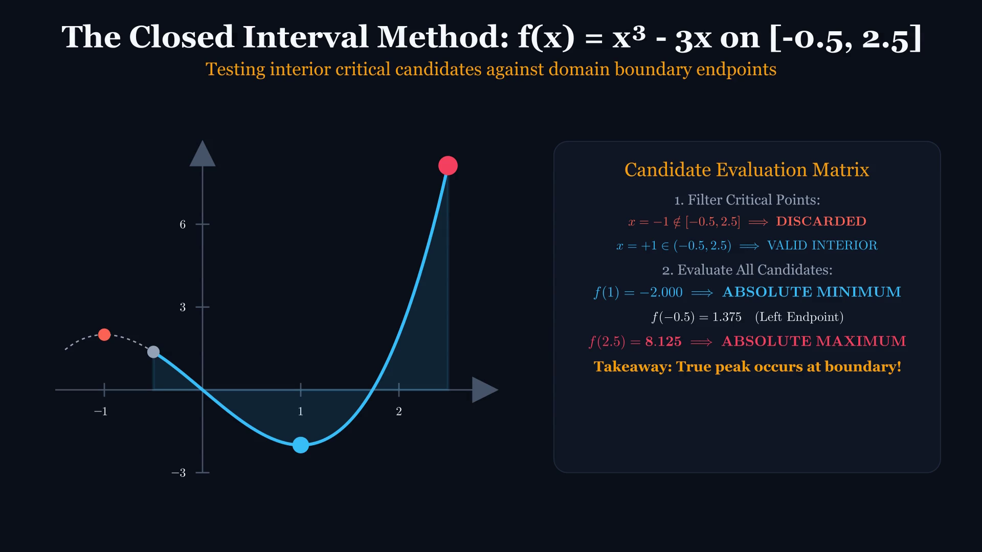
DIFFERENTIAL CALCULUS // ENGINEERING LECTURE
Closed Interval Method: The Extreme Value Theorem
KEY TEACHING OBJECTIVE
f(x) = x³ - 3x Restricted to the Closed Interval [-0.5, 2.5]
LECTURE FOCUS & CUES
Notice how the local maximum at x = -1 is EXCLUDED because it lies outside [-0.5, 2.5]! Where does the absolute maximum occur?
[Annotate freely in Keynote with Apple Pencil]
Notes:
Play clip. Candidate evaluation: interior critical point x=1 -> f(1)=-2. Endpoints: x=-0.5 -> f(-0.5)=1.375; x=2.5 -> f(2.5)=8.125 (Winner!).

Slide 15
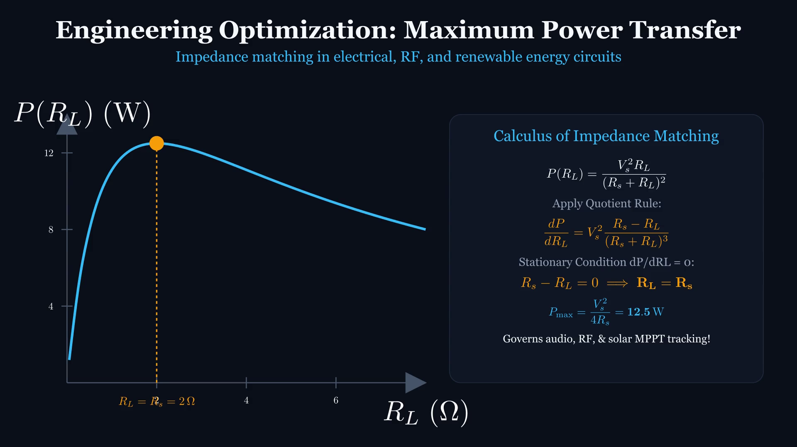
DIFFERENTIAL CALCULUS // ENGINEERING LECTURE
Engineering Optimization: Maximum Power Transfer Theorem
KEY TEACHING OBJECTIVE
Maximizing Load Power P(R_L) = V_th² * R_L / (R_th + R_L)²
LECTURE FOCUS & CUES
Differentiating with the Quotient Rule reveals: dP/dR_L = 0 occurs precisely when R_load = R_thevenin! Impedance matching in RF and audio circuits.
[Annotate freely in Keynote with Apple Pencil]
Notes:
Play clip. Highlight the engineering trade-off: at R_L = 0, current is maximum but voltage is 0 (P=0). At R_L = inf, voltage is maximum but current is 0 (P=0).

Slide 16
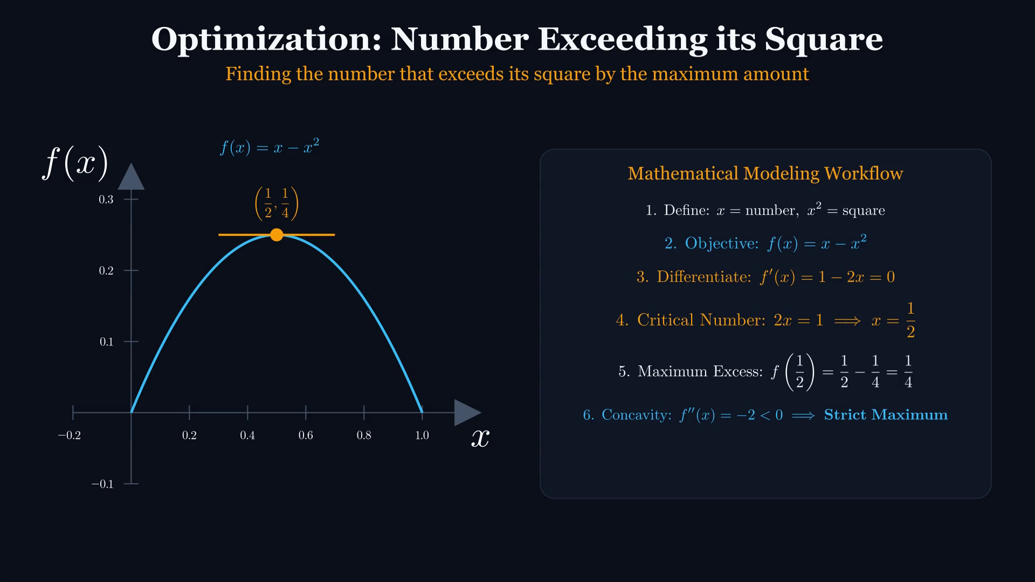
DIFFERENTIAL CALCULUS // ENGINEERING LECTURE
Optimization 1: Number Exceeding its Square
KEY TEACHING OBJECTIVE
What number exceeds its square by the maximum amount?
LECTURE FOCUS & CUES
Objective f(x) = x - x². Differentiating f'(x) = 1 - 2x = 0 yields critical number x = 1/2. Concavity f''(x) = -2 < 0 proves strict global maximum of 1/4.
[Annotate freely in Keynote with Apple Pencil]
Notes:
Emphasize translating verbal problem statements into analytical mathematical functions, followed by first and second derivative verification.

Slide 17
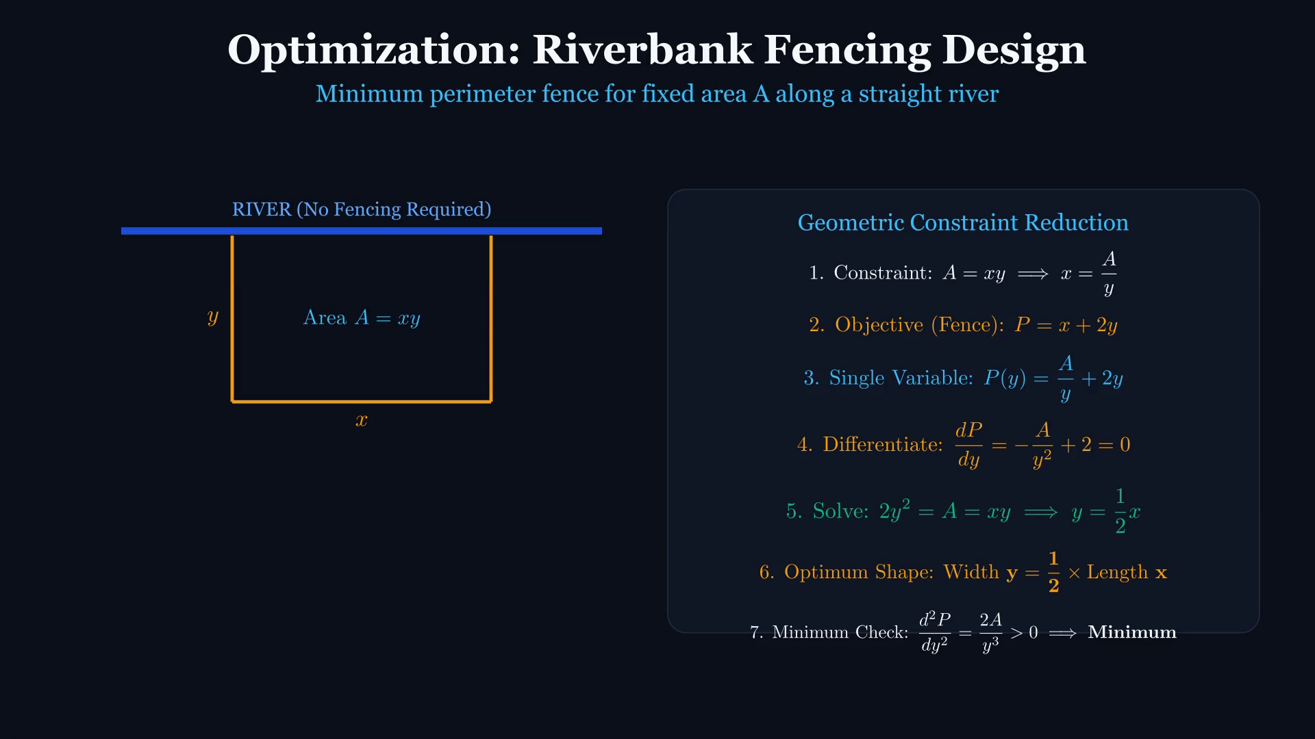
DIFFERENTIAL CALCULUS // ENGINEERING LECTURE
Optimization 2: Riverbank Fencing & Boundary Constraints
KEY TEACHING OBJECTIVE
Least fencing perimeter for fixed area A along a straight river
LECTURE FOCUS & CUES
Area A = xy reduces perimeter P = x + 2y to single variable P(y) = A/y + 2y. Differentiating: dP/dy = -A/y² + 2 = 0 => 2y² = A = xy => Width y = x/2.
[Annotate freely in Keynote with Apple Pencil]
Notes:
Geometric constraint reduces multivariable to single variable. With 1 natural boundary (river), optimal ratio is width = half length.

Slide 18
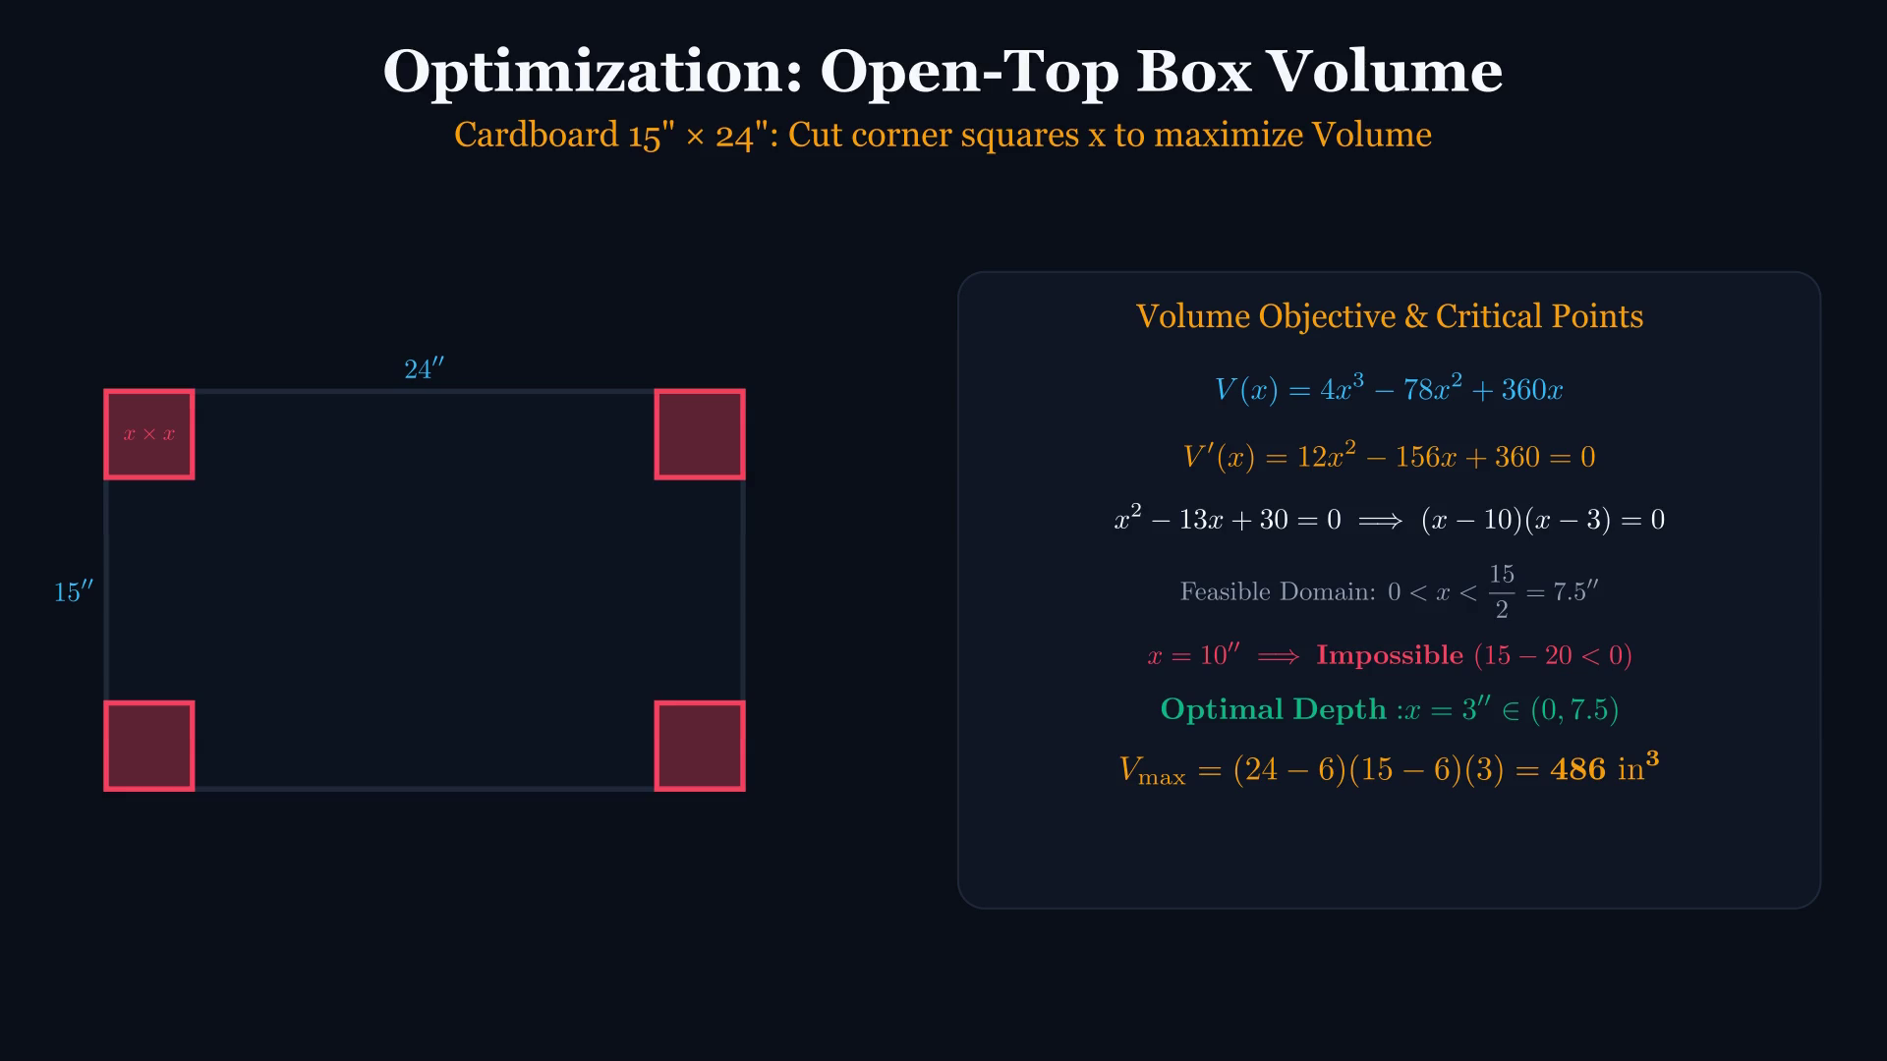
DIFFERENTIAL CALCULUS // ENGINEERING LECTURE
Optimization 3: Open-Top Box Volume Maximization
KEY TEACHING OBJECTIVE
15" × 24" Cardboard Sheet: Cut squares x to maximize Volume
LECTURE FOCUS & CUES
V(x) = (24-2x)(15-2x)x = 4x³ - 78x² + 360x. Setting V'(x) = 0 yields x = 3 or x = 10. Feasible physical domain (0, 7.5) eliminates x = 10! V_max = 486 in³.
[Annotate freely in Keynote with Apple Pencil]
Notes:
Critical points must be tested against physical boundaries. x=10 is extraneous because 15-2(10) < 0.

Slide 19
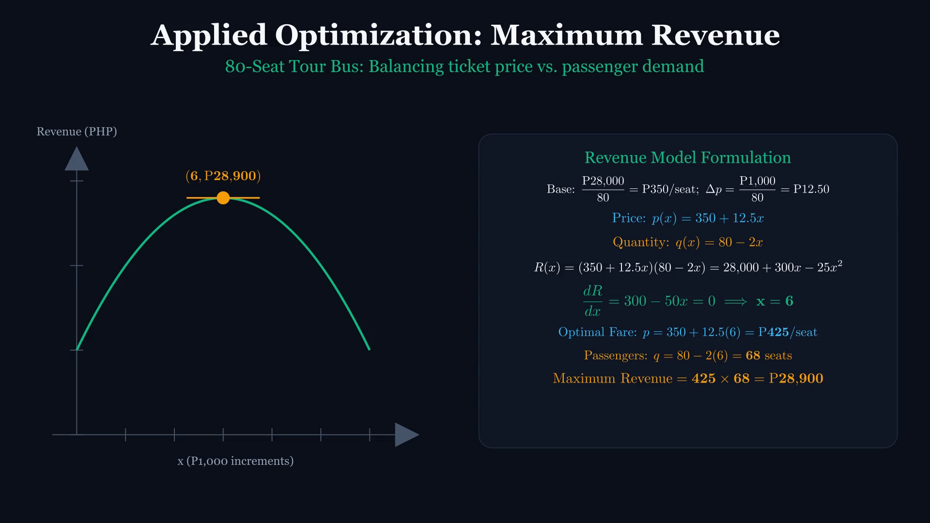
DIFFERENTIAL CALCULUS // ENGINEERING LECTURE
Optimization 4: Tour Bus Yield Management & Revenue
KEY TEACHING OBJECTIVE
80-Seat Tour Bus: Balancing ticket price vs. passenger demand
LECTURE FOCUS & CUES
Base fare: P350/seat. Increments: P12.50/seat with -2 passengers. R(x) = (350 + 12.5x)(80 - 2x) = 28,000 + 300x - 25x². dR/dx = 0 => x = 6. Fare = P425, Revenue = P28,900.
[Annotate freely in Keynote with Apple Pencil]
Notes:
Real-world business revenue optimization. Calculus discovers the pricing sweet spot between seat price and passenger occupancy.

Slide 20
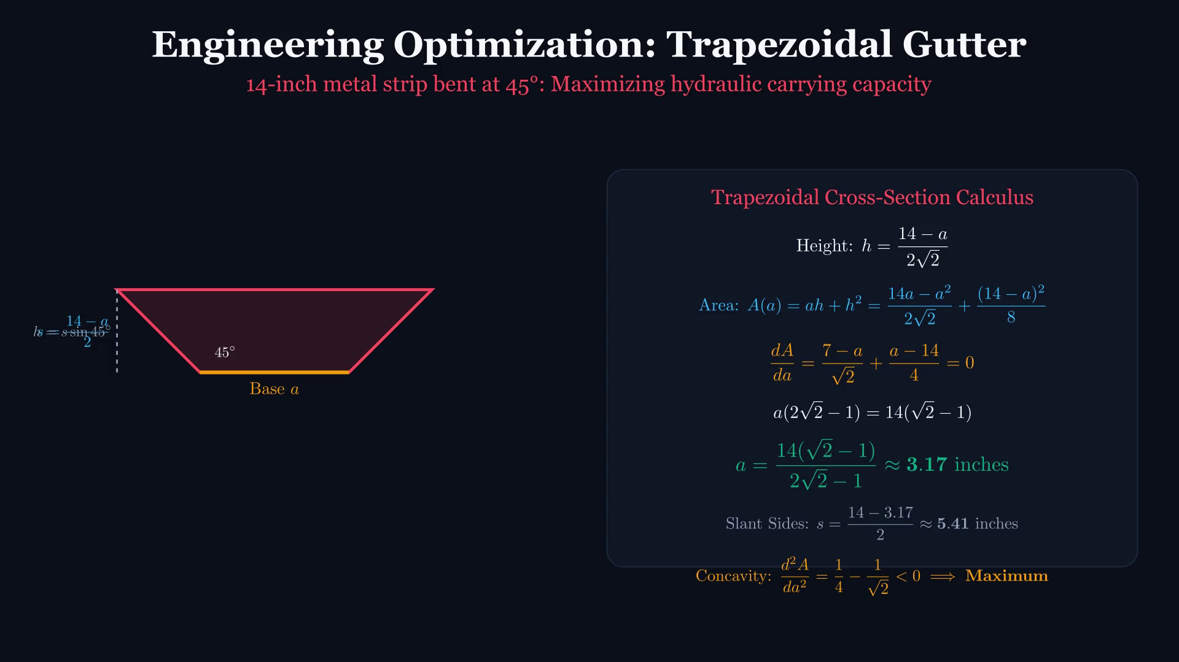
DIFFERENTIAL CALCULUS // ENGINEERING LECTURE
Optimization 5: Trapezoidal Gutter Hydraulic Capacity
KEY TEACHING OBJECTIVE
14-inch metal strip bent at 45°: Maximizing hydraulic carrying capacity
LECTURE FOCUS & CUES
Base a, sides s = (14-a)/2, height h = (14-a)/(2√2). Cross-section Area A = ah + h². Setting dA/da = 0 yields optimal base width a = 14(√2 - 1)/(2√2 - 1) ≈ 3.17 inches (slants s ≈ 5.41 inches).
[Annotate freely in Keynote with Apple Pencil]
Notes:
Advanced civil and mechanical engineering channel design. Exact radical algebra simplified to decimal dimensions.

Slide 21
STUDENT ACTIVE LEARNING // CONCEPT APPLICATION
Engineering Practice Challenge & Exit Ticket
ACTIVE LEARNING CHALLENGE
Analyze the structural response function:
f(x) = 2x³ - 3x² - 12x + 5 on [-2, 4]
1. Compute f'(x) and factor completely.
2. Identify all critical numbers inside [-2, 4].
3. Apply Second Derivative Test to classify local extrema.
4. Construct the EVT candidate table (criticals + endpoints).
5. Identify Global Maximum and Global Minimum coordinates.
SOLUTION CHECKLIST & ANSWER KEY
DERIVATIVE:
f'(x) = 6x² - 6x - 12 = 6(x - 2)(x + 1)
CRITICAL NUMBERS:
x = -1 and x = 2 (both inside [-2, 4])
SECOND DERIVATIVE:
f''(x) = 12x - 6
AT X = -1:
f''(-1) = -18 < 0 => Local Max at (-1, 12)
AT X = 2:
f''(2) = +18 > 0 => Local Min at (2, -15)
CANDIDATE TABLE:
f(-2) = 1
f(-1) = 12
f(2) = -15
f(4) = 37
GLOBAL EXTREMA:
Global Max: (4, 37) [Endpoint!]
Global Min: (2, -15) [Interior Critical!]
Notes:
INSTRUCTOR WRAP-UP & EXIT TICKET:
Give students 4 minutes to work. Walk the room or annotate with Apple Pencil.
Reveal the key insight: The local max (-1, 12) is soundly beaten by the endpoint (4, 37)!
Remind students: Never neglect endpoints in engineering optimization.

Slide 22
BIBLIOGRAPHY // PROBLEM SOURCES
Curriculum References & Academic Acknowledgements
PRIMARY APPLIED PROBLEM SOURCE: MATHALINO
The optimization case studies in this lecture are curated from the comprehensive engineering mathematics reviewer at Mathalino (mathalino.com):
• Problem 1: Number Exceeding Square
https://mathalino.com/reviewer/differential-calculus/01-04-number-problems-in-maxima-and-minima
• Problem 10: Riverbank Fencing Lot
https://mathalino.com/reviewer/differential-calculus/09-11-rectangular-lot-problems-in-maxima-and-minima
• Problem 16: Open-Top 15"x24" Box
https://mathalino.com/reviewer/differential-calculus/15-17-box-open-at-the-top
• Problem 03: 80-Seat Tour Bus Revenue
https://mathalino.com/reviewer/differential-calculus/03-maximum-revenue-tour-bus-80-seats
• Problem 42: Trapezoidal Gutter 14" Strip
https://mathalino.com/reviewer/differential-calculus/41-42-maxima-and-minima-problem-involving-a-trapezoidal-gutter
CALCULUS TEXTS & VISUAL STANDARDS
James Stewart, Calculus: Early Transcendentals (9th Edition)
Fermat's Theorem, Extreme Value Theorem, First & Second Derivative Tests, and optimization modeling frameworks.
3Blue1Brown (Grant Sanderson), Essence of Calculus
Kinematic visual intuition, rotating tangent vectors, geometric differential transformations, and continuous visual proofs.
Engineering Electrical & Civil Reference Standards
Maximum Power Transfer Theorem (Jacobi's Law, 1840) and open-channel hydraulic trapezoidal flow optimization.
Instructional Presentation Platform
Rendered via Manim Community Edition v0.22.0. Native Apple PencilKit inking support in Apple Keynote on iPad.

