Slide 1
DIFFERENTIAL CALCULUS FOR ENGINEERS
Maxima & Minima: Dynamic Motion, Extrema Tests & Optimization
A Motion-Graphics Interactive Lecture Designed for Live iPad & Apple Pencil Annotation
Core Function: f(x) = x³ - 3x | Engineering Application: Maximum Power Transfer
Notes:
OPENING REMARKS:
Welcome students. Today we connect the geometry of motion with rigorous calculus.
We will discover how derivatives act as velocity detectors for curves, why horizontal tangents can deceive us, and how engineering systems achieve peak efficiency through extremum principles.

Slide 2
DIFFERENTIAL CALCULUS // ENGINEERING LECTURE
Lecture Trajectory: From Kinetic Intuition to Optimization
01
Visual Motion & Critical Intuition
Moving tangent vectors, slope zero conditions, and singularities (corners/cusps).
02
First Derivative Test & Sign Charts
Factorization morphing, interval sign sampling, and direction transitions.
03
Second Derivative & Concavity Bending
Differential curvature f''(x), concavity bowls, and inflection terraces.
04
Closed-Interval Engineering Optimization
Extreme Value Theorem, candidate matrix, and Maximum Power Transfer.

Slide 3
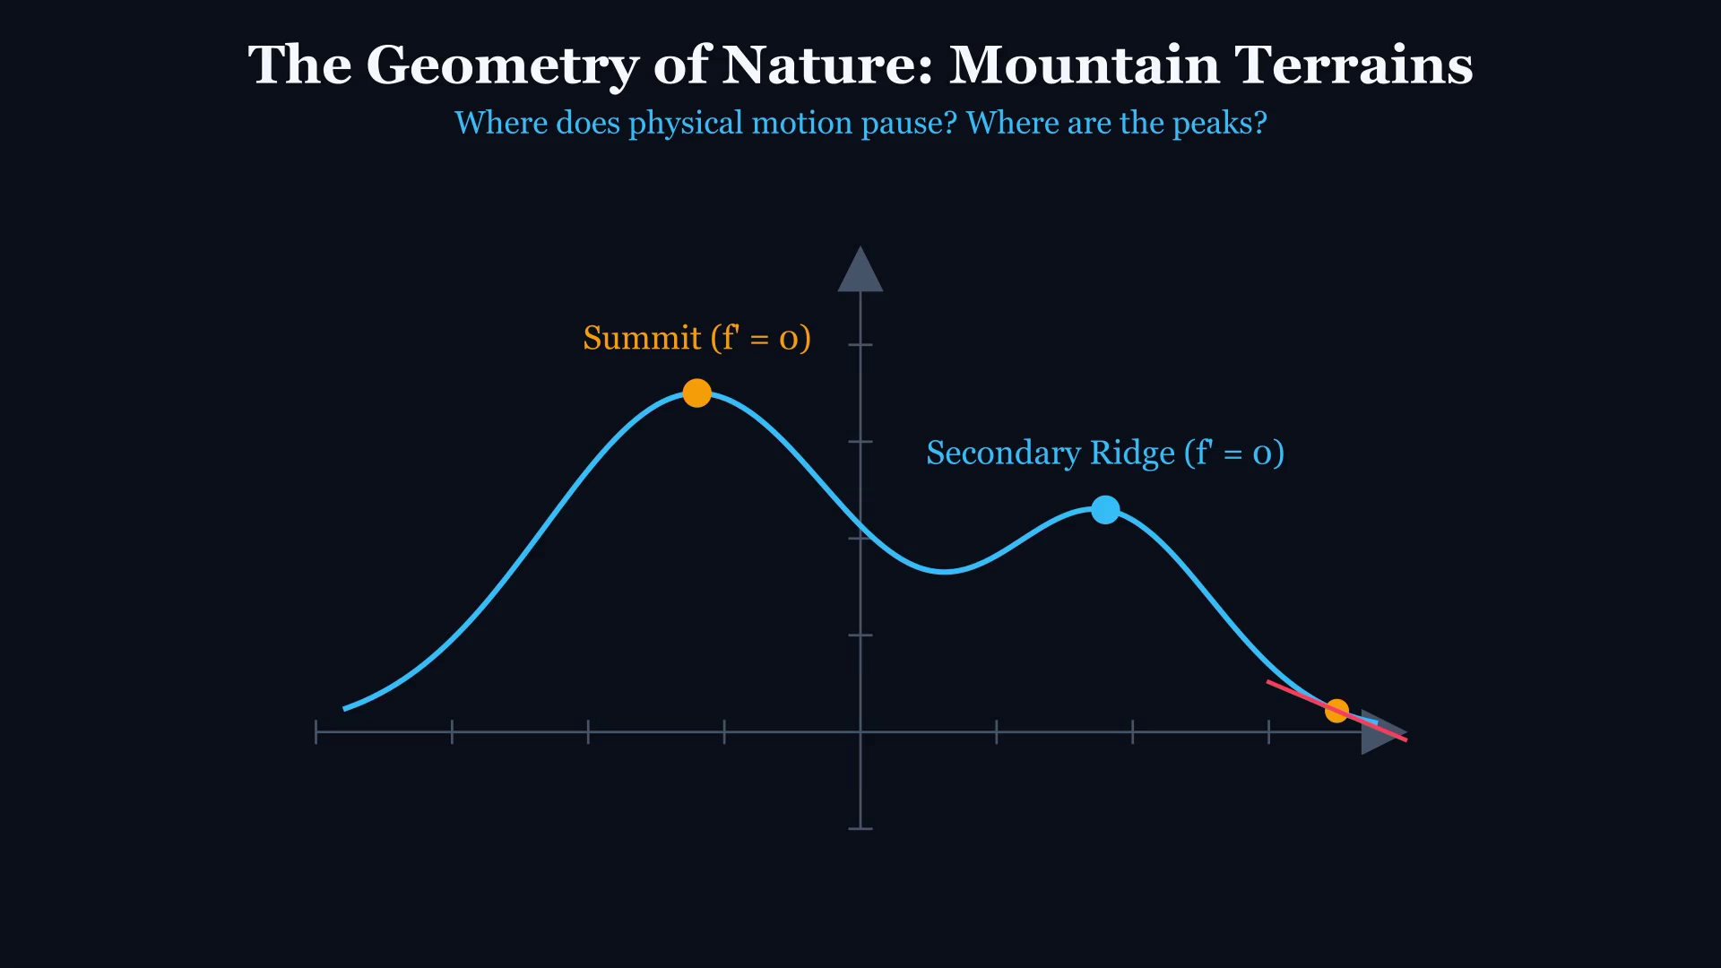
DIFFERENTIAL CALCULUS // ENGINEERING LECTURE
Terrain Exploration: The Geometry of Peaks & Valleys
KEY TEACHING OBJECTIVE
Identifying Extrema along an Elevation Profile
LECTURE PROMPT & PAUSE CUE
Ask the lecture hall: 'As our exploration probe traverses this mountain range, what exact instantaneous property characterizes the true summits and lowest valleys?'
[Tap video to play animation on iPad]
Notes:
Play the animation. Note how the probe ascends and descends. Highlight that slope is positive on ascent, zero at crests, negative on descent.

Slide 4
LIVE ANNOTATION WORKSPACE // APPLE PENCIL INTERACTION
Live Annotation: Direction of Motion & Tangent Equilibrium
APPLE PENCIL SCRATCHPAD: TERRAIN TANGENT INCLINE
Live Student Derivation Prompts:
✍️ Draw tangent lines with Apple Pencil at x = -2.5, x = -1.2, x = 0, and x = 1.8.
✍️ Write the algebraic inequality for slope: m > 0 vs. m = 0 vs. m < 0.
✍️ Circle the global highest point vs local sub-crest.
ANALYTIC FORMULATION & CHECKLIST
• Increasing interval: Rate of climb f'(x) > 0
• Peak crest: Instantaneous horizontal leveling f'(x) = 0
• Decreasing interval: Rate of descent f'(x) < 0
• Valley floor: Leveling out before re-ascent f'(x) = 0
Notes:
Engage students by sketching tangent arrows live. Emphasize that zero slope is the boundary marker between climbing and falling.

Slide 5
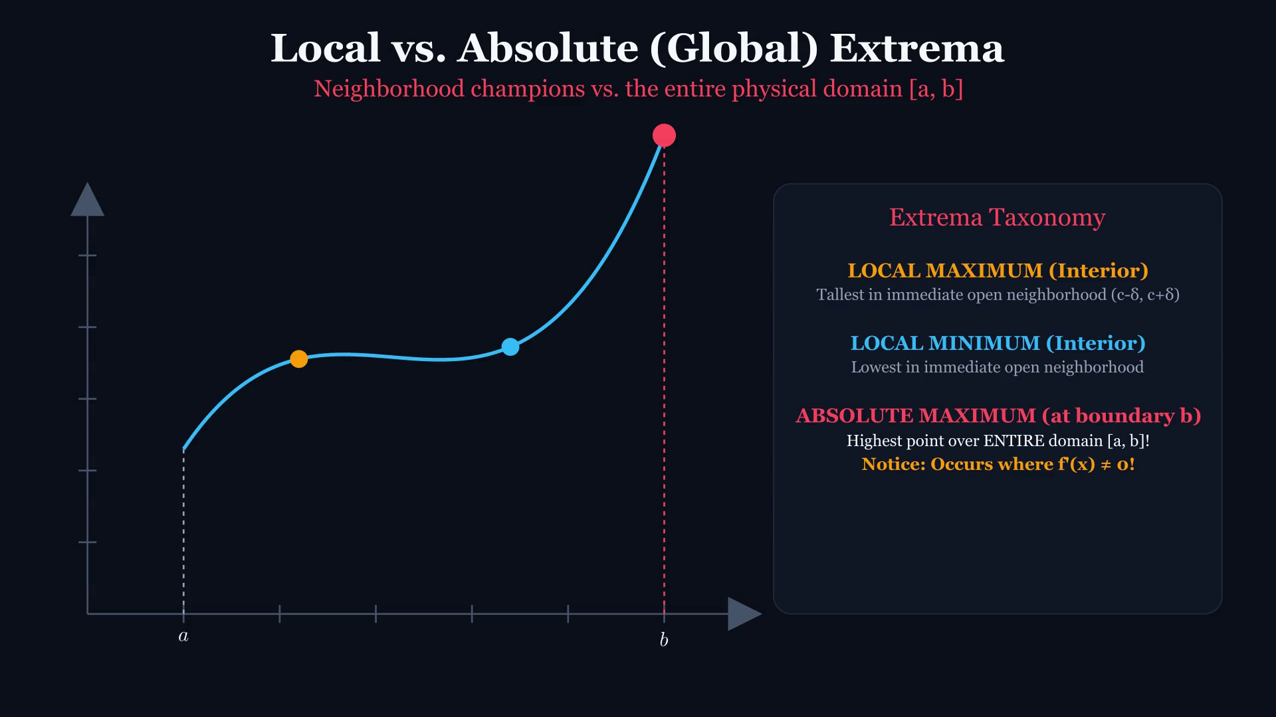
DIFFERENTIAL CALCULUS // ENGINEERING LECTURE
Topological Definitions: Local vs. Absolute Extrema
KEY TEACHING OBJECTIVE
Open Neighborhoods vs. Entire Domain Supremum
LECTURE PROMPT & PAUSE CUE
Key Conceptual Question: 'Can a local maximum have a lower numerical value than a local minimum in the same function?'
[Tap video to play animation on iPad]
Notes:
Play clip. Clarify that 'Local' requires an open ball (c-delta, c+delta), whereas 'Absolute' compares against all x in domain D.

Slide 6
LIVE ANNOTATION WORKSPACE // APPLE PENCIL INTERACTION
Live Annotation: The Neighborhood Test & Boundary Caps
APPLE PENCIL SCRATCHPAD: NEIGHBORHOOD VERIFICATION
Live Student Derivation Prompts:
✍️ Draw an open interval (c - δ, c + δ) around the local peak.
✍️ Show why the endpoint x = b cannot fit a two-sided ball.
✍️ Annotate why the right boundary is the Global Maximum.
ANALYTIC FORMULATION & CHECKLIST
• Local Max: f(c) >= f(x) for all x in (c - delta, c + delta)
• Boundary points on [a, b] cannot contain two-sided open intervals!
• Therefore: Boundary endpoints CANNOT be Local Extrema (by standard definition).
• Endpoints CAN and frequently DO serve as Absolute Extrema!
Notes:
This distinction prevents severe exam errors. Reinforce that local extrema are interior phenomena.

Slide 7
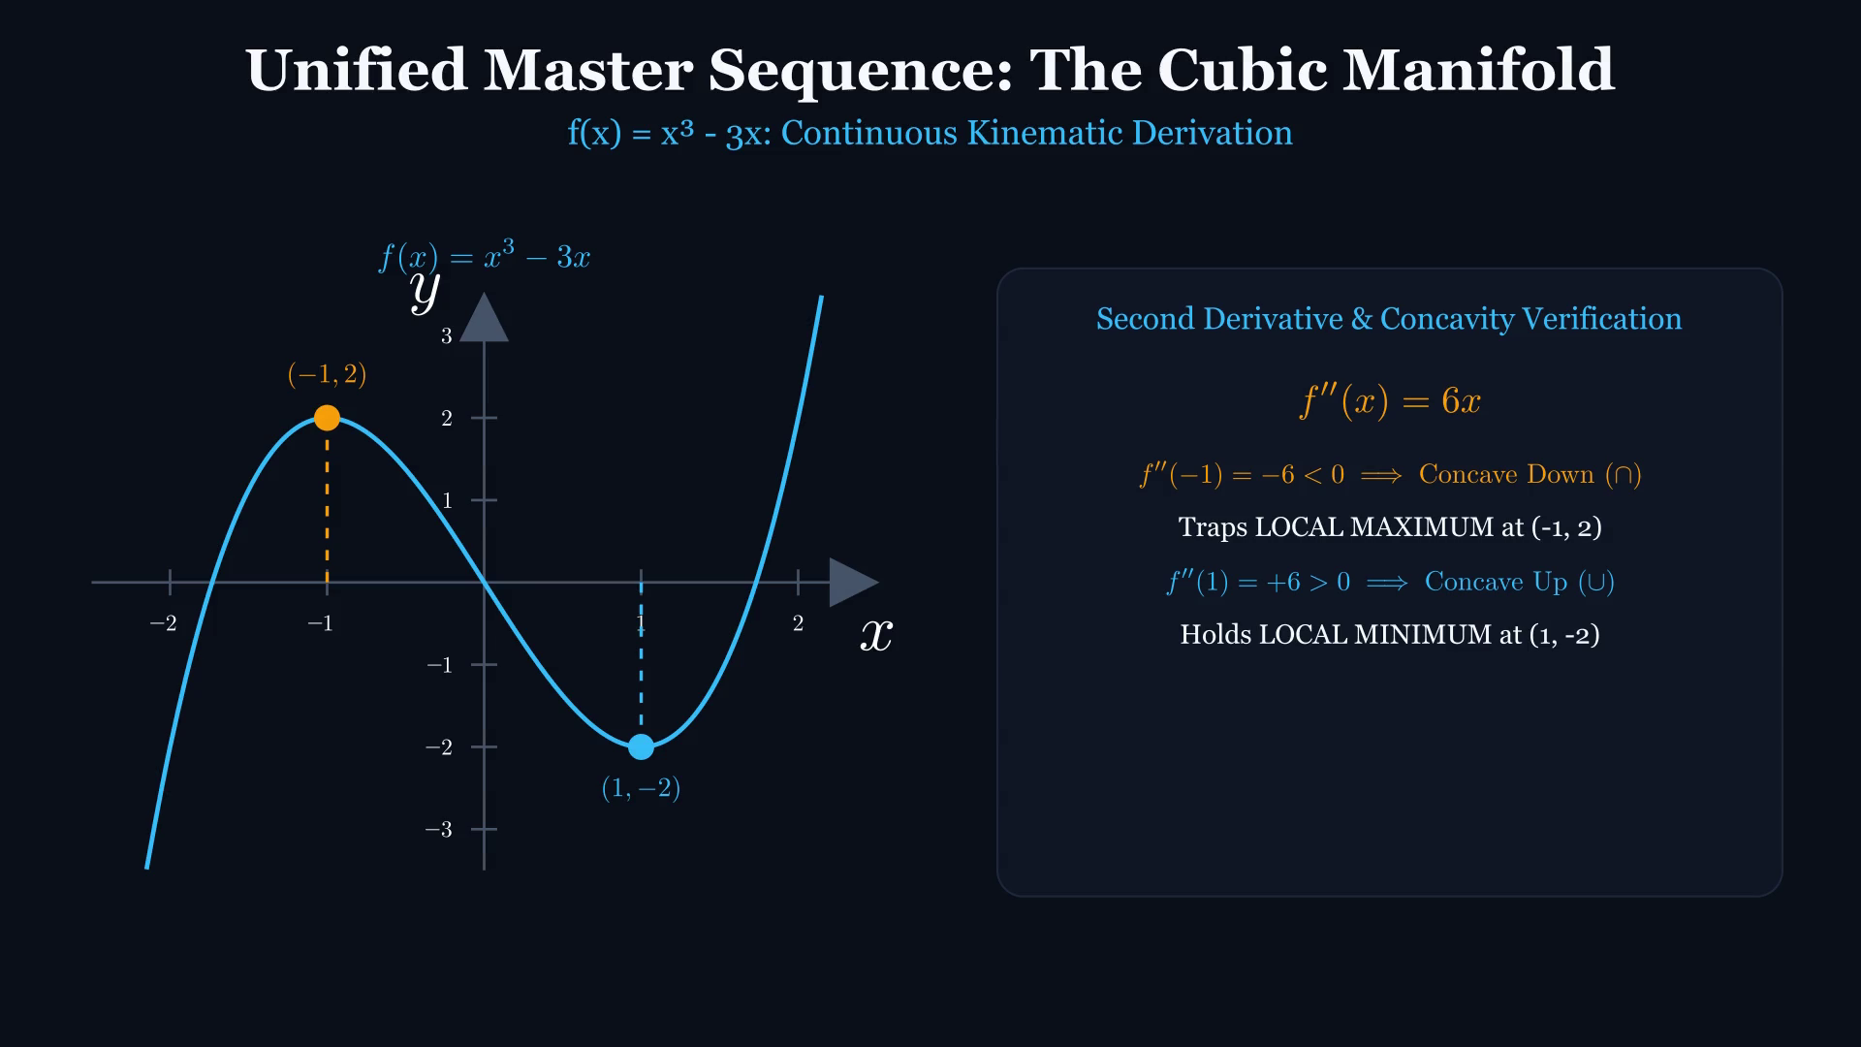
DIFFERENTIAL CALCULUS // ENGINEERING LECTURE
🌟 Unified Master Sequence: The Cubic Manifold
KEY TEACHING OBJECTIVE
Continuous 3Blue1Brown Kinematic Derivation of f(x) = x³ - 3x
LECTURE PROMPT & PAUSE CUE
Watch the complete sequence flow: curve creation, dynamic rotating slope tangent, equation morphing 3x² - 3 -> 3(x-1)(x+1) = 0, and concavity verification.
[Tap video to play animation on iPad]
Notes:
Play the continuous master animation. Tap video to pause and discuss any intermediate step with Apple Pencil.

Slide 8
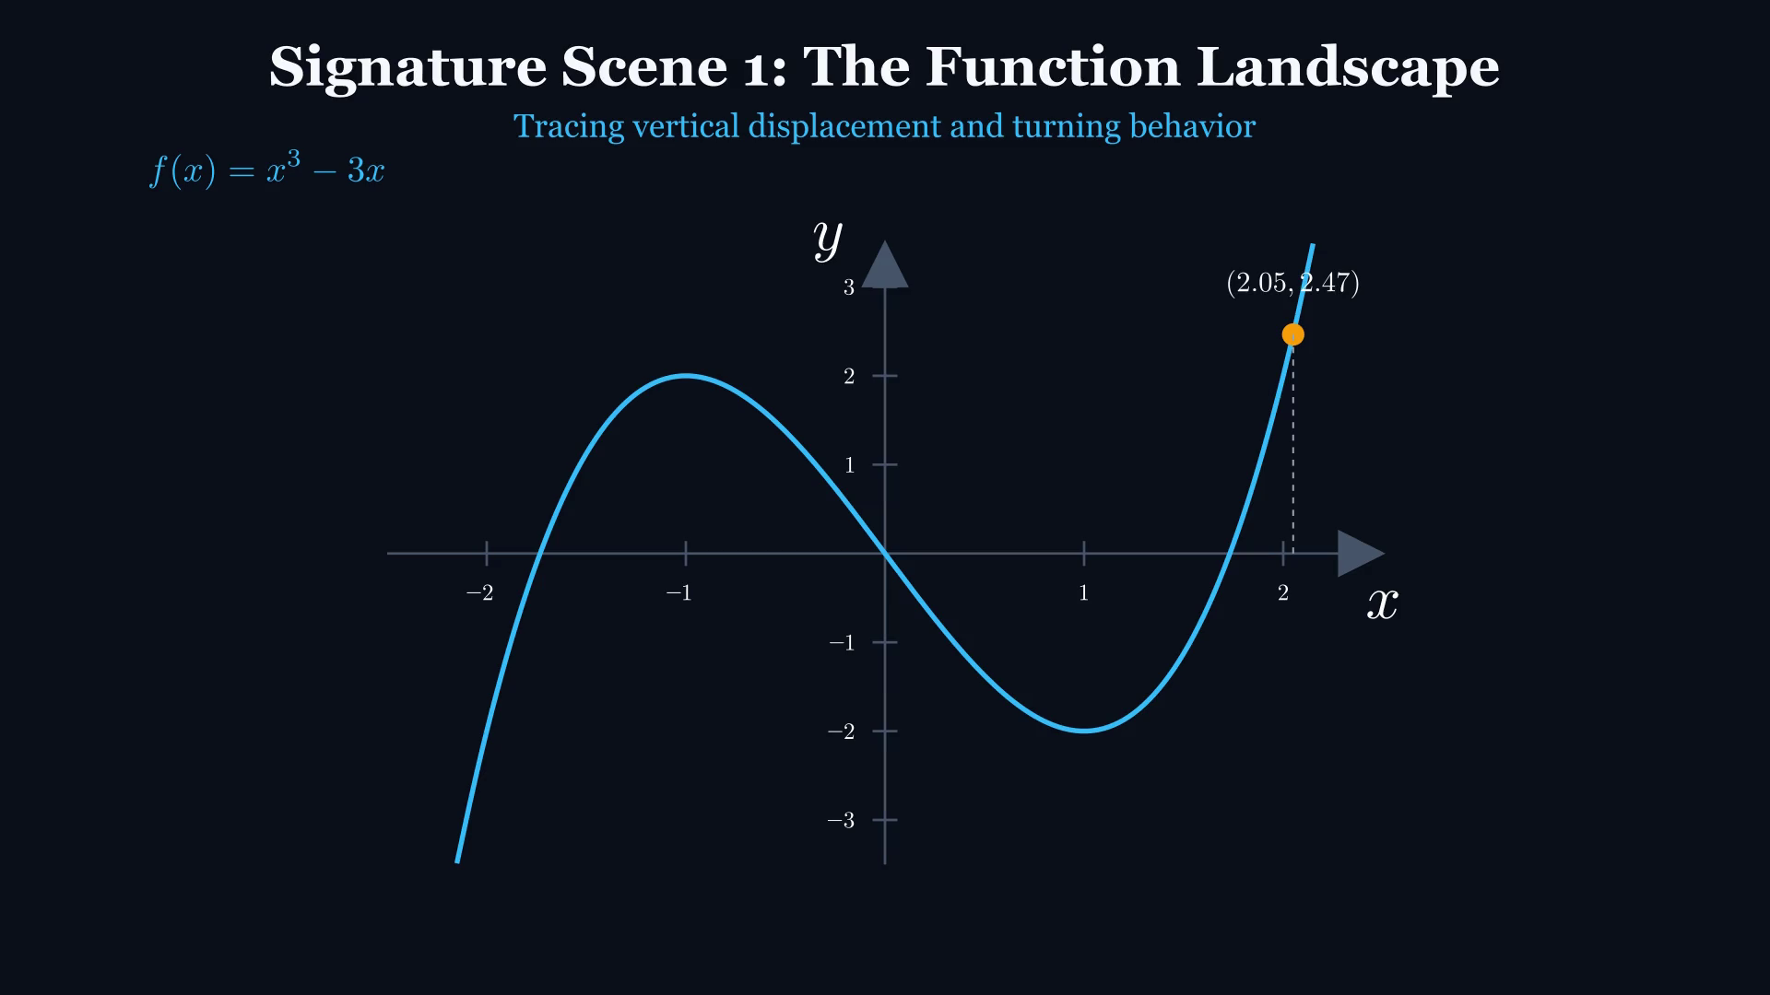
DIFFERENTIAL CALCULUS // ENGINEERING LECTURE
Signature Function: f(x) = x³ - 3x Trajectory
KEY TEACHING OBJECTIVE
Tracking the Coordinate State of an Odd Cubic Curve
LECTURE PROMPT & PAUSE CUE
Observe the symmetry: f(-x) = -f(x). What does odd symmetry tell us about the relationship between maxima and minima?
[Tap video to play animation on iPad]
Notes:
Introduce f(x) = x^3 - 3x as the primary worked model. Point travels from x = -2.2 to x = 2.2, traversing a crest and a trough.

Slide 9
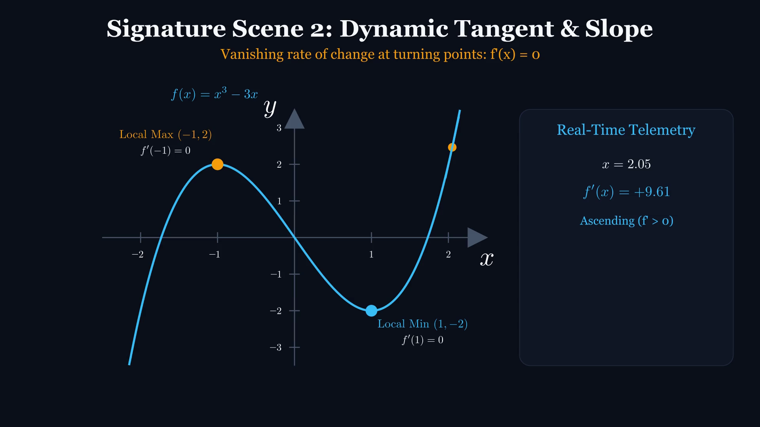
DIFFERENTIAL CALCULUS // ENGINEERING LECTURE
Kinetic Tangent: Dynamic Slope Telemetry
KEY TEACHING OBJECTIVE
Visualizing the Derivative as an Instantaneous Vector
LECTURE PROMPT & PAUSE CUE
Notice the real-time slope readout: as the point passes x = -1, the slope m collapses precisely from positive to zero to negative.
[Tap video to play animation on iPad]
Notes:
Play the clip. Point out the color change of the tangent line: Cyan (positive slope) to Amber (zero slope) to Coral (negative slope).

Slide 10
LIVE ANNOTATION WORKSPACE // APPLE PENCIL INTERACTION
Live Annotation: Instantaneous Slope Derivation
APPLE PENCIL SCRATCHPAD: DIFFERENTIATION FROM FIRST PRINCIPLES
Live Student Derivation Prompts:
✍️ Derive f'(x) step-by-step using the Power Rule.
✍️ Calculate f'(0) live and write why this represents maximum descent rate.
✍️ Calculate f'(1) and verify the second horizontal tangent.
ANALYTIC FORMULATION & CHECKLIST
• Given: f(x) = x³ - 3x
• Derivative: f'(x) = d/dx [x³ - 3x] = 3x² - 3
• At x = -1: f'(-1) = 3(-1)² - 3 = 0 (Horizontal)
• At x = 0: f'(0) = 3(0)² - 3 = -3 (Steepest descent)
Notes:
Guide the students through applying the power rule live. Write down the derivative in the scratchpad.

Slide 11
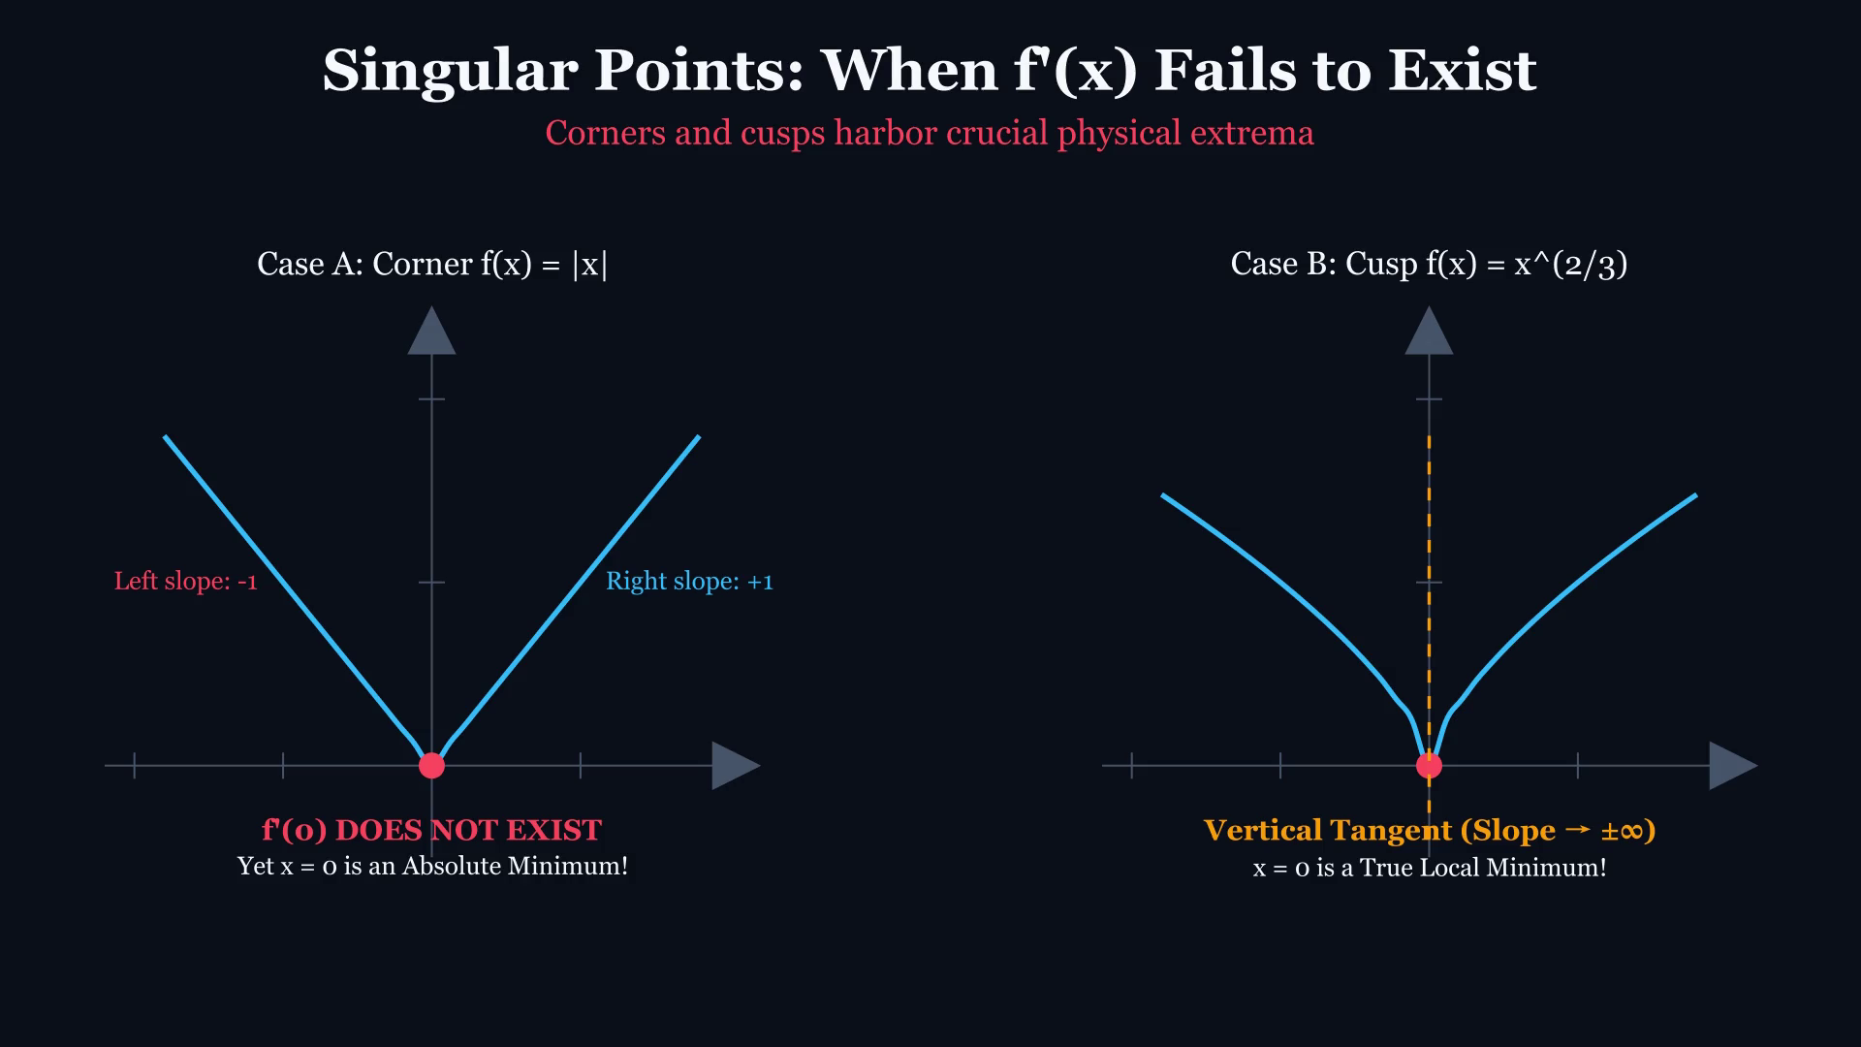
DIFFERENTIAL CALCULUS // ENGINEERING LECTURE
Singularities: When Derivatives Fail to Exist
KEY TEACHING OBJECTIVE
Critical Points Beyond Smooth Tangents: Corners & Cusps
LECTURE PROMPT & PAUSE CUE
Critical Challenge: 'Does a curve need a smooth horizontal tangent to have an absolute minimum? Look at |x| and x^(2/3).'
[Tap video to play animation on iPad]
Notes:
Play clip. Critical numbers occur where f'(c) = 0 OR where f'(c) does not exist (DNE), provided c is in the domain!

Slide 12
LIVE ANNOTATION WORKSPACE // APPLE PENCIL INTERACTION
Live Annotation: Left vs. Right Difference Quotients
APPLE PENCIL SCRATCHPAD: SINGULARITY LIMIT ANALYSIS
Live Student Derivation Prompts:
✍️ Compute lim_{h->0-} and lim_{h->0+} for |h|/h live.
✍️ Write the formal two-part definition of Critical Number c: (1) f'(c)=0 OR (2) f'(c) DNE, with c in Domain.
✍️ Highlight common student trap: 'Assuming critical points only come from setting derivative equal to 0'.
ANALYTIC FORMULATION & CHECKLIST
• Absolute Value f(x) = |x| at x = 0: lim(x->0-) = -1 != lim(x->0+) = +1
• Power Function f(x) = x^(2/3): f'(x) = (2/3)x^(-1/3) = 2/(3 * x^(1/3))
• As x -> 0, f'(x) -> ±∞ (Vertical Tangent / Cusp)
• Both functions reach a valid, indisputable Global Minimum at (0, 0)!
Notes:
Crucial misconception buster: many students forget to test points where denominator of f'(x) is zero.

Slide 13
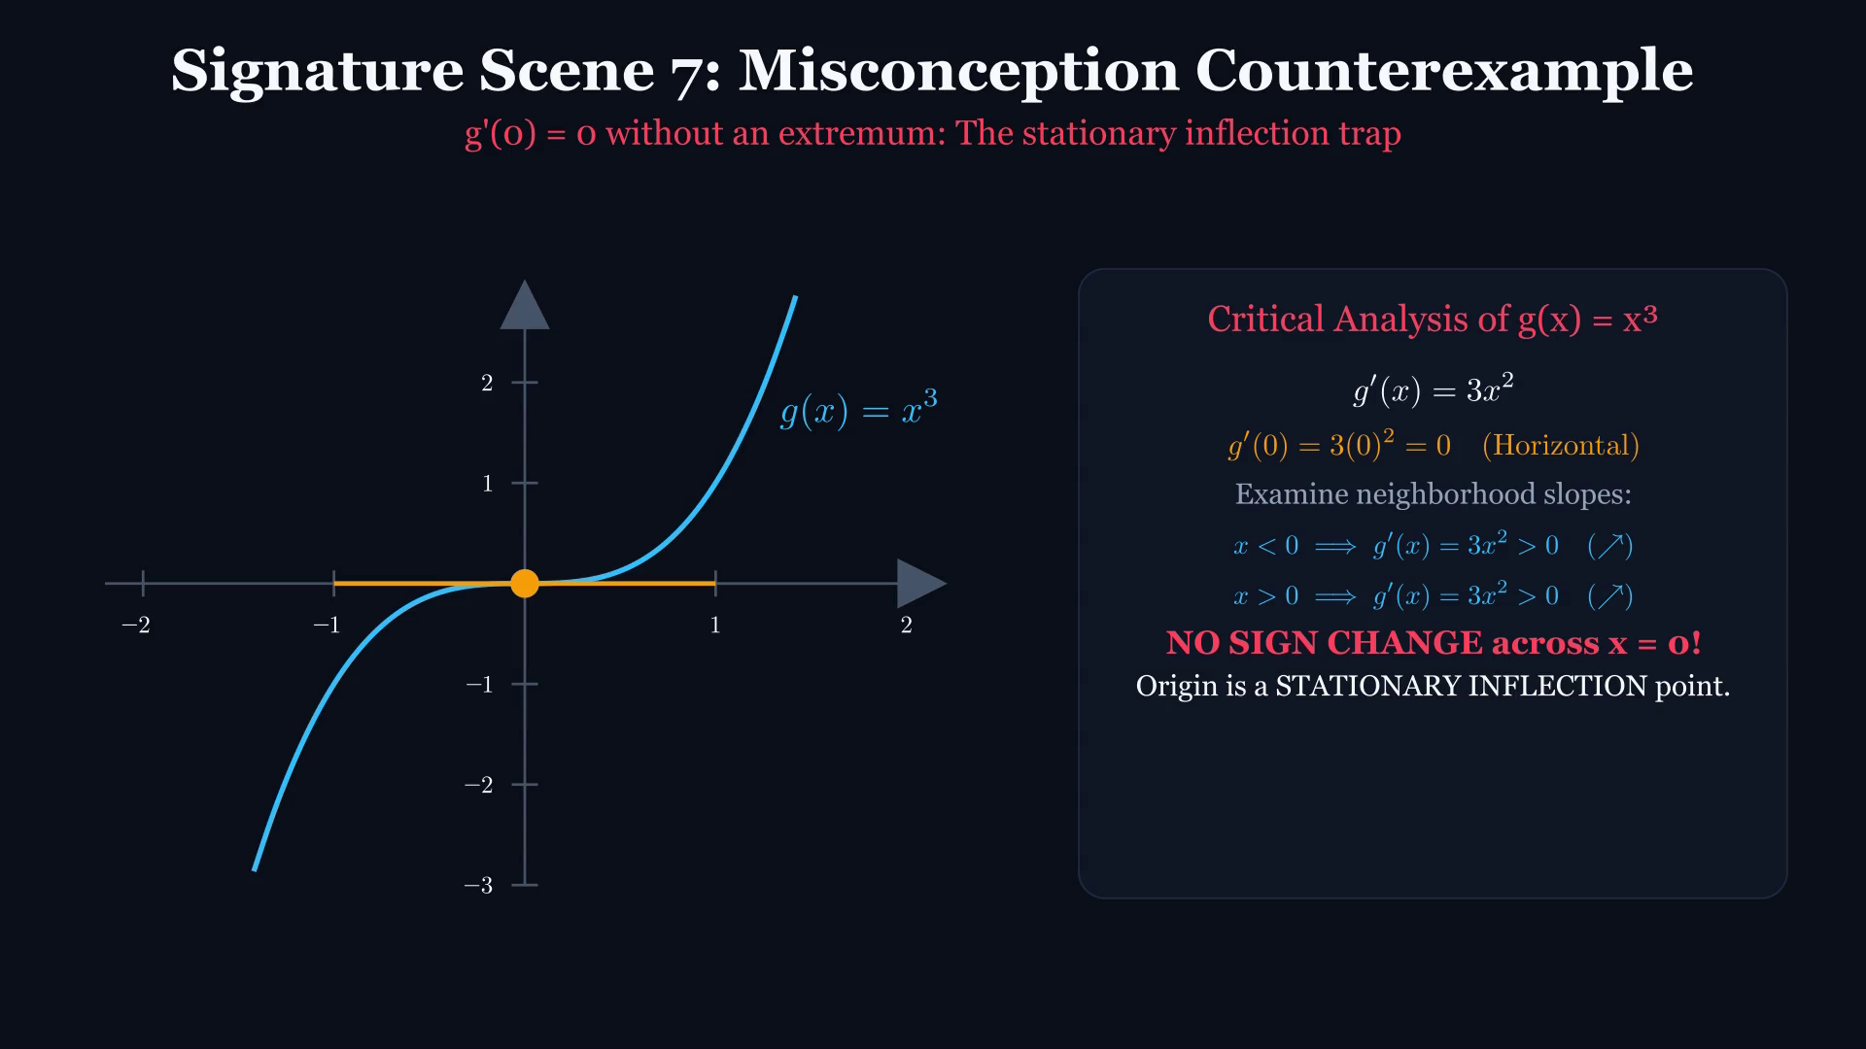
DIFFERENTIAL CALCULUS // ENGINEERING LECTURE
The Critical Trap: When f'(c) = 0 Yields NO Extremum
KEY TEACHING OBJECTIVE
Stationary Inflection Point on g(x) = x³
LECTURE PROMPT & PAUSE CUE
Examine g(x) = x³: g'(0) = 0. The tangent is perfectly horizontal. Is (0, 0) a maximum or a minimum?
[Tap video to play animation on iPad]
Notes:
Play clip. Tangent line goes horizontal at x=0, but the curve continues climbing. Zero derivative is NECESSARY, not SUFFICIENT.

Slide 14
LIVE ANNOTATION WORKSPACE // APPLE PENCIL INTERACTION
Live Annotation: Inflection Terraces & Necessary vs. Sufficient
APPLE PENCIL SCRATCHPAD: LOGICAL COUNTEREXAMPLE PROOF
Live Student Derivation Prompts:
✍️ Write the logic implication: Extremum => f'(c)=0 (True), f'(c)=0 => Extremum (False).
✍️ Sketch the sign line for 3x² showing (+) -> (0) -> (+).
✍️ Define 'Stationary Inflection Point' (Horizontal inflection point).
ANALYTIC FORMULATION & CHECKLIST
• Theorem (Fermat's): If f has a local extremum at c and f'(c) exists, then f'(c) = 0.
• Converse: 'If f'(c) = 0, then f has an extremum at c' is FALSE!
• For g(x) = x³: g'(x) = 3x² >= 0 for all x.
• Sign test: (+) before 0, and (+) after 0. No sign reversal!
Notes:
Draw attention to logic arrows: P => Q does not mean Q => P. This is tested on every university exam.

Slide 15
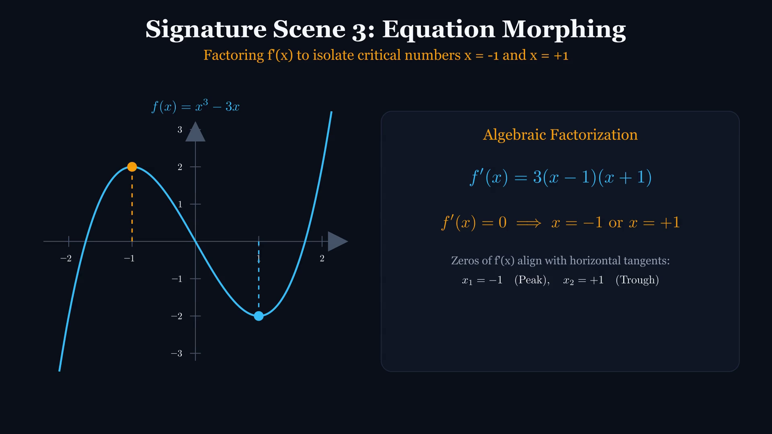
DIFFERENTIAL CALCULUS // ENGINEERING LECTURE
Algebraic Morphing: Factoring the Derivative
KEY TEACHING OBJECTIVE
3x² - 3 ==> 3(x² - 1) ==> 3(x - 1)(x + 1) = 0
LECTURE PROMPT & PAUSE CUE
Notice how the algebraic zeros x = -1 and x = +1 project vertically into physical coordinates on the function curve.
[Tap video to play animation on iPad]
Notes:
Play clip. Point out how factoring reveals the exact roots where the velocity of the curve momentarily freezes.

Slide 16
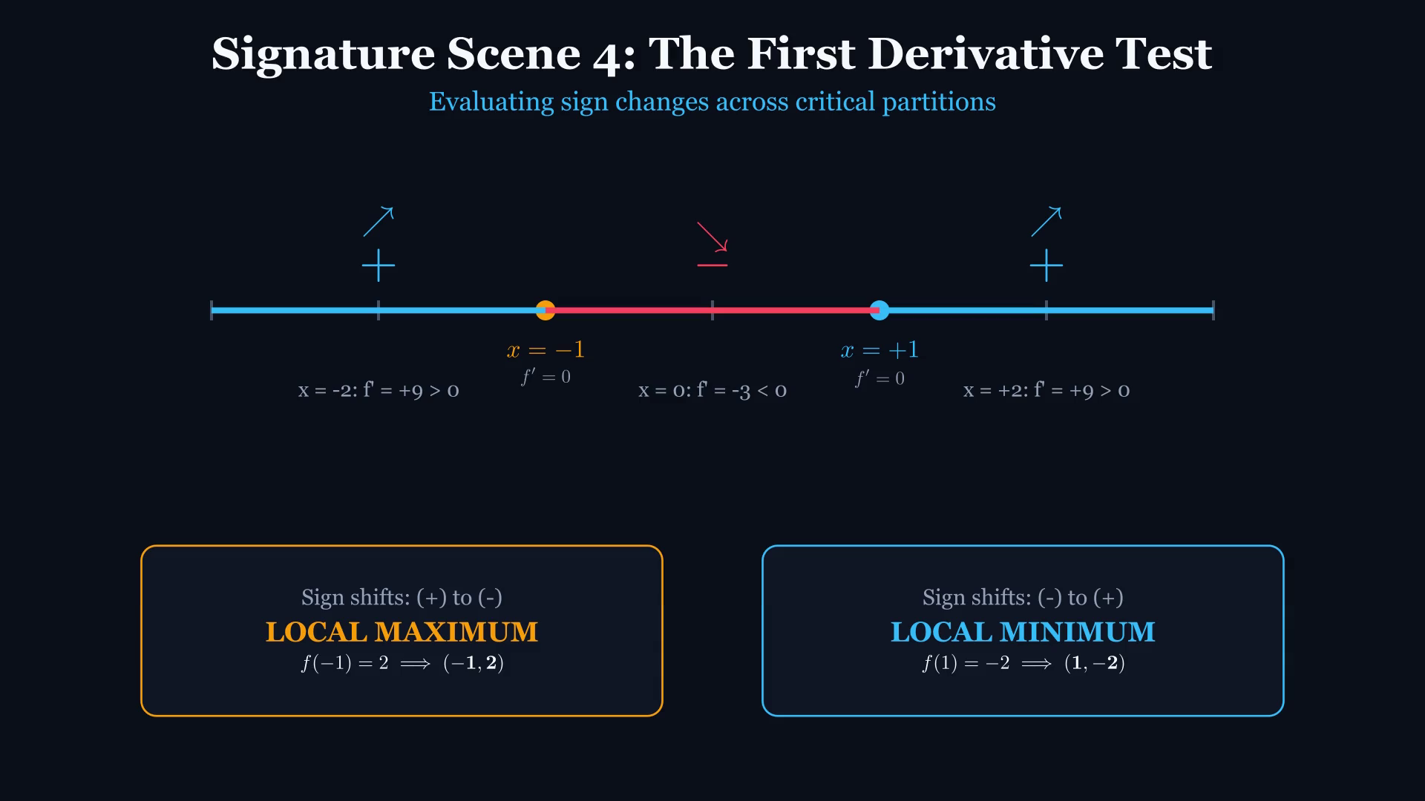
DIFFERENTIAL CALCULUS // ENGINEERING LECTURE
First Derivative Test: Dynamic Sign Partitioning
KEY TEACHING OBJECTIVE
Number Line Sampling & Directional Transitions
LECTURE PROMPT & PAUSE CUE
Watch the sign chart reveal: positive slopes push the curve up, zero halts it, negative slopes pull it down.
[Tap video to play animation on iPad]
Notes:
Play clip. The number line is partitioned by critical numbers into (-inf, -1), (-1, 1), and (1, inf).

Slide 17
LIVE ANNOTATION WORKSPACE // APPLE PENCIL INTERACTION
Live Annotation: First Derivative Sign Chart Matrix
APPLE PENCIL SCRATCHPAD: INTERVAL TEST TABLE
Live Student Derivation Prompts:
✍️ Draw the 3-row sign chart table with Apple Pencil.
✍️ Fill in test values and show factor signs: (x-1) and (x+1).
✍️ Draw the physical climbing/falling arrows: ↗ ↘ ↗.
ANALYTIC FORMULATION & CHECKLIST
• Interval 1: (-inf, -1) -> Test x = -2: f'(-2) = 3(-2)² - 3 = +9 > 0 (INC)
• Interval 2: (-1, 1) -> Test x = 0: f'(0) = 3(0)² - 3 = -3 < 0 (DEC)
• Interval 3: (1, inf) -> Test x = +2: f'(+2) = 3(2)² - 3 = +9 > 0 (INC)
• Conclusion: (+ to -) traps a LOCAL MAX; (- to +) holds a LOCAL MIN.
Notes:
Show students the factored testing method: instead of computing 3x^2-3, check signs of 3*(x-1)*(x+1) directly.

Slide 18
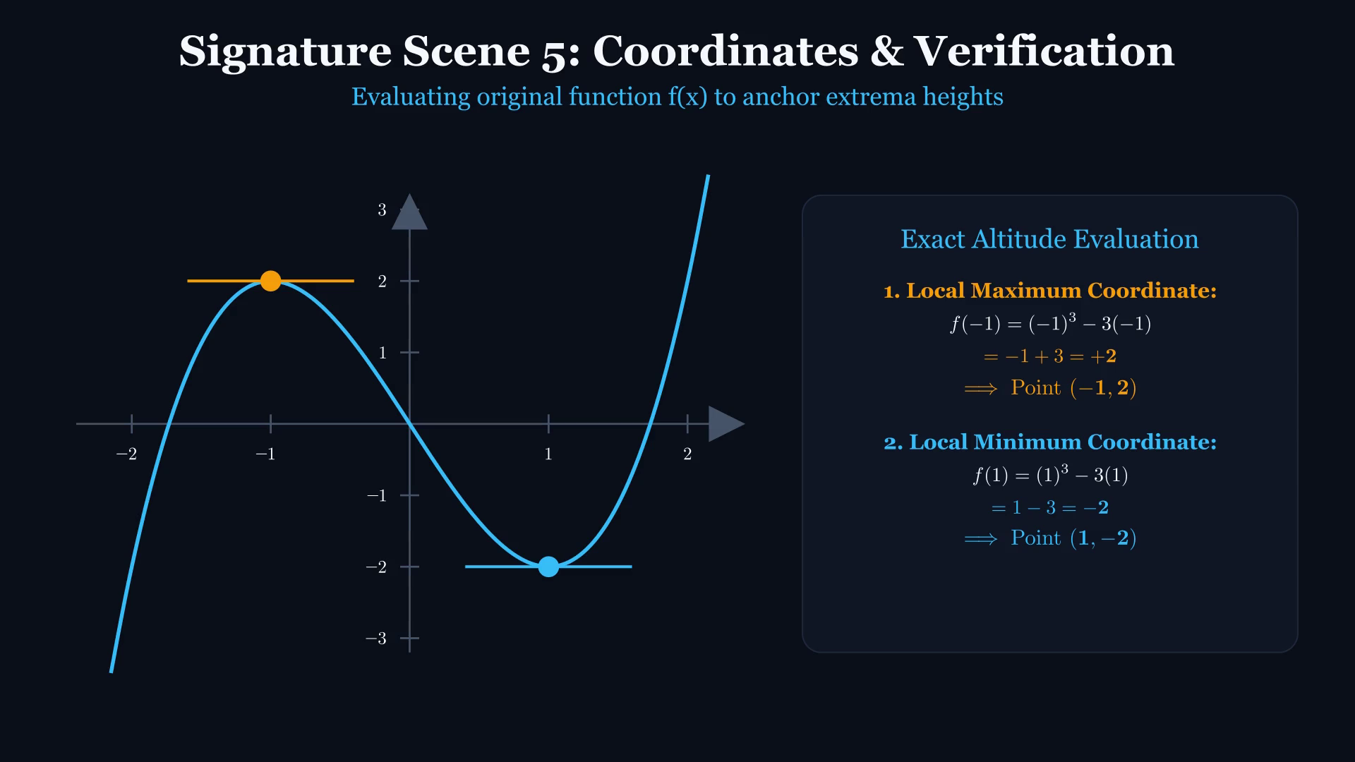
DIFFERENTIAL CALCULUS // ENGINEERING LECTURE
Coordinate Verification: Locating Exact Extrema
KEY TEACHING OBJECTIVE
Evaluating Critical Numbers in the ORIGINAL Function f(x)
LECTURE PROMPT & PAUSE CUE
Common blunder alert: Students plug x = -1 into f'(x) and get 0! Where must we substitute to find the height of the curve?
[Tap video to play animation on iPad]
Notes:
Play clip. Emphasize: f(-1) = (-1)^3 - 3(-1) = -1 + 3 = +2 -> Local Max (-1, 2). f(1) = (1)^3 - 3(1) = -2 -> Local Min (1, -2).

Slide 19
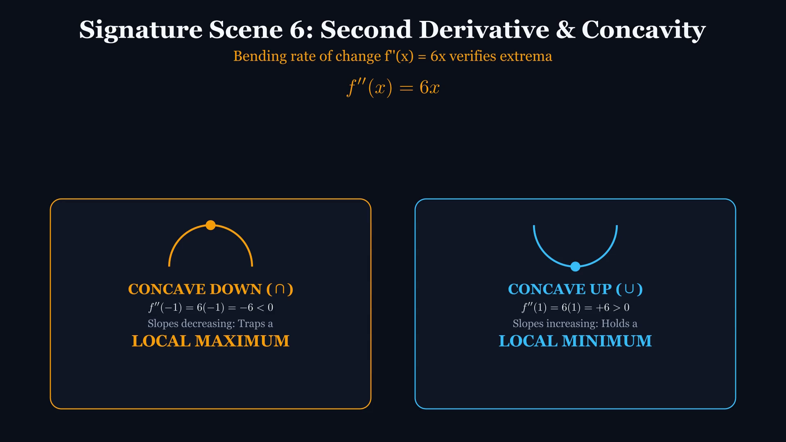
DIFFERENTIAL CALCULUS // ENGINEERING LECTURE
Second Derivative Test: Curvature & Concavity Bending
KEY TEACHING OBJECTIVE
f''(x) = 6x Measures the Rate of Change of Slope
LECTURE PROMPT & PAUSE CUE
Physical Intuition: If f'(x) = 0 and f''(x) < 0, slopes are decreasing (positive -> 0 -> negative). The curve MUST be concave down (trapping a peak).
[Tap video to play animation on iPad]
Notes:
Play clip. Note the two visual bowls: Concave Down (cap) with negative second derivative, Concave Up (cup) with positive second derivative.

Slide 20
THEORETICAL COMPARISON // EXAM STRATEGY
Extrema Decision Matrix: 1st vs. 2nd Derivative Test
FIRST DERIVATIVE TEST
APPLICABILITY
Universal. Works for smooth points AND singularities (corners/cusps).
MECHANISM
Checks sign change of f'(x) across x = c.
OUTCOMES
(+ to -) => Local Max
(- to +) => Local Min
(No change) => Neither
LIMITATION
Requires picking test points in every interval.
VERDICT
Always reliable. Fallback when 2nd test fails.
SECOND DERIVATIVE TEST
APPLICABILITY
Restricted. Requires f'(c) = 0 and f''(c) to exist.
MECHANISM
Evaluates single point concavity f''(c) directly.
OUTCOMES
f''(c) < 0 => Concave Down => Local Max
f''(c) > 0 => Concave Up => Local Min
f''(c) = 0 => INCONCLUSIVE (Must use 1st test!)
LIMITATION
Fails on cusps, corners, and flat inflection points.
VERDICT
Faster when differentiation is easy, but fragile.
Notes:
LECTURE EMPHASIS:
Stress the 'Inconclusive' case: for f(x)=x^4, f''(0)=0 and it has a min.
For f(x)=-x^4, f''(0)=0 and it has a max. For f(x)=x^3, f''(0)=0 and it has neither!
If f''(c)=0, never guess. Revert immediately to the First Derivative Test.

Slide 21
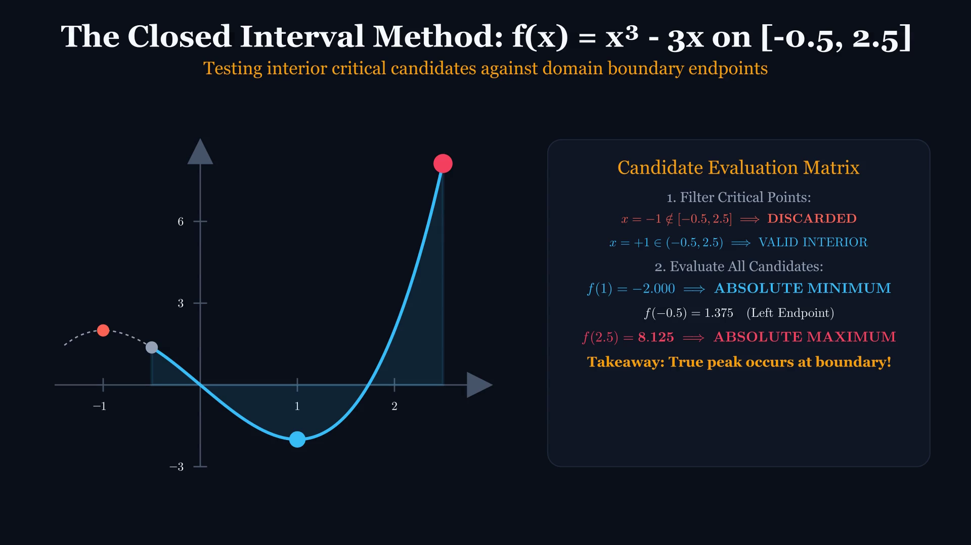
DIFFERENTIAL CALCULUS // ENGINEERING LECTURE
Closed Interval Method: The Extreme Value Theorem
KEY TEACHING OBJECTIVE
f(x) = x³ - 3x Restricted to the Closed Interval [-0.5, 2.5]
LECTURE PROMPT & PAUSE CUE
Notice how the local maximum at x = -1 is EXCLUDED because it lies outside [-0.5, 2.5]! Where does the absolute maximum occur?
[Tap video to play animation on iPad]
Notes:
Play clip. Candidate evaluation: interior critical point x=1 -> f(1)=-2. Endpoints: x=-0.5 -> f(-0.5)=1.375; x=2.5 -> f(2.5)=8.125 (Winner!).

Slide 22
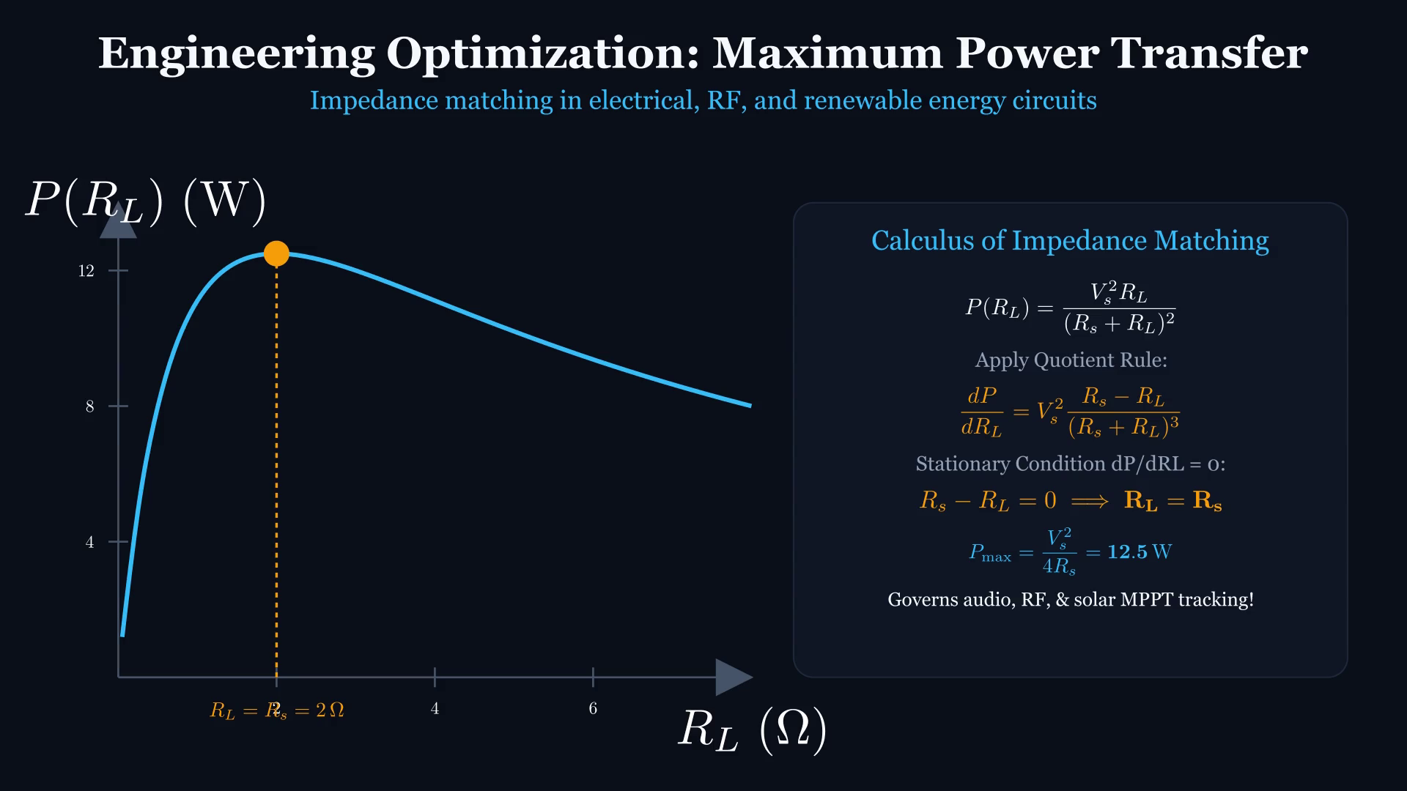
DIFFERENTIAL CALCULUS // ENGINEERING LECTURE
Engineering Optimization: Maximum Power Transfer Theorem
KEY TEACHING OBJECTIVE
Maximizing Load Power P(R_L) = V_th² * R_L / (R_th + R_L)²
LECTURE PROMPT & PAUSE CUE
Differentiating with the Quotient Rule reveals: dP/dR_L = 0 occurs precisely when R_load = R_thevenin! Impedance matching in RF and audio circuits.
[Tap video to play animation on iPad]
Notes:
Play clip. Highlight the engineering trade-off: at R_L = 0, current is maximum but voltage is 0 (P=0). At R_L = inf, voltage is maximum but current is 0 (P=0).

Slide 23
STUDENT ACTIVE LEARNING // LIVE DERIVATION
Engineering Practice Challenge & Exit Ticket
ACTIVE LEARNING CHALLENGE
Analyze the structural response function:
f(x) = 2x³ - 3x² - 12x + 5 on [-2, 4]
1. Compute f'(x) and factor completely.
2. Identify all critical numbers inside [-2, 4].
3. Apply Second Derivative Test to classify local extrema.
4. Construct the EVT candidate table (criticals + endpoints).
5. Identify Global Maximum and Global Minimum coordinates.
SOLUTION CHECKLIST & ANSWER KEY
DERIVATIVE:
f'(x) = 6x² - 6x - 12 = 6(x - 2)(x + 1)
CRITICAL NUMBERS:
x = -1 and x = 2 (both inside [-2, 4])
SECOND DERIVATIVE:
f''(x) = 12x - 6
AT X = -1:
f''(-1) = -18 < 0 => Local Max at (-1, 12)
AT X = 2:
f''(2) = +18 > 0 => Local Min at (2, -15)
CANDIDATE TABLE:
f(-2) = 1
f(-1) = 12
f(2) = -15
f(4) = 37
GLOBAL EXTREMA:
Global Max: (4, 37) [Endpoint!]
Global Min: (2, -15) [Interior Critical!]
Notes:
INSTRUCTOR WRAP-UP & EXIT TICKET:
Give students 4 minutes to work. Walk the room or display Apple Pencil annotations.
Reveal the key insight: The local max (-1, 12) is soundly beaten by the endpoint (4, 37)!
Remind students: Never neglect endpoints in engineering optimization.

Slide 24
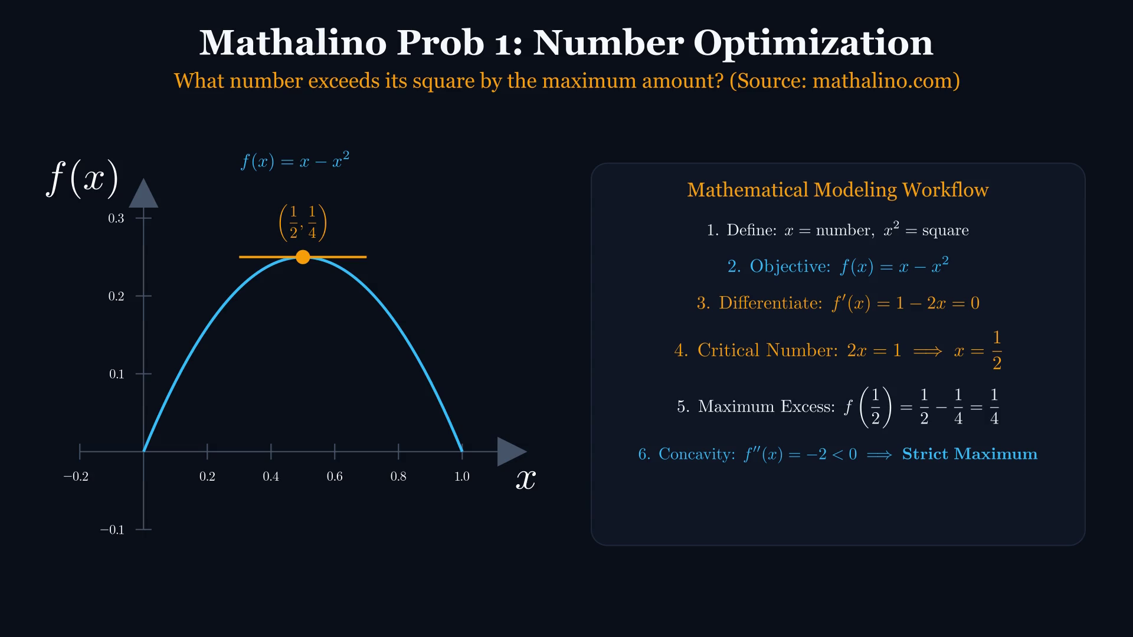
DIFFERENTIAL CALCULUS // ENGINEERING LECTURE
Mathalino Prob 1: Number Exceeding its Square
KEY TEACHING OBJECTIVE
What number exceeds its square by the maximum amount? (Source: mathalino.com)
LECTURE PROMPT & PAUSE CUE
Objective f(x) = x - x². Differentiating f'(x) = 1 - 2x = 0 yields critical number x = 1/2. Concavity f''(x) = -2 < 0 proves strict global maximum of 1/4.
[Tap video to play animation on iPad]
Notes:
Mathalino Prob 1. Source: mathalino.com/reviewer/differential-calculus/01-04-number-problems-in-maxima-and-minima. Emphasize model definition, derivative test, and concavity.

Slide 25
LIVE ANNOTATION WORKSPACE // APPLE PENCIL INTERACTION
Mathalino Prob 1: Modeling & Solution Workspace
APPLE PENCIL SCRATCHPAD: NUMBER OPTIMIZATION (MATHALINO 01)
Live Student Derivation Prompts:
✍️ ✍️ Write out the objective function f(x) and its derivative f'(x).
✍️ ✍️ Solve for critical number and compute second derivative f''(x).
✍️ ✍️ State final conclusion: number is 1/2, maximum excess is 1/4.
ANALYTIC FORMULATION & CHECKLIST
• Define variable x as the unknown number.
• Formulate objective function: f(x) = x - x².
• Differentiate and find critical number: f'(x) = 1 - 2x = 0 => x = 1/2.
• Verify with 2nd derivative: f''(1/2) = -2 < 0 (Maximum).
• Calculate maximum excess value: f(1/2) = 1/4.
Notes:
Instructor Guidance: Walk students through translating English problem statement into calculus objective function.

Slide 26
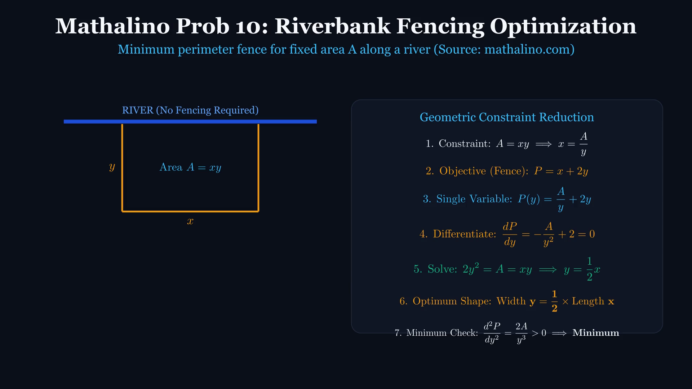
DIFFERENTIAL CALCULUS // ENGINEERING LECTURE
Mathalino Prob 10: Riverbank Fencing Optimization
KEY TEACHING OBJECTIVE
Least fencing perimeter for fixed area A along a riverbank (Source: mathalino.com)
LECTURE PROMPT & PAUSE CUE
Area A = xy reduces perimeter P = x + 2y to single variable P(y) = A/y + 2y. Differentiating: dP/dy = -A/y² + 2 = 0 => 2y² = A = xy => Width y = x/2.
[Tap video to play animation on iPad]
Notes:
Mathalino Prob 10. Source: mathalino.com/reviewer/differential-calculus/09-11-rectangular-lot-problems-in-maxima-and-minima. Geometric constraint reduces multivariable to single variable. Optimal shape: width is half length.

Slide 27
LIVE ANNOTATION WORKSPACE // APPLE PENCIL INTERACTION
Mathalino Prob 10: Fencing Constraint Workspace
APPLE PENCIL SCRATCHPAD: RIVERBANK FENCING (MATHALINO 10)
Live Student Derivation Prompts:
✍️ ✍️ Sketch the riverbank and the 3-sided fence.
✍️ ✍️ Substitute constraint x = A/y into P = x + 2y.
✍️ ✍️ Differentiate and prove that optimal width y = (1/2)x.
ANALYTIC FORMULATION & CHECKLIST
• Identify given constraint: Constant Area A = xy.
• Express objective fence length: P = x + 2y (no fence along river).
• Substitute x = A/y to obtain single-variable function P(y).
• Differentiate dP/dy = -A/y² + 2 = 0 => 2y² = A.
• Substitute A = xy: 2y² = xy => y = (1/2)x (width is half length).
Notes:
Instructor Guidance: Contrast 3-sided fence (y = x/2) with traditional 4-sided enclosure (square x = y).

Slide 28
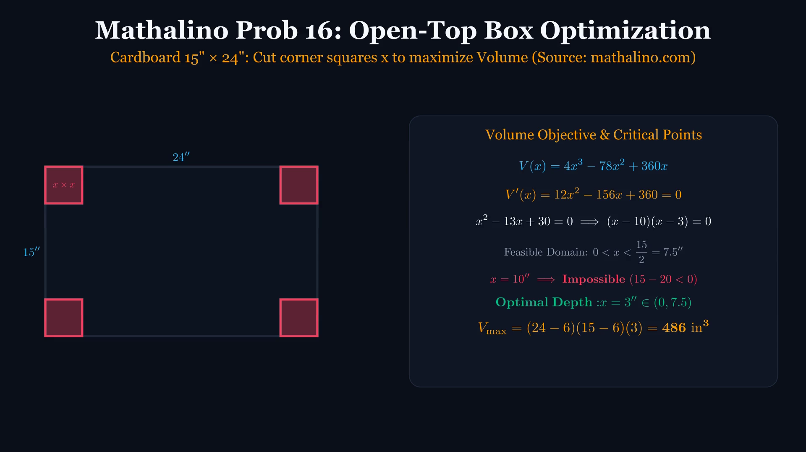
DIFFERENTIAL CALCULUS // ENGINEERING LECTURE
Mathalino Prob 16: Open-Top Box Optimization
KEY TEACHING OBJECTIVE
15" × 24" Cardboard Sheet: Cut squares x to maximize Volume (Source: mathalino.com)
LECTURE PROMPT & PAUSE CUE
V(x) = (24-2x)(15-2x)x = 4x³ - 78x² + 360x. Setting V'(x) = 0 yields x = 3 or x = 10. Feasible physical domain (0, 7.5) eliminates x = 10! V_max = 486 in³.
[Tap video to play animation on iPad]
Notes:
Mathalino Prob 16. Source: mathalino.com/reviewer/differential-calculus/15-17-box-open-at-the-top. Critical points must be tested against physical boundaries. x=10 is extraneous because 15-2(10) < 0.

Slide 29
LIVE ANNOTATION WORKSPACE // APPLE PENCIL INTERACTION
Mathalino Prob 16: Domain Feasibility & Volume Workspace
APPLE PENCIL SCRATCHPAD: OPEN-TOP BOX OPTIMIZATION (MATHALINO 16)
Live Student Derivation Prompts:
✍️ ✍️ Write dimensions of folded box in terms of x.
✍️ ✍️ Factor V'(x) = 0 and solve for critical numbers x = 3, 10.
✍️ ✍️ Disqualify x = 10 using width constraint 15 - 2x > 0.
✍️ ✍️ Compute maximum volume V(3) = 486 in³.
ANALYTIC FORMULATION & CHECKLIST
• Cardboard dimensions: 24'' by 15''. Corner cutout: x by x.
• Folded dimensions: Length = 24 - 2x, Width = 15 - 2x, Height = x.
• Objective: V(x) = 4x³ - 78x² + 360x.
• Differentiate: V'(x) = 12(x² - 13x + 30) = 12(x - 3)(x - 10) = 0.
• Physical domain check: 0 < x < 7.5''. Reject x = 10''.
• Optimal cut x = 3''. V_max = (18)(9)(3) = 486 in³.
Notes:
Instructor Guidance: Emphasize why domain inspection is mandatory in engineering optimization.

Slide 30
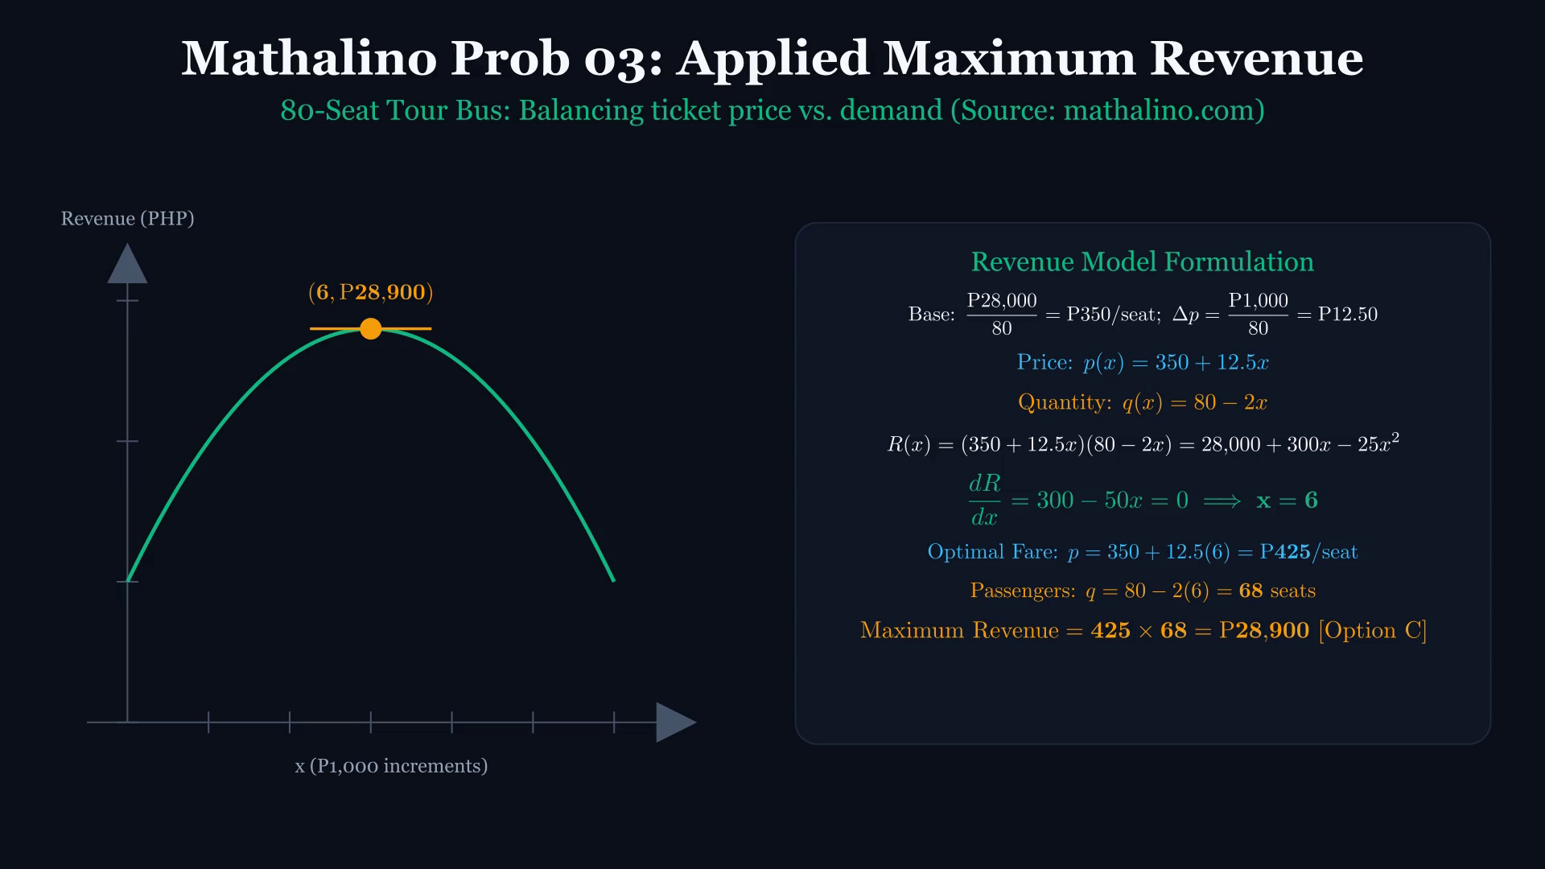
DIFFERENTIAL CALCULUS // ENGINEERING LECTURE
Mathalino Prob 03: Tour Bus Maximum Revenue
KEY TEACHING OBJECTIVE
80-Seat Tour Bus: Balancing ticket price vs. demand drop (Source: mathalino.com)
LECTURE PROMPT & PAUSE CUE
Base fare: P350/seat. Increments: P12.50/seat with -2 passengers. R(x) = (350 + 12.5x)(80 - 2x) = 28,000 + 300x - 25x². dR/dx = 0 => x = 6. Fare = P425, Revenue = P28,900 [Option C].
[Tap video to play animation on iPad]
Notes:
Mathalino Prob 03. Source: mathalino.com/reviewer/differential-calculus/03-maximum-revenue-tour-bus-80-seats. Real-world business revenue optimization. Matches Option C on Mathalino reviewer.

Slide 31
LIVE ANNOTATION WORKSPACE // APPLE PENCIL INTERACTION
Mathalino Prob 03: Revenue Model Workspace
APPLE PENCIL SCRATCHPAD: TOUR BUS REVENUE (MATHALINO 03)
Live Student Derivation Prompts:
✍️ ✍️ Formulate price p(x) and quantity q(x) expressions.
✍️ ✍️ Multiply to construct R(x) and differentiate dR/dx = 0.
✍️ ✍️ Solve for x = 6 and evaluate optimal fare P425 and revenue P28,900.
ANALYTIC FORMULATION & CHECKLIST
• Base fare: P28,000 / 80 seats = P350 per passenger.
• Increment per seat: P1,000 / 80 = P12.50 per passenger.
• Let x = number of P1,000 package increments.
• Price p(x) = 350 + 12.5x; Demand q(x) = 80 - 2x.
• R(x) = 28,000 + 300x - 25x² => dR/dx = 300 - 50x = 0 => x = 6.
• Optimal Fare: P425/seat; Passengers: 68; Max Revenue: P28,900.
Notes:
Instructor Guidance: Show how calculus balances price elasticity against volume.

Slide 32
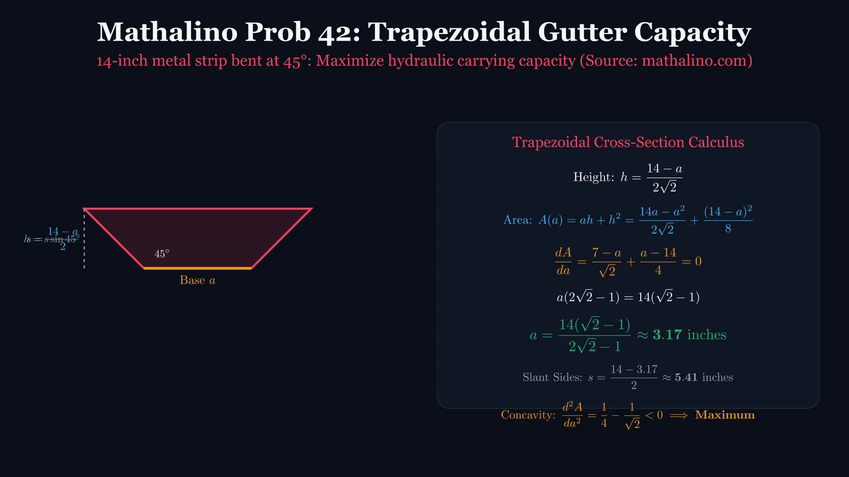
DIFFERENTIAL CALCULUS // ENGINEERING LECTURE
Mathalino Prob 42: Trapezoidal Gutter Capacity
KEY TEACHING OBJECTIVE
14-inch metal strip bent at 45°: Maximizing hydraulic carrying capacity (Source: mathalino.com)
LECTURE PROMPT & PAUSE CUE
Base a, sides s = (14-a)/2, height h = (14-a)/(2√2). Cross-section Area A = ah + h². Setting dA/da = 0 yields optimal base width a = 14(√2 - 1)/(2√2 - 1) ≈ 3.17 inches (slants s ≈ 5.41 inches).
[Tap video to play animation on iPad]
Notes:
Mathalino Prob 42. Source: mathalino.com/reviewer/differential-calculus/41-42-maxima-and-minima-problem-involving-a-trapezoidal-gutter. Advanced engineering civil/mechanical optimization. Exact radical algebra simplified to decimal.

Slide 33
LIVE ANNOTATION WORKSPACE // APPLE PENCIL INTERACTION
Mathalino Prob 42: Hydraulic Geometry Workspace
APPLE PENCIL SCRATCHPAD: TRAPEZOIDAL GUTTER (MATHALINO 42)
Live Student Derivation Prompts:
✍️ ✍️ Draw the cross-section trapezoid with base a, slants s, and height h.
✍️ ✍️ Write cross-sectional area A in terms of base width a.
✍️ ✍️ Differentiate dA/da = 0 and solve for base width a ≈ 3.17 inches.
ANALYTIC FORMULATION & CHECKLIST
• Tin strip width = 14 inches. Base = a, two slant sides s = (14 - a)/2.
• Bending angle θ = 45°. Height h = s sin 45° = (14 - a)/(2√2).
• Area A = ah + h² = (14a - a²)/(2√2) + (14 - a)²/8.
• Differentiate: dA/da = (7 - a)/√2 + (a - 14)/4 = 0.
• Solve linear equation for a: a = 14(√2 - 1)/(2√2 - 1) ≈ 3.17 inches.
• Compute slant sides: s = (14 - 3.17)/2 ≈ 5.41 inches.
Notes:
Instructor Guidance: Demonstrate how civil and mechanical engineering channels are optimized for maximum flow.

