Slide 1
Building a Case for Relational Reasoning Strategies as "Meta"-Tools in Human Learning and Performance
Patricia A. Alexander

Slide 2
Goals
Forward a claim about the association between relational reasoning with metacognition theory and research
Consider the nature of percepts and concepts in human learning and performance
Explore a model of percept-concept coupling as linked to relational thinking and reasoning
Overview relational reasoning as meta-strategic avenues for enhanced learning and performance

Slide 3
RELATIONAL REASONING AND METACOGNITION

Slide 4
BIT OF HISTORY…
The train stopped in Centerville every day at both one o’clock and at five o’clock. Dr. Jones needed to travel from Centerville to Milltown on business. He decided to go by train. He packed his bags. He caught a train at seven o’clock, and was in Milltown in time for his meeting.
Garner 1981
ERROR DETECTION

Slide 5
TRANSFER
CALIBRATION
EXPERTISE
EPISTEMIC BELIEFS
ERROR DETECTION
DOMAIN LEARNING
CONCEPTUAL DEVELOPMENT
STRATEGIC PROCESSING

Slide 6
MY CONTENTION
A failure to notice and to discern patterns within information contributes to metacognitive problems (e.g., error detection issues, calibration concerns, and lack of strategic or regulatory behavior) and, thus, negatively affects human learning and performance.

Slide 7
Alexander, P. A. (1981). Predictive accuracy of third and fifth graders across linguistic and nonlinguistic comprehension measures: The relationship between performance on graduated passage questions under listening and reading conditions and the Standard Progressive Matrices. Unpublished doctoral dissertation. University of Maryland.

Slide 8
RELATIONAL THINKING…
…can be simply conceived as the ability to perceive associations between and among pieces of information; an automatic cognitive process that can occur with or without conscious awareness

Slide 9
RELATIONAL REASONING…
…is the intentional harnessing of relational thinking processes as a means of enhancing one’s understanding and performance
METASTRATEGIC ABILITY

Slide 10
LINKING PERCEPTS AND CONCEPTS TO METACOGNITIVE BEHAVIOR

Slide 11
WHAT HAS CHANGED
Increased appreciation for non-cognitive factors (e.g., interest)
Growing awareness of sociocontextual forces (e.g., task conditions or Internet)
Undeniable influence of in-the-moment, dynamic aspects of learning and performance

Slide 12
Undeniable influence of in-the-moment, dynamic aspects of learning and performance

Slide 13
PERCEPT…
…is a mental impression formed in the moment largely from sense data; what the mind “sees” at any given place and time.

Slide 14
TOPOGRAPHY
HUMAN
MATERIAL
PHYSICAL ENVIRONMENT
CONSTRAINTS
AFFORDANCES
PERCEPT
CONCEPTUAL UNDERSTANDING
INDIVIDUAL
CHARACTERISTICS
INDIVIDUAL DIFFERENCES FACTORS
KNOWLEDGE
STRATEGIC AND METASTRATEGIC ABILITIES
GOALS/
INTENTIONS
PSYCHOSOCIAL FACTORS

Slide 15
CONCEPT…
…is a generalized understanding or notion derived over time and across multiple experiences in and with the world.

Slide 16
The starting point of all our reasoning is…our percepts….It is the external world we directly observe. What passes within we only know as it is mirrored in external objects.
Charles S. Peirce (1955) Two notes: On motives, on percepts.

Slide 17
I see an inkstand on the table: that is a percept. Moving my head, I get a different percept of the inkstand. It coalesces with the other. What I call the inkstand is a generalized percept, a quasi-inference from percepts, perhaps I might say a composite-photograph of percepts….Of course, in being real and external, [the inkstand] does not in the least cease to be a purely psychical product, a generalized percept, like everything of which I can take any sort of cognizance.
Charles S. Peirce (1955) Two notes: On motives, on percepts.

Slide 18
Points of Comparison
ATTRIBUTE PERCEPT CONCEPT
Presentation
In mundi
Immediate
Impressionistic; Largely felt or sensed
Continually in flux
Reliant on individual differences
Requires relational thinking
Re-Presentation
In mente
Over time
Can be examined or justified
Open to change
Reliant on individual differences
Requires relational thinking and reasoning
NATURE
LOCUS
TIMEFRAME
JUSTIFICATION
CHANGEABILITY
BASE ABILITIES
RELATEDNESS

Slide 19
MODELING THE PERCEPT-CONCEPT COUPLING

Slide 20
We thus see clearly what is gained and what is lost when percepts are translated into concepts. Perception is solely of the here and now: conception is of the like and unlike, of the future, of the past, and of the far away. But this map of what surrounds the present, like all maps, is only a surface: its features are but abstract signs and symbols of things that in themselves are concrete bits of sensible experience. We have but to weigh extent against content, thickness against spread, and we see that for some purposes the one, for other purposes the other, has the higher value. Who can decide off-hand which is absolutely better to live or to understand life? We must do both alternately, and a man can no more limit himself either than a pair of scissors can cut with a single one of its blades.
William James (1911/1996) Some problems of philosophy: A beginning of an introduction to philosophy, p. 74

Slide 21
IN FORMATION
C¹
C²
C³
C^{N}
P¹
PERCEPT
P²
CONCEPT
P³
P⁴
R E
FORMAT I ON
P^{n}
RT
RT
RR
In the Moment
In the Mind
Presentation
Re-Presentation
Involuntary Cognitive Processing
Involuntary and Voluntary Cognitive Processing

Slide 22
OFFERING RELATIONAL REASONING AS AVENUE FOR ENHANCED LEARNING AND PERFORMANCE

Slide 23
LET’S PLAY A LITTLE CONCEPTUAL GAME!

Slide 24
Write the first word that comes into your head…
HOT
BLACK
UP
FAST
STUDENT-DIRECTED
_____________
_____________
_____________
_____________
_____________

Slide 25
WHY RELATIONAL REASONING STRATEGIES?
Provide learners with means for harnessing attentional and perceptual processes
Can work individually or in concert to counter tendencies to piecemeal information or internalize fragmented knowledge
Foundational to learning and performance
Offers another venue for metastrategic development

Slide 26
INTRODUCING THE FOUR As OF RELATIONAL REASONING

Slide 27
ANALOGY
ANOMALY
ANTINOMY
ANTITHESIS
SIMILARITIES
DISSIMILARITIES
RELATIONAL REASONING
CONFLICTS

Slide 28
ANALOGY
Involves the recognition of relational similarity between two seemingly disparate ideas, objects, or events
3 : 4 = 9 : _____
HERD : COW :: FLOCK : _________
Notes:
ANALOGY: An inference or an argument from one particular to another particular. (Conversely, in induction, deduction, or abduction at least one of the premises or the conclusion is general.).
In ancient Greek the word αναλογια (analogia) meant proportionality in the mathematical sense; the Latin, in fact, translated it sometimes as proportion. In this sense, analogy was understood as identity of relation between any two ordered pairs, whether of mathematical nature or not. However, Plato and Aristotle attributed a wider meaning to analogy, seeing it as a shared abstraction, which not necessarily was a relation, but could also be an idea, a pattern, a regularity, an attribute, an effect, or a function. This wider meaning also characterizes the use of the term with cognitive scientists.
The Middle Ages saw a wide use of analogy, by lawyers, Christian theologians, and Islamic logicians. Kant used the term analogy in the most restrict sense of same relation between two pairs of objects.

Slide 29
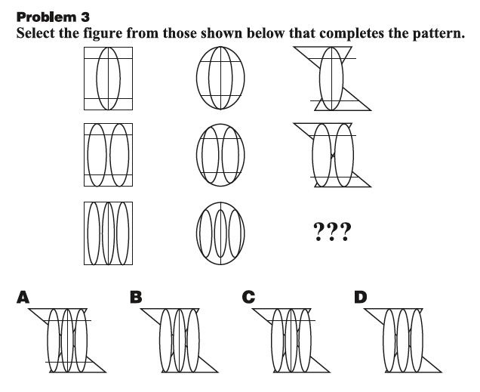

Slide 30

ANOMALY
Any occurrence or object that is strange, unusual, or unique; a discrepancy or deviation from an established pattern, rule, or trend
Notes:
30

Slide 31
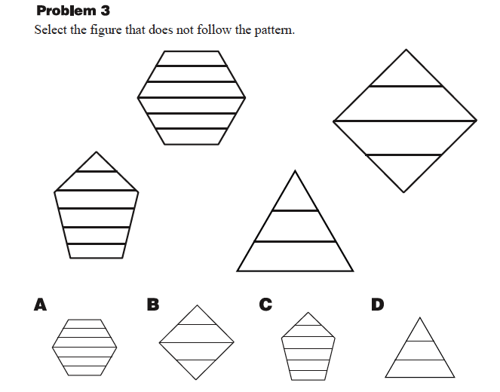

Slide 32
ANTINOMY
Refers to the mutual incompatibility, real or apparent, of two laws, rules, or principles
Meritocracy
Totalitarianism
Aristocracy
A¹
Democracy
A
Monarchy
Communism
Dictatorship
Fascism
Anarchy
Federalism
Theocracy
Notes:
32

Slide 33
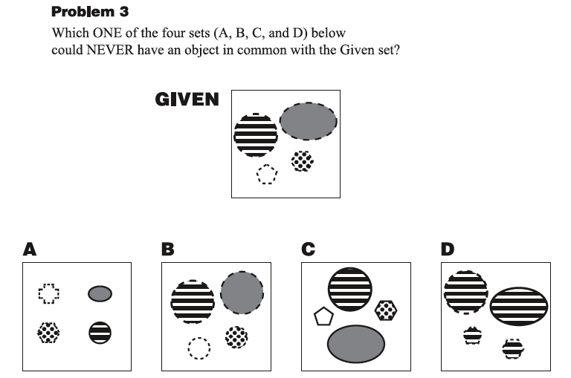

Slide 34
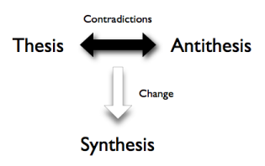
ANTITHESIS
Arises when two propositions, principles, or explanations are set in direct contrast or direct opposition
Notes:
Antithesis (Greek for "setting opposite") is a counter-proposition and denotes a direct contrast to the original proposition. In setting the opposite, an individual brings out of a contrast in the meaning (eg., the definition, interpretation, or semantics) by an obvious contrast in the expression.
In philosophy, it is used especially within theories of dialectical materialism and is usually attributed to Hegel, who, in turn, attributed it to Kant.
34

Slide 35
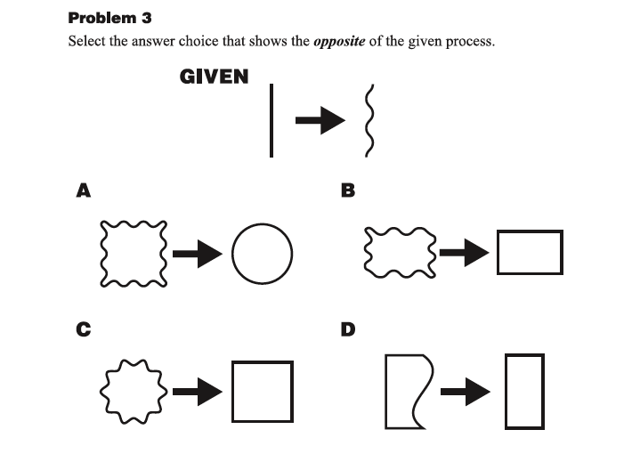

Slide 36
RELATIONAL REASONING AND METACOGNITION
Analogical reasoning has long been regarded as a mechanism for deeper conceptual understanding, conceptual change, and transfer (Clement, in press; Fugelsang & Dunbar, 2009; Thagard, in press)
Metacognitive awareness is also predicated on the ability to recognize how the information deviates in some non-trivial way from the prior patterns (anomalous reasoning: Chinn & Brewer, 1993; Chinn & Malhotra, 2002)
Notes:
Relational reasoning has also been recognized as a hallmark of expertise in science (Carey, Vosniadou, Erickson, Patel). For instance, experts in physics are able to identify the underlying structural similarities in problems even when surface features vary (cites), while novices cannot. Similarly, medical experts can readily perceive a set of symptoms as indicative of a particular condition, while novices do not. Further, relational reasoning has been described as a critical competency for science success in high school and college (ACT; ). For instance, manifestations of relational reasoning (e.g., analogy, anomaly, antinomy, or antithesis) have been linked to discernment of cause and effect science relations (Fugelsang & Dunbar, 2009); identification of anomalous scientific data (Chinn & Malhotra, 2002); the avoidance of science misconceptions (CHI); and, the generation of scientific discoveries (Chi & Hausmann, 2003). As well, relational reasoning has been linked to the comprehension of complex science texts, especially when those texts contain analogical references (Britten and Glynn), present conflicting evidence (cites), or follow an argument-counterargument structure (e.g., Braten & Stromso; Murphy), which feature prominently in measures of student science academic outcomes (AP, HSA, CCSS, ACT) and are the primary bases of instruction and assessment in college (Heller & Greenleaf, 2007; CCSS).

Slide 37
RELATIONAL REASONING AND METACOGNITION
Recognizing the incompatibility of two ideas is basic to the formation of defensible scientific categories (antinomous reasoning: Carey, 1985; Chi, in press; Chi & Hausmann, 2003)
The ability to juxtapose arguments or counterarguments or deeply process refutation texts have been tied to learning and performance (antithetical reasoning: Murphy, 2009; Murphy & Alexander, in press; Sinatra & Mason, in press)
Notes:
Relational reasoning has also been recognized as a hallmark of expertise in science (Carey, Vosniadou, Erickson, Patel). For instance, experts in physics are able to identify the underlying structural similarities in problems even when surface features vary (cites), while novices cannot. Similarly, medical experts can readily perceive a set of symptoms as indicative of a particular condition, while novices do not. Further, relational reasoning has been described as a critical competency for science success in high school and college (ACT; ). For instance, manifestations of relational reasoning (e.g., analogy, anomaly, antinomy, or antithesis) have been linked to discernment of cause and effect science relations (Fugelsang & Dunbar, 2009); identification of anomalous scientific data (Chinn & Malhotra, 2002); the avoidance of science misconceptions (CHI); and, the generation of scientific discoveries (Chi & Hausmann, 2003). As well, relational reasoning has been linked to the comprehension of complex science texts, especially when those texts contain analogical references (Britten and Glynn), present conflicting evidence (cites), or follow an argument-counterargument structure (e.g., Braten & Stromso; Murphy), which feature prominently in measures of student science academic outcomes (AP, HSA, CCSS, ACT) and are the primary bases of instruction and assessment in college (Heller & Greenleaf, 2007; CCSS).

Slide 38
CONCLUDING THOUGHTS

Slide 39
There is a continual orchestration between percept and concept in human thinking and reasoning and their oversight
Being attentive and perceptive would seem to be necessary but not sufficient conditions to being metacognitive
We continue to search for mechanisms for prompting and promoting metacognitive awareness and meta-strategic behavior in learners

Slide 40
Bringing relational reasoning to the forefront may contribute to learners’ awareness and strategic response
Measuring relational reasoning ability may afford insights into critical thinking dispositions or individual differences that matter to human learning and performance
There is much to be understood about relational reasoning and its role within human cognition and metacognition

Slide 41


ACKNOWLEDGMENTS
Peter Baggetta
and
Disciplined Reading and Disciplined Learning Research Laboratory
Denis Dumas
Lily Fountain
Emily Fox
Emily M. Grossnickle
Courtney Hattan
Alexandra List
Sandra M. Loughlin
Liliana Maggioni
Taslima Rahman

