Slide 1

Metacognition as Kludge
Peter Carruthers
with thanks to Logan Fletcher
Maryland Metacognition Seminar, 12/9/11

Slide 2
Outline
The theses
The meaning of “metacognition”
Metacognition of knowledge & learning
System 1 & System 2
Metacognition of reasoning & decision making
Conclusion

Slide 3
The theses
There is no adaptation for metacognition, but rather 1st-person use of mindreading faculty.
Metacognitive skills vary widely among people, depend on individual learning, and are generally not very effective.
Metacognitive monitoring is sensory-cue based, not direct.
Metacognitive interventions aren’t direct, but depend on indirect behavioral and attentional influence.

Slide 4
The Meaning of “Metacognition”
Metacognition involves self-directed meta-representation
(either conceptual or nonconceptual).
This is what psychologists mean – “thinking about [one’s own] thinking”.
Some in cog. sci. seem to mean only: influencing or controlling a cognitive process.
No quarrel.
There are multiple monitoring-and-control processes of a non-metarepresentational sort.

Slide 5
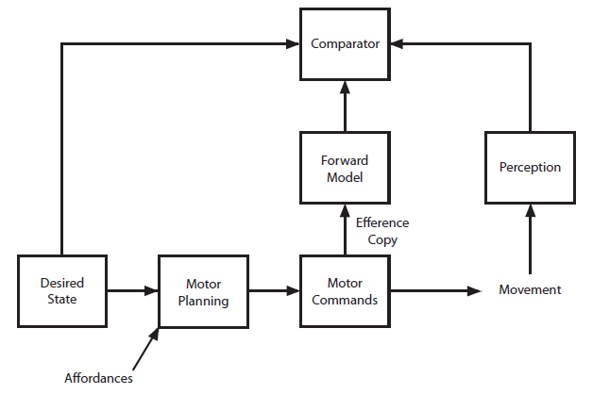

Monitoring and Control of Action

Slide 6
Metacog of knowledge & learning
Judgments of memory and learning are cue-based –
Memory: ease of access of fragments of target or items related to target.
Learning: fluency with which items are processed (e.g. fonts, time studying).
Not what one would predict if metacognition evolved for purposes of cognitive control.
One shouldn’t need to rely on indirect cues.

Slide 7
Metacog of knowledge & learning
Intention to learn has an effect on study patterns
but no effect on learning & recall with study patterns controlled for.
Most meta-learning strategies are behavioral
focusing of attention, mental rehearsal, etc.
Strategies are modestly effective at best; not a robust native competence.
More likely: guided by mindreading faculty in the absence of direct access to the process.

Slide 8
Metacog of knowledge & learning
fMRI: metacognition = mindreading.
Some studies contrast within metacognition.
FOK vs TOT; past vs future-directed confidence
using “don’t know” for contrast with both.
But this is metacognitive too!
Chua et al. (2006, 2009) contrast confidence and metamemory with first-order recognition.
Medial prefrontal, posterior cingulate, temporo-parietal junction.

Slide 9
System 1 & System 2
In order to explain patterns of response to reasoning tasks
and to explain individual differences
many postulate dual systems:
System 1 (intuitive) and System 2 (reflective).
Even those who get answers right still feel the “pull” of intuitive but incorrect response.
System 2 is supposed to monitor output of System 1, intervening where needed.

Slide 10
System 1 & System 2
System 1 (“intuitive”) – is fast, parallel, unconscious;
isn’t easily altered; is universal;
is impervious to verbal instruction;
is (partly) heuristic based;
is (mostly) shared with other animals.
Note: only the inputs and outputs of System 1 are available for monitoring by mindreading.
Evidence of any other form of monitoring is evidence of an adaptation for metacognition.

Slide 11
System 1 & System 2
System 2 (“reflective”) – is slow, serial, conscious;
malleable; variable (by culture and individual);
responsive to verbal instruction;
influenced by normative belief;
can involve application of valid rules.
Note: System 2 processes are available for monitoring by mindreading.
Evidence of native competence is needed to support adaptation for metacognition.

Slide 12
System 1 & System 2
System 1 doesn’t depend on working memory.
System 2 does.
An executively controlled system that can call up and manipulate stored information.
The cognitive basis of g - general intelligence.
Plus disposition to reflect.
Plus knowledge of reasoning rules and strategies.

Slide 13
System 1 & System 2
Monitoring of System 2 is sensory-cue-based
visuo-spatial, inner speech, etc.
Working memory uses executive resources to direct and focus attention
calling up and manipulating conceptualized sensory representations
exapting the “global broadcast” of attended sensory information (Baars).
Monitoring can be done by the mindreading faculty.

Slide 14
Metacognition of reasoning
No natural competence to intervene in and improve our own System 2 reasoning.
People are generally bad at reasoning about reasoning.
Emerges late in development.
Dependent upon culture and formal education.
Not what one would predict if there were an adaptation for metacognition.

Slide 15
Metacognition of reasoning
Monitoring of System 1 output leads to System 2 processing?
In some people – large individual variation.
Most seem not to employ System 2 at all.
Large variation in “mindware” – the reasoning rules appealed to in System 2.
Variation in factors triggering System 2 –
for some, disfluency; for others, content-dependent habits; etc.
No evidence of adaptation for the purpose.

Slide 16
Metacognition of affect
Monitoring for affective influence on judgment isn’t routine – weather & happiness
mood induction & judgments of risk.
Attention needs to be called to possible sources of affect.
For some people, drawing attention to affect makes the influence bigger, not smaller.
Capacities to discount incidental affect vary
often depend on folk knowledge.

Slide 17
Metacognition of decision making
Willpower: the marshmallow test (Mischel).
Need to monitor affect and imminent action & intervene.
Intelligent direction of attention.
Widely varying strategies:
look away; sit on hands; play with another object; sing songs to oneself; etc.
Metacognition is a cobbled-together skill.

Slide 18
Conclusions
No evidence that metacognitive monitoring is direct.
Rather, self-directed mindreading relying on sensorily-accessible cues.
No evidence of a native competence for metacognition.
Rather, individual and cultural learning.
Metacognition is a kludge.

