Slide 1
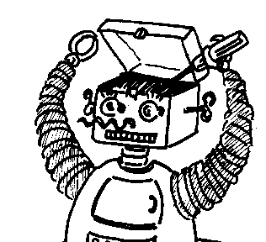
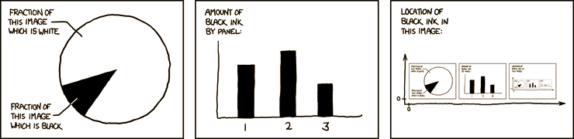

Maryland Metacognition Seminar
http://xkcd.com/
Metacognition — a biased overview
Don Perlis

Slide 2
Acknowledgements
Collaboration with NRL (Perzanowski, Blisard)
Large team (Anderson, Cox, Dinalankara, Fults, Jones, Josyula, Oates, Perlis, Sanders, Schmill, Shahri, Wilson) across four campuses (UMCP, UMBC, Bowie State, Franklin&Marshall)
Supported by NSF, ONR, AFOSR, UMIACS

Slide 3
Outline
Metacognition as cog-sci unifier
The nature(s) and importance of metacognition
Metacognition in logic, philosophy, psychology, linguistics, neuroscience, and computation.
Efforts toward robust flexible self-adjusting autonomous agents

Slide 4
A unifier?
Metacognition seemingly arises across the board in cognitive science. In this talk I will try to convey that phenomenon, and suggest possible reasons for it.
Notes:
I had intended to give a quick summary of metacog in philo, logic, psych,etc and then concentrate on our work; but as I began to prepare the summary part I kept thinking of more and more to say, and that aspect has gained the upper hand, as well as (possibly) made it rather disorganized, for which I apologize.

Slide 5
What is metacognition?
Meta-cognition: cognition about cognition…
or more generally, cognition about the cognizer
or even about cognizers in general
Notes:
About cogn: memory, knowledge, reasoning, intentions, etc
About agent: age, strength, history, etc
About agents: what they do, intend, believe… (talk by Rebecca Saxe yesterday, on thinking about others’ minds, RTPJ)

Slide 6
A quick glance at some themes
Aboutness (Brentano)
Agreement (Kripke, Putnam, etc)
Appearance-Reality Distinction (Flavell)
Time (thick or thin)
Self-correcting engines (Watt governor)

Slide 7
Two styles of metacog
Hierarchical:
Entity M processes information about entity S
Loopy:
Entity S processes information about itself
Notes:
A “me” or no “me”?
From math logic (Russell,Tarski); also in cogn psych (Nelson et al: monitor and control distal subsystem)
From language: reference; self-control;
From engineering: governors; AI/phil: Hofstadter, Wehyrauch
From neuro: VOR

Slide 8
Metacog in Logic
To be consistent or not to be consistent? (Russell, Tarski)
Paradox of self-reference, or safe stratification (but with infinite regress)?
The LIAR sentence: The LIAR sentence is false
(or: This sentence is false.)
Gilmore-Kripke approach: have cake and eat it too
[ True(‘A’) <-> A* ] (safe and expressive but unrealistic for agents)
Notes:
Truth-preds

Slide 9
Alternative: embrace inconsistencies (as unavoidable and important clues to things amiss and needing attention) and respond to them.
Tall order, in a logic.
Active logic
i: Now(i), P, -P
----------------
i+1: -Now(i), Now(i+1), Contra(i,P,-P)
Notes:
Truth-preds

Slide 10
Metacog in Philosophy
Brentano, Husserl, Kelly, Lloyd, Humphrey, Newton, Perry, Putnam,…
Perry’s shopper: what does one learn, when one realizes a description applies to himself?
Robot needs to fix its (own) arm
The hard problem, explanatory gap, mind/brain, consciousness: strong self-reference?
Notes:
What is reference? What picks out a particular link as the meaning of a symbol? Not sentences alone; need an agent to decides (or borrow) that S means T.

Slide 11
Metacog in Linguistics
“Pool” starts with “P” and rhymes with “T”…
Quotation has been ignored (but shouldn’t be)
Grice: when speaker utters U, what is conveyed?
Do we recall words, or meanings?
A: What’s that big thing over there?
B: Huh? What large object in that direction?
Notes:
Shomir’s diss

Slide 12
Metacog in Psychology
Everyday reasoning: making coffee (things go wrong, need to assess and respond)
Apportioning study time: more time on the hard parts, or be sure to master the easier parts? (Nelson et al)

Slide 13
Metacog in Neuroscience
Various papers on brain activity and self-corrective cognition
Efferent copy (VOR, etc)
Recent work by Saxe on RTPJ and thinking about others’ mental states
Notes:
Vestibular occular reflex

Slide 14
Metacog in Computation
FOL (Weyhrauch et al, 1980-): agency, reflection and time
Principles of metareasoning (Russell, Wefald 1989)
Meta-AQUA (Cox, Ram 1992)
Non-monotonic reasoning: what I don’t know tells me a lot (Doyle, McCarthy, McDermott, Reiter, Moore)
Active Logic: time, contradiction, rapid semantic shift.
The metacognitive loop (MCL)

Slide 15
Toward human-level autonomy
Chippy
Rational Anomaly-Handling
Why it has been so hard
How biology does it
RAH principles
Notes:
Note-Assess-Guide

Slide 16
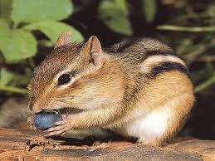
Chippy has a problem
Chippy learns over time (say, by reinforcement learning) where it tends to have success at finding food (in trees)
Then things change quickly as cold weather sets in (food is now on the ground)

Slide 17
Chippy’s standard learning algorithm cannot adapt quickly, and must first unlearn the previous reward policy (a process as slow as learning it in the first place)
In all, it takes Chippy more than double the time to learn the new food locations.

Slide 18
A much smarter policy would be to jettison the old policy once it has failed repeatedly, instead of tinkering with it incrementally, and just start from scratch.

Slide 19
How a wise Chippy could reason
I am trying to find food, using a learned strategy
It is no longer working, not even close
Best to give it up and learn a new strategy
Notes:
Will show graph illustrating results later

Slide 20
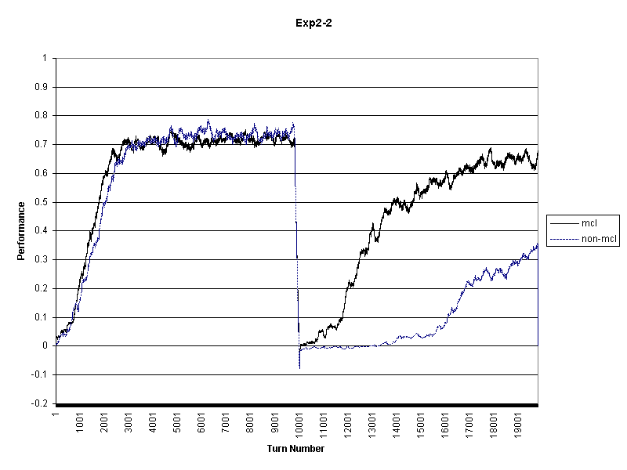
Chippy’s recovery

Slide 21
RAH Principles
Note anomalies
Assess them (familiarity, importance, available strategies)
Guide a response into place
Note-Assess-Guide: the metacognitive loop (MCL)

Slide 22
MCL: Anyone for a game of BOLO?
Build a “brain”, let it play
World of goals, dangers
Can study it in advance, then play, or…
…learn on the fly, as needed (i.e., as judged by the brain)

Slide 23
MCL: From BOLO to Finland
Different implementations, but same underlying features, in: navigation, game-playing, reinforcement learning, non-monotonic reasoning, NLP, etc.
General-purpose MCL (three ontologies: indications, failures, responses)
Notes:
Wake up in Finland!

Slide 24
MCL: On a practical theme
Ship-board firefighting
Noisy, uncertain, multi-skill, real-time: ideal testbed for MCL with learning as a repair strategy

Slide 25

A major safety issue

Slide 26

Action, error, communication

Slide 27
Conclusions
Metacognition is ubiquitous in cognition.
It may be what allows an agent to be flexible and robust across widely varying situations.
It may require sophisticated kinds of processing that
(i) are largely available, if we put the pieces
together, and/or
(ii) has still-elusive features bearing on
questions in logic, language, psychology,
philosophy, etc.

Slide 28
…and as I note the time, I see that I should stop, including the stopping of this very line of thought.
THANKS FOR LISTENING!

