Slide 1
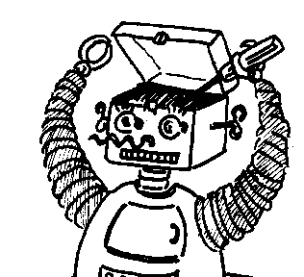

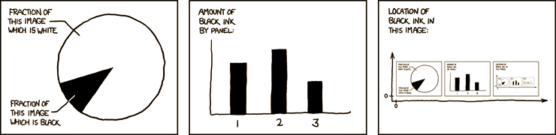
Toward an Integrated Metacognitive Architecture
Michael T. Cox
UMIACS, University of Maryland, College Park
http://xkcd.com/
Notes:
“I’m Mike Cox, and this presentation is early work about integrated metacognitive architectures.” This is a simple opening and no one would believe that anything of substance has been said yet. After all the title slide has my name on it, and the title is self-explanatory. But the fact that we actually take all of these complicated self-referential statements with such little interest illustrates how little we realize concerning the topic. For intelligent agents this is extremely difficult and central.
Discuss the cartoon. Transition to the next slide.

Slide 2
Why a Metacognitive Architecture?
Why Cognitive Architectures?
To better understand the mechanisms of reasoning across tasks
To account for human data
To study high-level cognition by specifying the underlying infrastructure
Metacognition because it is especially human and gets at the nature of what it means to be intelligent
Integrated because many different aspects exist
And much of it is confused
And none have put it all together
And this is the only way to get at human-level AI
Notes:
from http://www.isle.org/symposia/cogarch/
A cognitive architecture specifies the underlying infrastructure for an intelligent system. Briefly, an architecture includes those aspects of a cognitive agent that are constant over time and across different application domains. The specification of a cognitive architecture consists of its representational assumptions, the characteristics of its memories, and the processes that operate on those memories.

Slide 3
Outline
Introduction
Outline
Cognitive and Metacognitive Architectures
Representations
The Self-Regulated Learning Task
Conclusion

Slide 4
Cognitive and Metacognitive Architectures
Introduction
Outline
Cognitive and Metacognitive Architectures
Representations
The Self-Regulated Learning Task
Conclusion

Slide 5
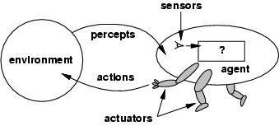
Action and Perception Cycle
Doing Reasoning
from Russell & Norvig, 2002

Slide 6
Simple Model of Metareasoning
from Cox & Raja (2011)
Notes:
Note the difference between metareasoning and metacognition

Slide 7
The Meta-Cognitive Loop (MCL)
Introspective Monitoring
Meta-level Control
from Anderson et al., (2008)

Slide 8
Meta-AQUA Metacognitive Architecture
Introspective Monitoring
Meta-level Control
from Cox & Ram (1999)

Slide 9
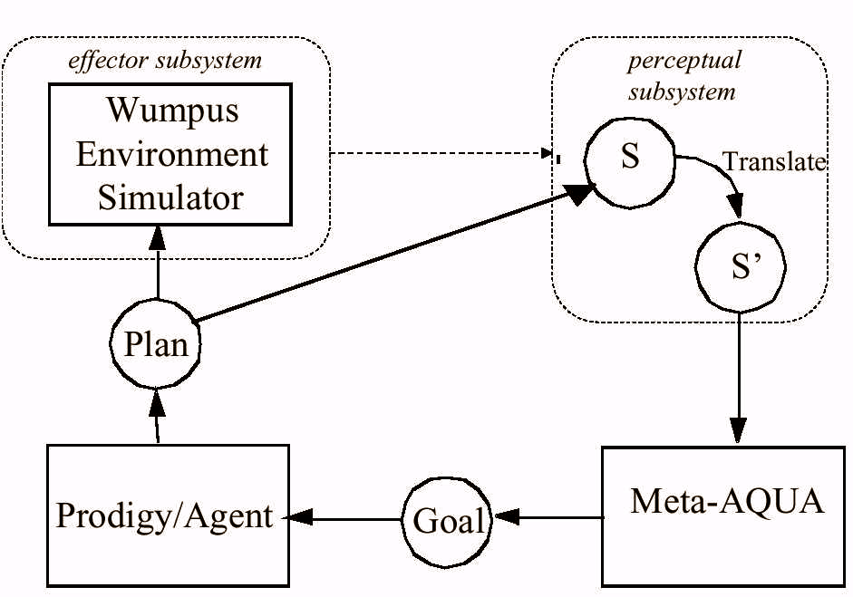
INTRO: The INitial inTROspective Agent
Ground Level
Object Level
Object and Meta-Level
Object Level
from Cox (2007)
Notes:
The problem is that INTRO is hard wired to generate attainment goal instead of learning goal.

Slide 10
Cognitive Model
from Norman (1986)
Notes:
Explain why no learning box.

Slide 11
Metacognitive Model

Slide 12
An Integrated Metacognitive Architecture
Metacognition
Cognition

Slide 13
Representations
Introduction
Outline
Cognitive and Metacognitive Architectures
Representations
The Self-Regulated Learning Task
Conclusion

Slide 14
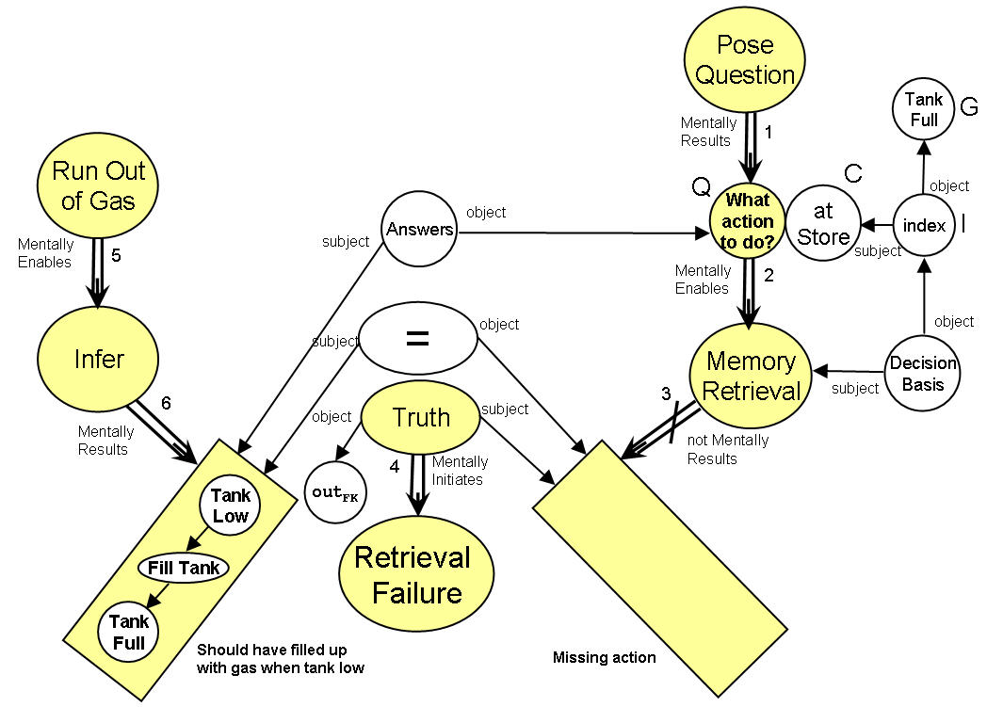
Representations For Mental Traces

Slide 15
Truth Values on Graph Nodes
Description | A | E | G | I | M
Absent Memory | in_{FK} | out_{FK} | in_{FK} | out_{BK} | out_{BK}
Absent Index | in_{FK} | out_{FK} | in_{FK} | out_{BK} | in_{BK}
Absent Question | in_{FK} | out_{FK} | out_{FK} | x | x
Absent Feedback | out_{FK} | out_{FK} | x | x | x
 |  |  |  |  | X=don’t care

Slide 16
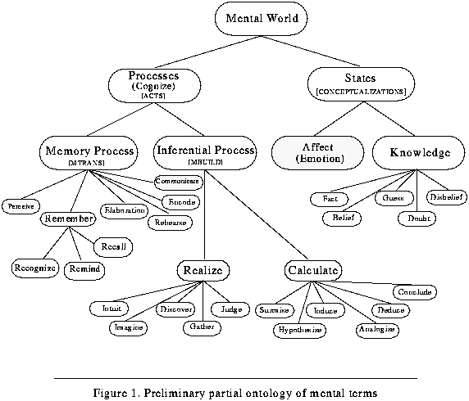
Partial Ontology for Mental Terms

Slide 17
Self-Models
How to represent episodic memory?
Case-based reasoning
Soar’s episodic memory
How to represent model of self?
Physical attributes
Mental attributes
Dispositions
Attitudes
Emotions
Intellectual abilities
Social attributes

Slide 18
The Self-Regulated Learning Task
Introduction
Outline
Cognitive and Metacognitive Architectures
Representations
The Self-Regulated Learning Task
Conclusion

Slide 19
Task: Self-Regulated Learning (SRL)
SRL focuses on deliberate learning
SRL scope is wide and task is difficult
SRL has extant data (e.g., Azevedo)
The problem of studying for a test
Must master the domain
Must understand one’s self
One’s own knowledge
One’s own reasoning ability
Must understand the teacher’s priorities

Slide 20
How to Study for a Test
Reason about the domain (e.g., chemistry)
Reason about one’s knowledge of the domain
Reason about skills in the domain (e.g., lab skills)
Reason about reasoning (problem-solving) in the domain
Reason about personal strengths and weaknesses in domain (I struggled with Chem I, so need to work harder; I study best in quiet environments)
Reason about teacher and what is likely to be on test
Reason about resources (e.g., time left to study)
Notes:
Studying for a test is also social (for some people). The benefits for study groups.

Slide 21
Task Decomposition I
Context
Reading assignment, take notes
Attend lecture, take notes
Perform homework
Study for test
Take test
Study for test
Review notes
Review readings
Review old tests
Practice problems
Notes:
Note involves language

Slide 22
Task Decomposition II
To review readings
Must have indicated key parts when first read
Integrate notes from lecture
Identify parts needing elaboration
Do elaboration
Iterate until confident or no time remaining
Lecture Notes
Readings
Basic background
Key text
Key text
Partially understood
Partially understood
Figure
Caption
Homework
Figure
Self Model
Teacher Model
yes
Time left & not prepared?
Halt
no

Slide 23
Desiderata
System that has self-identity
Knows its own strengths and weaknesses
Knows what it does not know
Knows what it wants for the future
Has a memory for what it has done in the past
Has a sense of its current physical presence in space and time (e.g., knows what is graspable)
Is self-confident and acts deliberately
Can empathize with others
Can explain itself to others
Generates its own goals (is an independent actor)
*Wonders about what happens when it gets turned off
Notes:
Self-identity <> self-awareness; I am an intellectual versus I am tired.

Slide 24
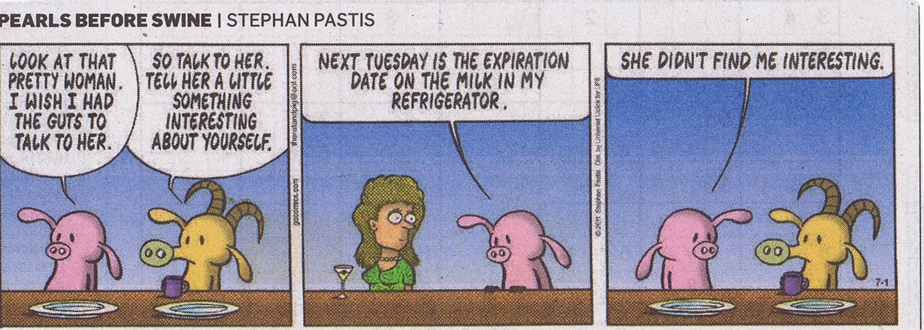
Self-Description

Slide 25
Conclusion
Introduction
Outline
Cognitive and Metacognitive Architectures
Representations
The Self-Regulated Learning Task
Conclusion

Slide 26
Conclusion
A number of different architectures exist that bear on metacognition
None have integrated the many aspects of cognition and metacognition
To do so would capture something uniquely human and at the heart of what it means to be intelligent
This presentation represents a small start

