Slide 1


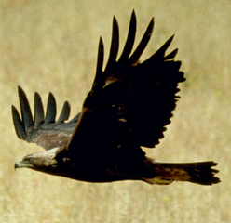





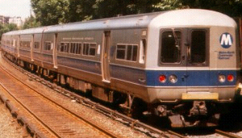

ALMA: A REASONING SYSTEM WITH A LIFETIME OF ITS OWN
Don Perlis, Waiyian Chong, Darsana Josyula, Yoshi Okamoto, Khemdut Purang.
Reasoning by real systems evolves in time. This fact is an essential part of the reasoning for many applications, eg:
  planning with tight deadlines
  taking coordinated action at the right time
  noting and correcting reasoning errors
  reasoning with contradictory information
  real time belief revision
  natural language dialogue
Active logics are a special family of formalisms in which time evolution is updated during reasoning
ALMA
  active logic inference engine
  reasons in real time
  accepts observations during reasoning
  makes resolution based inferences
CARNE
  front-end to ALMA
  interface to the world
  can execute specialized procedures
Common Sense Reasoning
Alma(Inference)
Carne(Interface)
10:00 a.m
5:00 p.m
5:01 p.m
Step Management
So, Tweety flies
So, Tweety does not fly.
Contradiction Detection
Alma Interfacing
Contradiction Handling
Action Execution
I used to believe that Tweety flies, but I was wrong
Applying Inference Rules
Domain Interfacing
Carne Interfacing
Tweety is a bird
Tweety is a penguin
Application to Natural Language Dialogue
(1) User: Send the New York train to Buffalo
(2) System: [sends Northstar to Buffalo]
(3) User: No. Send the New York train to Buffalo
(4) System: [returns Northstar to Buffalo]
  Good [sends Metroliner to Buffalo]
  Bad [sends Northstar to Buffalo]
The pattern [Do X] - (1), [No, Do X] - (3) generates a contradiction in ALMA and then triggers a repair
5:00 a.m
Metroliner at Pittsburgh
Northstar at New York
7:00 a.m
Send the Pittsburgh train to New York.
10:00 a.m
Send the New York train to Buffalo.
Buffalo
Albany
Buffalo
Albany
Pittsburgh
New York
New York
Pittsburgh
10:01 a.m
No.
10:02 a.m
Send the New York train to Buffalo.
Buffalo
Albany
Buffalo
Albany
New York
New York
Pittsburgh
Pittsburgh

