Slide 1

Computing with Physical Systems Part 2: Biology and physics
Arvind Murugan
Associate Professor of Physics, University of Chicago
http://muruganlab.uchicago.edu/

Slide 2
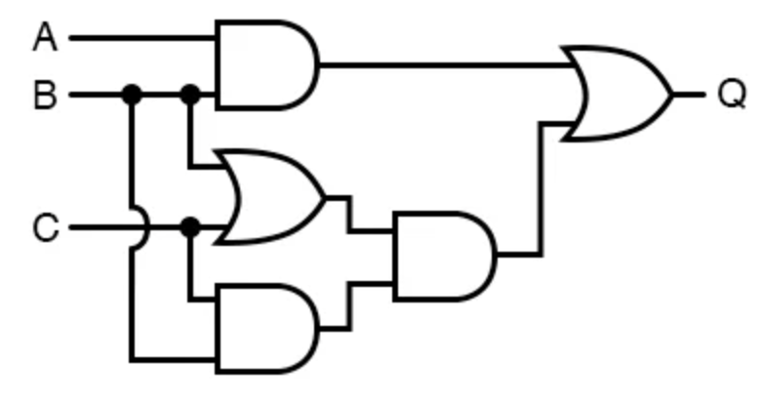
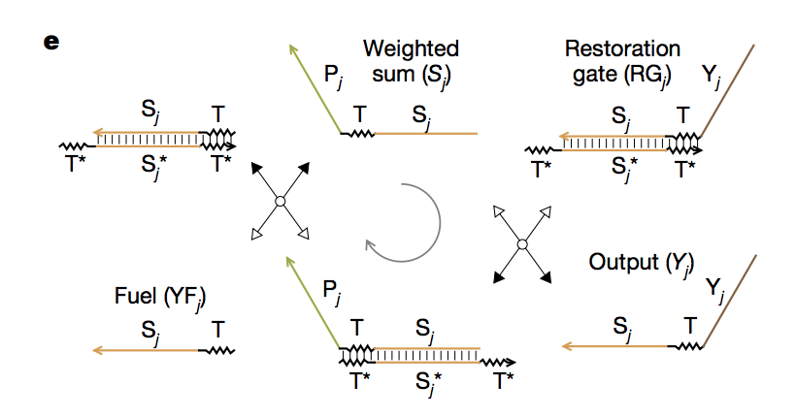
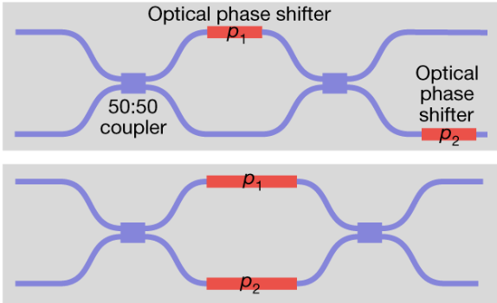
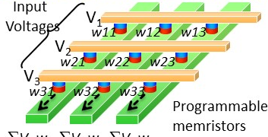
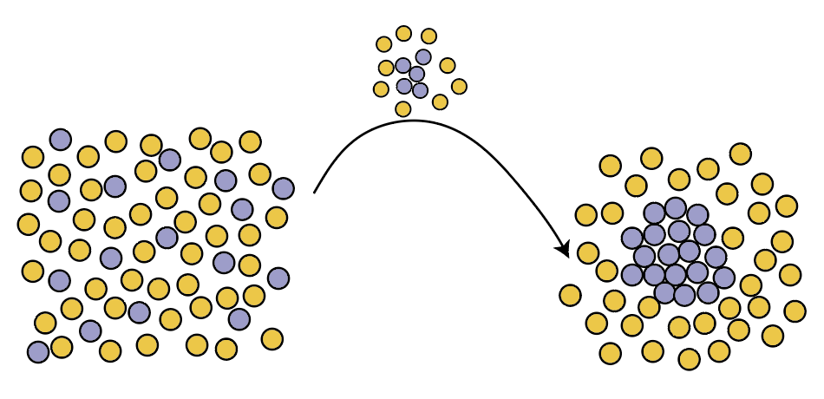
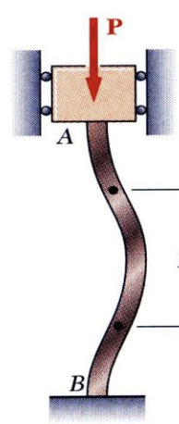
Algorithm-first vs Physics-first approaches
Advantage:
Compact dense..
Software
Hardware
Molecular circuits
Photonic circuits
Neuromorphic circuits
Abstraction
hierarchy
Algorithm first
Problem to solve
(a computation)
Natural collective phenomena
Physics first
How do you program it?
(since everything is connected)
+ Evolution
+ Evolution in reservoir mode
+ Physical learning
+ Some modified backprop
Program through physical learning
1st order phase transitions (nucleation)
elastic instabilities
Collective dynamics
Advantages:
Modular, limited coordination
Makes things engineerable
(so complex even though our brains are limited)
Molecular circuits
Photonic circuits
Neuromorphic circuits

Slide 3
Algorithm-first vs Physics-first approaches
Advantage:
Compact dense..
Software
Hardware
Why physics-first??
Synthetic biology
Doing more with less
(Fewer components, less energy)
Real biology
Easily exploited by evolution
… but hard to spot
(not modular)
Physical learning
=> adaptative computation
Abstraction
hierarchy
Algorithm first
Problem to solve
(a computation)
Natural collective phenomena
Physics first
How do you program it?
(since everything is connected)
+ Evolution
+ Evolution in reservoir mode
+ Physical learning
+ Some modified backprop
Program through physical learning
Collective dynamics
Advantages:
Modular, limited coordination
Makes things engineerable
(so complex even though our brains are limited)
Molecular circuits
Photonic circuits
Neuromorphic circuits

Slide 4
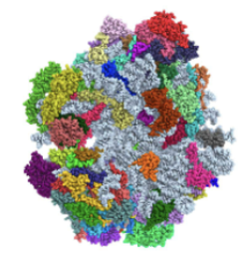
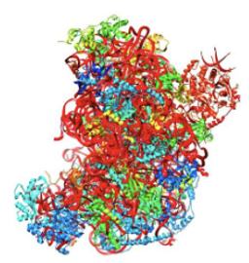
Physics-first does more with less
Abstraction first
mRNA1
pH
ATP
mRNA2
Response
Build struct. 1
Build struct. 2

Slide 5
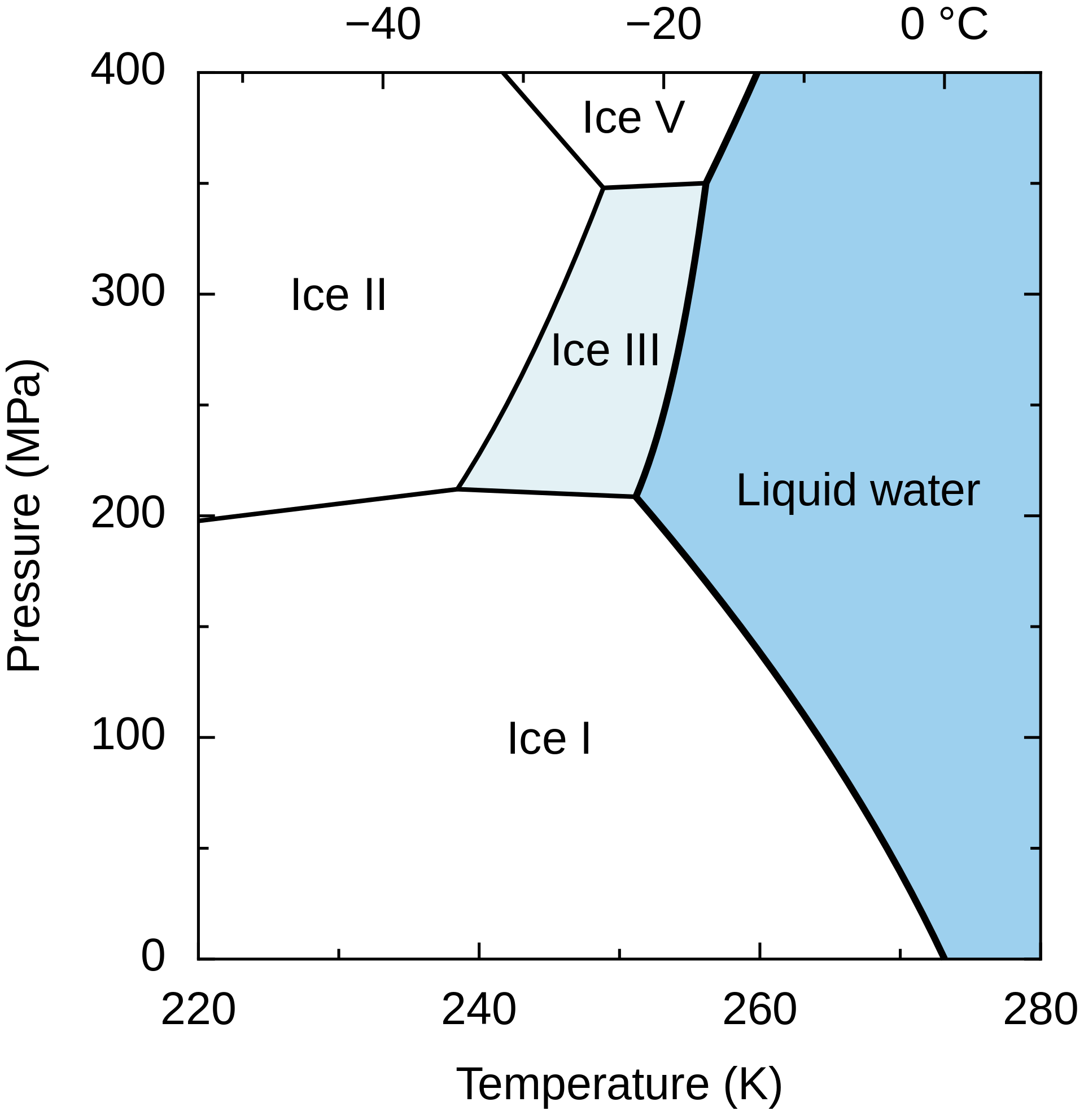
Physics-first does more with less
Abstraction first
Physics first
mRNA1
pH
ATP
mRNA2
ATP
Response
mRNA1
Phase diagram for water
Phase diagram for complex molecular soups
Build struct. 1
Build struct. 2

Slide 6
Physical learning eliminates need for a model
Abstraction first
Physics first
mRNA1
Molecular Hebbian learning
pH
ATP
mRNA2
ATP
Response
mRNA1
Build struct. 1
Build struct. 2

Slide 7
Physical learning eliminates need for a model
Abstraction first
Physics first
mRNA1
Molecular Hebbian learning
pH
ATP
mRNA2
ATP
Response
mRNA1
Build struct. 1
Build struct. 2

Slide 8
Open questions
Expressivity
Physical learning rules
What about the underlying physics enables more complex computation?
What kinds of local physical processes allow for robust learning?
Non-eq dynamics,
non-linearities,
High disorder,
Multicomponent limit…
Hebbian learning of molecular interactions
Direct aging in mechanics
Contrastive learning through non-eq dyn.
Forward-forward through …?
…
Why?? (besides better computers)
To do more computation with less in real and synthetic biology
To allow cells to teach themselves the right computation (no external programming, no evolution)

Slide 9
end

Slide 10
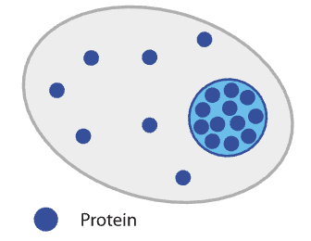
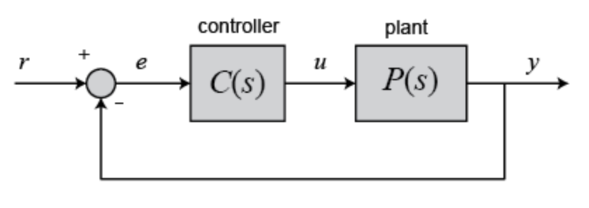
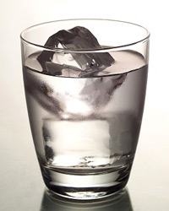
Why physics-first??
Current thinking
(brain-muscle separation)
Alternative
(brain-muscle separation)
Problem: Hold a molecular concentration fixed
Phase separation
Solution:
Klosin et al Science 2020
Integral feedback loop

