Slide 1
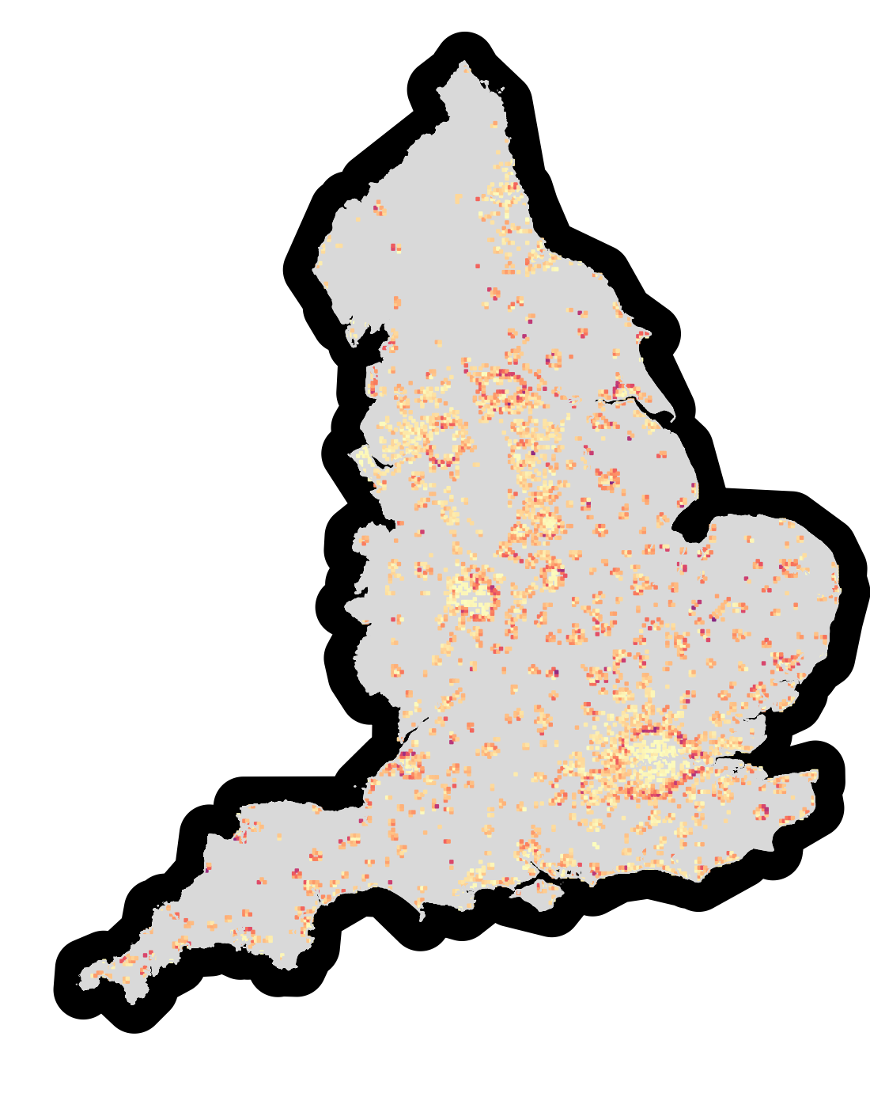
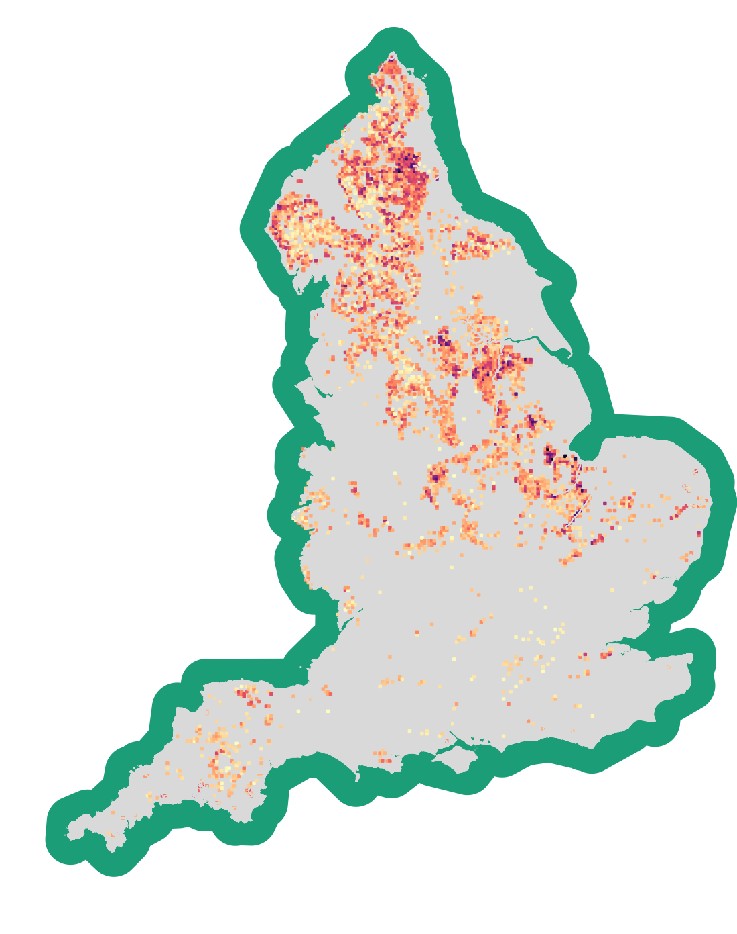
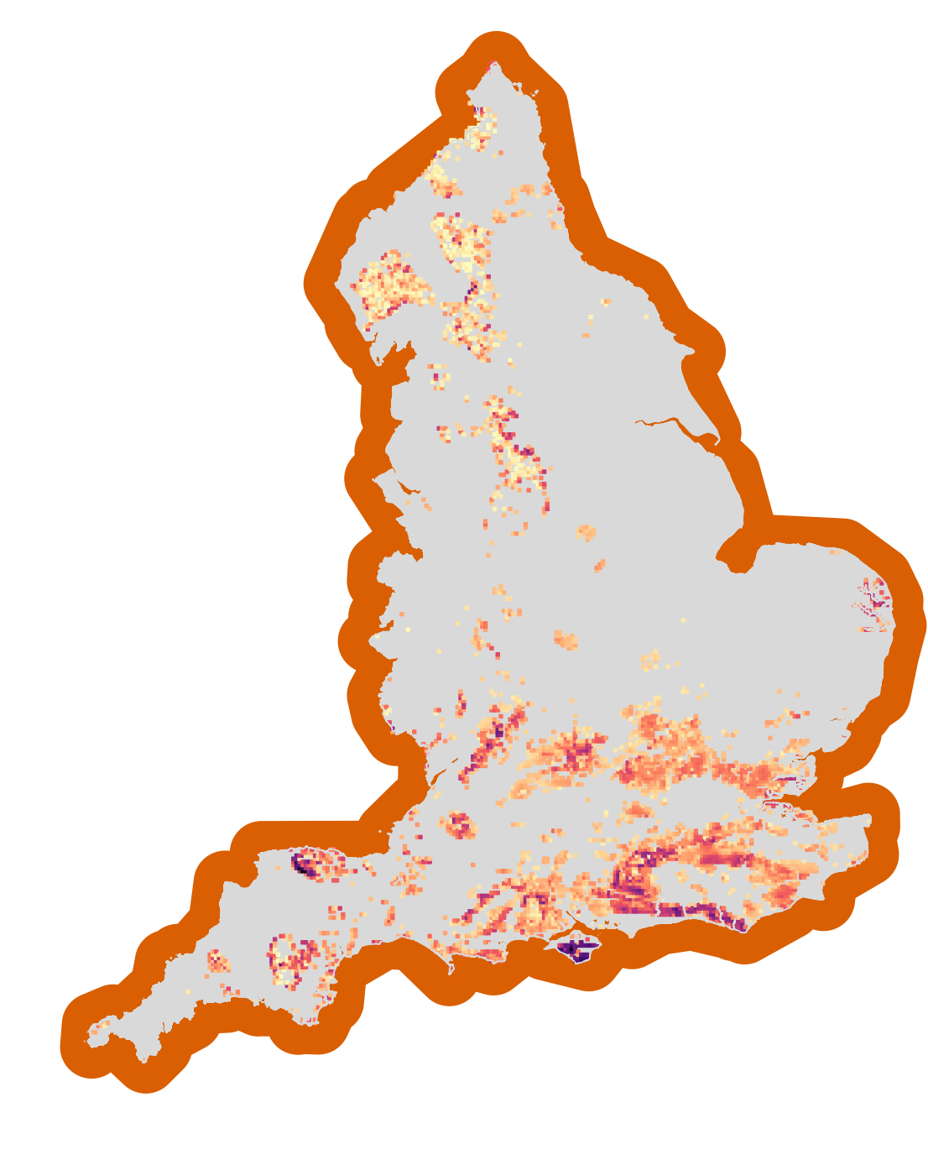
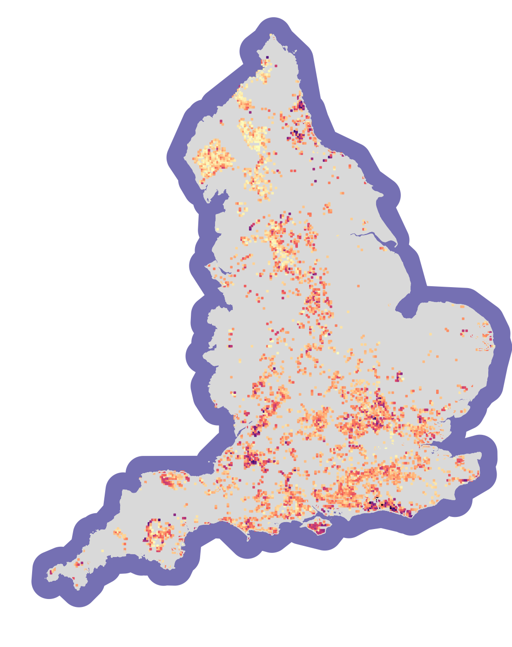
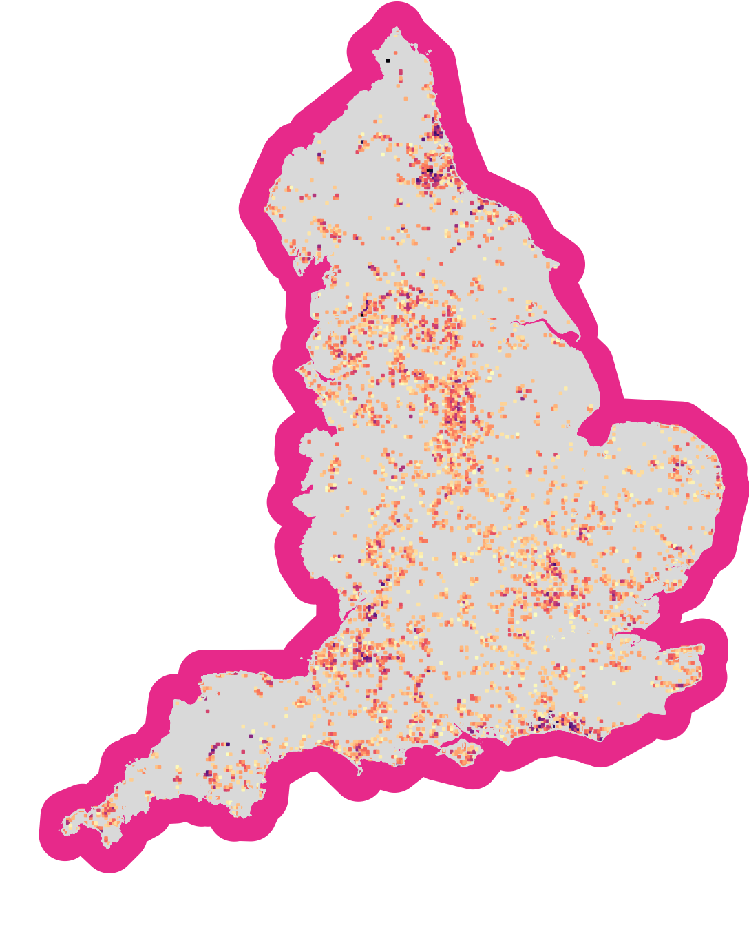

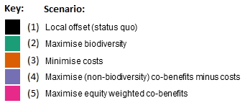
(a) Offset scenarios: Spatial distribution of sites
(b) Offset outcomes: Radar Chart
(c) Offset gains and losses: Histograms
Local offset (status quo)
(2) Maximise biodiversity
(i) Biodiversity gain
Maximum biodiversity
(ii) Costs
0
4
8
12
16
Minimum costs
Species richness change (%)
Maximum
co-benefits minus costs
(3) Minimise costs
(4) Maximise co-benefits minus
costs
-3
-2
-1
0
(iii) Co-benefits
Costs (£ billion)
Maximum equity weighted co-benefits
(5) Maximum equity weighted
co-benefits
(iv) Co-benefits minus costs
0.00
0.25
0.50
0.75
1.00
Recreation benefit (£ billion)
-3
-2
-1
0
Net benefit (£ billion)

