Slide 1
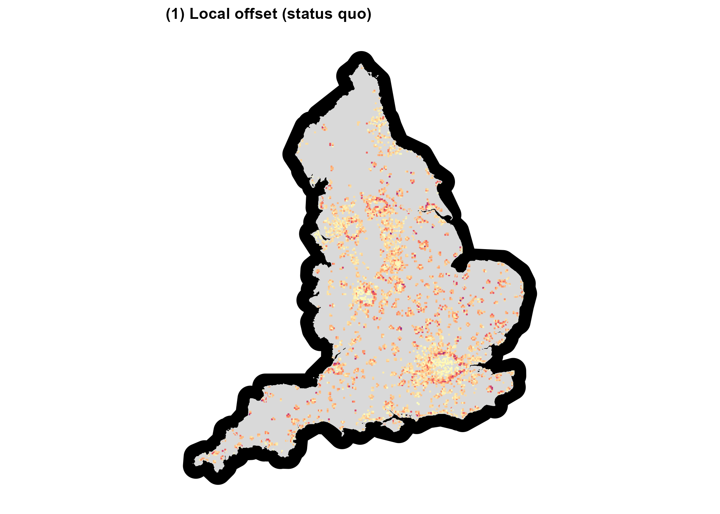
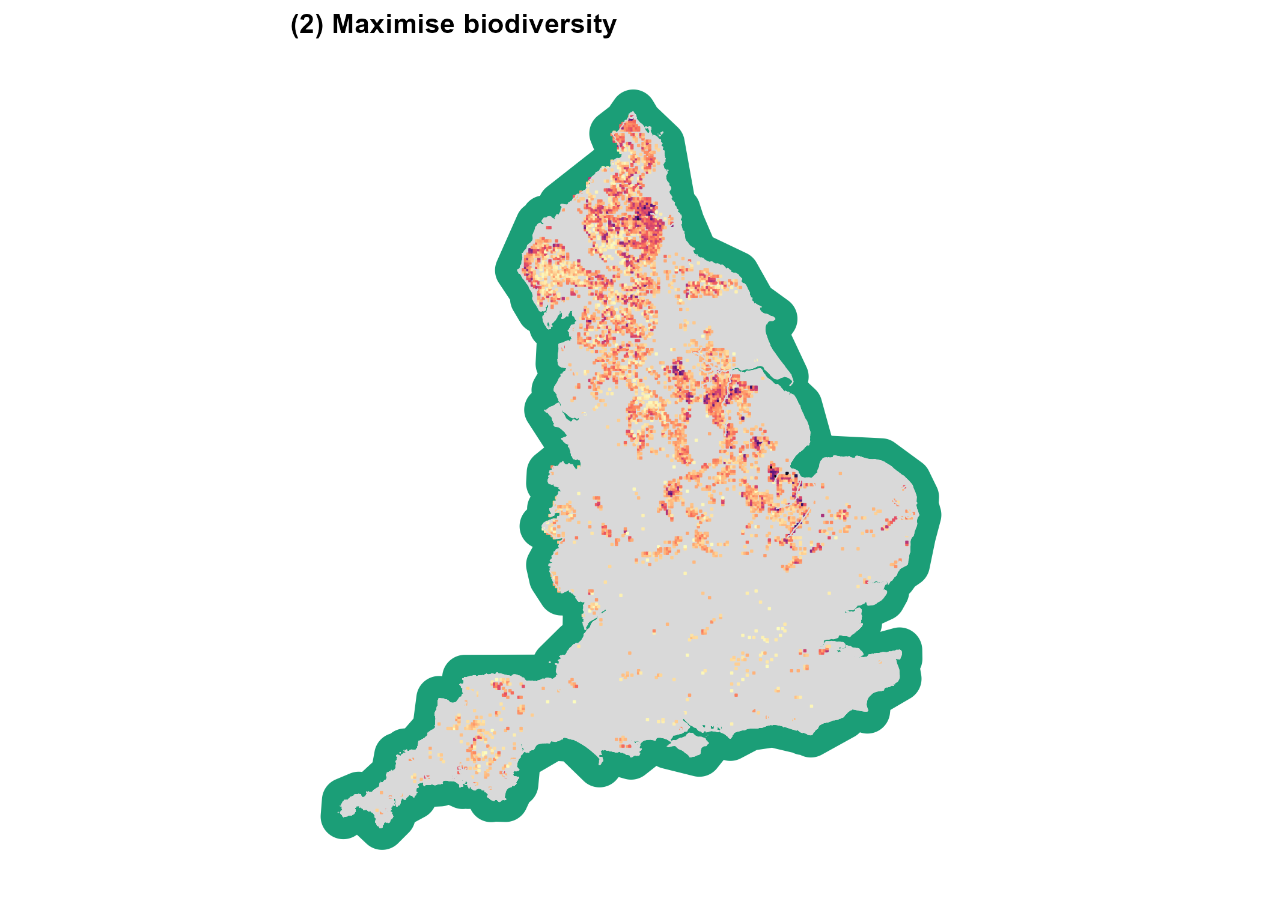
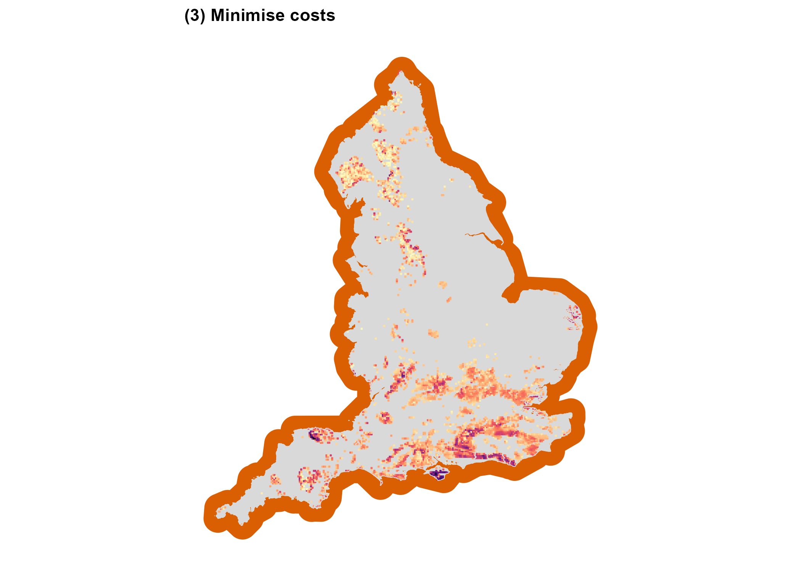
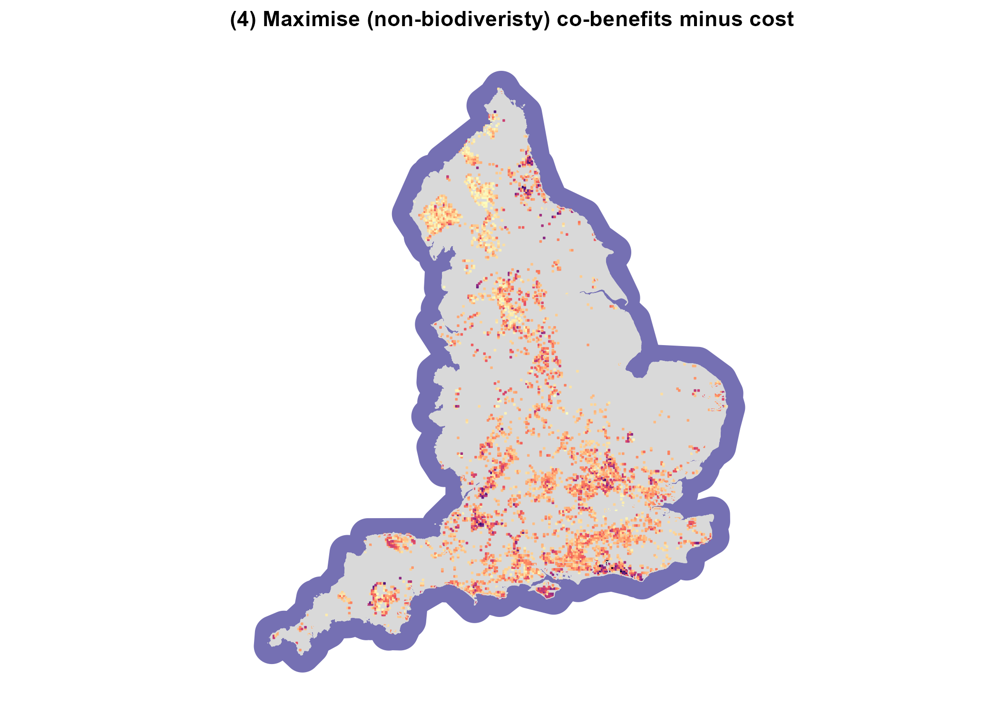
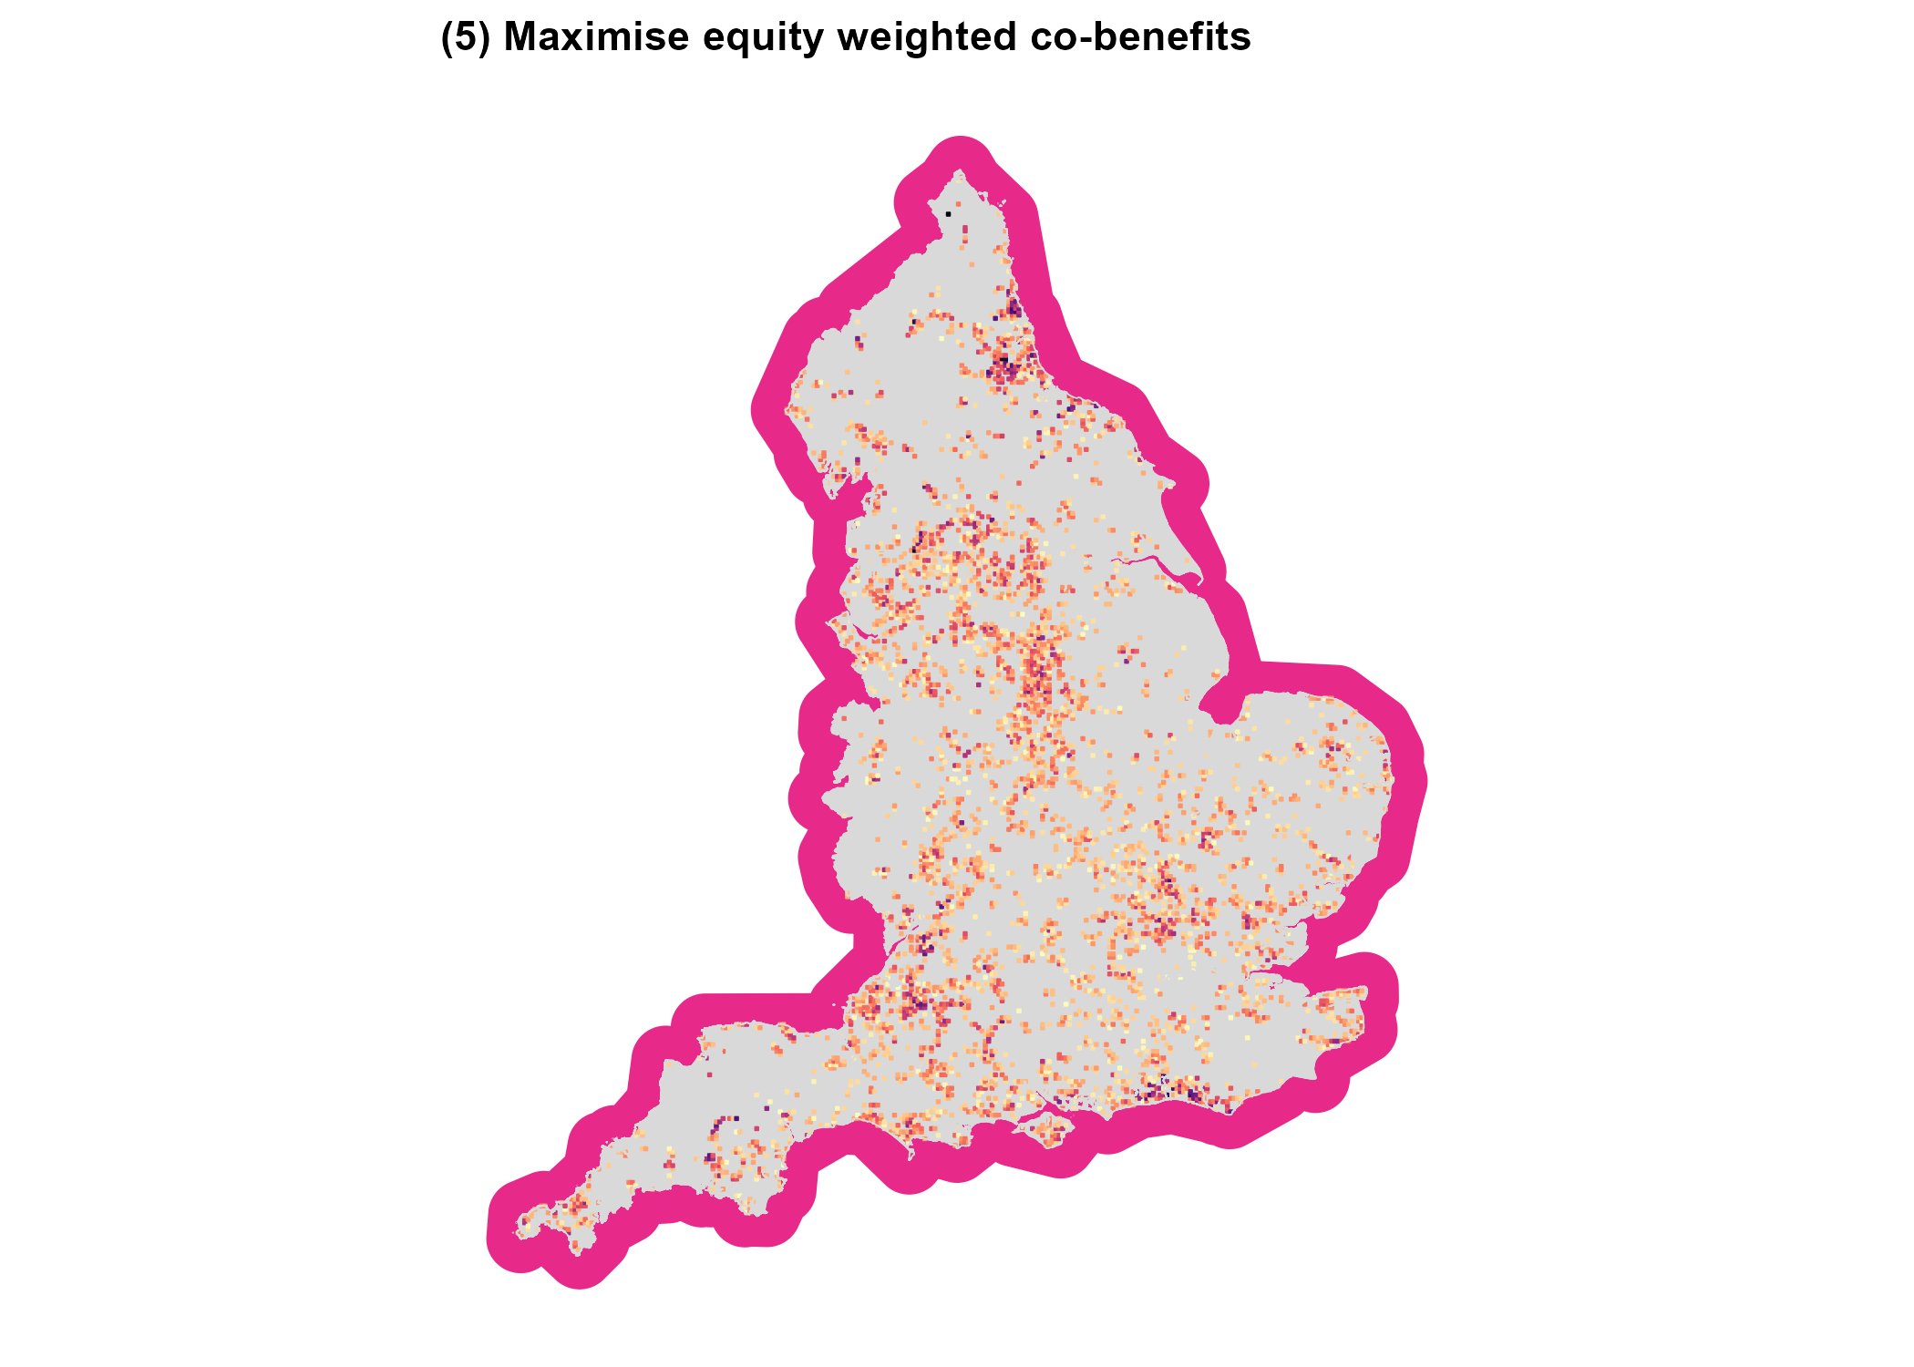
(a) Offset scenarios: Spatial distribution of sites
(b) Offset outcomes: Radar Chart
(c) Offset gains and losses: Histograms
Local offset (status quo)
(2) Maximise biodiversity
Maximum biodiversity
(1) Biodiversity gain
Minimum costs
Maximum
co-benefits minus costs
(2) Costs
0
4
8
12
16
Species richness change (%)
(3) Minimise costs
(4) Maximise co-benefits minus
costs
Maximum equity weighted co-benefits
-3
-2
-1
0
(3) Co-benefits
Costs (£ billion)
Key:
Local offset (status quo)
Maximise biodiversity
(5) Maximum equity weighted
co-benefits
Minimise costs
Maximise (non-biodiveristy) co-benefits minus costs
(4) Co-benefits minus costs
0
250
500
750
1000
Maximise equity weighted co-benefits
Recreation benefit (£ million)
-3
-2
-1
0
Net benefit (£ billion)

Slide 2
(a) Offset scenarios: Spatial distribution of sites
(b) Offset outcomes: Radar Chart
(c) Offset gains and losses: Histograms
Local offset (status quo)
(2) Maximise biodiversity
Maximum biodiversity
(i) Biodiversity gain
Minimum costs
Maximum
co-benefits minus costs
(ii) Costs
0
4
8
12
16
Species richness change (%)
(3) Minimise costs
(4) Maximise co-benefits minus
costs
Maximum equity weighted co-benefits
Key:
-3
-2
-1
0
(iii) Co-benefits
Costs (£ billion)
Local offset (status quo)
Maximise biodiversity
Minimise costs
Maximise (non-biodiversity) co-benefits minus costs
(5) Maximum equity weighted
co-benefits
Maximise equity weighted co-benefits
(iv) Co-benefits minus costs
0
250
500
750
1000
Recreation benefit (£ million)
-3
-2
-1
0
Net benefit (£ billion)

Slide 3
(a) Offset scenarios: Spatial distribution of sites
(b) Offset outcomes: Radar Chart
(c) Offset gains and losses: Histograms
Local offset (status quo)
(2) Maximise biodiversity
Maximum biodiversity
(i) Biodiversity gain
Minimum costs
Maximum
co-benefits minus costs
(ii) Costs
0
4
8
12
16
Species richness change (%)
(3) Minimise costs
(4) Maximise co-benefits minus
costs
Maximum equity weighted co-benefits
Key:
-3
-2
-1
0
(iii) Co-benefits
Costs (£ billion)
Local offset (status quo)
Maximise biodiversity
Minimise costs
Maximise (non-biodiversity) co-benefits minus costs
(5) Maximum equity weighted
co-benefits
Maximise equity weighted co-benefits
(iv) Co-benefits minus costs
0
250
500
750
1000
Recreation benefit (£ million)
-3
-2
-1
0
Net benefit (£ billion)

