Slide 1
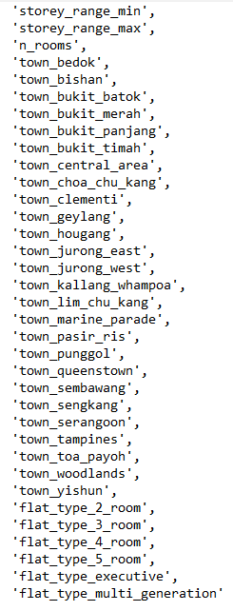
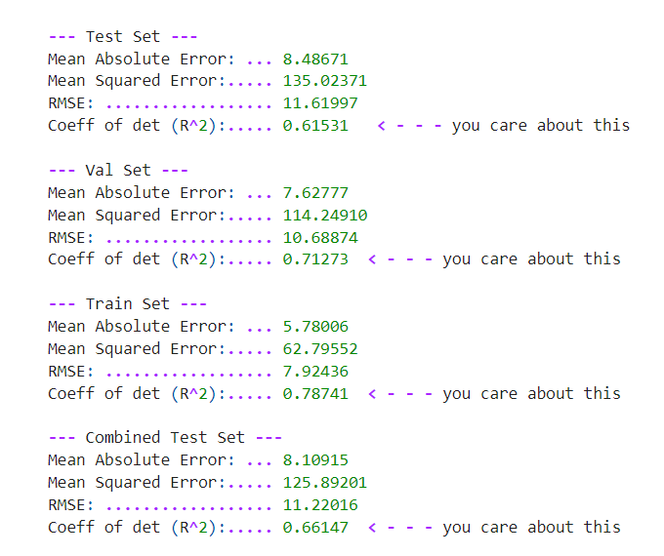
Random forest regression - baseline
FEatures
 | Resale Transaction Data Only
Target | Price per sq Meter per Lease Year
Categorical Features | Town and Flat Type
Removed Features with High VIF | Yes
Number of Features Used | 35
R² Train | 0.787
Test | 0.615
Validate | 0.713
MSE Train | 62.796
Test | 135.024
Validate | 114.249
Results
tbresee@umich.edu

