Slide 1
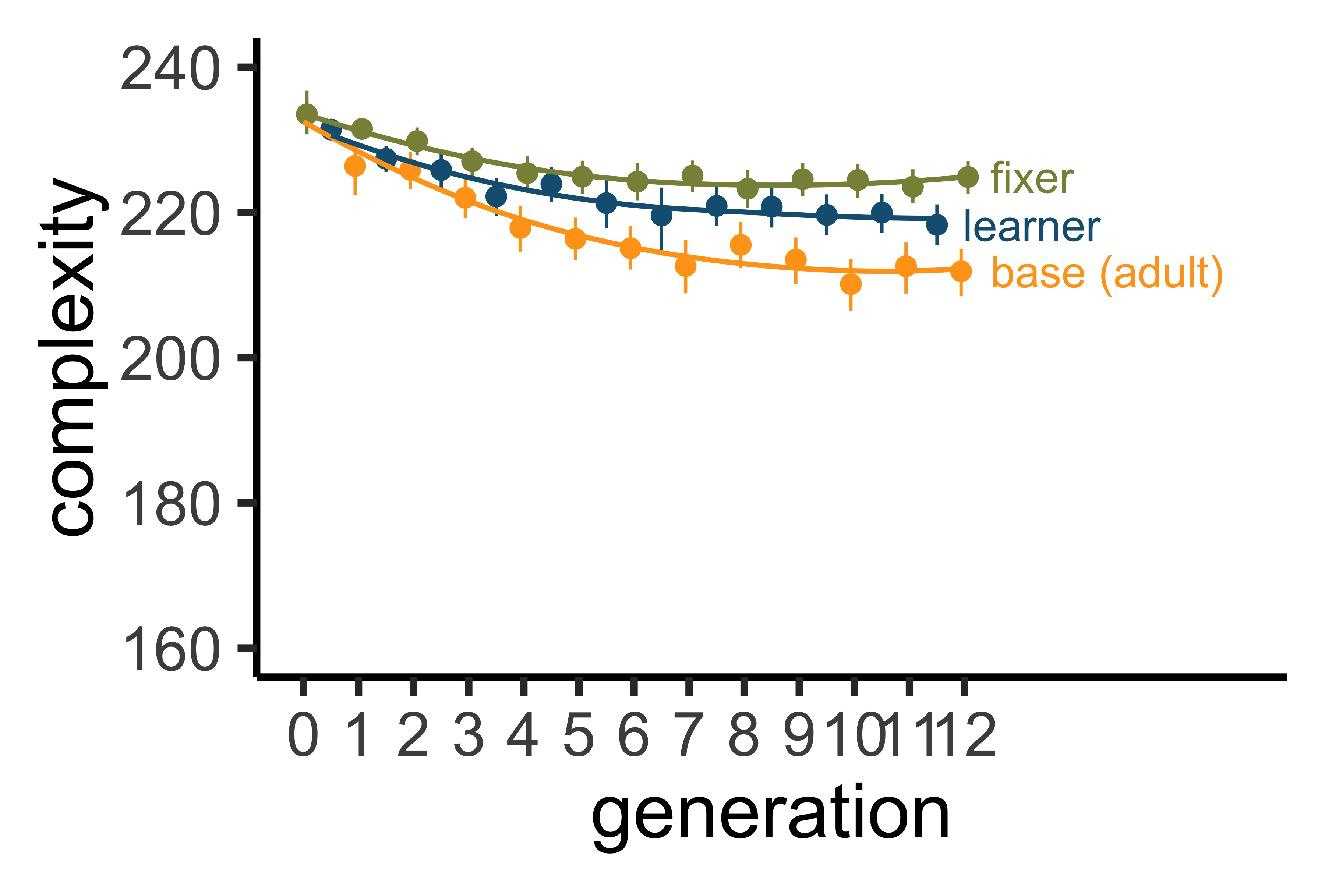
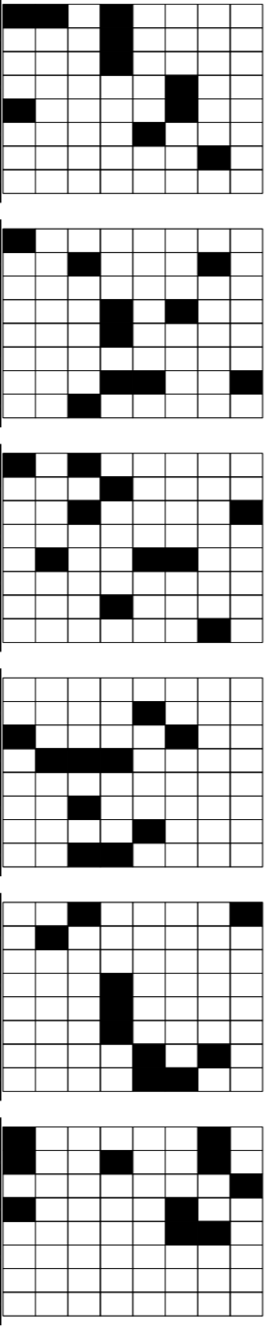
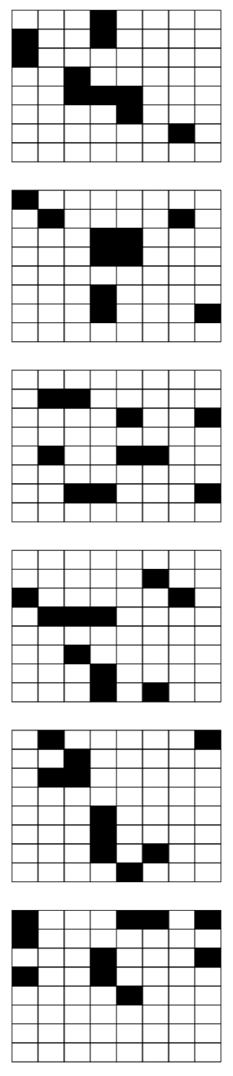
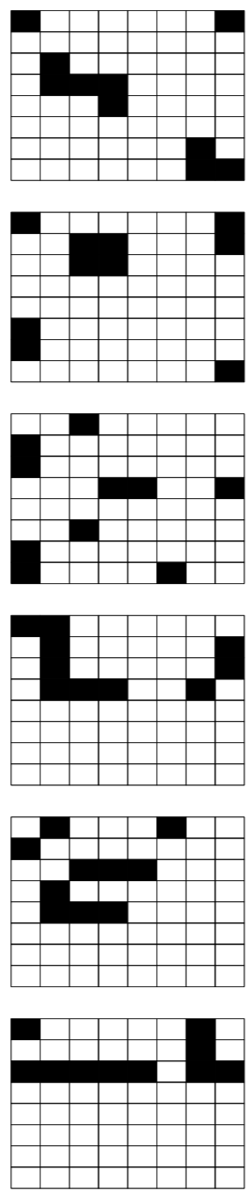
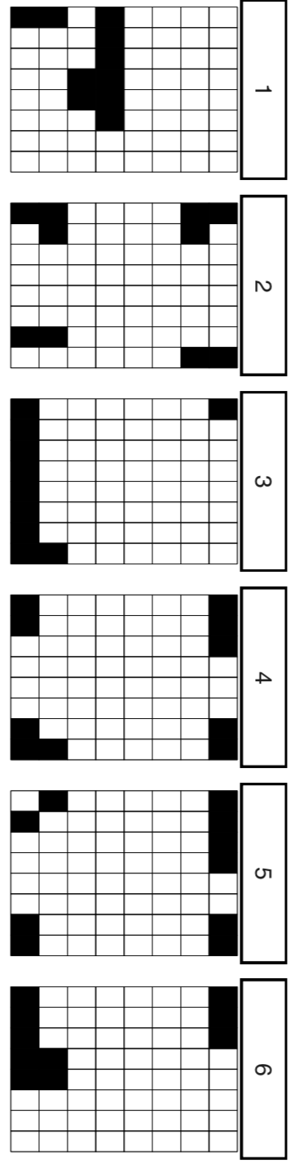
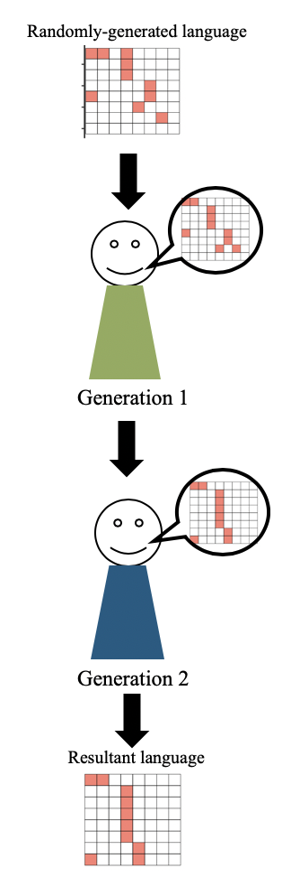
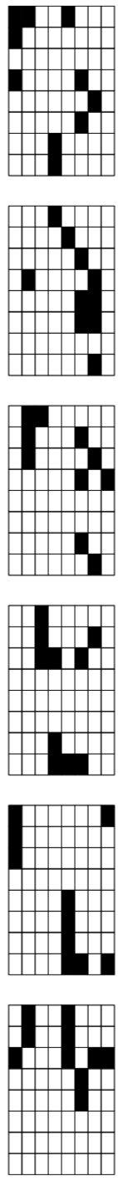
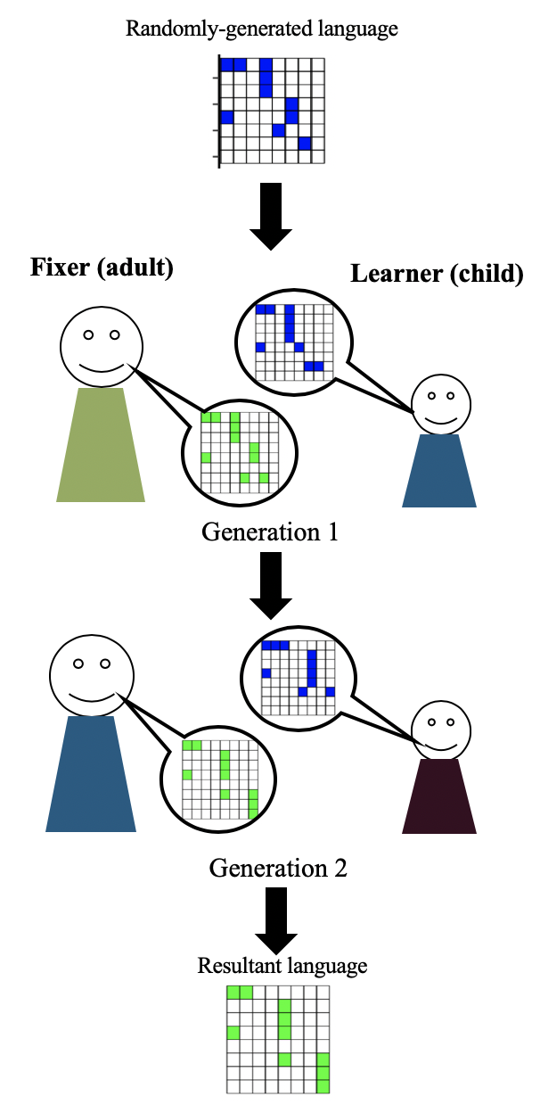
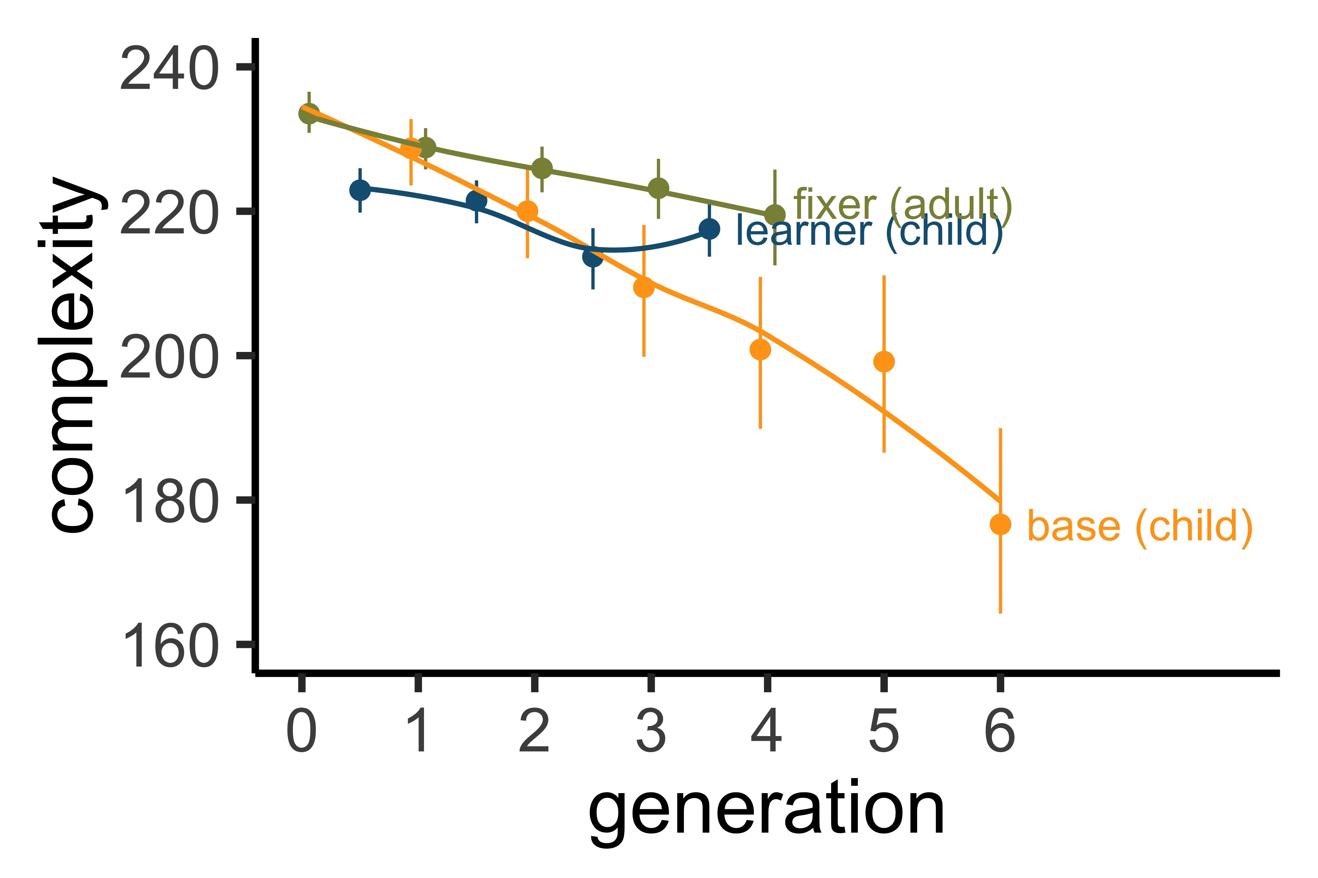
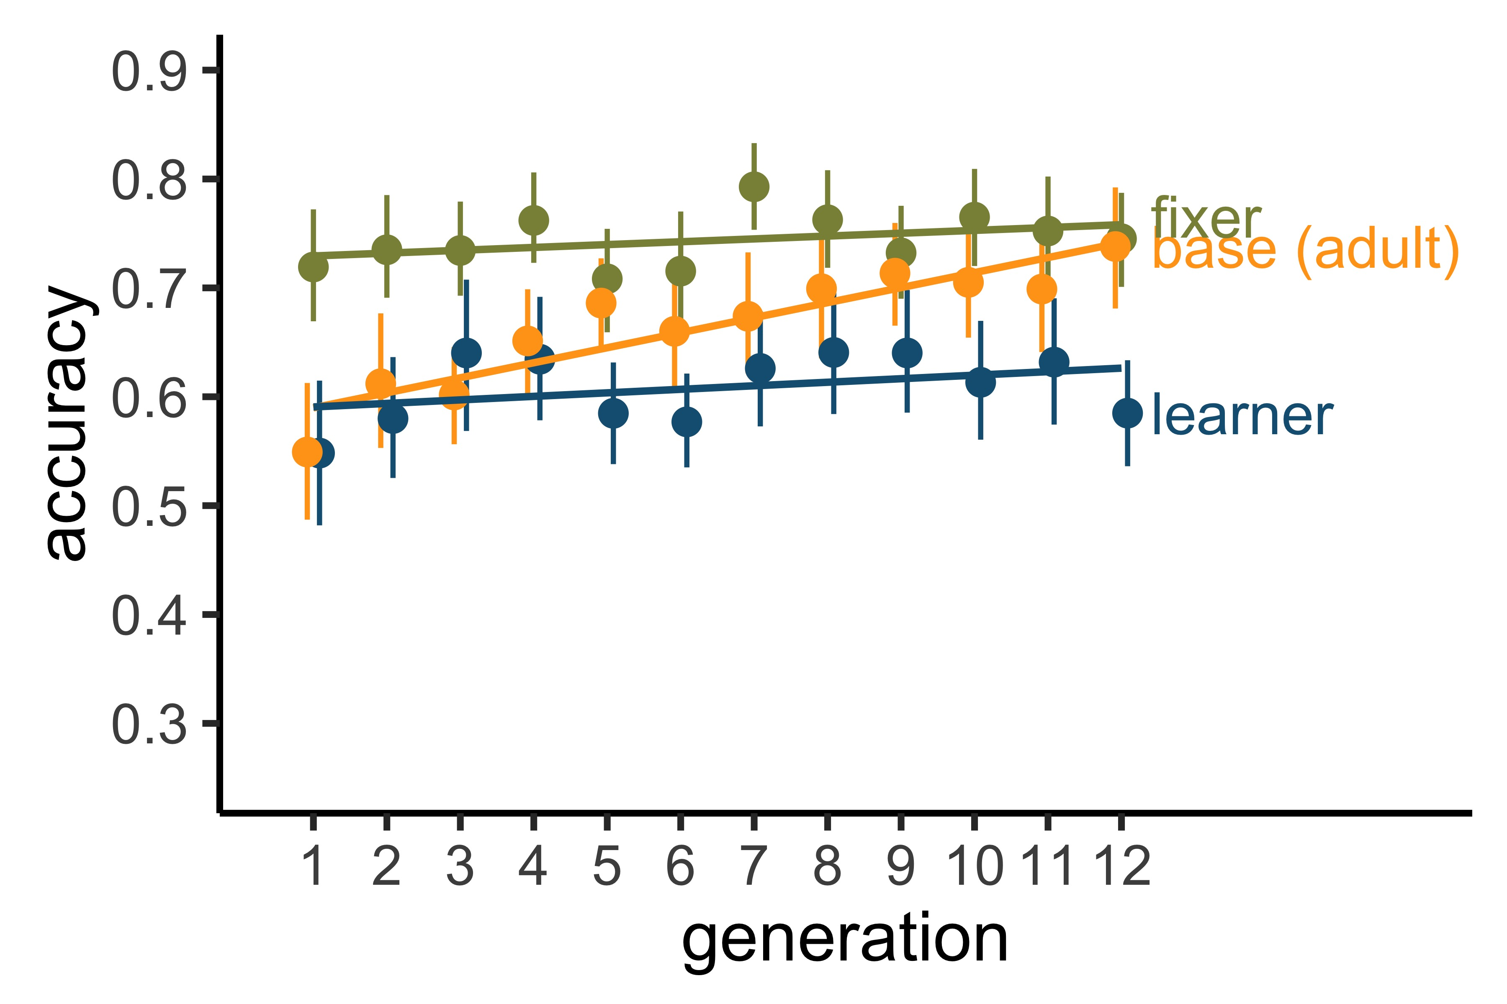
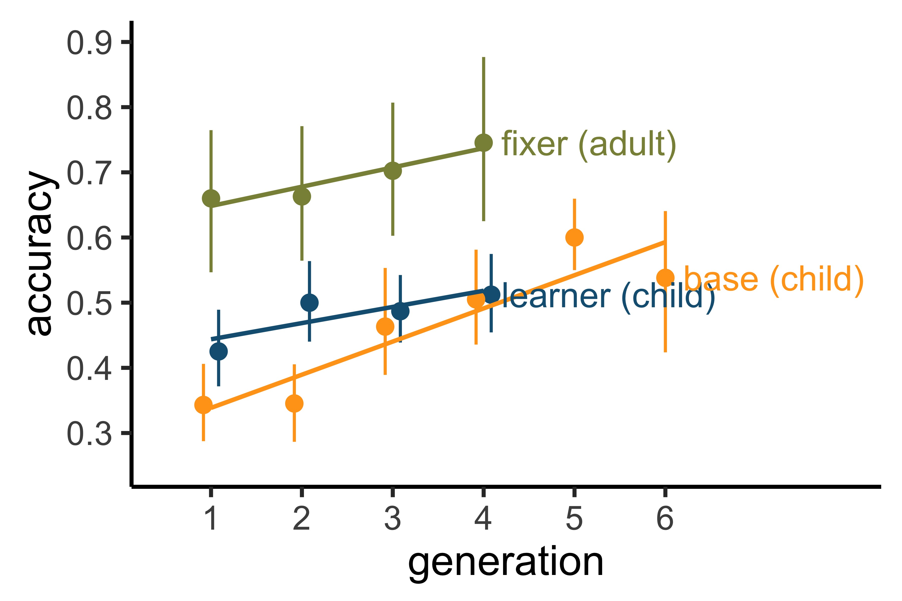
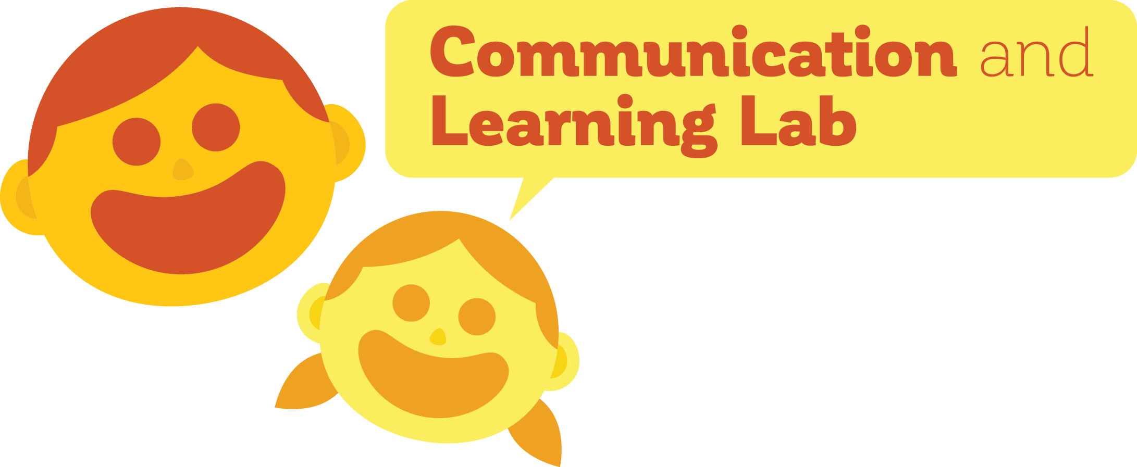


Parents protect languages from oversimplification by children during language evolution.
Title: Subtitle
Leeroy Jenkins, author2, author3, author4
Interlocutors preserve complexity in language
FUTURE WORK
Qualitative analysis: are the errors made by parents and children the same?
Structure task: are the languages produced more internally structured (similar) over time?
DISCUSSION CTD.
This study replicated previous work by Kempe et al. (2015)
Complexity measures
Madeline Meyers, Dan Yurovsky
INTRO
Why do languages change, aside from acquiring new vocabulary?
Transmissibility pressure: the language needs to be learnable, and therefore simple.
Early language learners have greater transmissibility biases—what protects against oversimplification?
Language learning is an active, social process: involving feedback from those who are more knowledgeable in the language (e.g., parents)
Implicit and explicit feedback/correction have a significant effect on the language learning process, and may affect language transmission and evolution on a larger scale
METHODS
RESULTS
ADULTS
GRID PATTERNS
Children Gens. 0, 1, 3, 6
BASELINE
DYAD
ADULTS & CHILDREN
Adults Gens 0, 1, 3, 6
DISCUSSION
Adults protect languages from simplification by children, re-introducing levels of complexity which match adult baseline performance
Adding in a corrective element to the language-learning process—like feedback from an editor or parent—allows a higher degree of complexity to be retained in the language
Both horizontal and vertical transmission are necessary to retain languages which are both descriptive (complex) and transmissible (easy to learn)
Adults:
N= 480 mTurkers
40 chains, 12 generations
Children (in progress):
N= 61 children (6;0-8;0) from MSI Chicago
Adults:
N= 960 mTurkers
Adults & Children (in progress):
N= 82 children (6;0-8;0) from MSI Chicago
N = 82 adults from mTurk
Take a picture to see preregistrations, GitHub, poster and conference paper

