Slide 1

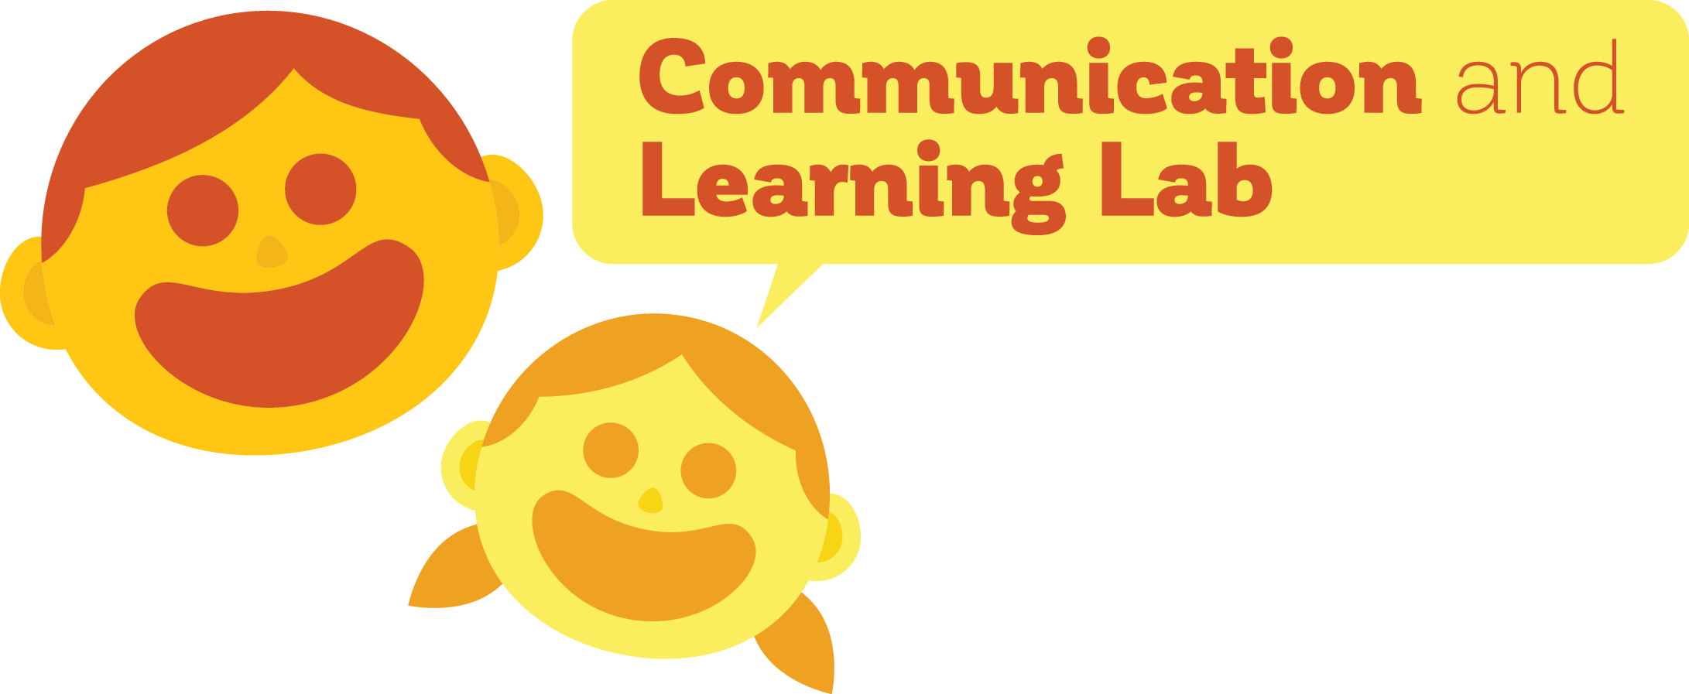
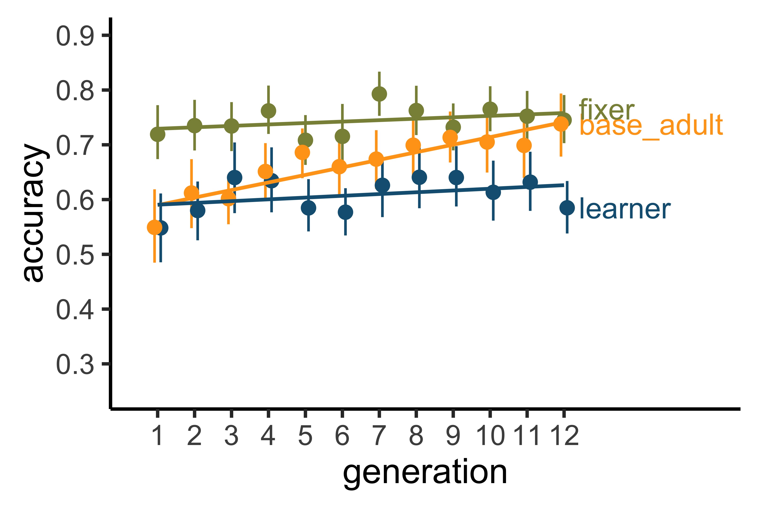
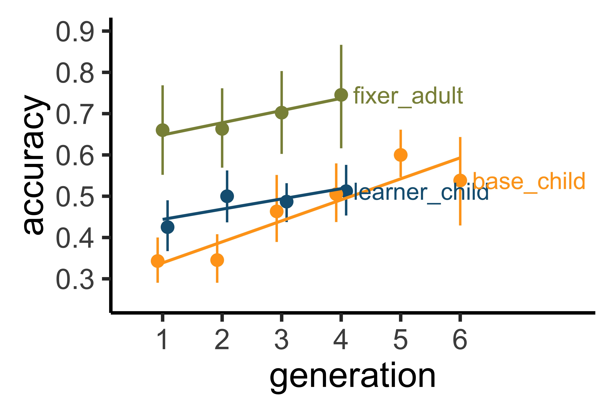
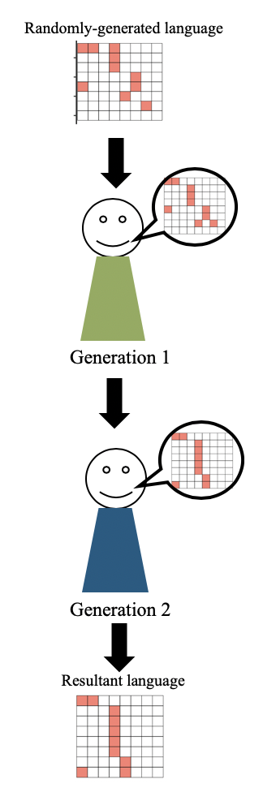
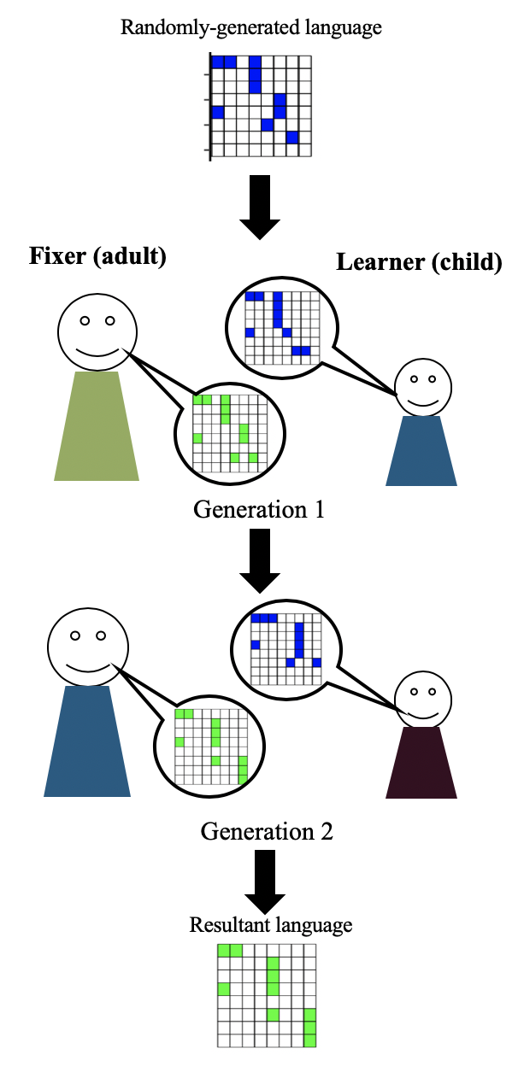
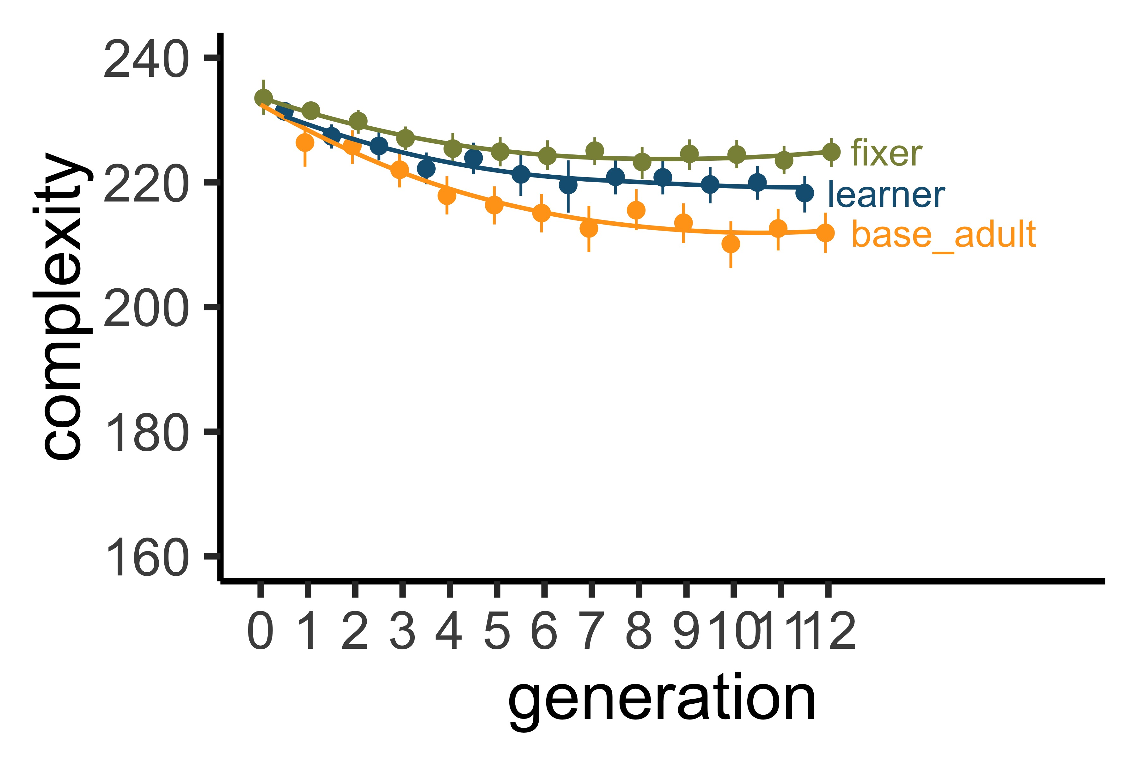
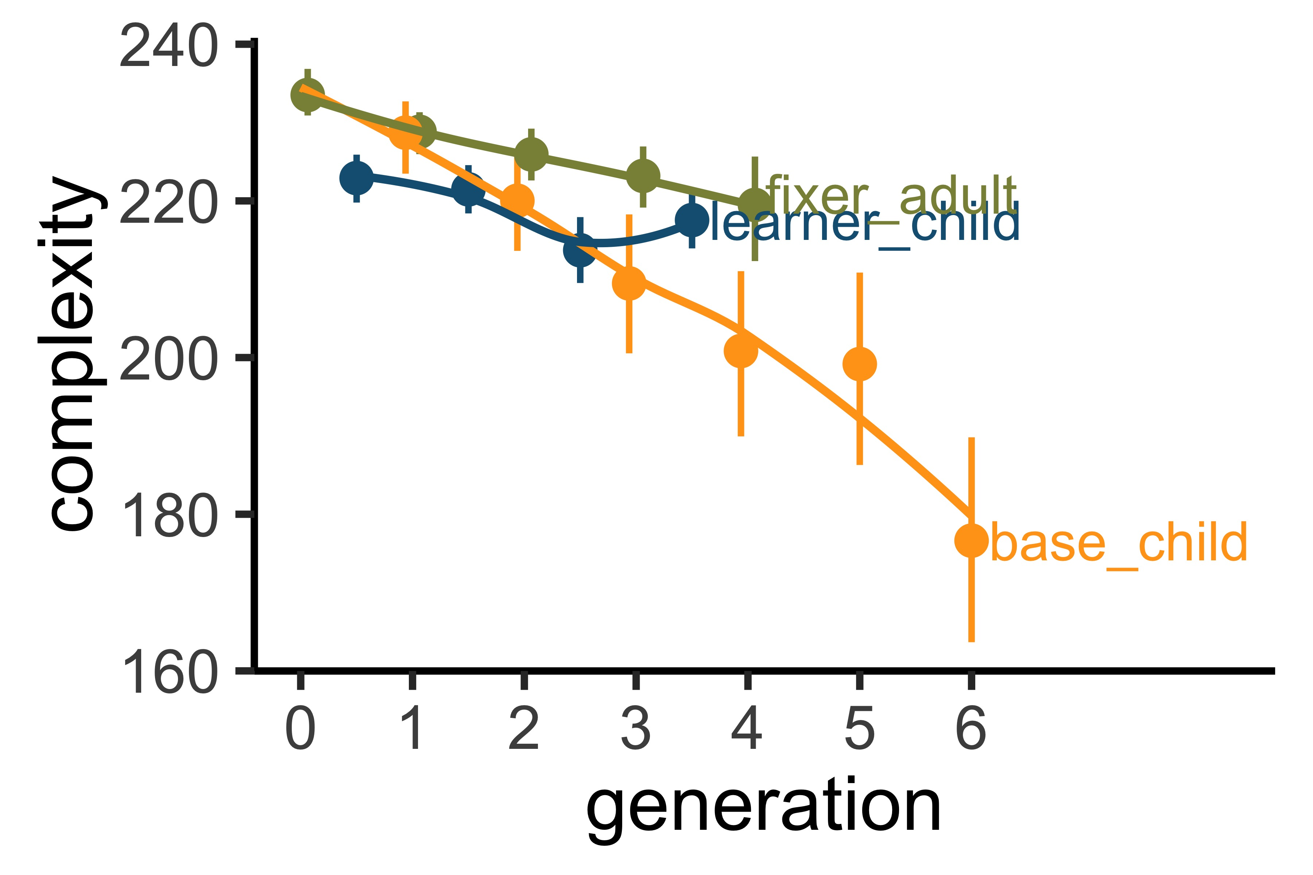

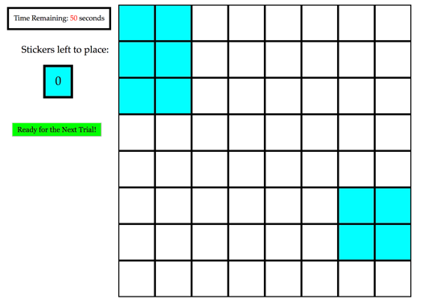
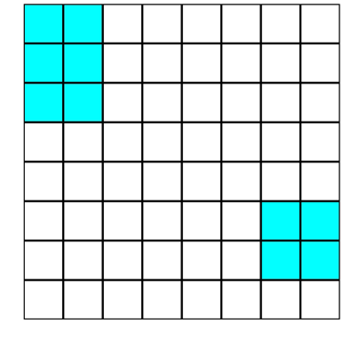

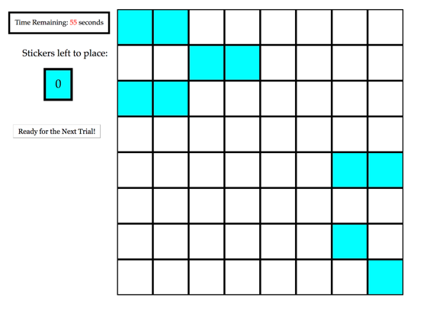
Interlocutors preserve complexity in language
Madeline Meyers, Dan Yurovsky
The Department of Psychology, University of Chicago
Background
Results
Why do languages change and evolve, aside from acquiring new vocabulary?
Transmissibility pressure: the language needs to be learnable, and therefore simple.
Early language learners have potentially greater pressures towards transmissibility – what protects against oversimplification?
Language learning is an active, social process: involving feedback from those who are more knowledgeable in the language (e.g. parents).
We predict that the the influence of these knowledgeable speakers, by way of implicit or explicit correction, protects against oversimplification in the language-transmission process.
The addition of a corrective element in a novel language-learning task allows a higher degree of complexity to be retained while retaining a consistent level of percent accuracy.
Adults
Children & Adults
Iterated Learning Paradigm
Baseline Experiment
Dyad Experiment
Methods
Conclusions & Future Work
Baseline Experiment & Learners in Dyad Experiment
Adults protect languages from simplification by children, reintroducing levels of complexity which match adult baseline performance
Adding a corrective element into the language learning process—like feedback from a teacher or parent—allows a higher degree of descriptiveness to be retained in language
Vertical and horizontal language transmission may be the mechanism by which languages are protected from degeneration
Baseline results replicated original work by Kempe et al. (2015)
Ongoing work is examining the nature of the errors produced by parents and children, as well as if the languages are becoming more structured over generations
1. Adult Baseline Experiment:
480 U.S. adults on Amazon Mechanical Turk
40 chains of 12 generations each
2. Child Baseline Experiment (in progress):
61 children ages 6-8; data collected at the Museum of Science and Industry and the University of Chicago in Hyde Park
20 incomplete chains of 6 generations each
Input Grid:
Max 60 seconds
Fixers in Dyad Experiment
3. Adult-Adult Dyad Experiment:
960 U.S. adults on Amazon Mechanical Turk
40 chains of 12 generations each
4. Adult-Child Dyad Experiment (in progress):
82 children (learners, ages 6-8); 82 adults (fixers, mTurk)
20 incomplete chains of 6 generations each
Target Grid:
10 seconds
Visual Mask:
3 seconds
Input Grid:
Max 60 seconds

