Slide 1

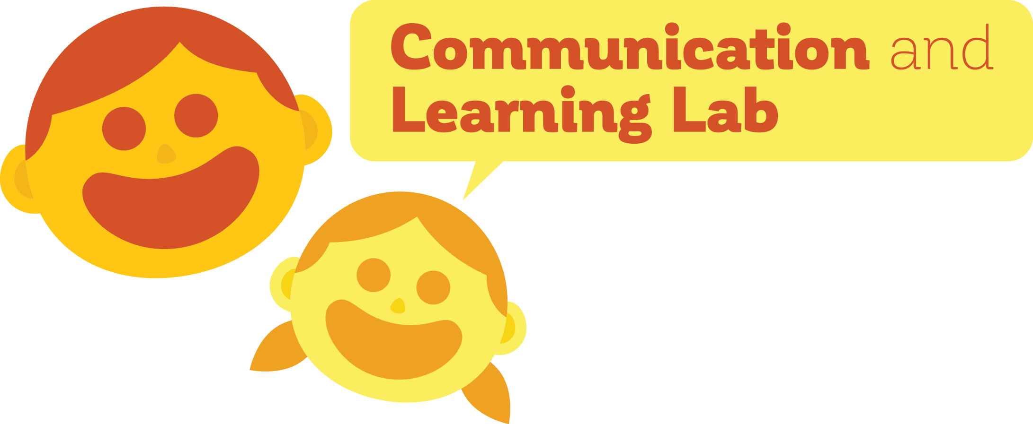
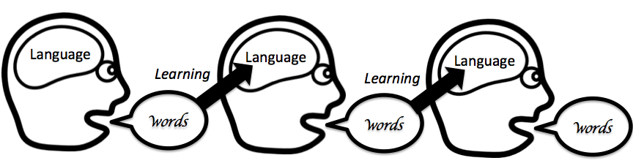
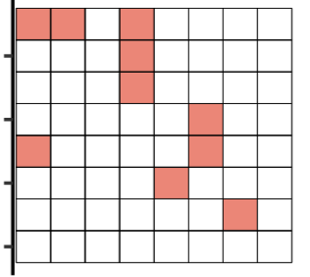
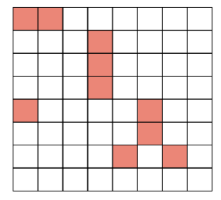
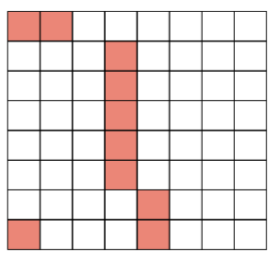
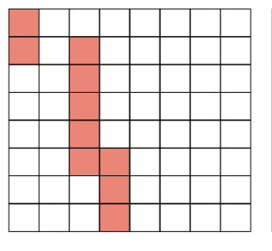
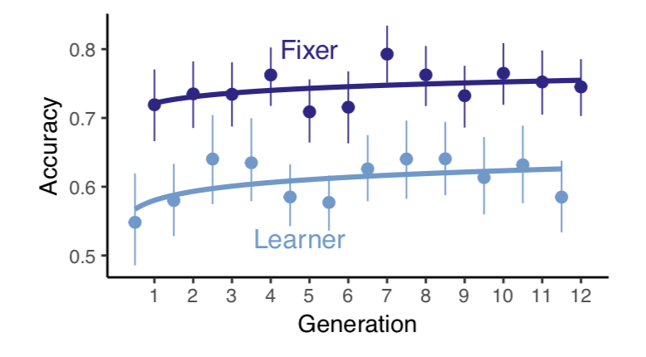
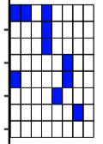
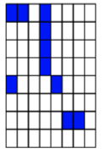
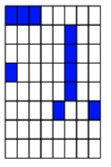
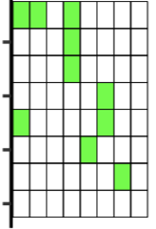
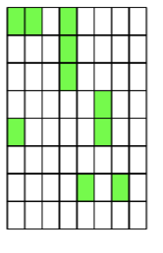
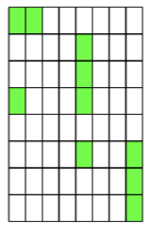
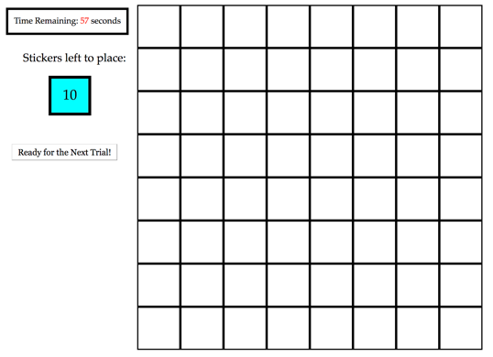
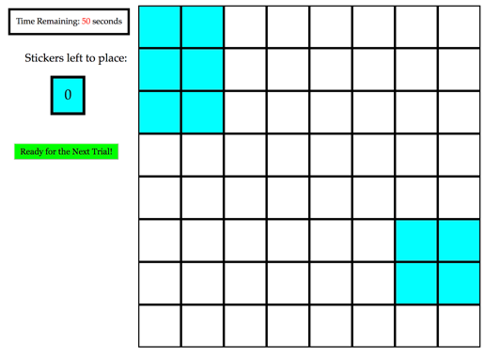
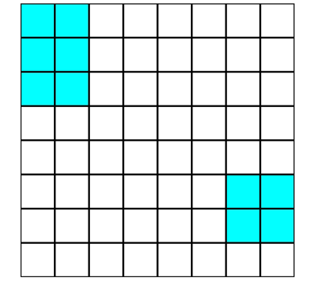
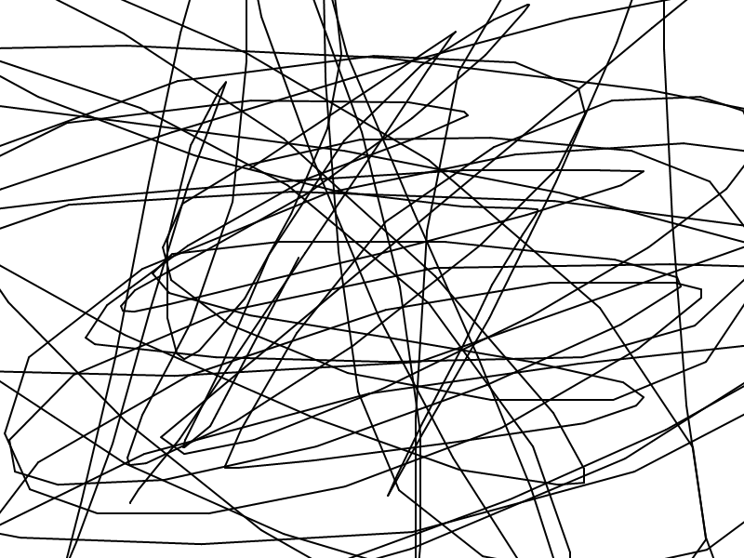
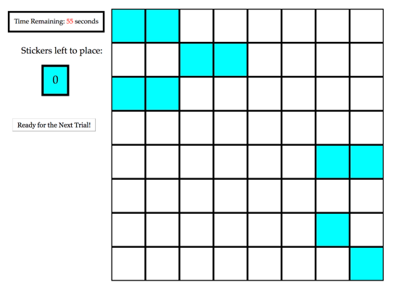
Interlocutors preserve complexity in language
Madeline Meyers, Dan Yurovsky
The Department of Psychology, University of Chicago
Background
Results
Why do languages change and evolve, aside from acquiring new vocabulary?
Transmissibility pressure: the language needs to be learnable, and therefore simple.
Early language learners have potentially greater pressures towards transmissibility – what protects against oversimplification?
Language learning is an active, social process: involving feedback from those who are more knowledgeable in the language (e.g. parents).
We predict that the the influence of these knowledgeable speakers, by way of implicit or explicit correction, protects against oversimplification in the language-transmission process.
The addition of a corrective element in a novel language-learning task allows a higher degree of complexity to be retained while retaining a consistent level of percent accuracy.
Baseline
Iterated Learning Paradigm
Dyad
1. Baseline Experiment
Randomly-generated language
Resultant language
Dyad
Baseline
Generation 1
Generation 2
Generation 3
2. Dyad Experiment
Learner
“Fix the errors”
“Fix the errors”
Fixer
Randomly-generated language
Resultant language
Method
Conclusions & Future Work
1. Baseline Experiment & Learners in Dyad Experiment
Adding a corrective element into the language learning process—like feedback from a teacher—allows a higher degree of descriptiveness to be retained in language
Vertical language transmission may be the mechanism by which languages are protected from degeneration
Three measures of pattern complexity had strikingly similar results
Results replicated original work by Kempe et al. (2015)
Data collection is ongoing with children ages 6-8 at the Museum of Science and Industry in Child Baseline and Child-Adult Dyad conditions
Adult Baseline Experiment:
Replication:
480 U.S. adults on Amazon Mechanical Turk
40 chains of 12 generations each
Input Grid:
Max 60 seconds
2. Fixers in Dyad Experiment
Target Grid:
10 seconds
Visual Mask:
3 seconds
Adult-Adult Dyad Experiment:
Replication:
960 U.S. adults on Amazon Mechanical Turk
40 chains of 12 generations each
Input Grid:
Max 60 seconds

