Slide 1
Cyclones, Anticyclones & Cyclone Phailin
- By Zara Ali

Slide 2
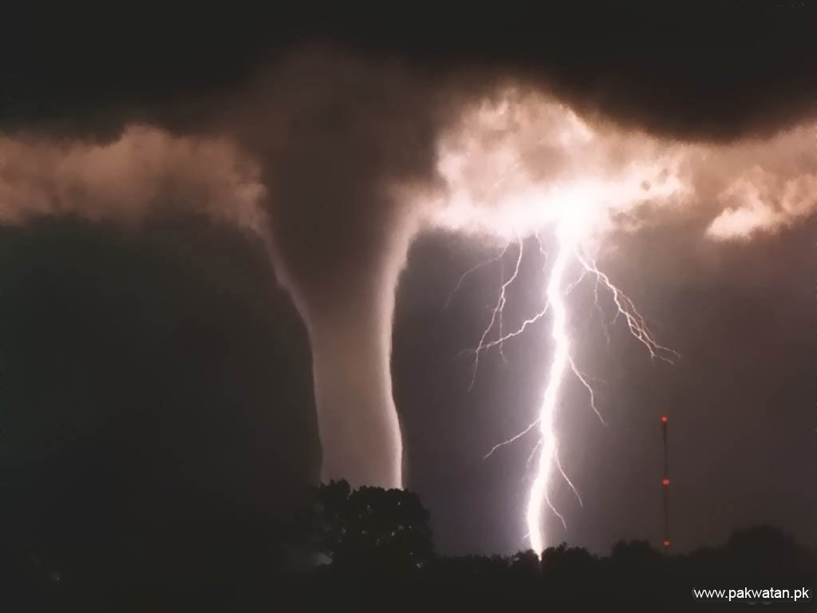
Cyclones:
Cyclone in meteorology refers to a low pressure area with winds spiraling inwards, also known as low pressure system.
A cyclone rotates clockwise in Southern Hemisphere & anti-clockwise in the Northern Hemisphere.
Tropical cyclones form only over warm ocean waters near the equator, a cyclone is formed when, warm, moist air over the ocean rises upward from near the surface. As this air moves up and away from the ocean surface, it leaves in less air near the surface. So basically as the warm air rises, it causes an area of lower air pressure below.

Slide 3
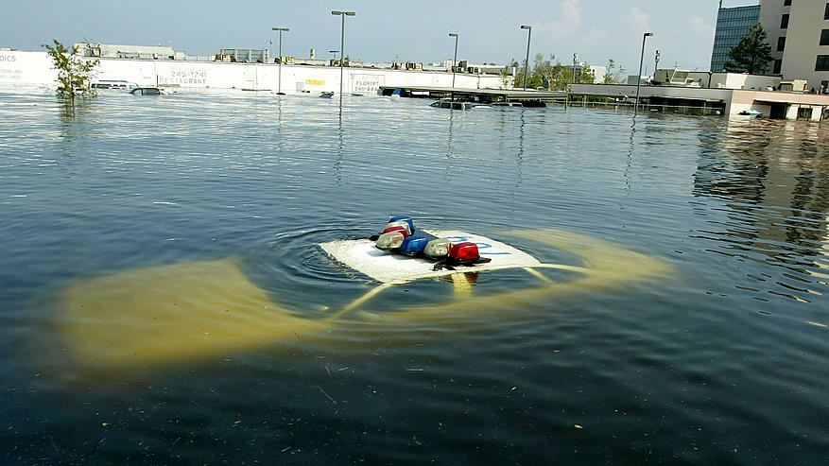
‘Cyclone’ is the general term for a variety of low pressure systems, which include tropical cyclone, extra tropical cyclone, tornadoes.
The calmest part of a cyclone is its eye which is present in the middle.
Hurricanes, cyclones, and typhoons are all the same weather phenomenon, we just use different names for these storms in different places. In the Atlantic and Northeast Pacific, the term “hurricane” is used. The same type of disturbance in the Northwest Pacific is called a “typhoon” and “cyclones” occur in the South Pacific and Indian Ocean.
Flood caused by Cyclone Katrina

Slide 4
There are a several kinds of cyclones, Ex: Cyclone Phailin, Cyclone Nilam, Cyclone Katrina & so on…
Hurricanes usually form in tropical areas of the world & develop over warm water and use it as an energy source & lose strength as they move over land.
Coastal regions are most at danger from hurricanes.
n 2005 Hurricane Katrina killed over 1800 people in the United States and caused around $80 billion dollars worth of property damage.

Slide 5
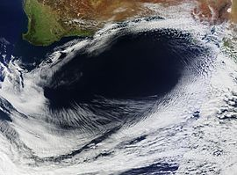
Anticyclones:
An anticyclone (that is, opposite to a cyclone) is a weather phenomenon defined as large scale circulation of winds around a central region of high atmospheric pressure, also known as high pressure system.
It rotates just in the opposite direction from cyclones which is, clockwise in the Northern Hemisphere, counterclockwise in the Southern Hemisphere”.
Anticyclones form from air masses cooling more than their surroundings, which causes the air to contract slightly making the air more dense. Since dense air weighs more, the weight of the atmosphere overlying a location increases, causing increased surface air pressure.

Slide 6
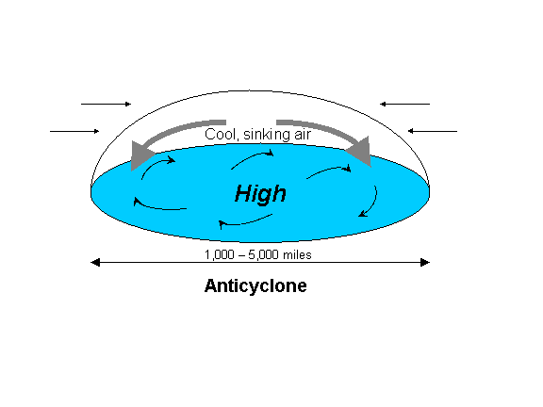
The strongest anticyclones occur over snow-covered portions of Asia and North America in the winter when clear, dry air masses cool from a loss of infrared radiation, while little sunlight is absorbed to offset that infrared cooling.
The sinking air in an anticyclone stabilizes the atmosphere, bringing clear, sunny weather.
Winds between an anticyclone and a cyclone can be especially strong.
Diagram showing the circulation of anticyclone

Slide 7
In summer, anticyclones bring dry, hot weather. In winter, clear skies may bring cold nights and frost.
In cold conditions, anticyclones may also bring fog and mist. This is because the cold forces moisture in the air to condense at low altitudes.
The coriolis force caused by Earth’s rotation gives winds within high-pressure systems.
Sir Francis Galton first discovered anticyclones in the 1860s.

Slide 8
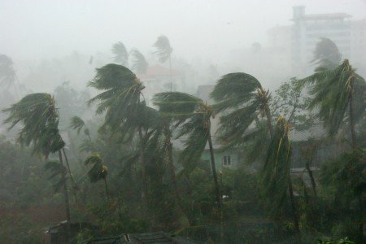
Cyclone Phailin
Cyclone Phailin, was a very severe cyclonic storm.
It was the second strongest tropical cyclone ever to make landfall in India, behind only the 1999 Odisha cyclone.
Phailin is the Thai word for ‘sapphire’ & according to the followed procedure of naming tropical cyclones over North Indian Ocean, it was turn of a name suggested by Thailand in the list of assigned names.

Slide 9
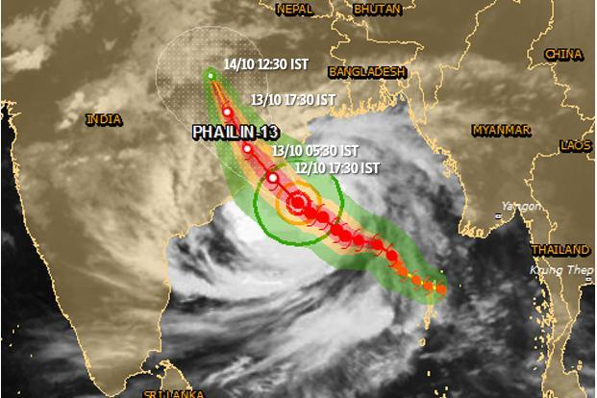
The next cyclone in the region will be called Helen, a name from the list of cyclone name given by Bangladesh.
Cyclone Phailin on Oct 12, 2013 Sunday evening left a trail of destruction knocking down lakhs of homes affecting nearly 90 lakh people and destroying paddy crops worth about Rs.2,400 crore, but Odisha and Andhra Pradesh escaped from widespread loss of life.
As many as 90,000 people were evacuated and sent to safer places in the Srikakulam district, which borders Odisha.
Part of map showing the structure of Cyclone Phailin

Slide 10
The Andhra Pradesh government and the Chief Minister met representatives of the Army and Navy seeking their assistance if required.
In Odisha, the government issued a high alert to the districts of Balasore, Bhadrak, Mayurbhanj, Keonjhar, Dhenkanal, Jajpur, Cuttack, Jagatsinghpur, Kendrapara, Puri, Khurda, Nayagarh, Gangam and Gajapati, and cancelled the Dusshera holidays of employees of all 30 districts of the state, asking them to ensure the safety of people.
During October 13, heavy rain from the outer bands of Phailin lashed Jharkhand.
A rainfall total of 74.6 mm (2.94 in) was recorded at Ranchi, while Jamshedpur recorded 52.4 mm (2.06 in), and Bokaro recorded 58.4 mm (2.30 in).

Slide 11
THE END

