Slide 1
COVID-19 Variant Exploration
How is COVID-19 Evolving Over Time in the US
Michael Chiaramonte
Matt Lantin
Cole Swartz

Slide 2
What is a variant?
The Greek letter names, Alpha, Beta, Delta, and Omicron are what the news and government organizations use for simplicity. However, this isn’t the full picture.
Omicron has over 20 individual variants (Ex: B.2 / BA.5 / XBB.1)
The name of the individual variant changes when it mutates and adds additional numbers. To make them easier to write, when a significant enough change happens, the letters change as well.
For example, Omicron variant XBB was created when two different strains infected one individual and their DNA was recombined into a new strain with aspects of both parent strains.
You can think of this as taxonomy as well. The Greek letters are the families, the English letters are the genus, and the numbers denote the individual species.
Notes:
This is the question that your experiment answers

Slide 3
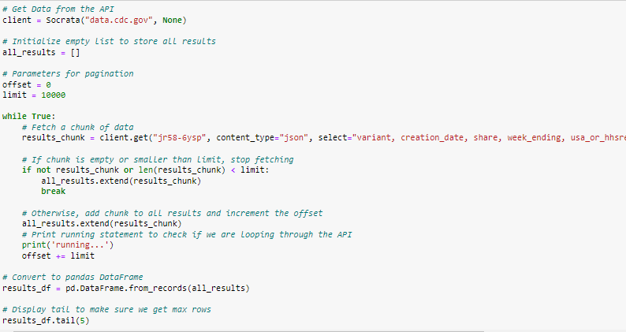
Data collection
We used two different methods to retrieve the data we wanted to analyze:
Retrieved COVID death count data from downloading a csv from the following link: https://covid.cdc.gov/covid-data-tracker/#trends_weeklydeaths_testpositivity_00
Retrieved variant share % data from a CDC API at the following link: https://data.cdc.gov/Laboratory-Surveillance/SARS-CoV-2-Variant-Proportions/jr58-6ysp
Variant dataset was massive (over 1 million rows)
To get the entire dataset, we figured out a way to query the data in ‘chunks’
This way, instead of creating one huge API request, we create 100 smaller API requests and avoid straining the API while ensuring we get all the data
Notes:
This is the question that your experiment answers

Slide 4
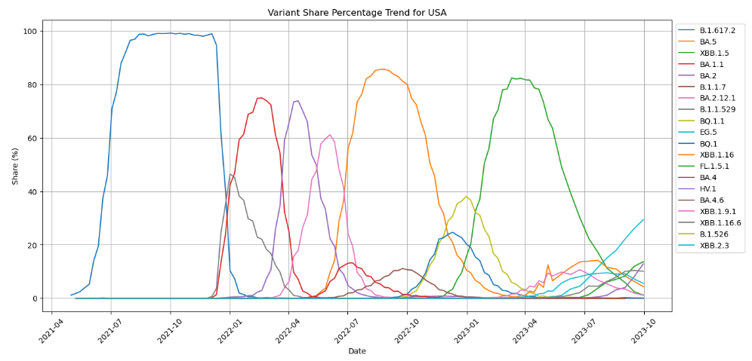
USA Covid variants Over Time
B.1.617.2
BA.5
XBB.1.5
BA.1.1
BA.2
5 main time periods where there existed a single dominant variant (>75%):
B.1.617.2 from 5/8/2021 to 12/25/2021
BA.1.1 from 1/1/2022 to 3/19/2022
BA.2 from 3/26/2022 to 6/11/2022
BA.5 from 6/18/2022 to 12/24/2022
XBB.1.5 from 12/31/2023 to 7/22/2023
Notes:
This is the question that your experiment answers

Slide 5
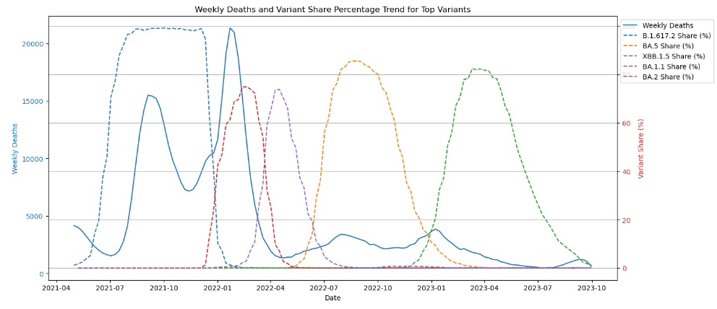
Which variants are the Deadliest?
Highest Death Period
We can see that variant B.1.617.2 (Delta) and BA.1.1 (Omicron) are showing higher death counts
However, as Omicron starts mutating more the COVID related deaths have dropped significantly
Notes:
This is the question that your experiment answers

Slide 6
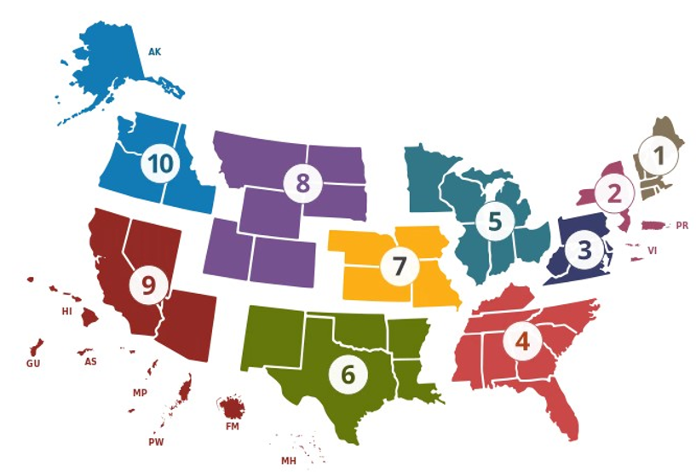
Health and Human Services (HHS) Region Map
Region 1: Boston
Region 2: New York
Region 3: Philadelphia
Region 4: Atlanta
Region 5: Chicago
Region 6: Dallas
Region 7: Kansas City
Region 8: Denver
Region 9: San Francisco
Region 10: Seattle

Slide 7
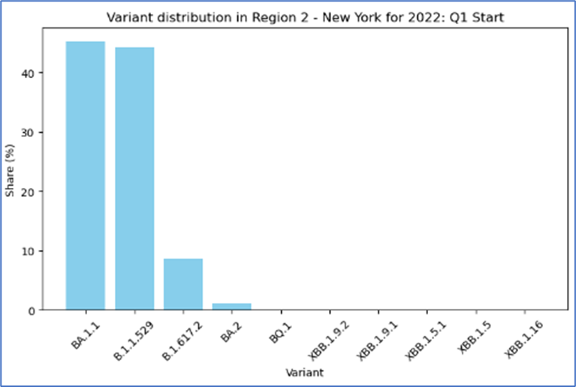
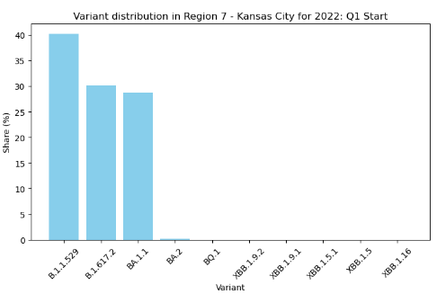
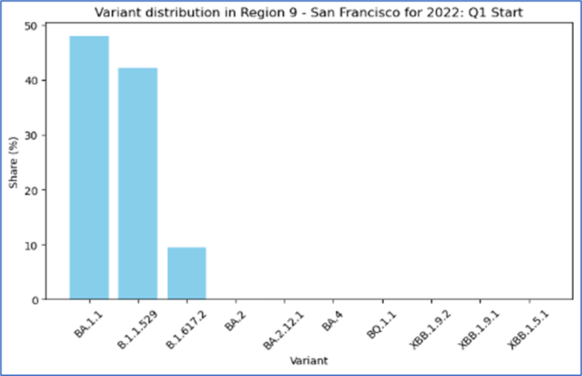
Variant distribution within Specific HHS REgion
Focused on a ‘transition’ period between dominant variant B.1.617.2 and BA.1.1
There exists a 3rd variant B.1.1.529 that was a significant share of all COVID.
We can conclude that based on this data, BA.1.1 was a descendent of B.1.1.529 and B.1.1.529 had to mutate to become the dominant COVID variant.

Slide 8
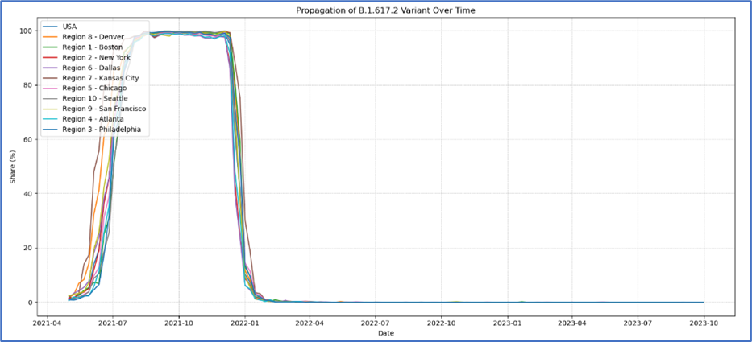
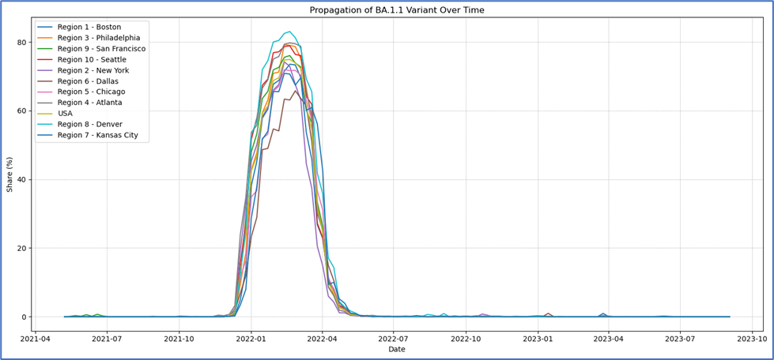
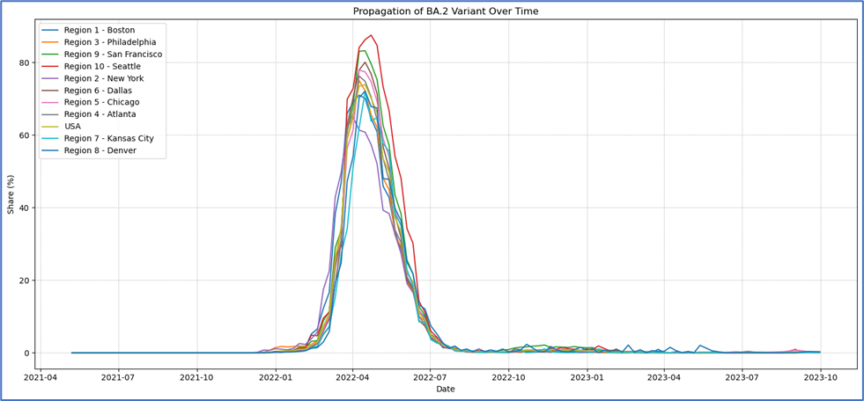
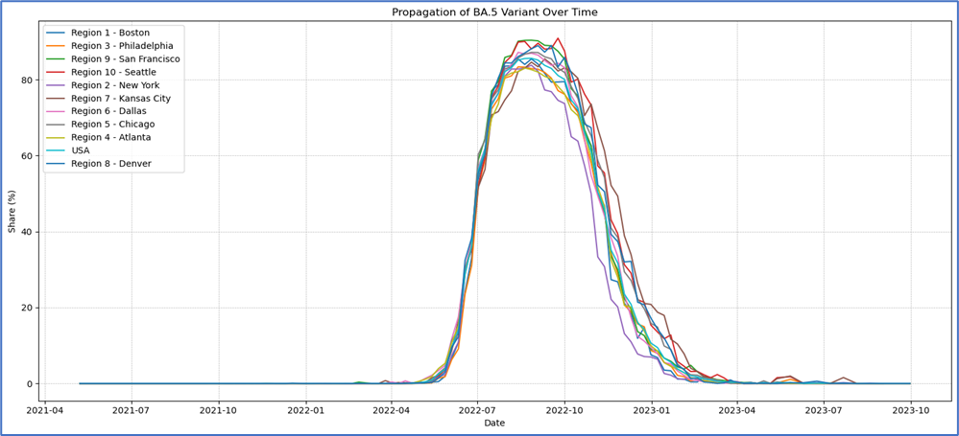
How is a variant propagating through the USA?
The first 4 variants showing more similar spikes in the trends for each region

Slide 9
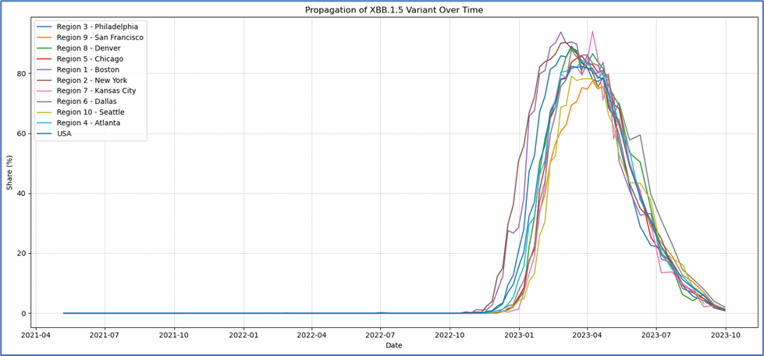
How is a variant propagating through the USA?
The last variant, XBB.1.5, shows much more variation in when the initial spikes happened
We can calculate the moment each regions trend deviated from the historical baseline to determine when the variant first showed up

Slide 10

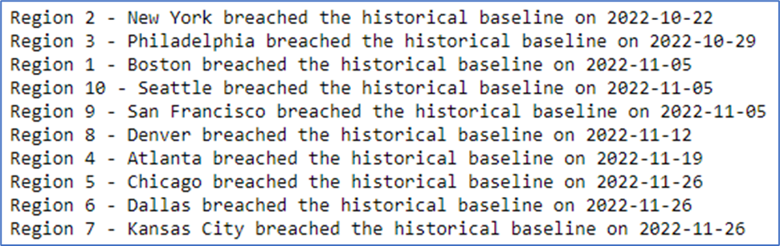
How is a variant propagating through the USA?
Based on which weeks were flagged when, we can infer that XBB.1.5 started at the coastal regions and then found its way inward.
This can indicate this variant was spread from neighboring geographical areas
Possible Transmission Map
XBB.1.5
XBB.1.5
XBB.1.5
XBB.1.5
XBB.1.5
XBB.1.5
XBB.1.5
XBB.1.5
Notes:
Summarize your research in three to five points.

Slide 11
Summary Points
Despite the significant number of COVID-19 variants that exist, there will always be one that emerges as the dominant share % of all samples
This dominance lasts around 6 months before it eventually dies down or mutates into a new variant that becomes the dominant one
Latest variant EG.5 looks to be following this same trend.
New variants aren’t necessarily a bad thing, as we can see that after BA.1.1 variant went down the next dominant variant didn’t lead to a death spike
There can be different share percentages per variant per HHS region, and it is not always following the overall US trend
We can track how a variant is moving throughout the entire US by checking when the variant first spikes in a region and narrow down a possible origin point.
Parabolic trend of each dominant variant can show that it is possible people are becoming immune to a certain variant forcing it to mutate to survive.
Notes:
Summarize your research in three to five points.

