Slide 1
Covid-19 Variant Exploration
How is COVID-19 Evolving Over Time

Slide 2
The Greek letter names, Alpha, Beta, Delta, and Omicron are what the news and government organizations use for simplicity. However, this isn’t the full picture.
Omicron has over 20 individual variants (Ex: B.2 / BA.5 / XBB.1)
The name of the individual variant changes when it mutates and adds additional numbers. To make them easier to write, when a significant enough change happens, the letters change as well.
For example, Omicron variant XBB was created when two different strains infected one individual and their DNA was recombined into a new strain with aspects of both parent strains.
You can think of this as taxonomy as well. The Greek letters are the families, the English letters are the genus, and the numbers denote the individual species.
Notes:
This is the question that your experiment answers

Slide 3
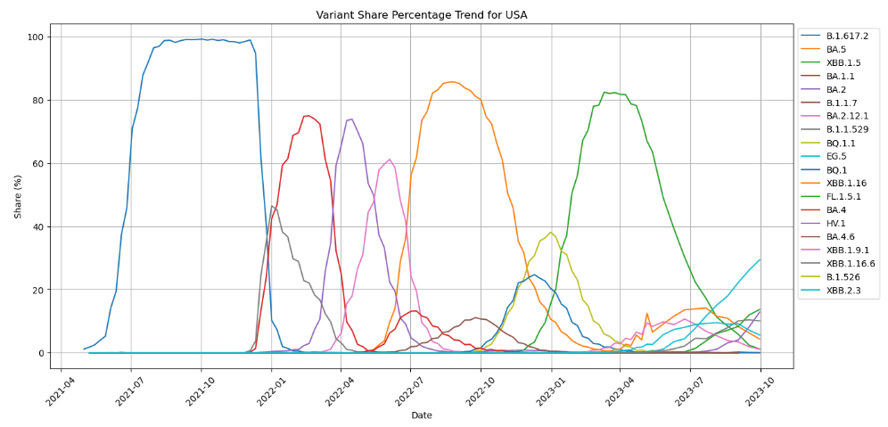
USA Covid variants Over Time
B.1.617.2
BA.5
XBB.1.5
BA.1.1
BA.2
5 main time periods where there existed a single dominant variant (>75%):
B.1.617.2 from 5/8/2021 to 12/25/2021
BA.1.1 from 1/1/2022 to 3/19/2022
BA.2 from 3/26/2022 to 6/11/2022
BA.5 from 6/18/2022 to 12/24/2022
XBB.1.5 from 12/31/2023 to 7/22/2023
Notes:
This is the question that your experiment answers

Slide 4
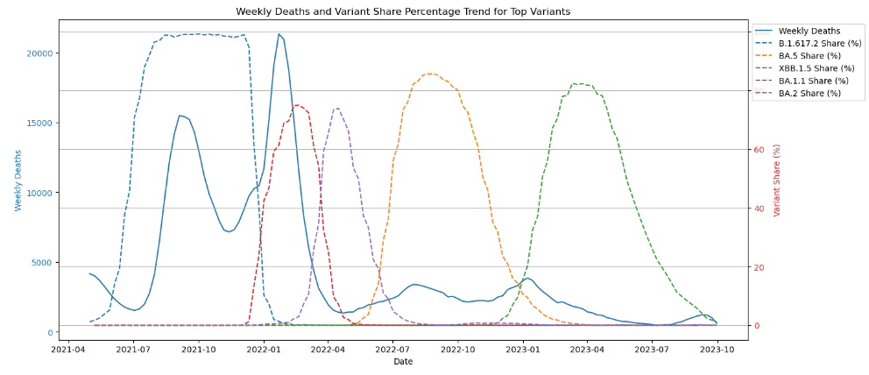
Which variants are the Deadliest?
Highest Death Period
We can see that variant B.1.617.2 (Delta) and BA.1.1 (Omicron) are showing higher death counts
However, as Omicron starts mutating more the COVID related deaths have dropped significantly
Notes:
This is the question that your experiment answers

Slide 5
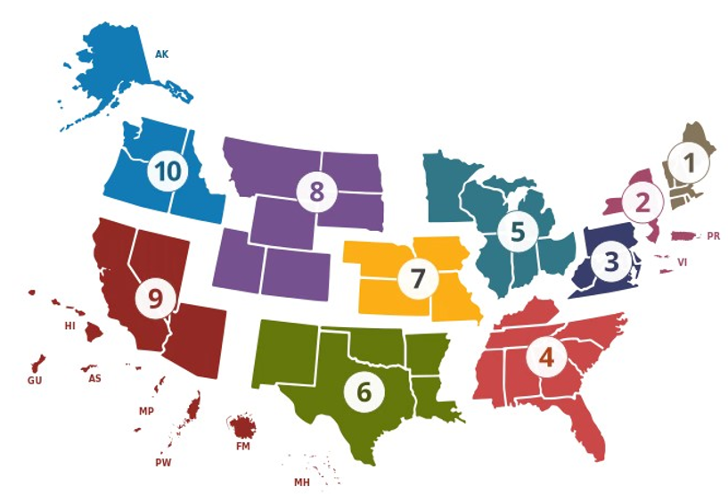
Health and Human Services (HHS) Region Map
Region 1: Boston
Region 2: New York
Region 3: Philadelphia
Region 4: Atlanta
Region 5: Chicago
Region 6: Dallas
Region 7: Kansas City
Region 8: Denver
Region 9: San Francisco
Region 10: Seattle

Slide 6
Health and Human Services (HHS) Region Map

Slide 7
Notes:
Summarize your research in three to five points.

