Slide 1
DATA STRUCTURES USED FOR THE GEOLOCALIZATION OF ROBOTIC BEES AND AVOIDING CRASHES BETWEEN THEM
Maria Camila Morales Ríos
Medellín, May 15th.

Slide 2
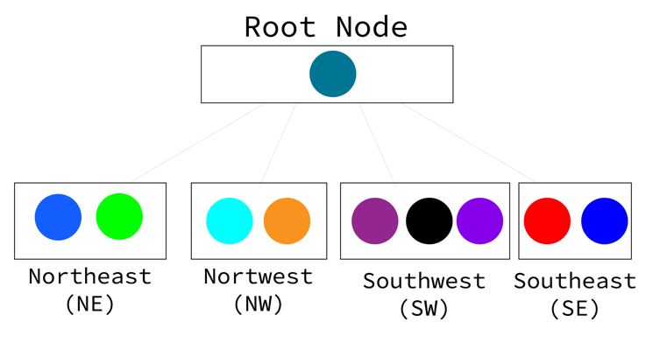
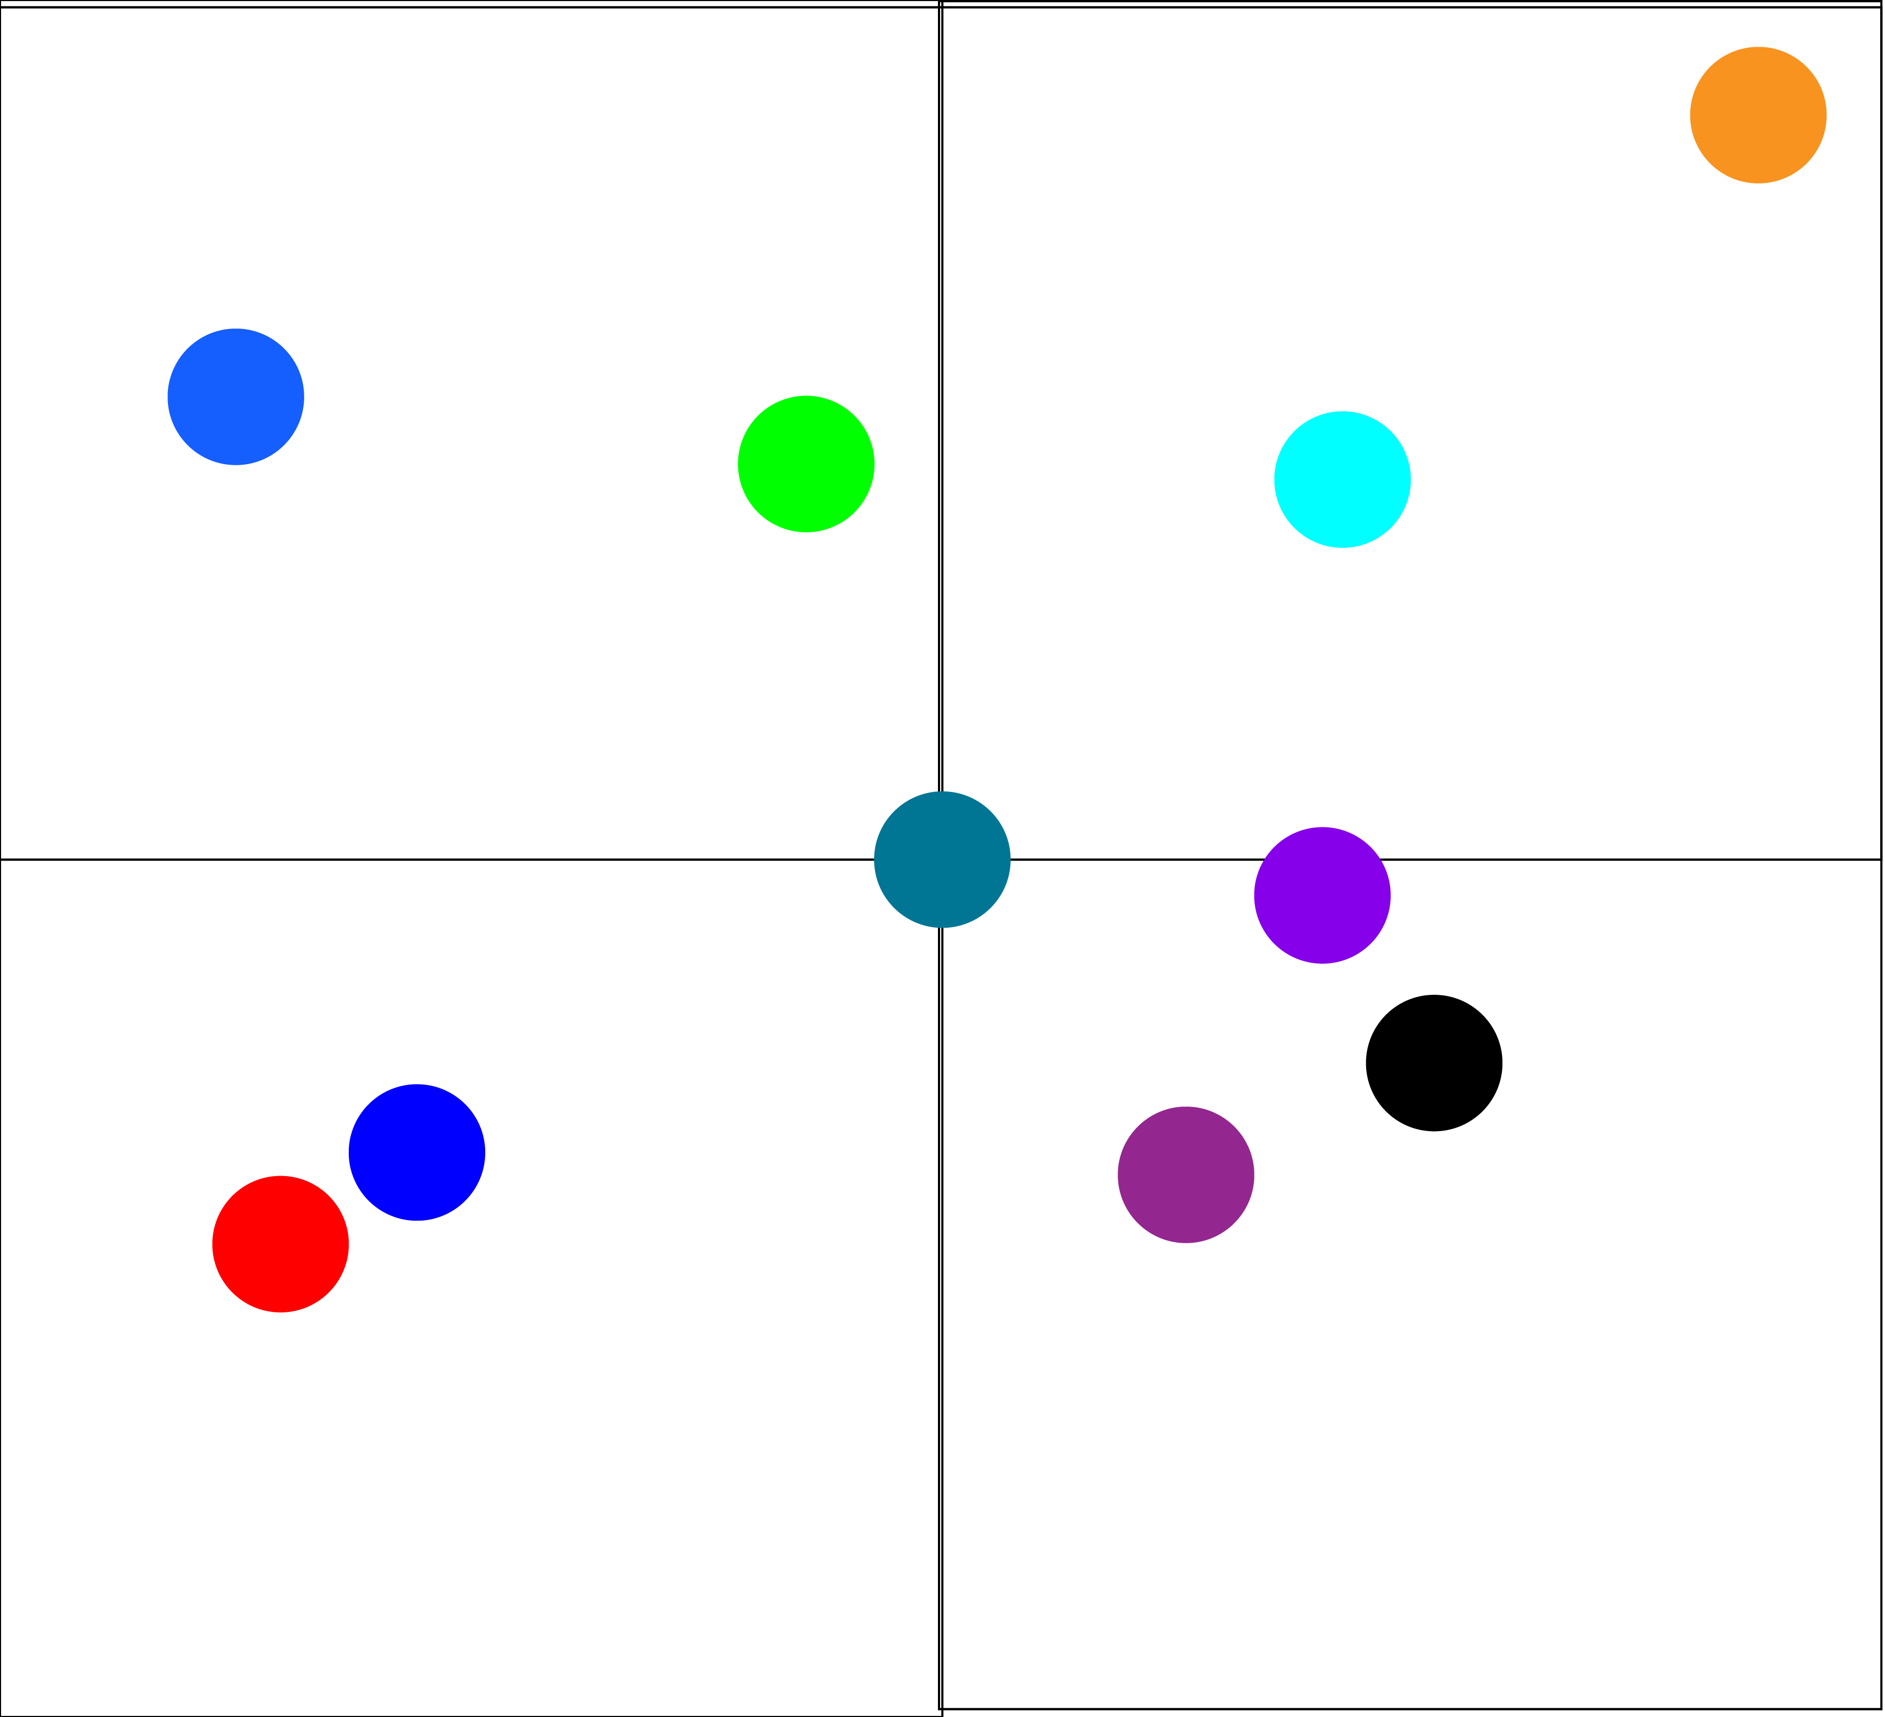
Designed Data Structure
Graphic 1: Quadtree data structure for a population of 10 bees based in a 4 quadrant design, each circle represents a bee.

Slide 3
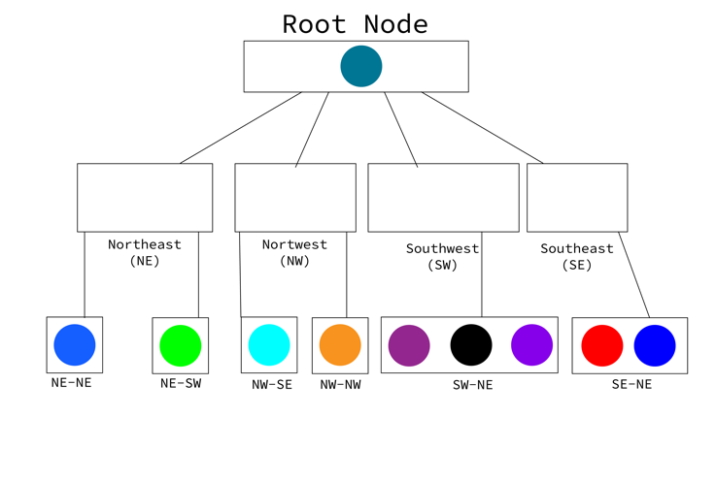

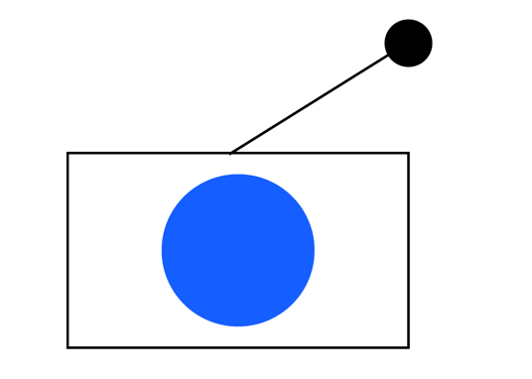
Data Structure Operations
Graphic 2: Defining a root node
Graphic 4: Defining s a region quadtree of a shape in the plane and its tree data structure in which each node has four children. Every node in the three corresponds to a quadrant or squared box in the region of interest hence, the quadrants NE (northeast), NW (northwest), SW (southwest) and SE (southeast).
Graphic 3: Inserting a node to the root

Slide 4
Data Structure Operations
Method | Complexity
Remove | O(1)
Insert | O(log s)
GetCollisions | O(s )*O (m)
Graphic 5: Complexity analysis of the methods

Slide 5
Data Structure Operations
 | 10 bees (Ms) | 100 bees (Ms) | 10000 bees (Ms) | 1000000 bees (Ms)
Remove | 12,3 | 12,3 | 12,3 | 12,3
Insert | 15 | 27 | 7034 | 1346000
GetCollisions | 17 | 118 | 57894 | 34591008
Graphic 6: execution time of the methods based on a certain data inserted

Slide 6
Design Criteria of the Data Structure
- I choose the quadtree as a solution to the problem because the idea of dividing a square area into smaller square and quadrants was one of the most interesting spatial Partitioning I found, these subcubes form the child nodes of the root node, the child nodes are, in turn, recursively subdivided in the same fashion, the Quadtree stops being a recursive creation when the tree reaches a maximum depth, or the child nodes keep getting smaller than some preset minimum size.
- At comparing it with the other data structures that were investigated I discovered that implementing a the spatial hash algorithm was not the best based on the fact that spatial attributes are of higher dimensions, and thus more complicated, make spatial hashing a difficult problem, the AABB tree is very efficient for queries,, but a Quadtree is more flexible over time, as the modification are kept more locally.

Slide 7
Time and Memory Consumption
 | 10 bees | 100 bees | 10000 bees | 1000000
Memory consumed | 0,010 MB | 0,036 MB | 2,013 MB | 43,218 MB

