Slide 1
Licensing (non-)exhaustivity in wh-questions: Experimental studies
Morgan Moyer^{i,j} and Kristen Syrett^{i} ^{i}Rutgers University, ^{j}Stanford University,
Experiments in Linguistic Meaning 1
University of Pennsylvania September 16, 2020
Notes:
Today I'd like to discuss factors which constrain and license Mention-some readings of embedded questions.

Slide 2


Heyyyy.
Hey! Who was at the party last night?
EVERYONE! Selen, Liv, Gabby, Arcadia, Andrew, Josh, Sonia, Adam, Dev, ………….
https://www.elitedaily.com/p/18-cute-texts-to-send-your-best-friend-right-now-just-because-16421636
You know who came to the party.
Mention-All
(MA)
Exhaustive
Notes:
So I'll start just by giving some background on semantics here.
Questions don't have truth conditions. However, there are two ways that we can study the meaning of questions in truth conditional semantics.
1. if we look at the answers, we see that those can be propositional
if we have a toy model where...
then if we substitute each place for 'where' in the question (and unzip our question syntax), we generate a set of propositional answers.
this has led semanticists to say that questions denote this set of (propositional) answers.
2. second, there are cases where interrogative clauses occurr as complements to propositional attitude verbs, as in 'dana knows.....'
Now, it's an interesting question, whehter and how the attitude verb constraints the answers in this set

Slide 3
Semantics of questions & answers (Hamblin 1973; Karttunen 1977; Groenendijk & Stokhof 1982, 1984)
The felicity of answers tells us about question meaning.
Questions want the exhaustive set of answers.
The meaning of a wh-question is the exhaustive set of its answers.
I’m ignoring strong vs. weak, and questions of truth on purpose!
Sometimes exhaustivity is too strong.

Slide 4


Excuse me, where can we find coffee?
Hidden Grounds, it’s just around the corner.
That person knows where to find coffee!
https://news.artnet.com/art-world/summer-tourist-art-disasters-310753
Mention-Some (MS)
Non-exhaustive

Slide 5

Excuse me, where can I find coffee?
Hidden Grounds, Red Bay Coffee Co, Peet’s, Stumptown, Starbucks…
Hidden Grounds, it’s just around the corner.
That person knows where to find coffee!
That person doesn’t know where to find coffee!
https://www.zikoko.com/money/10-ways-to-make-money-as-a-student-in-nigeria/attachment/black-woman-writing-758x506/
MS licensed by context.

Slide 6



Heyyyy.
Hey! Who was at the party last night?
Selen.
…##!$%^
https://www.elitedaily.com/p/18-cute-texts-to-send-your-best-friend-right-now-just-because-16421636
MS constrained by question form.
Notes:
So I'll start just by giving some background on semantics here.
Questions don't have truth conditions. However, there are two ways that we can study the meaning of questions in truth conditional semantics.
1. if we look at the answers, we see that those can be propositional
if we have a toy model where...
then if we substitute each place for 'where' in the question (and unzip our question syntax), we generate a set of propositional answers.
this has led semanticists to say that questions denote this set of (propositional) answers.
2. second, there are cases where interrogative clauses occurr as complements to propositional attitude verbs, as in 'dana knows.....'
Now, it's an interesting question, whehter and how the attitude verb constraints the answers in this set

Slide 7
Today’s talk
A. Introduction | (Non-)exhaustivity in Qs and As
B. MS | The Modal Theory vs. The Goal Theory
C. Experiment 1 | Linguistic form
D. Experiment 2 | Contextual goal
E. Conclusion | Dual licensing
Notes:
In today's talk, I'm going to walk you through 4 observations about the distribution of the MS reading. We will see that while, MS seems constrained by the linguistic form of the question, is it also licensed by discourse goals. Because I don't have all the time in the world but I do have a lot of data to share with you, I'm gonna take a bird's eye view of the theoretical literature, and probably gloss over many details. If you are concerned about any of that, i welcome your questions in the question period.
In the first set of experiments, we will confirm a long standing observation that some question forms are indeed more felicitous with MS, but I will also show that appropriate discourse goals ultimately override formal constraints.
In the second set of experiments, I'll present some results from an on-going corpus analysis, and a study that attempts to quantify the conditional probability of MS/MA interpretation, given question form. If time runs short, then I'll leave off the last study, which I can summarize briefly.

Slide 8
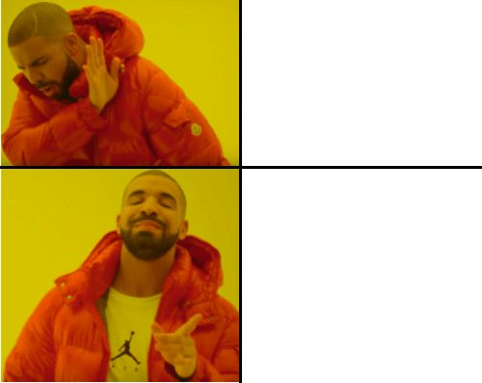
Form constraints
MS?
Dana knows who came to the party.
Dana knows where to find coffee.
Matrix Verbs: weak vs. strong MA
Karttunen 1977; Groenendijk & Stokhof 1982, 1984; Berman 1991; Heim 1994; Ginzburg 1995; Lahiri 2002; Spector 2005; Guerzoni & Sharvit 2007; Egré 2008; Zimmermann 2010; Klinedinst & Rothschild 2011; George 2011; Theiler 2014; Romero 2015; Spector & Egré 2015; Uegaki 2015; Theiler, Roelofson, & Aloni 2019; Mayr 2019; Uegaki & Sudo 2019, a.o.
Wh-Word
Hintikka 1976; Ginzburg 1995; Asher & Lascarides 1998
◇ Modal & -FIN
George 2011, Ch6; Nicolae 2014; Fox 2014; Dayal 2016; Xiang 2016, 2020; Bhatt 1999 for -FIN

Slide 9
Form/◇ Modal Theory
Modal/-FIN questions grammatically license MS via scope ambiguity. (George 2011; Fox 2014; Nicolae 2014; Xiang 2016; Bhatt 1999 for -fin)
Overt or covert existential priority modal:
…where to find coffee ≈ where we can find coffee (Bhatt 1999)
Notes:
There are two primary theories as to why a question might want a non-exhaustive answer. CLICK
The Modal Theory posits that the presence of a modal (or a covert modal in a non-finite embedded clause) is what permits a non-exhaustive answer. CLICK
The pragmatic theory posits that non-exhaustivity will be permitted when a non-exhaustive answer satisfies contextual discourse goals.
Now, here, we're grouping together several theories that aren't formally identical, but the main unifying factor is the importance of some feature of the context.
There’s also ambiguity theories, which hold that all questions are ambiguous between the two readings. As yimei mentioned, these will ultimately reduce to pragmatic theories because ”pragmatics” will determine the reading.
but we will put these aside for the purposes of this presentation.

Slide 10
MS across question forms
How do I get to the buried treasure?
Dana knows how we get to Central Park.
(Hintikka 1976; Asher & Lascarides 1998)
What’s a typical Russian name?
(Roelofsen, Ciardelli, Aloni)
Who’s going to the party? (Dayal, pc)
Who has a light? (Groenendijk & Stokhof 1982, 1984; van Rooij 2003)
Notes:
B: none of these factors are categorial in the determination of sentence meaning

Slide 11



Discourse goal licensing Groenendijk & Stokhof 1982,1984; Ginzburg 1995; Asher & Lascarides 1998; van Rooij 2003, 2004
Where can I find coffee? Dana knows where to find coffee.
https://news.artnet.com/art-world/summer-tourist-art-disasters-310753
https://www.zikoko.com/money/10-ways-to-make-money-as-a-student-in-nigeria/attachment/black-woman-writing-758x506/
Who came to Elton John’s party? Dana knows who came to Elton John’s party.
https://up-magazine.info/en/technologies-a-la-pointe/lab/7529-facebook-veut-inventer-le-paparazzi-personnel/
https://www.threerivers.edu/2020/07/31/new-data-analytics-certificate-at-three-rivers-community-college/
Notes:
Another long-noted robust observation is that whether a Mention-some answer or interpretation is acceptable will be determined by some kind of non-exhaustive discourse goals.
The classic demonstration of this is "Where can I find an Italian newspaper?" but I like to use this example cause it lets me make a joke about aaron.
is the tourist vs. the entrepreneur.

Slide 12
Goal Theories
MS licensed by non-exhaustive contextual goals. (Groenendijk & Stokhof 1982, 1984; Ginzburg 1995; Asher & Lascarides 1998; Beck & Rullmann 1999; Lahiri 2002; van Rooij 2003, 2004; Schulz & van Rooij 2004; IS folks, Theiler et al 2019; Roelofsen & Dotlačil 2019)
All questions should allow MS when goals are MS, ceterus peribus…
MS will never be more informative than MA (Van Rooij 2003, 2004)
Notes:
The pragmatic theory posits that non-exhaustivity will be permitted when a non-exhaustive answer satisfies contextual discourse goals.
They take as their basic data point
Now, here, we're grouping together several theories that aren't formally identical, but the main unifying factor is the importance of some feature of the context.
There’s also ambiguity theories, which hold that all questions are ambiguous between the two readings. these will ultimately reduce to pragmatic theories because ”pragmatics” will determine the reading.
but we will put these aside for the purposes of this presentation.

Slide 13
Hypotheses
H1 | Modal (/non-finite) is necessary for MS. MS should be accepted only in the presence of modal/non-finite clauses, modulo pragmatics.
H0 | Modal (/non-finite) is not necessary for MS.
We should see acceptance across both clauses, modulo pragmatics.
Notes:
we can articualte two hypotheses: MS could only be available in modal clauses. so participants should reject nonmodals. On the other hand, we might
These hypotheses are getting at the question of whether the modal is necessary for MS?
Importantly were trying to abstract away from particular theories here

Slide 14
Stimuli | -FIN where
Billy and his neighbors are playing hide and seek in the park. It is his turn to close his eyes and count to ten.
Actually, his friends are hidden under the slide, in the tunnel, and behind the swings, but not in the tree.
After he is finished counting, he sees his classmate Jimmy, and asks Jimmy to help him find his friends.
Notes:
Here's an example stimulus for a nonfinite clause

Slide 15
Test
MS
Answer
Jimmy says, “Under the slide.”
Billy reports, “Jimmy knows where to find the people hiding.”
Is Billy right?
Yes No
Verb
WH
-FIN

Slide 16
Experiment 1 | Form Factors Only n=232 (14 excluded for non-native speaker status )
MA
MS
Mixed T+F
False
Acceptability judgement task
Qualtrics software (Provo, UT)
Run in-lab
Within subjects
Answer
Matrix verb
Wh-word
Between subjects: finiteness
All factors fully crossed (32 lists)
know
predict
who
where
-FIN
+FIN
Notes:
So Experiment 1 fully crossed each factor. So within subjects we

Slide 17
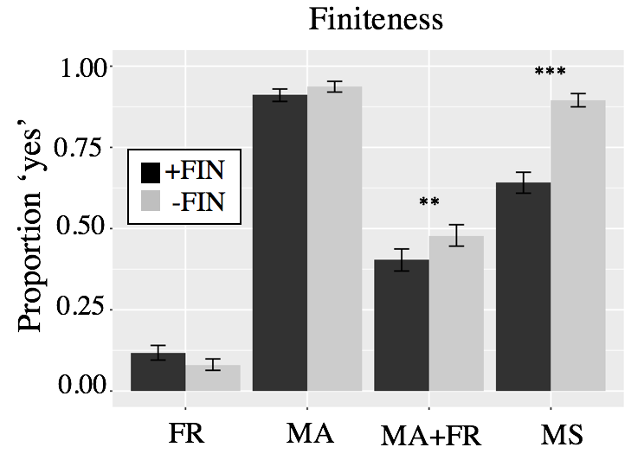
Mom knows where they found the people hiding
Jimmy knows where
to find the people hiding
False
MA
Mixed
T+F
MS
Notes:
EXPLAIN X AXIS IN ORDER

Slide 18
Mom knows where they found the people hiding
Jimmy knows where
to find the people hiding
False
MA
Mixed
T+F
MS
Notes:
Here are results. on the y axis is proportion 'yes' reponses to the test sentences....The x-axis graphs context. So the let most bars are the False controls, where a character proffers negative answers as true, represented by blue letters. the next bars over show the MA condition, which were true controls. The second from right are conditions where a subject has a false belief. And the far right are the Mention-some condtion trials, where a character presentes one true answer. We see here a significant difference between finite in black and nonfinite in grey.

Slide 19
Significant effect
of FIN in MS (X²(1)=83.642, p<.0001)
Mom knows where they found the people hiding
Jimmy knows where
to find the people hiding
False
MA
Mixed
T+F
MS
Notes:
Here are results. on the y axis is proportion 'yes' reponses to the test sentences....The x-axis graphs context. So the let most bars are the False controls, where a character proffers negative answers as true, represented by blue letters. the next bars over show the MA condition, which were true controls. The second from right are conditions where a subject has a false belief. And the far right are the Mention-some condtion trials, where a character presentes one true answer. We see here a significant difference between finite in black and nonfinite in grey.

Slide 20
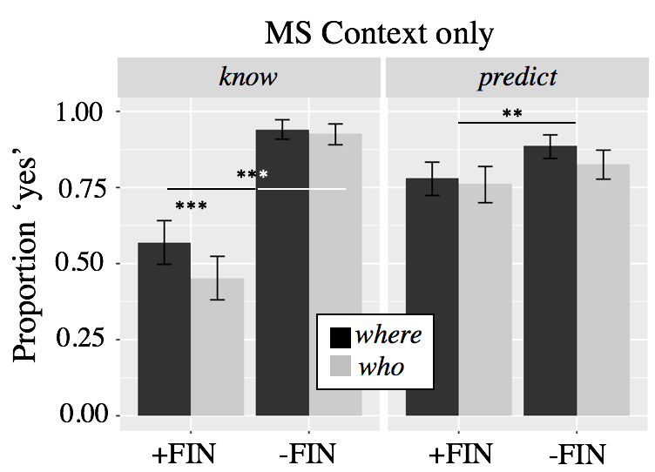
Mom knows where they found the
people hiding
Jimmy knows where to find the people hiding
Mom predicted where they found the people hiding
Jimmy predicted where to find the people hiding
Notes:
I mean there’s a significant difference in predict but +FIN predict is 75% acceptable, so it’s not really degraded acceptability here
With know, it IS degraded, clearly

Slide 21
Summary | Experiment 1
Significant differences due to all Form Factors.
Finiteness x Verb (X²(3) = 118.66, p<0.0001)
+FIN: know-wh less acceptable than predict-wh
Maybe consistent with lexical semantic/selectional restrictions from the verb Grimshaw 1979; Heim 1994; Zimmermann 2010; George 2011; Spector & Égre 2015

Slide 22
Modal is not a categorical factor
H1 is too strong.
If we rely solely on grammar for licensing mention-some, we make the wrong predictions about finite predict-wh questions.
Context.
(Interesting effects of individual test scenarios!)
Notes:
The lack of a modal doesn’t deliver categorical ungrammaticality.

Slide 23
Resolving a speaker’s goals Ginsburg 1995; Asher & Lascarides 1998; van Rooij 2003
# MA
☞MS
Further, only informative MS answers are felicitous.
Goal = have a cup of coffee
Goal = interview all cafes in town
☞MA
# MS
Notes:
Another long-noted robust observation is that whether a Mention-some answer or interpretation is acceptable will be determined by some kind of non-exhaustive discourse goals.
The classic demonstration of this is "Where can I find an Italian newspaper?" but I like to use this example cause it lets me make a joke about aaron.
is the tourist vs. the entrepreneur.

Slide 24
Contextual manipulations
Contextual Stakes | whether lives are at risk. (Not the only natural way to understand goals)
High vs. Low Stakes
Answer ranking | how informative is the answer. reducing uncertainty (Shannon 1948; van Rooij 2003, 2004) Not asymmetrical entailment between answers (cf. Fox 2014)
Number of MS answers given (single MO, or multiple MS)
How much information is in the answer (max or min)

Slide 25
A local apartment building has caught on fire. The landlord’s floor plan shows the following breakdown of tenants per floor:
Floor A has 10 tenants,
Floor B has 8,
Floor C has 5,
Floor D has 2,
Floor E has 1, and
Floor F has 0.
The fire chief is deciding where to send his firefighters, because there are people trapped but they don’t know on which floors.
Max Informative
“ABCDE”
“AB”
“A”
“DE”
“E”
High Stakes
-FIN
Min Informative

Slide 26
He asks his firefighters, “Where should we go to find the trapped people?”
Firefighter A says, “Floor A.”
Firefighter B says, “Floors A, B, C, D, and E.”
Firefighter C says, “Floors D and E.”
Max Informative
“ABCDE”
“AB”
“A”
“DE”
“E”
Min Informative
Who knows where to go to find the trapped people? (Choose all that apply)
Firefighter A Firefighter B Firefighter C None of the Above
Notes:
We called this a high stakes condition because lives are at risk
A low stakes example would be finding coffee.
We have a study actually which compares MS in embedded questions with bare plurals and with DDs
There is no effect

Slide 27
Hypotheses
H1 | Answer acceptability will depend on Stakes.
MA > MS/MO in High Stakes
MS(/MO) in Low > in High Stakes
MA in Low Stakes: MA ≥ MS(/MO), van Rooij

Slide 28
Hypotheses
H2 | MS/MO acceptability will depend on Informativity.
Max MS/MO Answers more acceptable than Min MS/MO.
MS > MO (van Rooij)
Notes:
≥ because he admits that MS can be as acceptable as MA if utility is balanced by a least effort principle which favors MS over MA

Slide 29
Experiment 2 | Context vs. Form n=318 (6 excluded for non-native English; 6 for browser incompatibility issues)
Created in Ibex Farm
Run on MTurk
Within subjects:
Stakes
Answer type
Informativity
Between Subjects
Finiteness
High
Low
Mention-One (MO)
Mention-Some (MS)
Mention-All (MA)
Max
Min
Notes:
6 excluded for non-native speaker status, 6 for browser incompatibility issues

Slide 30
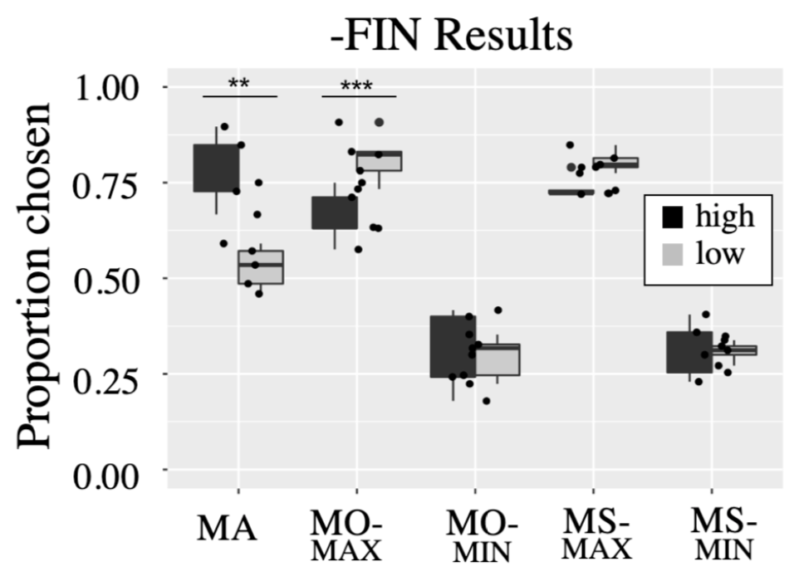
Non-Finite Clauses
Max Informative
“ABCDE”
“AB”
“A”
“DE”
“E”
Who knows where to eat out?
n.s.
Min Informative
Interaction between
MA /MO-max and Stakes.
MS vs. MO not signf’t
Informativity of MS/MO significant.
MS vs. MA in High Stakes not signf’t
ABCDE
A
E
AB
DE
Answer
Notes:
Discourse goals can make exhaustivity acceptable or not
Ignore the stakes manipulation for a second.
Low stakes, happy with mention most or mention one, but crucially hate the mention all
- bad for yimei because MA should be acceptable
If it’s a strong notion of mention-one, then we shouldn’t see AB in low stakes
High stakes doesn’t mean just mention-all, but mention enough (mention more than one)
- if HS requires MA, wouldn’t see acceptability of AB (MS)
- not MA driving the bus, it’s mention-ENOUGH

Slide 31
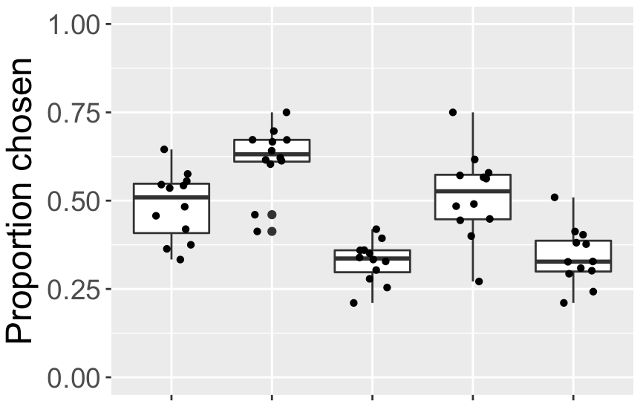
Finite Clauses
Max Informative
“ABCDE”
“AB”
“A”
“DE”
“E”
Who knows where Dana ate out?
Min Informative
***
MO-max more acceptable than MA
Informativity of MS/MO significant.
MS vs. MA not significant
ABCDE
A
E
AB
DE
Answer
Notes:
Here we say the same thing
Even though responses are generally depressed, the relationship between MA and M-AB is the same

Slide 32
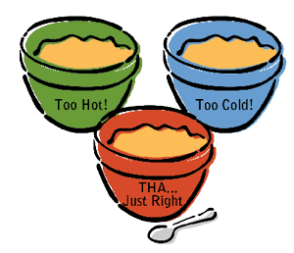
Summary | Experiment 2
MA is dispreferred in Low Stakes.
MOST information isn’t always best.
Even in +FIN(-Modal) questions
Participants calculate a threshold of informational sufficiency relative to contextual goals.
Notes:
Third point: It looks like there are “thresholds” for acceptability in both the low and high stakes cases. In the high stakes case, you have to minimally answer ‘AB’, but AB+ will do (i.e. ABCD). In the low stakes case, you have to minimally answer ‘A’, but more is fine (AB), however all is too much information – it violates the pragmatic goals in place.
Why is the threshold in the high stakes case AB? Well potentially because the guideline speakers are using is something like “give some significant percentage of the people” (maybe the most people on the least floors). But crucially, despite the high stakes there is no strong requirement to identify ALL the answers.
Why would the low stakes cases have a threshold of ‘A’ – well because it is a maximally informative answer (it isn’t something that is really low on the usefulness scale), but it also isn’t something that has to be maximally informative in the same way that the high stakes cases require (the one good answer is enough, we don’t need enough good answers to meet some threshold of having enough coffee)

Slide 33
Taking stock | dual licensing
There’s a “semantic” component | -FIN (modal) clauses do boost acceptability of MS.
Interaction with embedding verb (wh-word too)
But these are not categorical effects
There’s a “pragmatic” component | acceptability of MS/MA conditioned on Stakes
Relative informativity trumps absolute exhaustivity

Slide 34
Uncertainty in dialogue
Underspecified meaning:
(non-)exhaustivity
referential domain
granularity
specificity
Excuse me, where can we find coffee?
The hearer must reason about
the meaning of the linguistic signal
speaker’s goals/plan
Private and not always made explicit

Slide 35
Cues in the linguistic signal
Did the speaker ask (a), (b), or (c)?
(a) Where can we find some coffee?
(b) Where are all the coffee shops?
(c) Where can we find coffee?
P(MS) > P(MA)
P(MA) > P(MS)
P(MA) ≈ P(MS)
Additional information needed!
Notes:
But note that context can also change the likelihood of MS and

Slide 36


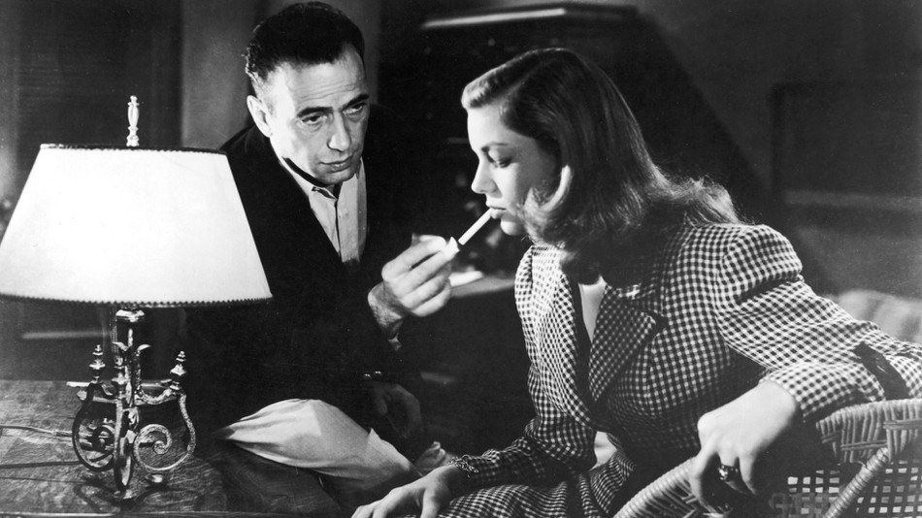
World knowledge and expectations (Degen 2015; Degen & Tanenhaus 2015; Goodman & Stuhlmüller 2013; Degen, Tessler & Goodman 2015; Zondervan, Meroni & Gualmini 2008; Tonhauser, Bever & Degen in press, a.o….)
Who has a light?
Notes:
I didn’t talk about this, but there was a lot of variation in Ex1 and Ex2 based on the individual test items---effects of Story

Slide 37
General Discussion
Acceptability of an answer is neither purely a form or purely a contextual matter. It’s a combination of the two.
(Non-)exhaustivity is not really semantics vs. pragmatics, because the two are dependent on each other for filling in missing information.
Notes:
Where does this leave us
Given experiment 3 it seems people’s judgements aren’t purely about form or about context
We see some judgements difference related to a modal, and some related to task differences
But there’s more work to be done to understand how exactly that works.

Slide 38






Thank you!
Kristen Syrett Yimei Xiang Veneeta Dayal Paul Pietroski Alex Lascarides Judith Degen
Rutgers Lab for Developmental Language Studies Semantics-U-Name-it-at-Rutgers (SURGE)
Funding from NSF BCS-DDRIG #1918068 to Syrett/Moyer, Rutgers Off-Campus Dissertation Fellowship, Rutgers Aresty Research Center, and the Rutgers Center for Cognitive Science
Rangaraj Tirumala
Divya Appasamy
Knyck Sutherland Tim Dawson

