Slide 3


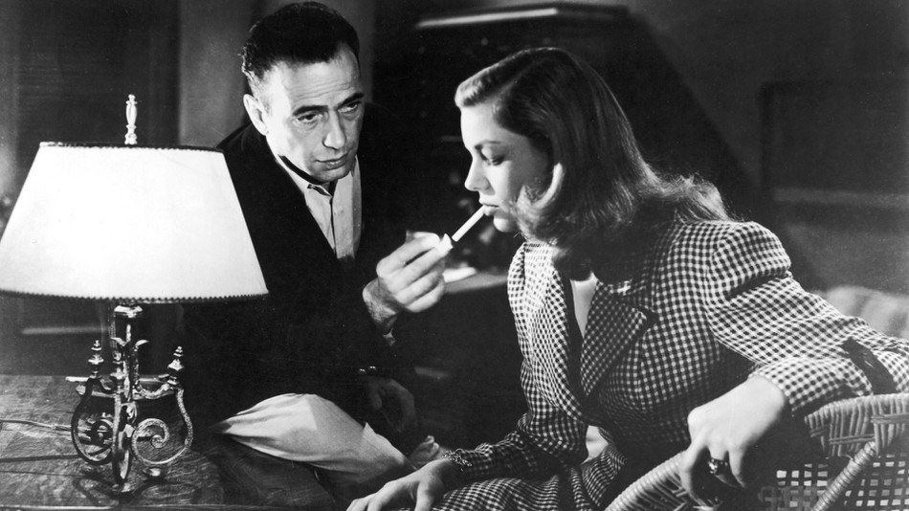

(Non-)exhaustivity in Wh-Questions
Morgan Moyer
Where can I find coffee?
(a) Hidden Grounds.
Mention-Some
(b) Hidden Grounds, Starbucks,
Peets, OQ, the train station, ...
Mention-All
Dana knows where I can find coffee.
The meaning of a question is the set of all its (true) answers (Karttunen 1977; Groenendijk & Stokhof 1982, 1984)
Who came to the party
(a) Selen.
#
Mention-Some
But many natural counterexamples
How do I get to the buried treasure?
What’s a typical Russian name?
Who’s going to the party?
Who has a light?
(b) Selen, Liv, Arcadia, Sam,
Sonia, Adam, Andrew, Josh,…
Mention-All
Dana knows where I can find coffee.
Naturalistic productions from corpus + online annotation task (+ ML to predict judgements? + RSA? )
fine grained interaction between form, context, goals
Wh-Word
Matrix verbs
Modality/tense
world knowl. expectations

