Slide 1
State-Denoised RNNs
Analog to denoising autoencoders
noise robustness
Why is noise in RNNs so devastating?
it amplifies over time

Slide 2
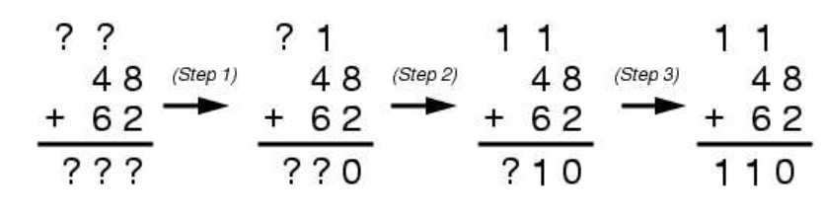
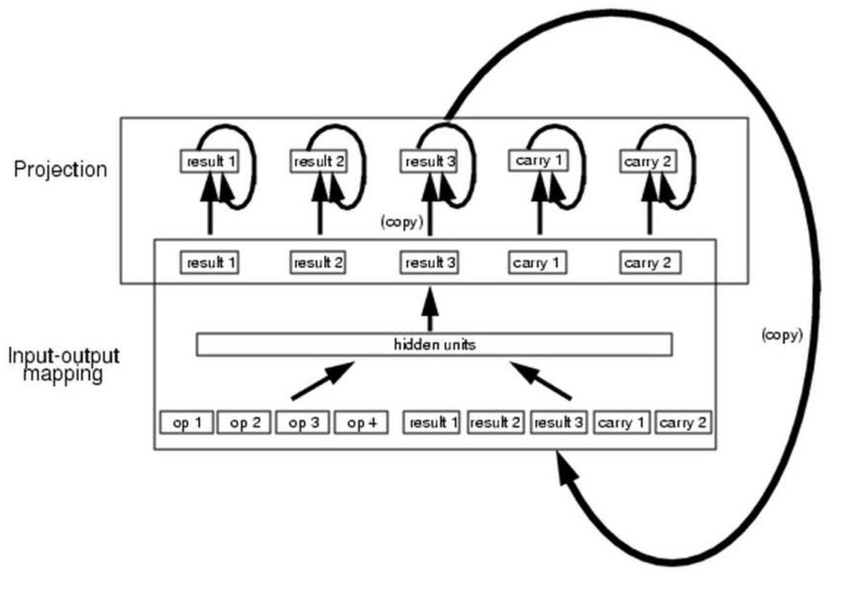
Denoising RNNs: Motivation
Challenge
Architecture

Slide 3
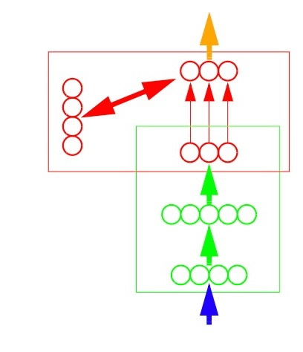
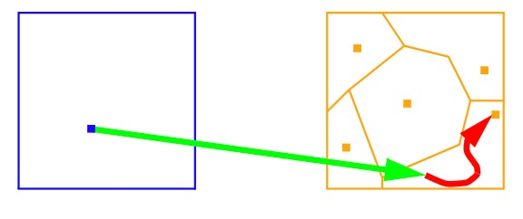
Denoising RNNs
Mapping-projection architecture

Slide 4
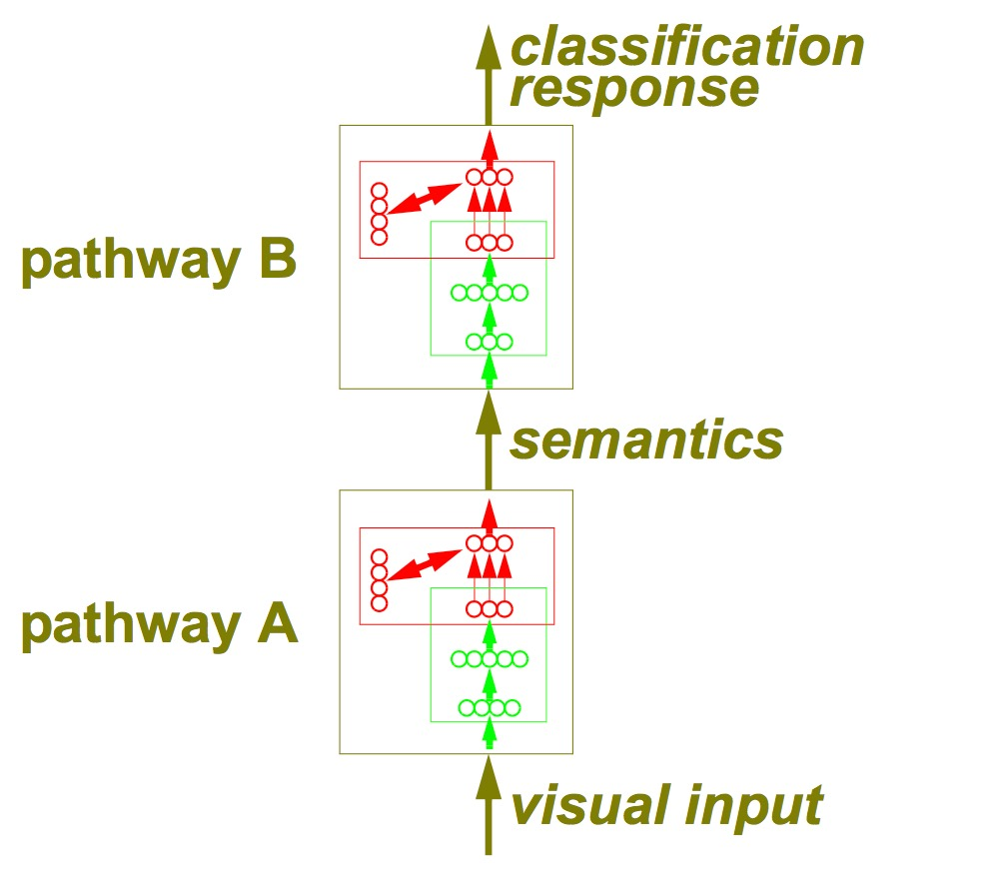
Denoising RNNs
A theory of (access) consciousness

Slide 5
Denoising RNNs
within
time
step
across
time
steps

Slide 6
Denoising RNNs
training signal
…
…
…
…
…

Slide 7
Denoising RNNs
…
…
…
noise
…
training signal
noise
noise

Slide 8
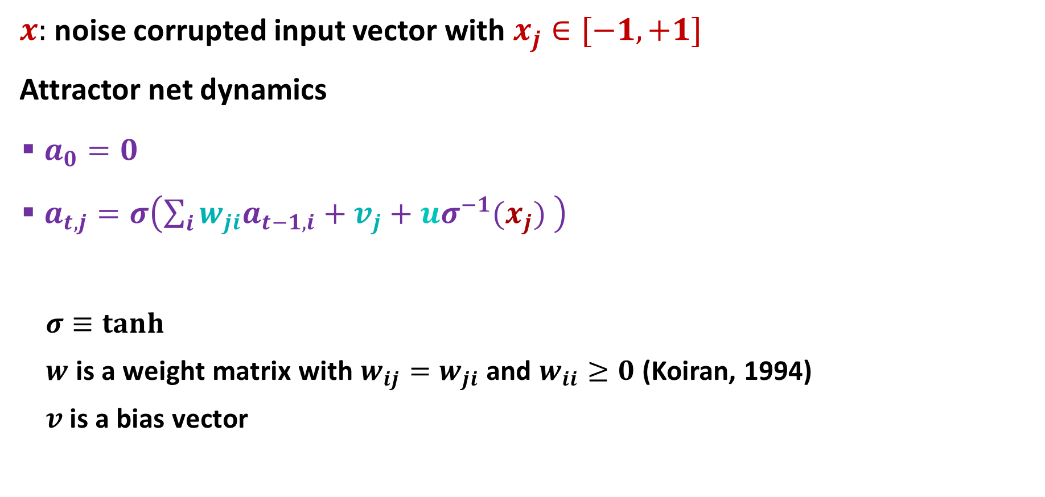
Attractor Net
$x:$ noise corrupted input vector with $x_{j}∈[−1,+1]$
Attractor net dynamics
$a_{0}=0$
$a_{t,j}=σ\left(\sum_{i}{{w_{ji}a}_{t−1,i}}+v_{j}+{uσ}^{−1}(x_{j}) \right)$
$σ≡tanh$
$w$ is a weight matrix with $w_{ij}=w_{ji}$ and $w_{ii}≥0$ (Koiran, 1994)
$v$is a bias vector

Slide 9
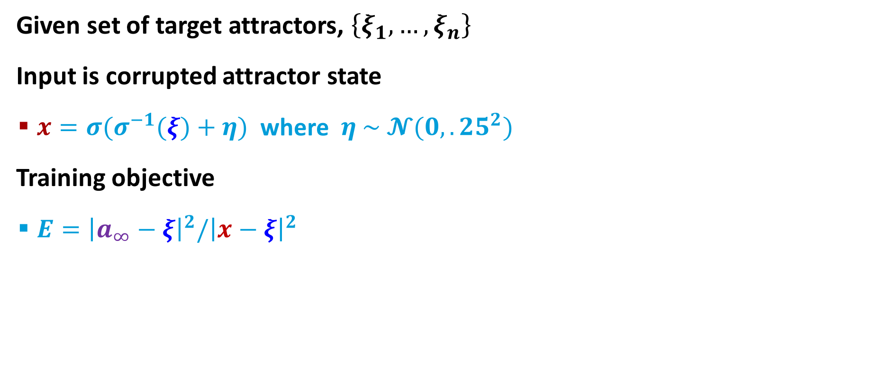
Training Attractor Net
Given set of target attractors, $\left\{ξ_{1}, …, ξ_{n}\right\}$
Input is corrupted attractor state
$x={σ(σ}^{−1}(ξ)+η)$ where $η \sim 𝓝(0,.25^{2})$
Training objective
$E={\left|a_{∞}−ξ\right|}^{2}/{\left|x−ξ\right|}^{2}$
…
training signal
noise

Slide 10
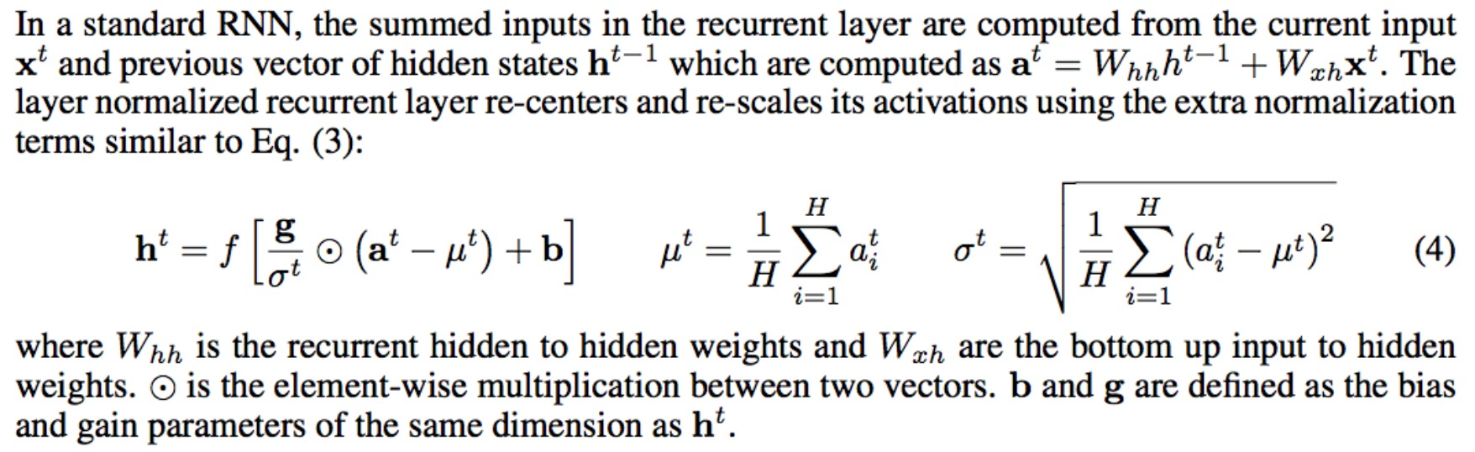
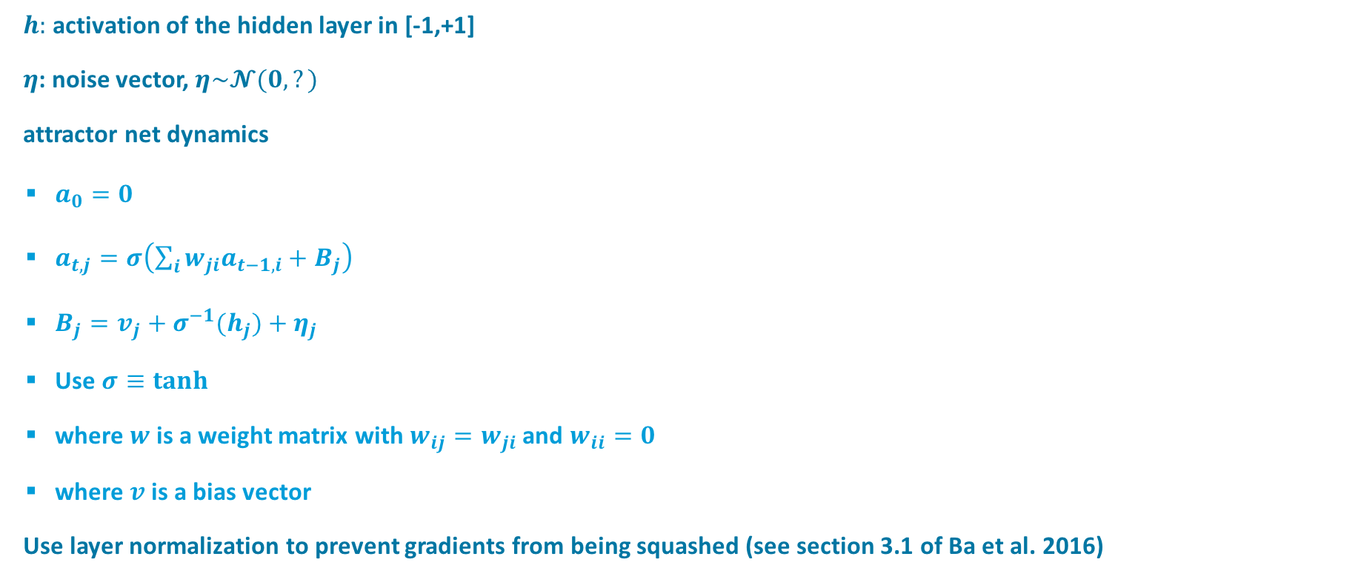
$h:$ activation of the hidden layer in [-1,+1]
$η$: noise vector, $η\sim 𝓝(0,?)$
attractor net dynamics
$a_{0}=0$
$a_{t,j}=σ\left(\sum_{i}{{w_{ji}a}_{t−1,i}}+B_{j}\right)$
$B_{j}=v_{j}+{σ^{−1}(h}_{j})+η_{j}$
Use $σ≡tanh$
where $w$ is a weight matrix with $w_{ij}=w_{ji}$ and $w_{ii}=0$
where $v$is a bias vector
Use layer normalization to prevent gradients from being squashed (see section 3.1 of Ba et al. 2016)

Slide 11
Results
Learning 5 element sequence parity function
training on all data, 100 replications
 | generic (tanh) RNN | state-denoised RNN | RNN + attractor net trained with pred error
training set accuracy | 93.3% | 97.8% 2 sided paired t-test t(99)=3.42, p<.001 | 75.8%
% successes | 57 | 69 | 41

Slide 12
Results
Learning majority function from few examples
12 element binary sequences
training on 64 random examples, testing on remaining
tanh RNN
 | generic (tanh) RNN | state-denoised RNN | RNN+attractor trained via prediction task
training set accuracy | 86.5% | 90.3% 2 sided paired t-test t(99)=3.12, p=.0025 | 82.4% 2 sided paired t-test t(99)=3.35 p=.0011

