Slide 1
Access Consciousness and the Construction of Actionable Representations
NIPS 2017 Workshop on Cognitively Informed AI
Michael C. Mozer and Denis Kazakov Department of Computer Science University of Colorado at Boulder
Notes:
Yoshua talk: license to resurrect an idea about consciousness and give it a 2017 spin. I think it is related to yoshua’s ideas.
I want to start off with a property that psychologists believe conscious mental states to possess.

Slide 2
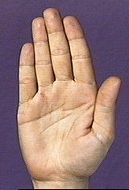

Conscious States Are Interpretations
awareness
PALM
hand
activation
tree
time
Notes:
Tell u about experiment with pu-lih-si-mus words like PALM
The basic result is ...

Slide 3
Lexical Decision
TREE
TURE
“word”
“nonword”
Measure response latency
Notes:
flash up letter string

Slide 4
Semantic Priming
congruent
unrelated
prime
LEAF
time
AUTO
TREE
TREE
target
500 ms
550 ms

Slide 5
Semantic Priming with Polysemous Words (Marcel, 1980)
congruent
incongruent
unrelated
LEAF
HAND
HAND
PALM
PALM
AUTO
TREE
TREE
TREE
supraliminal
500 ms
550 ms
550 ms
subliminal
500 ms
500 ms
550 ms
Notes:
subliminal: at chance

Slide 6
Semantic Priming with Polysemous Words (Marcel, 1980)
sub-
liminal
supra-
liminal
congruent
incongruent
unrelated
LEAF
HAND
HAND
activation
hand
PALM
PALM
AUTO
TREE
TREE
TREE
tree
supraliminal
500 ms
550 ms
550 ms
time
subliminal
500 ms
500 ms
550 ms
Conscious states are interpretations

Slide 7
Mapping-Projection Architecture (Mathis & Mozer, 1995)
Mapping
quick and dirty
Projection
slow but accurate
converges on a meaningful state (interpretation)
semantics
semantics
attractor
net
feedforward
net
visual image
visual image
Notes:
points represent previously learned semantic states
attractor net: recurrent net with attractor dynamics
BUT WHAT DOES THIS HAVE TO DO WITH AWARENESS?

Slide 8
detection
verbal naming
lexical
decision
semantics
visual image
Notes:
Cascade pathways
Many response systems.
[*] The flexibility of the semantic representation to influence processing is related to awareness.

Slide 9
Degrees of Awareness of a Visual Stimulus (Allport, 1988)
unconscious
conscious
at chance on a
presence/absence
task
reliable
detection
but at
chance for
identification
above chance
identification
with low
confidence
reliable identification,
guides action in
flexible, arbitrary
manner
Notes:
… what does it mean to response in arbitrary ways?

Slide 10
What sort of representation in output of pathway A will support appropriate behavior of pathway B?
Sufficient condition on output from A
B
Pr(B correct)
A
persistence
familiarity to B
Notes:
Sufficient condition for access consciousness: temporal persistence of a representation and familiarity of that representation
coordination among pathways
Switch gears and talk about comp utility of this simple mapping projection architecture.
I’m going to use a dorky simple sequential task

Slide 11
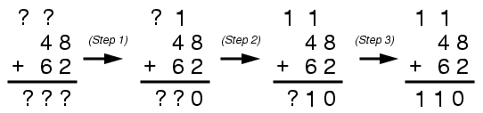
Challenge: Sequential Operations
result₁
result₂
result₃
carry₁
carry₂
result₁
result₂
result₃
carry₁
carry₂
hidden
op₁
op₂
op₃
op₄
result₁
result₂
result₃
carry₁
carry₂
Notes:
noise in output -> fed back to input, degenerates
add a clean up mechanism via atractor net

Slide 12
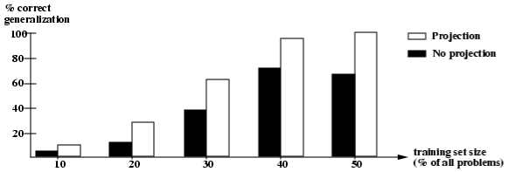
Incorporating Projection Improves Generalization

Slide 13
State-Denoising RNNs
In an RNN, feedback at each step can introduce noise
Noise can amplify over time
Suppose we could ‘clean up’ the representation at each step to reduce that noise?
May lead to better learning and generalization

Slide 14
State-Denoising RNNs
within
time
step
across
time
steps

Slide 15
State-Denoising RNNs
…

Slide 16
State-Denoising RNNs
…
…
…
…
…

Slide 17
Training Phase I
training signal
Freeze attractor weights
Train all other weights with supervised signal
…
…
…
…
…

Slide 18
Training Phase II
Train only attractor weights
Saved hidden states as input with added noise
Goal: reconstruct noise-free input
…
training signal
…
…
…
noise
noise
noise
Notes:
Gaussian mean zero noise

Slide 19

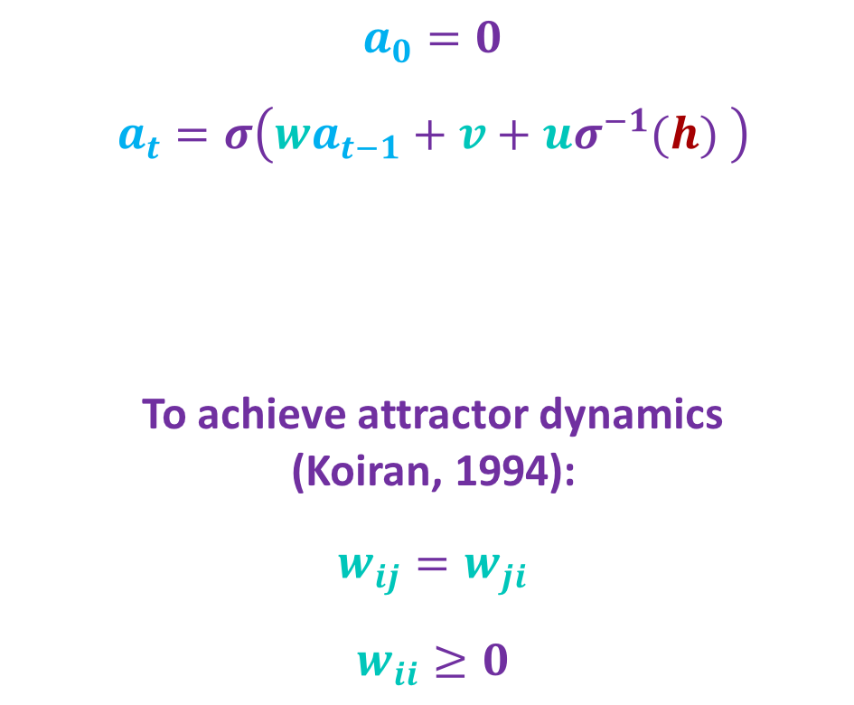

Attractor Net
$a_{0}=0$
$a_{t}=σ\left(wa_{t−1}+v+{uσ}^{−1}(h) \right)$
To achieve attractor dynamics (Koiran, 1994):
$w_{ij}=w_{ji}$
$w_{ii}≥0$
$$a$$
model parameters
$$h$$

Slide 20
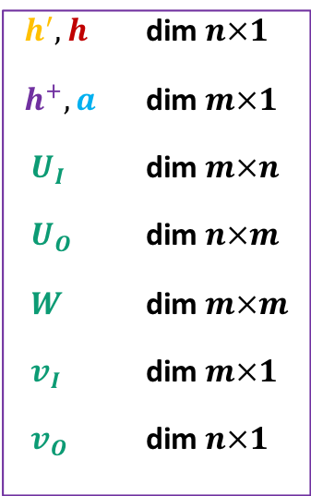
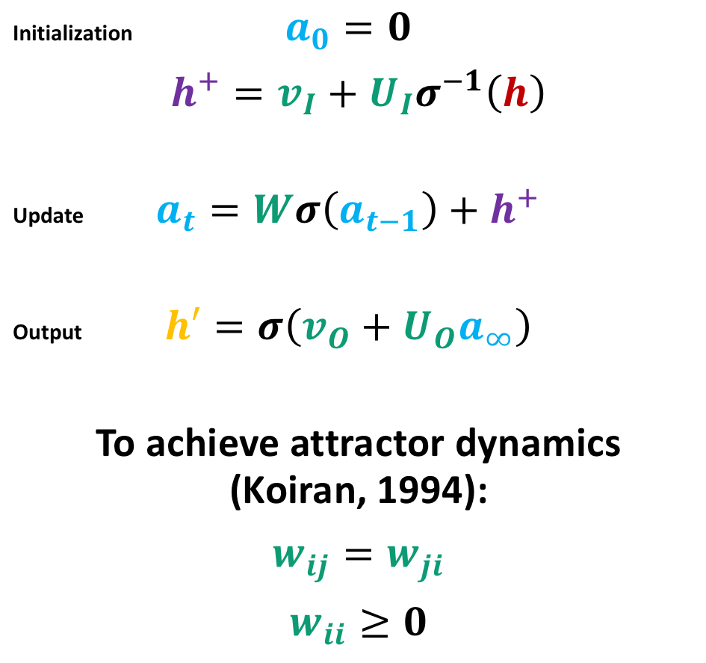



Attractor Net II
$$h′$$
Initialization $a_{0}=0$
$h^{+}=v_{I}+{U_{I}σ}^{−1}\left(h\right)$
Update $a_{t}=Wσ\left(a_{t−1}\right)+h^{+}$
Output $h′=σ\left(v_{O}+U_{O}a_{∞}\right)$
To achieve attractor dynamics (Koiran, 1994):
$w_{ij}=w_{ji}$
$w_{ii}≥0$
$h^{′},h$ dim $n×1$
${ h}^{+}, a$ dim $m×1$
$U_{I}$ dim $m×n$
$U_{O}$ dim $n×m$
$W$ dim $m×m$
$v_{I}$ dim $m×1$
$v_{O}$ dim $n×1$
$$a$$
$$h$$

Slide 21

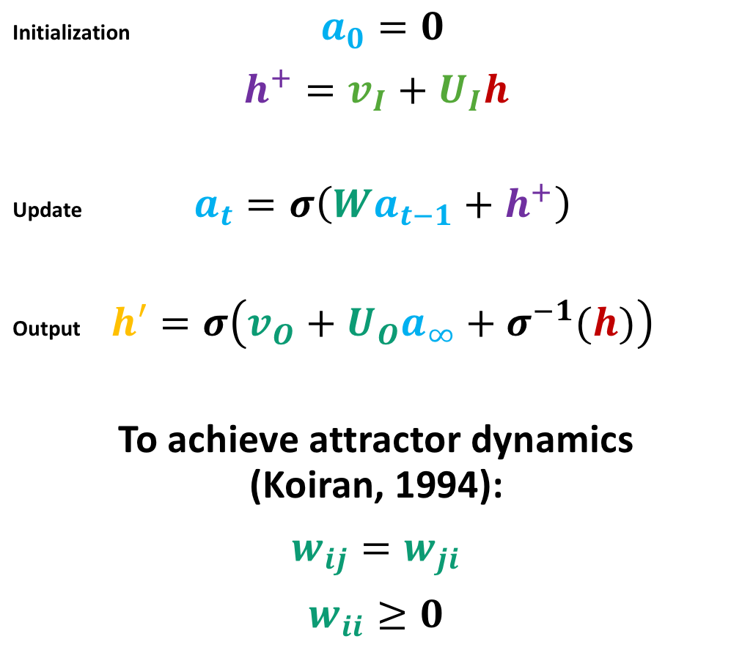
Attractor Net III – Not As Good As Previous
Initialization $a_{0}=0$
$h^{+}=v_{I}+U_{I}h$
Update $a_{t}=σ\left({Wa}_{t−1}+h^{+}\right)$
Output $h′=σ\left(v_{O}+U_{O}a_{∞}+σ^{−1}(h)\right)$
To achieve attractor dynamics (Koiran, 1994):
$w_{ij}=w_{ji}$
$w_{ii}≥0$
$h^{′},h$ dim $n×1$
${ h}^{+}, a$ dim $m×1$
$U_{I}$ dim $m×n$
$U_{O}$ dim $n×m$
$W$ dim $m×m$
$v_{I}$ dim $m×1$
$v_{O}$ dim $n×1$
$$h′$$
$$a$$
$$h$$

Slide 22

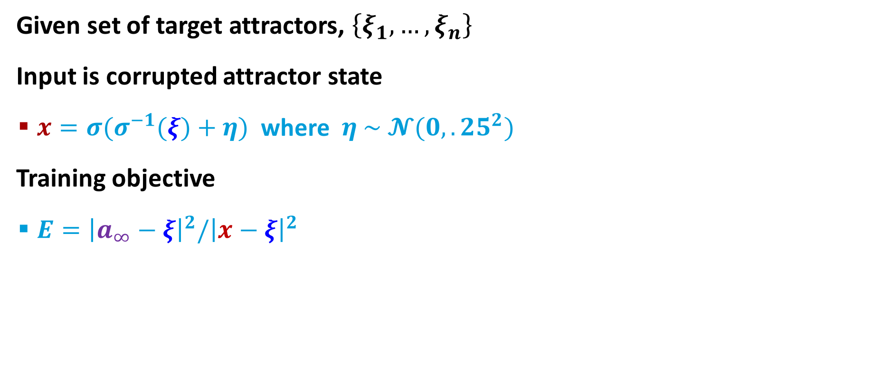

Training Attractor Net
$$a$$
Given set of target attractors, $\left\{ξ_{1}, …, ξ_{n}\right\}$
Input is corrupted attractor state
$x={σ(σ}^{−1}(ξ)+η)$ where $η \sim 𝓝(0,.25^{2})$
Training objective
$E={\left|a_{∞}−ξ\right|}^{2}/{\left|x−ξ\right|}^{2}$
$$x$$

Slide 23
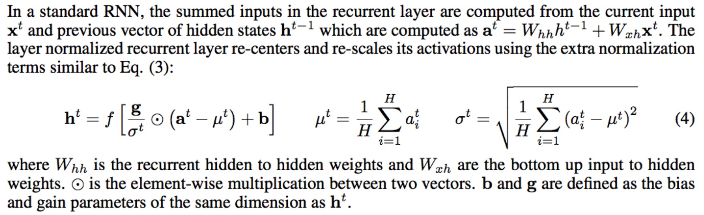

$h:$ activation of the hidden layer in [-1,+1]
$η$: noise vector, $η\sim 𝓝(0,?)$
attractor net dynamics
$a_{0}=0$
$a_{t,j}=σ\left(\sum_{i}{{w_{ji}a}_{t−1,i}}+B_{j}\right)$
$B_{j}=v_{j}+{σ^{−1}(h}_{j})+η_{j}$
Use $σ≡tanh$
where $w$ is a weight matrix with $w_{ij}=w_{ji}$ and $w_{ii}=0$
where $v$is a bias vector
Use layer normalization to prevent gradients from being squashed (see section 3.1 of Ba et al. 2016)

Slide 24
Parity Function
00101 -> 1
11011 -> 0
5 element sequences
training on all 32 sequences
100 replications
 | generic (tanh) RNN | state-denoising RNN | RNN + attractor net trained with pred. error
training set accuracy | 93.3% | 97.8% 2 sided paired t-test t(99)=3.42, p<.001 | 75.8%
% successes | 57 | 69 | 41
Notes:
5 steps in attractor net

Slide 25
Parity Function
00101 -> 1
11011 -> 0
5 element sequences
training on all 32 sequences
testing on all 32 sequences with added uniform noise in [-0.1, +0.1]
100 replications
 | generic (tanh) RNN | state-denoising RNN | RNN + attractor net trained with pred. error
Median test set performance | 85.9% | 96.9% | 75.0%
Notes:
5 steps in attractor net

Slide 26
Majority Function – NIPS VERSION
12 element binary sequences
training on 64 random examples, testing on remaining
tanh RNN
 | generic (tanh) RNN | state-denoising RNN | RNN+attractor trained via prediction task
test accuracy | 86.5% | 90.3% 2 sided paired t-test t(99)=3.12, p=.0025 | 82.4% 2 sided paired t-test t(99)=3.35 p=.0011
Notes:
stop training when 100% on training set

Slide 27
Majority Function – 2/28/18
12 element binary sequences
training on 64 random examples, testing on remaining
no noise in test
tanh RNN
 | generic (tanh) RNN | state-denoising RNN | RNN+attractor trained via prediction task
test accuracy | 87.57% | 90.06% 2 sided paired t-test t(99)=2.09, p=.0395 | 89.58% 2 sided paired t-test p > .05
Notes:
stop training when 100% on training set

Slide 28
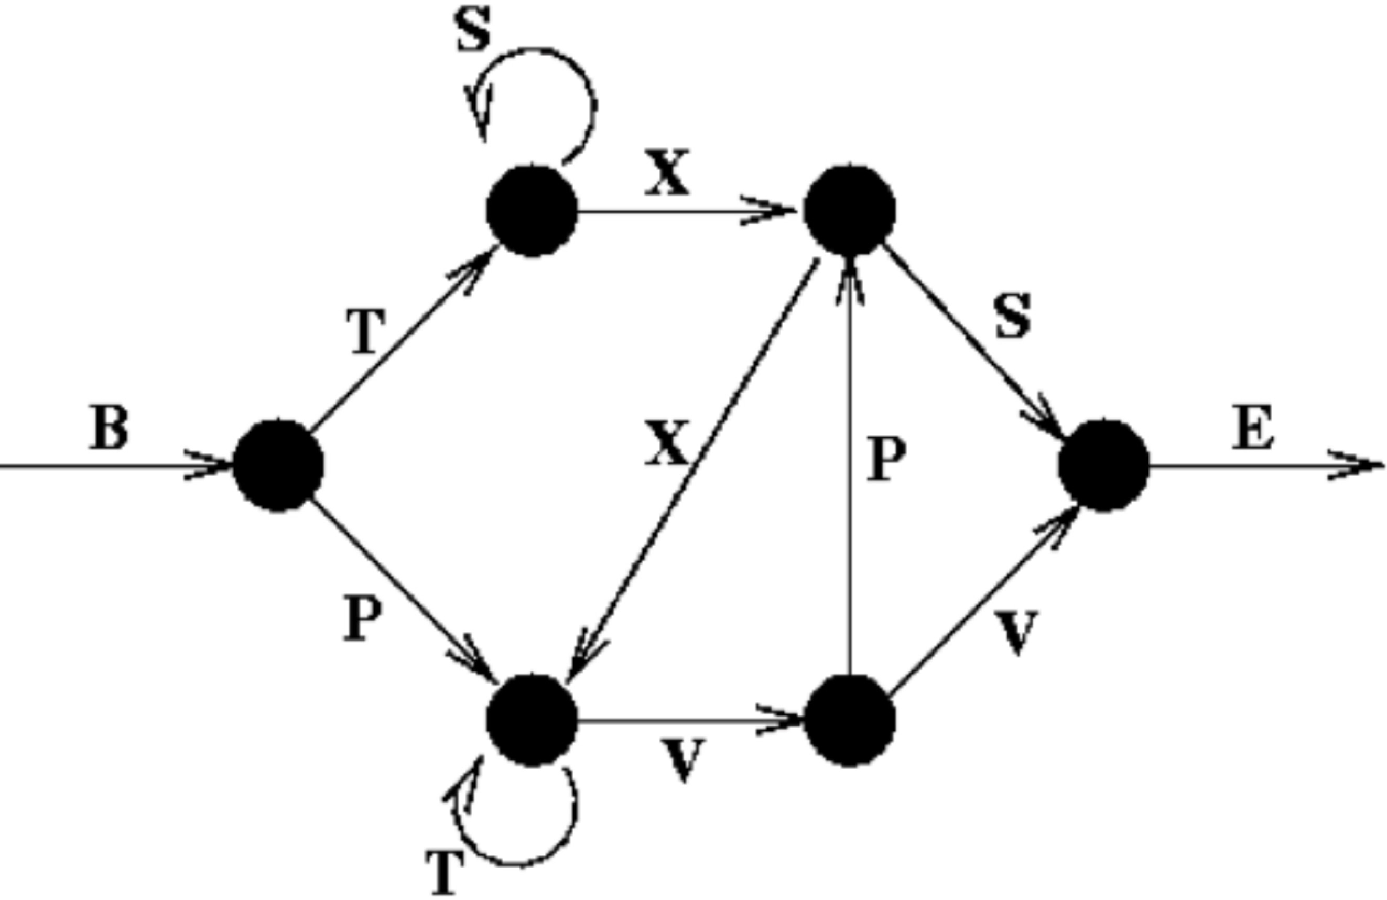

Reber Grammar
Learning Reber grammar
200 training, 200 testing with 100 $+$, 100 $−$
negative examples formed by replacing single symbol in sequence
sequences up to 15 elements long
 | generic (tanh) RNN | state-denoised RNN | RNN+attractor trained via prediction task
test set accuracy | 83.9% | 87.7% 2 sided paired t-test t(99)=4.77, p<.00001 | 80.8% 2 sided paired t-test t(99)=3.35, p=.001

Slide 29
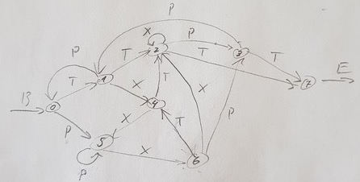
Kazakov Grammar
400 training, 2000 testing
sequences up to 20 elements long
 | generic (tanh) RNN | state-denoised RNN | RNN+attractor trained via prediction task
test set accuracy | 76.8% | 76.5% t(99) < 1

Slide 30
Wrap Up
hand
Consciousness is at the interface between subsymbolic and symbolic representations
Symbols are effective for communication
between people (language)
and internally in the mind?
Some reason to hope this idea will improve information transmission in recurrent neural nets
activation
tree
time
Notes:
symbols effective for communication: common point yoshua

Slide 31
I’m done
Notes:
Reln to other work: Ba
Not discretization
+ not running to fixed point
+ composition structure
+ subspace attractors

Slide 32
Like max pooling with convolutional net
suppressing some information to let other information through

Slide 33
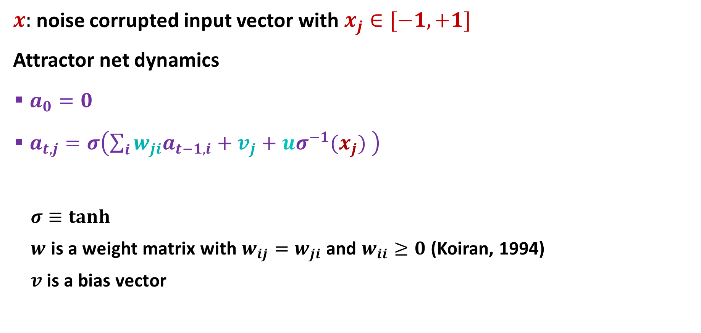
Attractor Net
$x:$ noise corrupted input vector with $x_{j}∈[−1,+1]$
Attractor net dynamics
$a_{0}=0$
$a_{t,j}=σ\left(\sum_{i}{{w_{ji}a}_{t−1,i}}+v_{j}+{uσ}^{−1}(x_{j}) \right)$
$σ≡tanh$
$w$ is a weight matrix with $w_{ij}=w_{ji}$ and $w_{ii}≥0$ (Koiran, 1994)
$v$is a bias vector

Slide 35
Supervised Training
training signal
…
…
…
…
…

Slide 36
Varieties of Consciousness
Phenomenal Consciousness
Access Consciousness

