Slide 1
Access Consciousness and the Construction of Actionable Representations
Michael C. Mozer and Denis Kazakov Department of Computer Science University of Colorado at Boulder

Slide 2
State-Denoised RNNs
Analog to denoising autoencoders
noise robustness
Why is noise in RNNs so devastating?
it amplifies over time

Slide 3
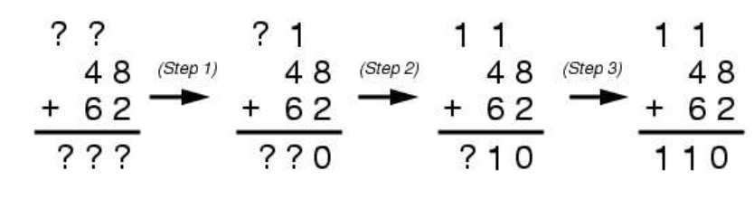
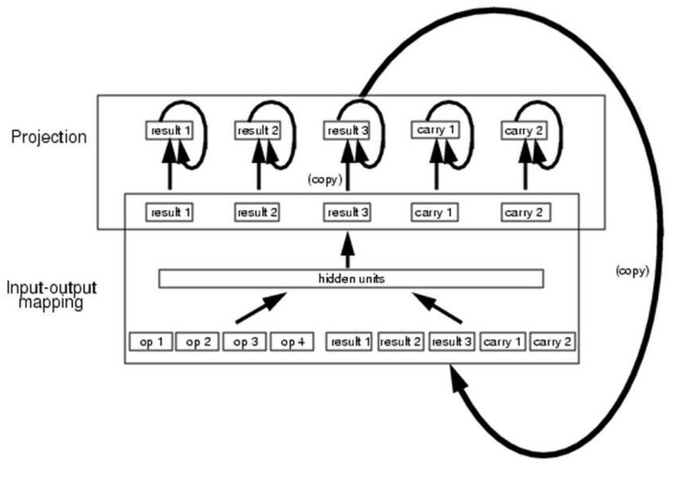
Denoising RNNs: Motivation
Challenge
Architecture

Slide 4
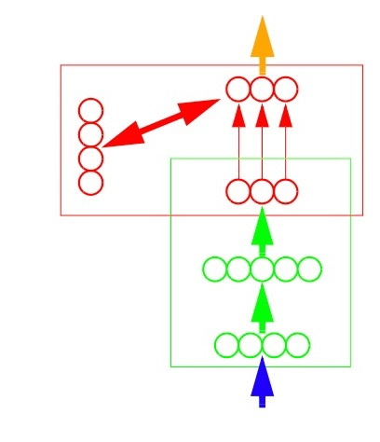
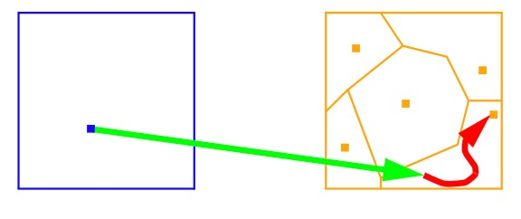
Denoising RNNs
Mapping-projection architecture

Slide 5
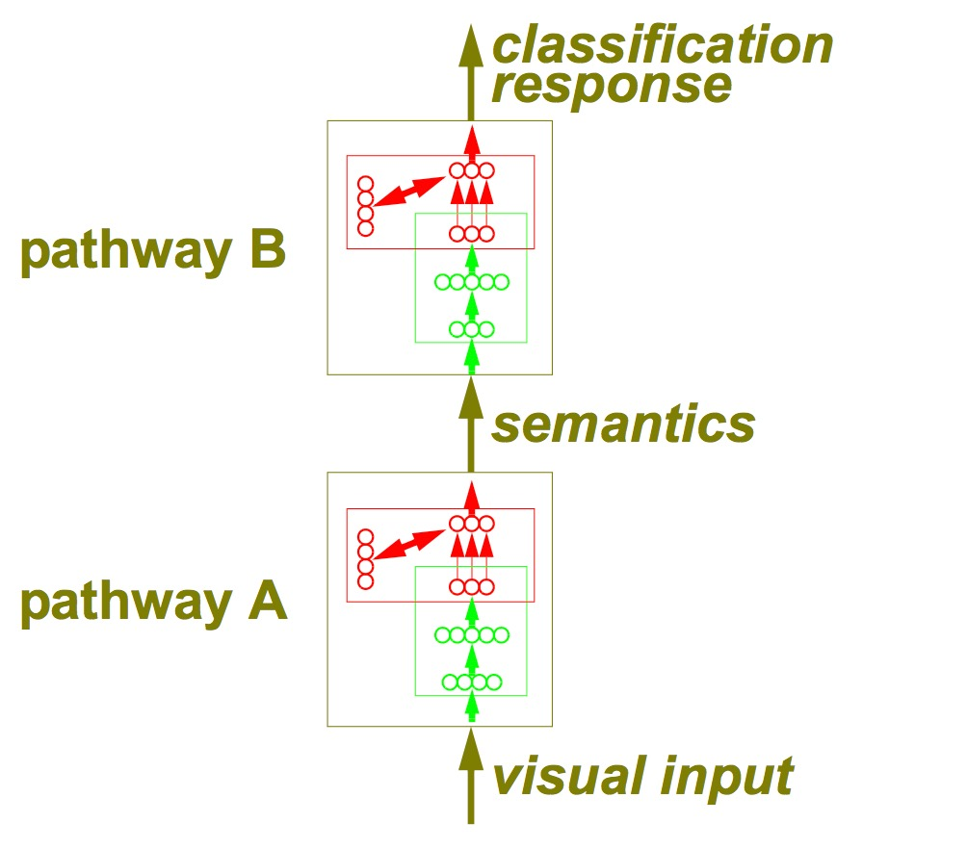
Denoising RNNs
A theory of (access) consciousness

Slide 6
Denoising RNNs
within
time
step
across
time
steps

Slide 7
Denoising RNNs
training signal
…
…
…
…
…

Slide 8
Denoising RNNs
…
…
…
noise
…
training signal
noise
noise

Slide 9
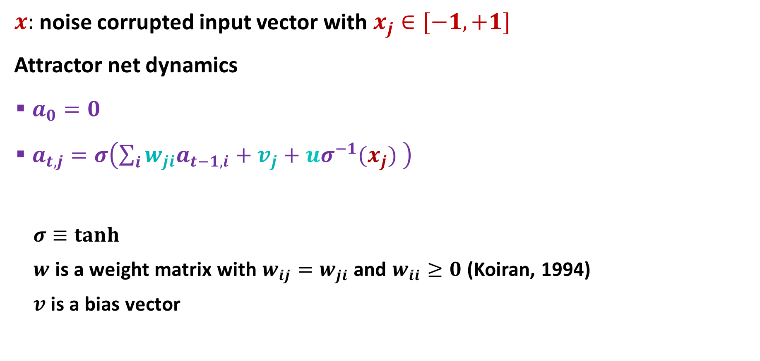
Attractor Net
$x:$ noise corrupted input vector with $x_{j}∈[−1,+1]$
Attractor net dynamics
$a_{0}=0$
$a_{t,j}=σ\left(\sum_{i}{{w_{ji}a}_{t−1,i}}+v_{j}+{uσ}^{−1}(x_{j}) \right)$
$σ≡tanh$
$w$ is a weight matrix with $w_{ij}=w_{ji}$ and $w_{ii}≥0$ (Koiran, 1994)
$v$is a bias vector

Slide 10
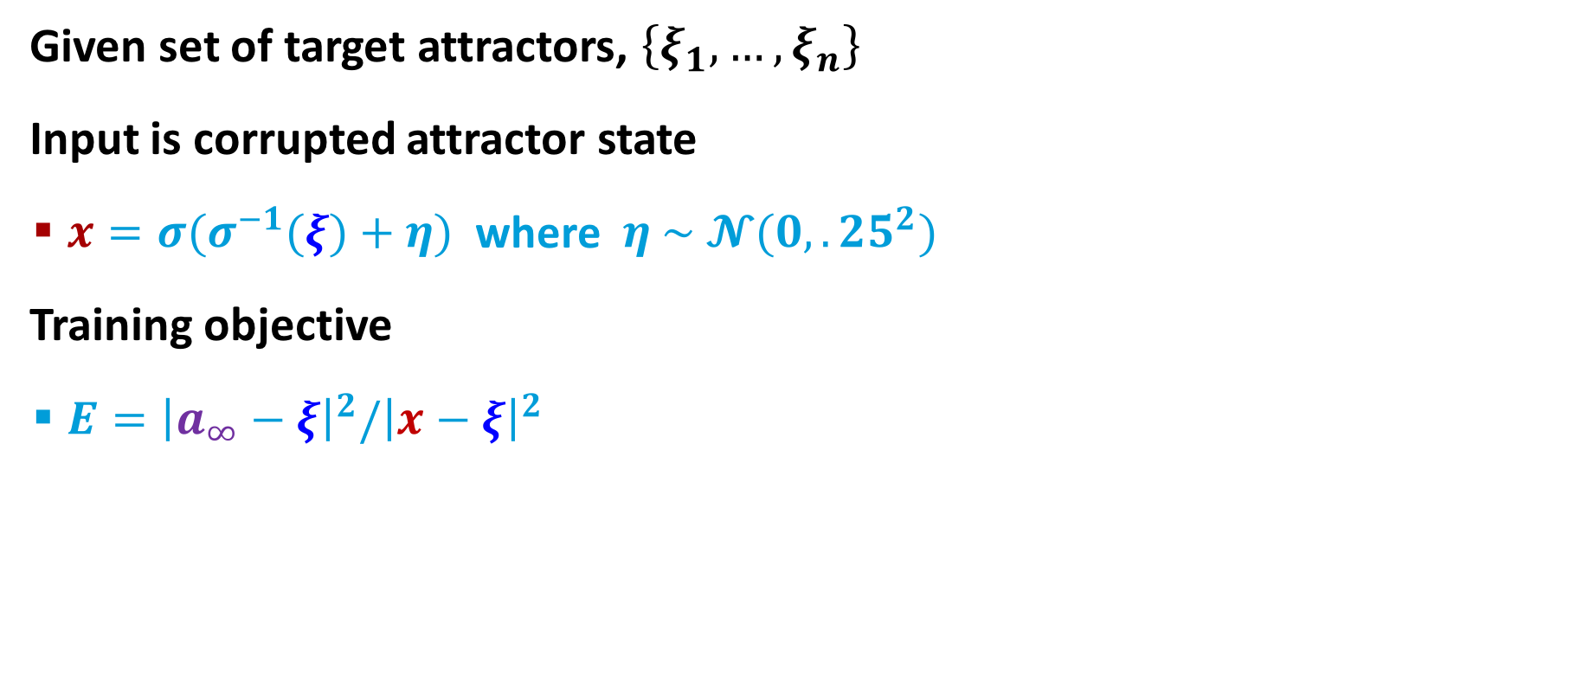
Training Attractor Net
Given set of target attractors, $\left\{ξ_{1}, …, ξ_{n}\right\}$
Input is corrupted attractor state
$x={σ(σ}^{−1}(ξ)+η)$ where $η \sim 𝓝(0,.25^{2})$
Training objective
$E={\left|a_{∞}−ξ\right|}^{2}/{\left|x−ξ\right|}^{2}$
…
training signal
noise

Slide 11
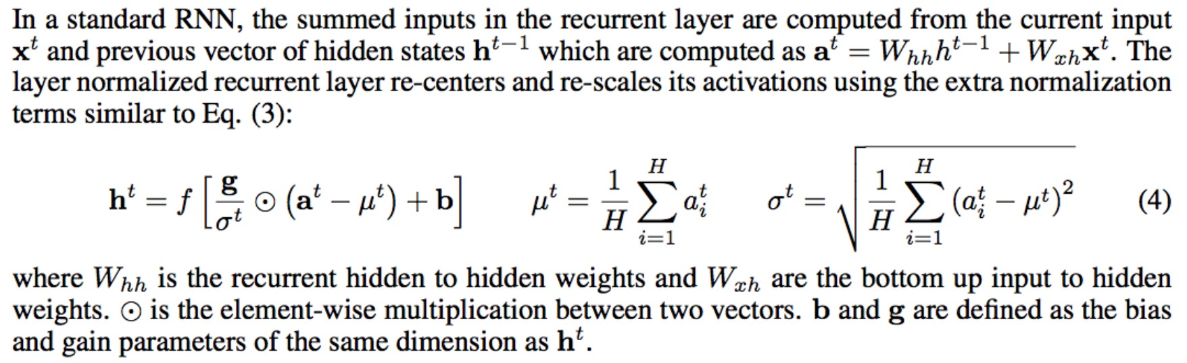
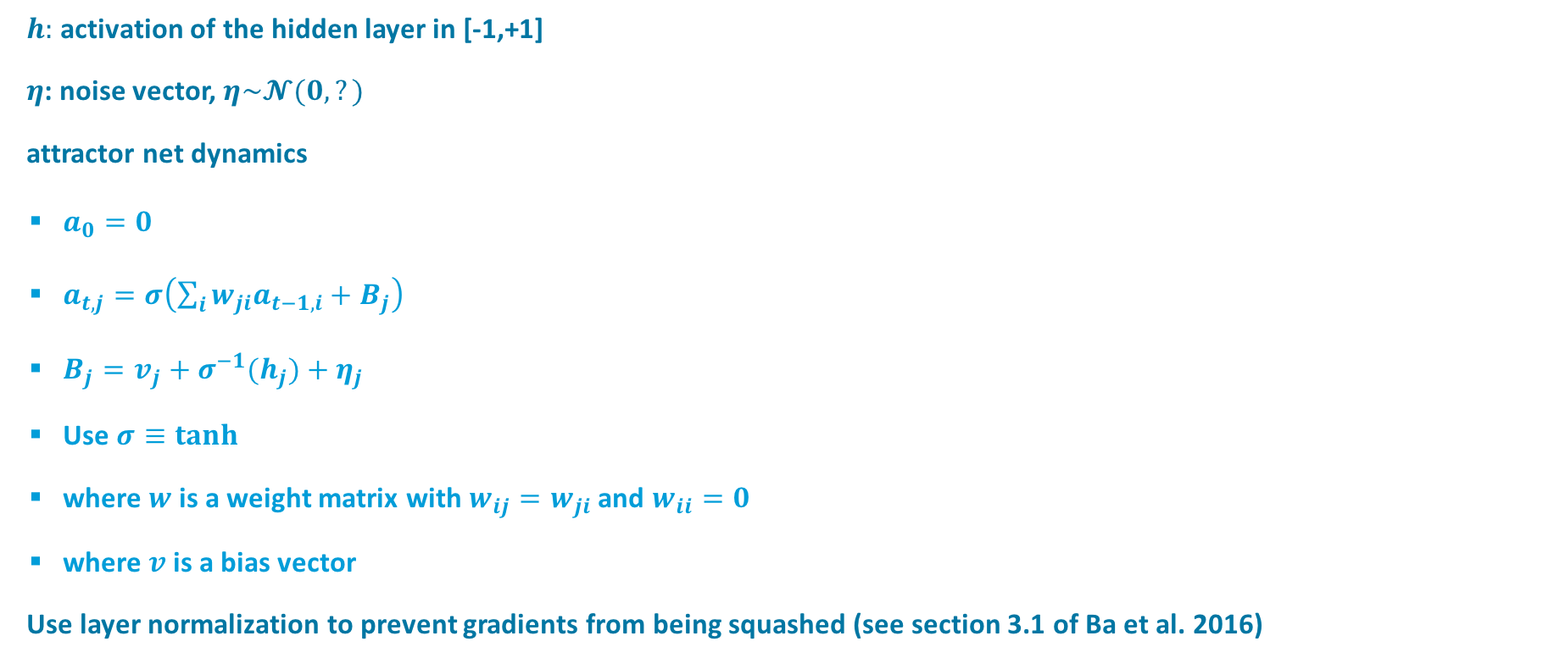
$h:$ activation of the hidden layer in [-1,+1]
$η$: noise vector, $η\sim 𝓝(0,?)$
attractor net dynamics
$a_{0}=0$
$a_{t,j}=σ\left(\sum_{i}{{w_{ji}a}_{t−1,i}}+B_{j}\right)$
$B_{j}=v_{j}+{σ^{−1}(h}_{j})+η_{j}$
Use $σ≡tanh$
where $w$ is a weight matrix with $w_{ij}=w_{ji}$ and $w_{ii}=0$
where $v$is a bias vector
Use layer normalization to prevent gradients from being squashed (see section 3.1 of Ba et al. 2016)

Slide 12
Parity Function
Learning 5 element sequence parity function
training on all data, 100 replications
 | generic (tanh) RNN | state-denoised RNN | RNN + attractor net trained with pred error
training set accuracy | 93.3% | 97.8% 2 sided paired t-test t(99)=3.42, p<.001 | 75.8%
% successes | 57 | 69 | 41
Notes:
5 steps in attractor net

Slide 13
Majority Function
Learning majority function from few examples
12 element binary sequences
training on 64 random examples, testing on remaining
tanh RNN
 | generic (tanh) RNN | state-denoised RNN | RNN+attractor trained via prediction task
testset accuracy | 86.5% | 90.3% 2 sided paired t-test t(99)=3.12, p=.0025 | 82.4% 2 sided paired t-test t(99)=3.35 p=.0011
Notes:
stop training when 100% on training set

Slide 14
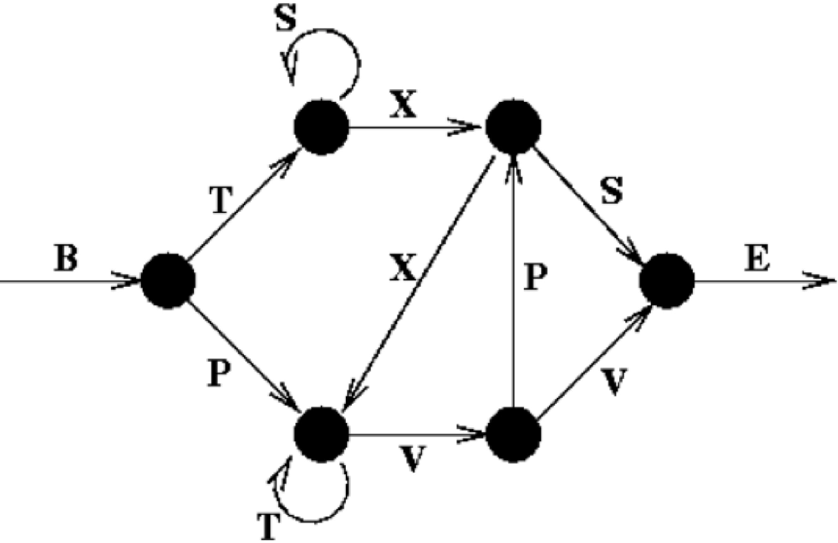
Reber Grammar
Learning Reber grammar
200 training, 200 testing
sequences up to 15 elements long, with B and E markers
 | generic (tanh) RNN | state-denoised RNN | RNN+attractor trained via prediction task
test set accuracy | 83.9% | 87.7% 2 sided paired t-test t(99)=4.77, p<.00001 | 82.4% 2 sided paired t-test t(99)=3.35 p=.0011

Slide 15
Like max pooling with convolutional net
suppressing some information to let other information through

