Slide 1
State-Denoised RNNs
Analog to denoising autoencoders
noise robustness
Why is noise in RNNs so devastating?
it amplifies over time

Slide 2
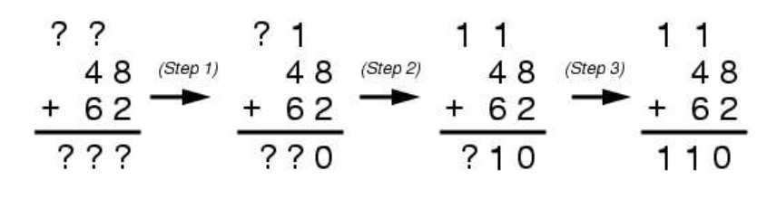
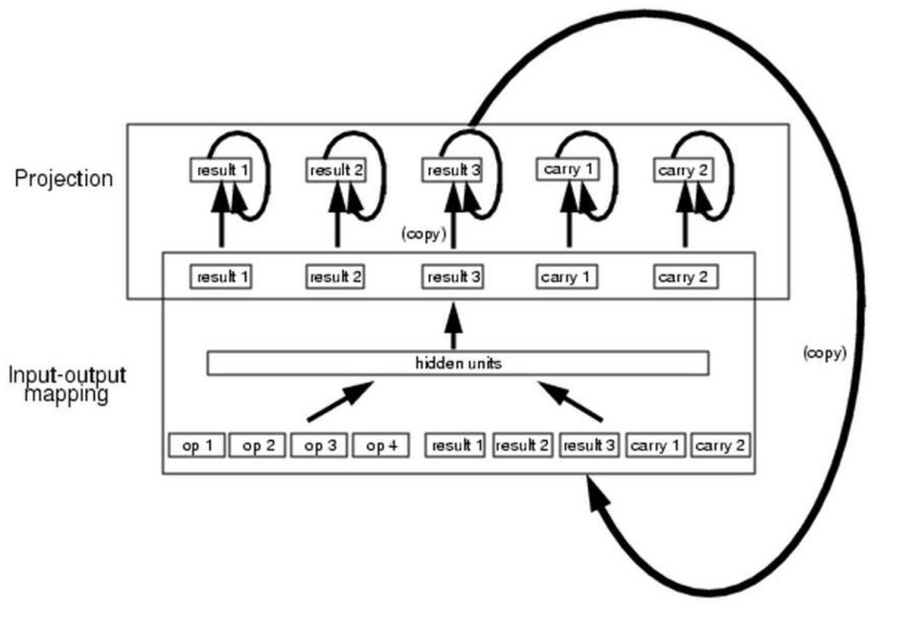
Denoising RNNs: Motivation
Challenge
Architecture

Slide 3
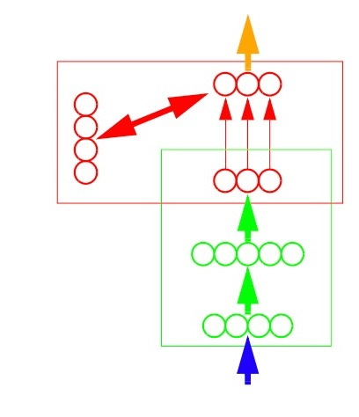
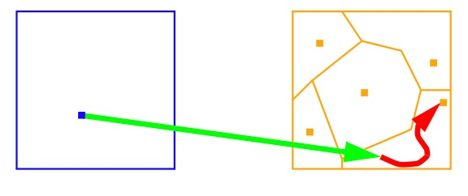
Denoising RNNs
Mapping-projection architecture

Slide 4
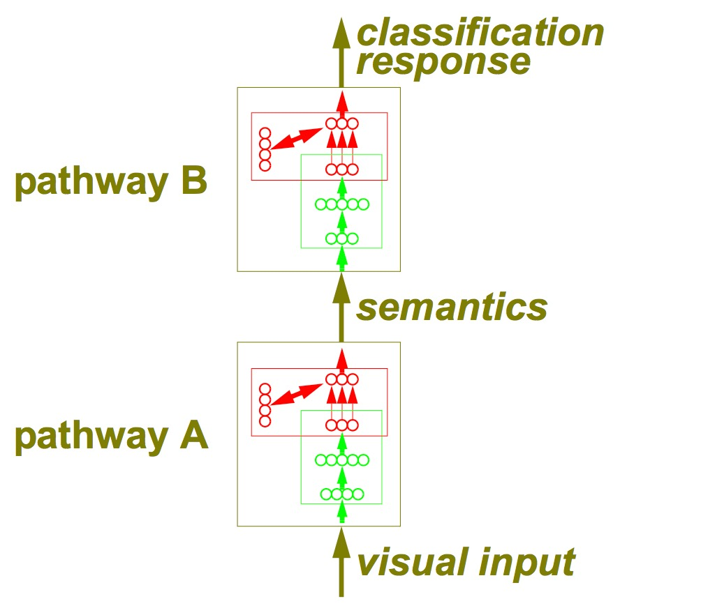
Denoising RNNs
A theory of (access) consciousness

Slide 5
Denoising RNNs
Specific project idea
use parity network from assignment 6
add in attractor net dynamics

Slide 6
Denoising RNNs
within
time
step
across
time
steps

Slide 7
Denoising RNNs
…
…
…
…
…

Slide 8
Denoising RNNs
training signal
…
…
…
noise
…
…
training signal
noise
noise

Slide 9
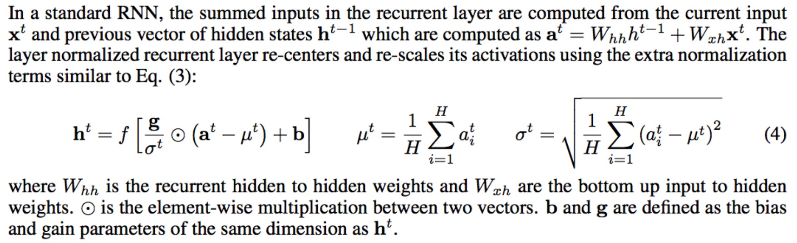
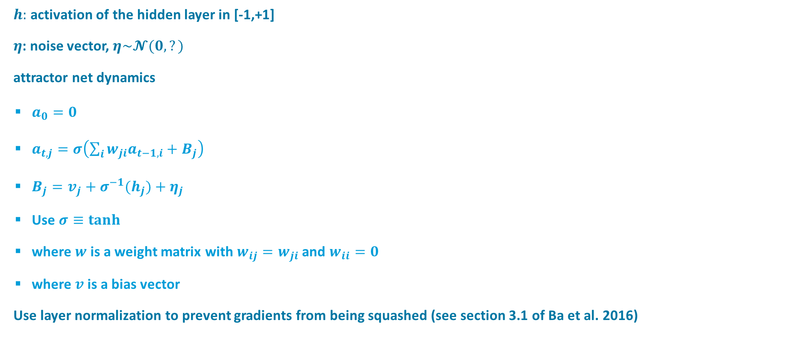
$h:$ activation of the hidden layer in [-1,+1]
$η$: noise vector, $η\sim 𝓝(0,?)$
attractor net dynamics
$a_{0}=0$
$a_{t,j}=σ\left(\sum_{i}{{w_{ji}a}_{t−1,i}}+B_{j}\right)$
$B_{j}=v_{j}+{σ^{−1}(h}_{j})+η_{j}$
Use $σ≡tanh$
where $w$ is a weight matrix with $w_{ij}=w_{ji}$ and $w_{ii}=0$
where $v$is a bias vector
Use layer normalization to prevent gradients from being squashed (see section 3.1 of Ba et al. 2016)

