Slide 1
Access Consciousness and the Construction of Actionable Representations
Michael C. Mozer and Denis Kazakov Department of Computer Science University of Colorado at Boulder

Slide 2
Varieties of Consciousness
Phenomenal Consciousness
Access Consciousness

Slide 3
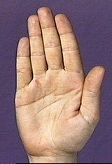

Conscious States Are Interpretations
Consider a polysemous word
awareness
PALM
hand
activation
tree
time

Slide 4
Lexical Decision
TREE
TURE
“word”
“nonword”
Measure response latency
Notes:
flash up letter string

Slide 5
Semantic Priming
congruent
unrelated
prime
LEAF
time
AUTO
TREE
TREE
target
500 ms
550 ms

Slide 6
Semantic Priming with Polysemous Words (Marcel, 1980)
congruent
incongruent
unrelated
LEAF
HAND
HAND
PALM
PALM
AUTO
TREE
TREE
TREE
supraliminal
500 ms
550 ms
550 ms
subliminal
500 ms
500 ms
550 ms

Slide 7
Semantic Priming with Polysemous Words (Marcel, 1980)
sub-
liminal
supra-
liminal
congruent
incongruent
unrelated
LEAF
HAND
HAND
activation
hand
PALM
PALM
AUTO
TREE
TREE
TREE
tree
supraliminal
500 ms
550 ms
550 ms
time
subliminal
500 ms
500 ms
550 ms
Conscious states are interpretations

Slide 8
Mapping-Projection Architecture (Mathis & Mozer, 1995)
Mapping
quick and dirty
Projection
slow but accurate
converges on a meaningful state (interpretation)
semantics
semantics
attractor
net
feedforward
net
visual image
visual image
Notes:
points represent previously learned semantic states
attractor net: recurrent net with attractor dynamics
BUT WHAT DOES THIS HAVE TO DO WITH AWARENESS?

Slide 9
Degrees of Awareness of a Visual Stimulus (Allport, 1988)
unconscious
conscious
at chance on a
presence/absence
task
reliable
detection
but at
chance for
identification
above chance
identification
with low
confidence
reliable identification,
guides action in
flexible, arbitrary
manner
Notes:
… what does it mean to response in arbitrary ways?

Slide 10
detection
verbal naming
lexical
decision
semantics
visual image
Notes:
Don Mathis and I showed that this architecture could explain results from the priming task, and more generally
under what conditions a representation from one pathway will influence a subsequent pathway

Slide 11
What sort of representation in output of pathway A will support appropriate behavior of pathway B?
Pr(B correct)
B
persistence
familiarity to B
A
Sufficient condition
Notes:
Sufficient condition for access consciousness: temporal persistence of a representation and familiarity of that representation

Slide 12
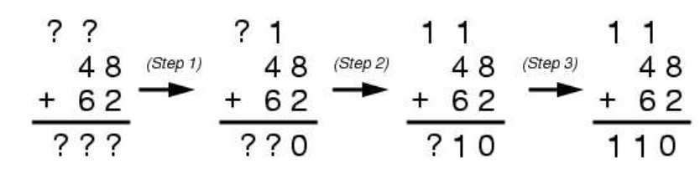
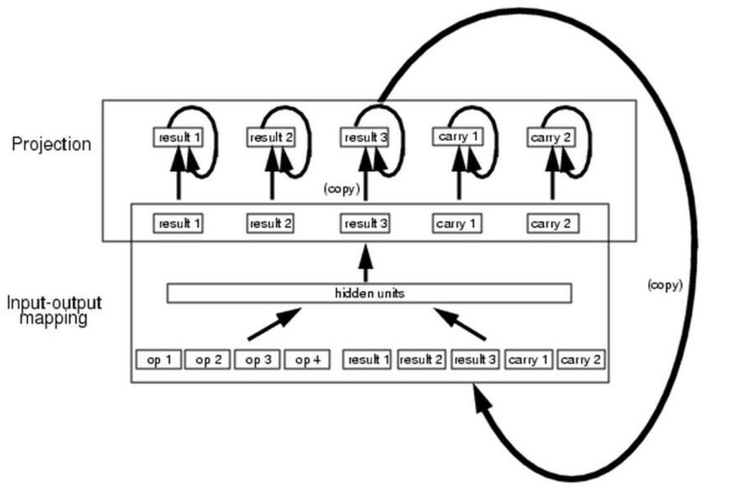
Denoising RNNs: Motivation
Challenge
Architecture

Slide 13
result₁
result₂
result₃
carry₁
carry₂
hidden
op₁
op₂
op₃
op₄
result₁
result₂
result₃
carry₁
carry₂

Slide 14
result₁
result₂
result₃
carry₁
carry₂
result₁
result₂
result₃
carry₁
carry₂
hidden
op₁
op₂
op₃
op₄
result₁
result₂
result₃
carry₁
carry₂

Slide 15
State-Denoised RNNs
Analog to denoising autoencoders
noise robustness
Why is noise in RNNs so devastating?
it amplifies over time

Slide 16
State-Denoising RNNs
within
time
step
across
time
steps

Slide 17
State-Denoising RNNs
training signal
…
…
…
…
…

Slide 18
State-Denoising RNNs
…
…
…
noise
…
training signal
noise
noise

Slide 19
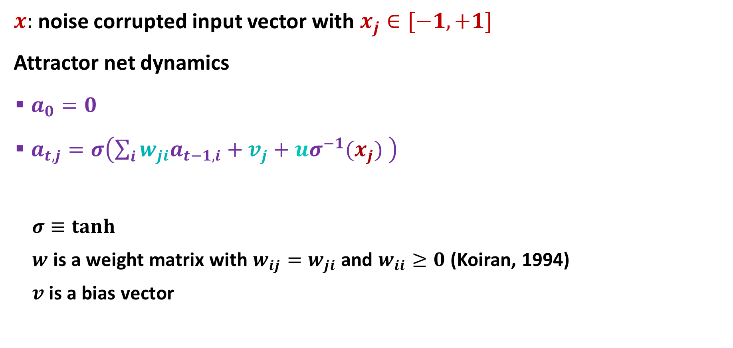
Attractor Net
$x:$ noise corrupted input vector with $x_{j}∈[−1,+1]$
Attractor net dynamics
$a_{0}=0$
$a_{t,j}=σ\left(\sum_{i}{{w_{ji}a}_{t−1,i}}+v_{j}+{uσ}^{−1}(x_{j}) \right)$
$σ≡tanh$
$w$ is a weight matrix with $w_{ij}=w_{ji}$ and $w_{ii}≥0$ (Koiran, 1994)
$v$is a bias vector

Slide 20
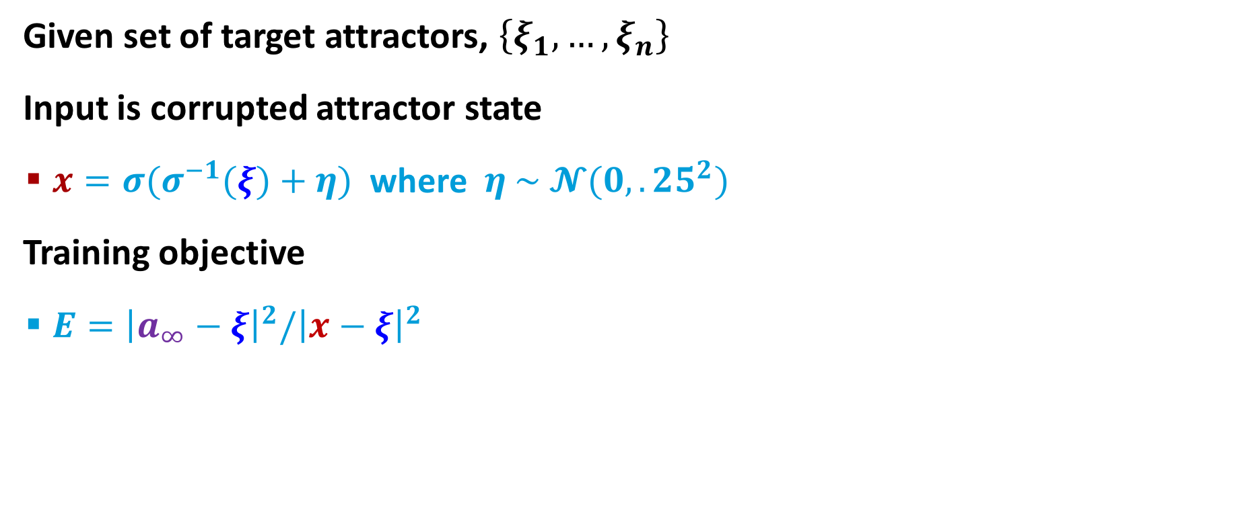
Training Attractor Net
Given set of target attractors, $\left\{ξ_{1}, …, ξ_{n}\right\}$
Input is corrupted attractor state
$x={σ(σ}^{−1}(ξ)+η)$ where $η \sim 𝓝(0,.25^{2})$
Training objective
$E={\left|a_{∞}−ξ\right|}^{2}/{\left|x−ξ\right|}^{2}$
…
training signal
noise

Slide 21
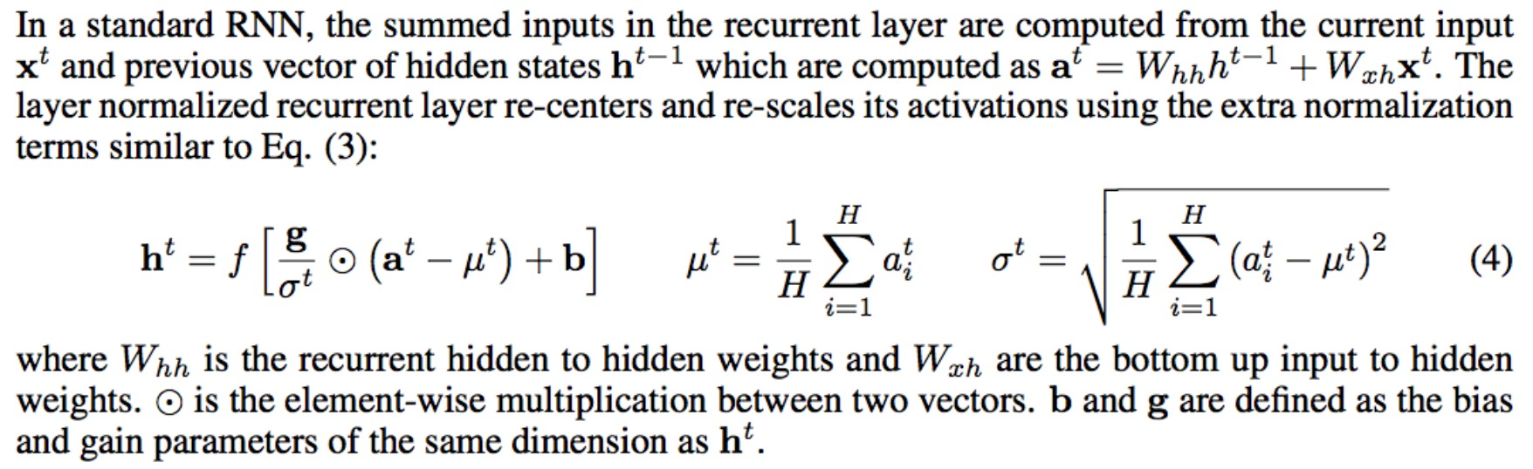

$h:$ activation of the hidden layer in [-1,+1]
$η$: noise vector, $η\sim 𝓝(0,?)$
attractor net dynamics
$a_{0}=0$
$a_{t,j}=σ\left(\sum_{i}{{w_{ji}a}_{t−1,i}}+B_{j}\right)$
$B_{j}=v_{j}+{σ^{−1}(h}_{j})+η_{j}$
Use $σ≡tanh$
where $w$ is a weight matrix with $w_{ij}=w_{ji}$ and $w_{ii}=0$
where $v$is a bias vector
Use layer normalization to prevent gradients from being squashed (see section 3.1 of Ba et al. 2016)

Slide 22
Parity Function
Learning 5 element sequence parity function
training on all data, 100 replications
 | generic (tanh) RNN | state-denoised RNN | RNN + attractor net trained with pred error
training set accuracy | 93.3% | 97.8% 2 sided paired t-test t(99)=3.42, p<.001 | 75.8%
% successes | 57 | 69 | 41
Notes:
5 steps in attractor net

Slide 23
Majority Function
Learning majority function from few examples
12 element binary sequences
training on 64 random examples, testing on remaining
tanh RNN
 | generic (tanh) RNN | state-denoised RNN | RNN+attractor trained via prediction task
testset accuracy | 86.5% | 90.3% 2 sided paired t-test t(99)=3.12, p=.0025 | 82.4% 2 sided paired t-test t(99)=3.35 p=.0011
Notes:
stop training when 100% on training set

Slide 24
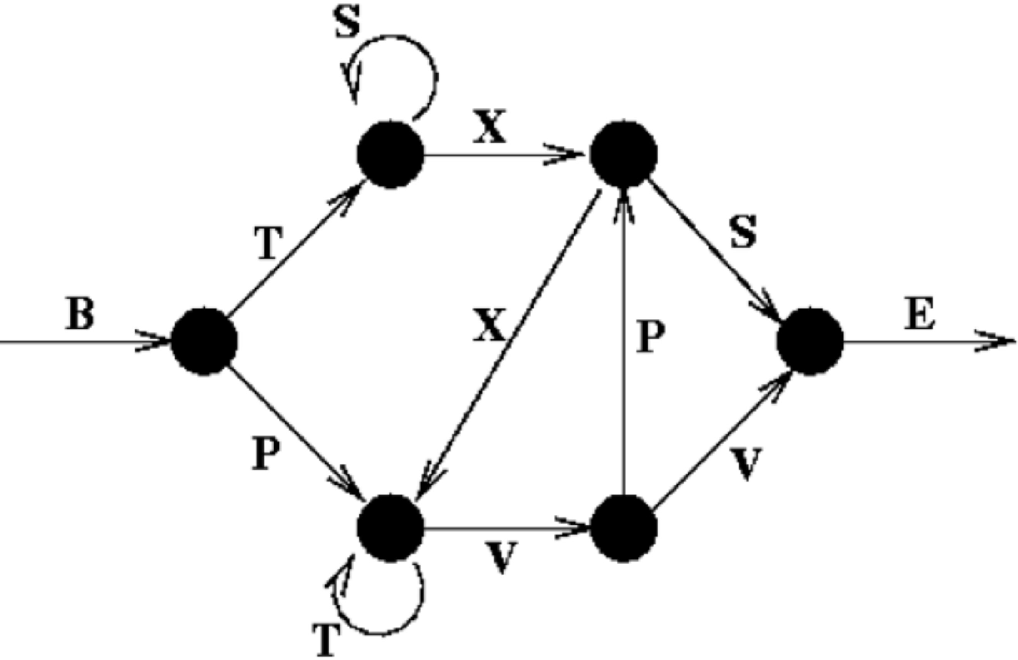
Reber Grammar
Learning Reber grammar
200 training, 200 testing
sequences up to 15 elements long, with B and E markers
 | generic (tanh) RNN | state-denoised RNN | RNN+attractor trained via prediction task
test set accuracy | 83.9% | 87.7% 2 sided paired t-test t(99)=4.77, p<.00001 | 80.8% 2 sided paired t-test t(99)=3.35, p=.001

Slide 25
Kazakov Grammar
400 training, 2000 testing
sequences up to 15 elements long, with B and E markers
 | generic (tanh) RNN | state-denoised RNN | RNN+attractor trained via prediction task
test set accuracy | 80.7% | 79.6% 80.0% with lrate_attractor.00333 2 sided paired t-test t(99)=4.77, p<.00001 | % 2 sided paired t-test t(99)=3.35 p=.0011

Slide 26
Like max pooling with convolutional net
suppressing some information to let other information through

