Slide 1

Reinforcement Learning for Autonomous Hybrid Combine Harvester Control
Robotics 1 (Jackson Godbersen, Robert McMullen, Xiaoquan Zhao)
2024 April 30

Slide 2
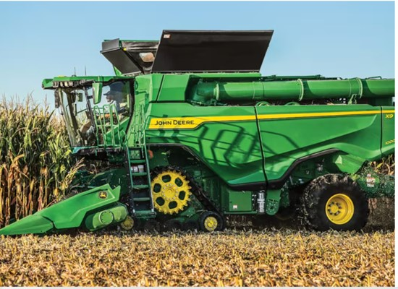
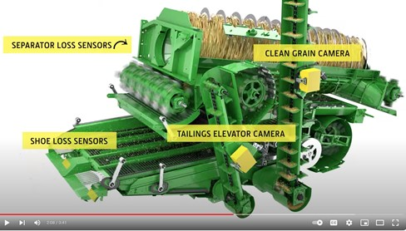
Autonomous Hybrid Combine Harvester Control
Goal: Maximize grain harvested, minimize energy consumption, complete field in allotted time
https://www.youtube.com/watch?v=ZzX8sLiJiHI
www.deere.com

Slide 3
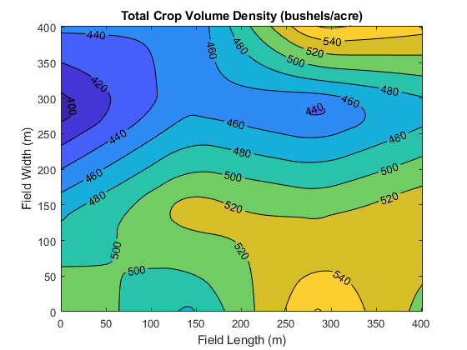
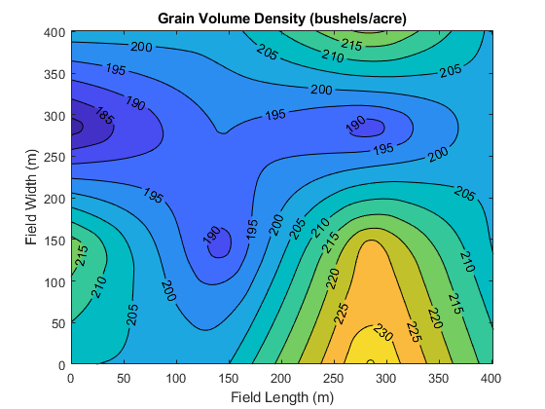
Environment – Field
Changing crop conditions generate dynamic states [1]
Crop volume map
Grain volume map

Slide 4
Environment – Combine
Estimated from [5]
Fuel
Engine
Tractive power to combine
Power
Motor/Battery
Process Crop
Approximated from [4]
Estimated from descriptions in [1,2,3]

Slide 5
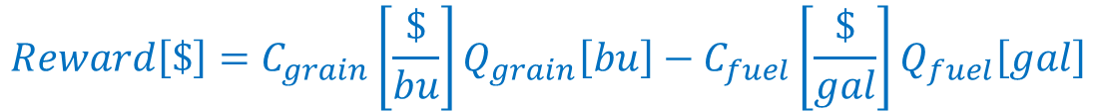
Autonomous Hybrid Combine Control Reinforcement Learning
$$Reward\left[\$\right]=C_{grain}\left[\frac{\$}{bu}\right]Q_{grain}\left[bu\right]−C_{fuel}\left[\frac{\$}{gal}\right]Q_{fuel}\left[gal\right]$$
Discount grain value for grain harvested after a time limit (= 10 km/hr average combine speed)
System states:
Combine speed (km/hr)
Grain processing efficiency
Battery SOC
Reward
Agent
Requested engine power
Requested motor/battery power
Combine control setting
Environment
Power consumption (Tractive and crop processing)
Grain harvest rate
Notes:
Cgrain = 0.75*Cgrain when allotted harvest time is exceeded. Allotted time set for 10 km/hr mean combine speed through field.

Slide 6
Field Harvest Simulation

Slide 7
Field Harvest Simulation – Baseline Control
Baseline Control:
Combine control setting:
Assume combine speed (one of the environment states) ≈ 10x normalized crop rate
Combine control setting = 0.7(combine speed) + 0.35
Requested battery power:
Discharging = 50 kW for SOC 0.7 -> 0.2
Charging = -21 kW for SOC 0.2 -> 0.7
Requested engine power = 300 kW
Notes:
I tried a few different settings and manually landing on a “pretty good” baseline control scheme.

Slide 8
Field Harvest Simulation – Baseline Control (Cumulative Reward = $264)

Slide 9
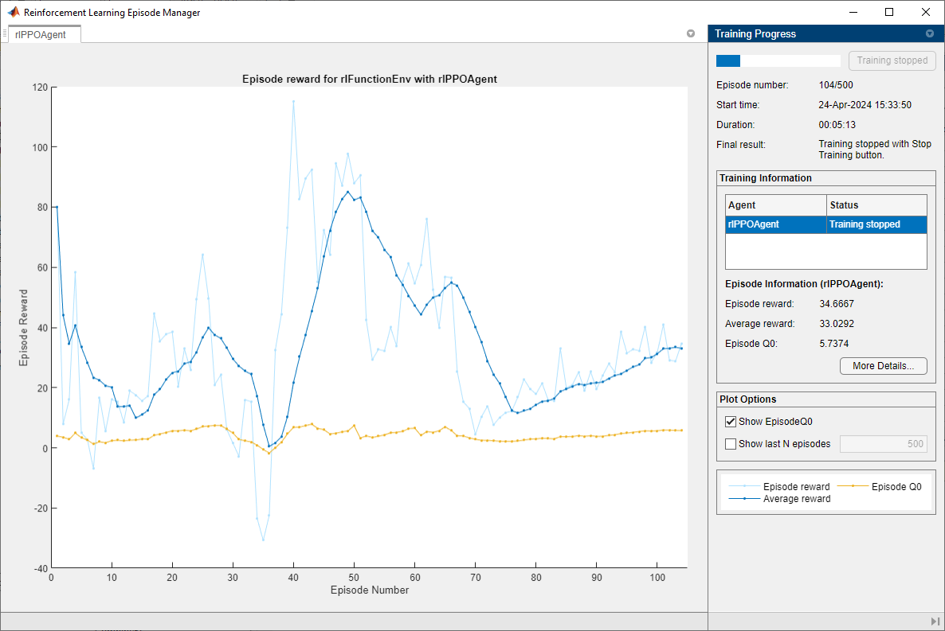
Problem Formulation – Lessons Learned
It helps to have some idea where the solution can be found
$100 reward
Make sure boundary conditions are modeled accurately: Policy found and exploited environment limit errors
Notes:
Policy training found multiple ill-defined boundaries and exploited them. Example shown is check on battery SOC was done at the end of the time step, so it wasn’t limiting motor power. For the second iteration to fix this one, the policy figured out it could request a large motor power to pass through many grids before the environment checked this power.

Slide 10
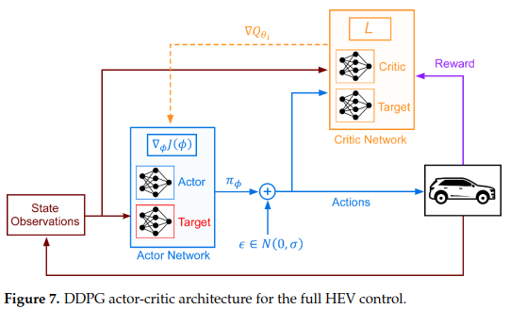
Reinforcement Learning – Agent Model
Research: Limited published information from ag / off-road machines, extensive literature for hybrid powertrain control (mostly passenger car)
Ganesh [6]: DQN, DDPG, model-based
Yao [7]: DDPG
Li [8]: DQN, twin delay DDPG, PPO
Selected PPO and TD-DDPG agent model architectures to evaluate

Slide 11



Reinforcement Learning – Agent Model
PPO
TD-DDPG
$$\max_{θ}{𝔼\left[\frac{π\left(a|s;θ^{π}\right)}{π\left(a|s;θ^{π−}\right)}A−C∙{KL}_{π_{θ,old}}\left(π_{θ}\right)\right]}$$
$$\hat{g}=𝔼\left[∇_{θ^{μ}}μ\left(s;θ^{μ}\right)∇_{a}Q\left(s,a;θ^{Q}\right)\right]$$
$$a=μ\left(s;θ^{μ}\right)$$
Discount Factor: 0.99
Clip Factor: 0.2
Discount Factor: 0.99
Smoothing Factor: 0.005
Actor Network (Policy):
Input = 3 x 128, ReLU
Hidden = 128 x 128, ReLu
Output (mean) = 128 x 3, tanh, scaling
Output (StDev) = 128 x 3, softmax
Optimizer: adam, 0.01 LR
Critic Network (Value):
Input = 3 x 128, ReLU
Hidden = 128 x 128, ReLu
Output = 128 x 1
Optimizer: adam, 0.01 LR
Actor Network (Policy):
Input = 3 x 128, ReLU
Hidden = 128 x 128, ReLU
Output = 128 x 3, tanh, scaling
Optimizer: adam, 0.01 LR
Discount Factor: 0.99
Smoothing Factor: 0.005
Critic Network (Value):
Inputs = 3 x 128 (current), = 3 x 128 (delayed), ReLU
Hidden = 256 x 128, ReLU
Output = 128 x 1
Optimizer: adam, 0.01 LR
Discount Factor: 0.99
Smoothing Factor: 0.005

Slide 12
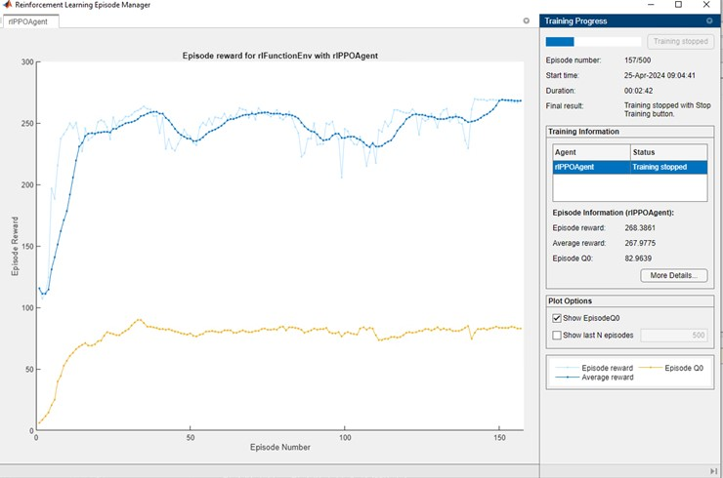
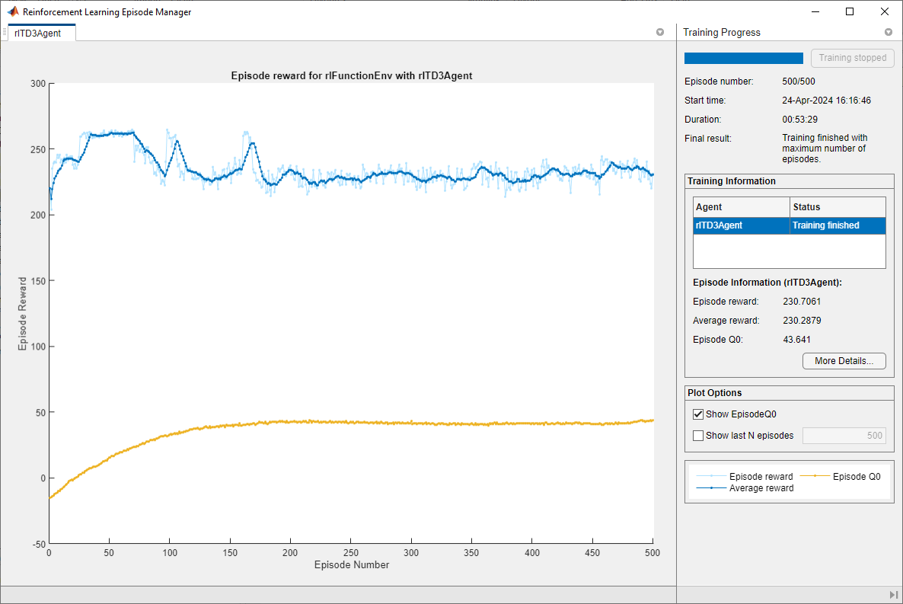
RL Model – Training
PPO
Twin Delayed - DDPG
< 3 minutes to run 157 episodes
53 minutes to run 500 episodes even when starting from a lucky initial guess

Slide 13
Field 1 Simulation Results – PPO (Cumulative Reward = $268)
States
Actions
Reward
Notes:
PPO found max reward when running max fuel efficiency power level for engine through the entire field, exhausting the battery storage without attempting to recharge, and doing a good job of controlling grain efficiency near its max for the full field.

Slide 14
Field 1 Simulation Results – TD-DDPG (Cumulative Reward = $269)
States
Actions
Reward
Notes:
Twin delayed DDPG found max reward when running constant settings of max engine power, exhausting the battery storage without attempting to recharge, and 0.85 combine control setting.

Slide 15
Field 1 Simulation – Re-Baseline (Cumulative Reward = $280)
Baseline Actions:
Requested Engine Power = 300kW
Requested Motor Power = 60kW
Combine control setting = 0.93
Notes:
From TD-DDPG results, I attempted constant settings for actions, and found max engine power and exhausting battery energy without trying to recharge, like TD-DDPG results, but with 0.93 fixed combine control setpoint produced a significant increase in reward.
I also retrained PPO and got similar results to TD-DDPG, and the same reward, for 300 kW engine power, exhaust intial SOC from the battery, and combine control around 0.85, but with more active control.
I generated two other fields, and the same results were observed.

Slide 16
Results and Conclusions
System model simplifications led to high reward for fixed actions
RL model accurately learned high-reward policy with fixed actions
But fixed combine control setting for highest reward was not found – is critic network limiting exploration?
TD-DDPG generated policy with more stable actions than PPO, but took 5x longer to train

Slide 17
Future Work – Improve Combine Control Setting Action
Normalize states and actions?
Optimizer and learning rate?
More hidden layers for value or policy networks or both?
Notes:
DDPG in Yao paper used 6 FC hidden layers x 300 nodes to control the full hybrid electric powertrain for passenger car – more complicated than my system.
Future work could also include “un-simplifying” system, attempting discrete motor action (charge/discharge) instead of continuous motor power action.

Slide 18
References
De Baerdemaeker, Josse, and Wouter Saeys. "Advanced control of combine harvesters." IFAC Proceedings Volumes 46, no. 18 (2013): 1-5.
Humberg, D. “Chapter 36: Profitability can be Enhanced by Reducing Corn Harvest Losses”, iGrow Corn Best Management Practices, South Dakota State University Extension, 2019.
Humberg, D. “Chapter 37: Combine Adjustments to Reduce Harvest Losses”, iGrow Corn Best Management Practices , South Dakota State University Extension, 2019.
Fan, J., et.al., “A Novel Power Management Strategy for Hybrid Off-Road Vehicles”, Control Engineering Practice, Vol 101 (2020), Elsevier. doi:10.1016/conengprac.2020.104452
Moreda, G. P., M. A. Muñoz-García, and P. J. E. C. Barreiro. "High voltage electrification of tractor and agricultural machinery–A review." Energy Conversion and Management 115 (2016): 117-131.
Ganesh, Akhil Hannegudda, and Bin Xu. "A review of reinforcement learning based energy management systems for electrified powertrains: Progress, challenge, and potential solution." Renewable and Sustainable Energy Reviews 154 (2022): 111833.
Yao, Zhengyu, Hwan-Sik Yoon, and Yang-Ki Hong. "Control of hybrid electric vehicle powertrain using offline-online hybrid reinforcement learning." Energies 16, no. 2 (2023): 652.
Li, Yuecheng, Hongwen He, Amir Khajepour, Yong Chen, Weiwei Huo, and Hao Wang. "Deep reinforcement learning for intelligent energy management systems of hybrid-electric powertrains: Recent advances, open issues, and prospects." IEEE Transactions on Transportation Electrification (2024).

Slide 19
Presentation Feedback – Actions for Report
Make RL training plots final report. Loss from training.
Extend learning for PPO and DDPG to same number of episodes.
Correct reward function?

