Slide 1
Using Neural Networks to Detect Pneumonia
Matthew Noonan
Flatiron School- Data Science
29 November ,2022

Slide 2
OUTLINE
Introduction
Business Understanding
Data Understanding
Results
Improvements

Slide 3
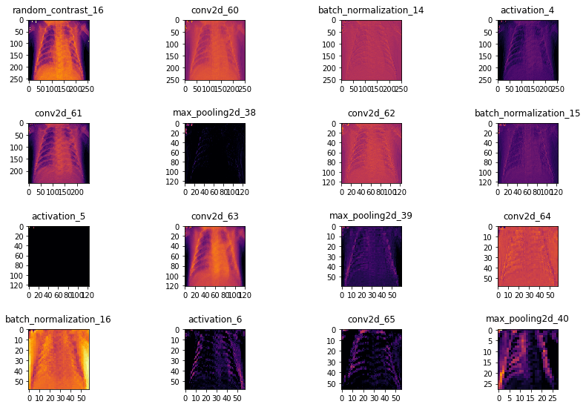
Introduction
CNN—Convolutional Neural Network
Detects important features at pixel level
Learns which features associate with which classes
Architecture
Input
Layers
Output
Metrics
Learning curve plot
Accuracy
Loss

Slide 4
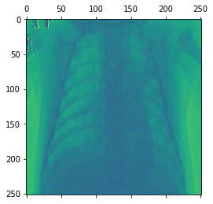
BUSINESS UNDERSTANDING
Hospital wants to upgrade its Xray machines
New model of machine has machine learning diagnostic feature
Streamlines triage and diagnosis by flagging xray prints suggestive of pneumonia
Allows medical staff to focus attention on likely positive cases

Slide 5
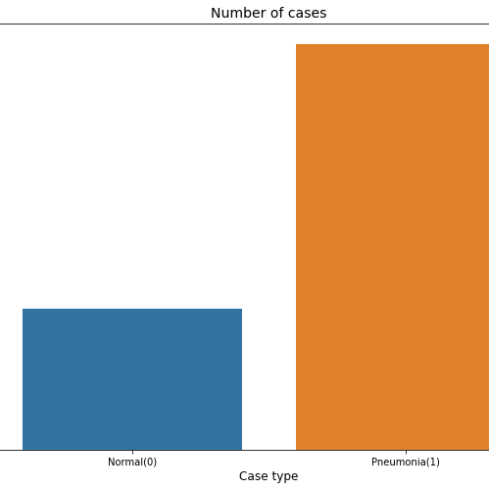
DATA
X-Ray images from Guangzhou Women’s and Children’s Hospital
5,856 jpeg images
Classified as ‘Normal(0)’ or ‘Pneumonia(1)’

Slide 6
Results Test Accuracy per Model
Baseline | Model_1 | Model_2 | Model_3 | Model_4 | Model_5 | Model_6 | Model_7
93.39% | 95.05% | 95.05% | 94.36% | 93.51% | 95.05% | 94.70% | 94.02%

Slide 7
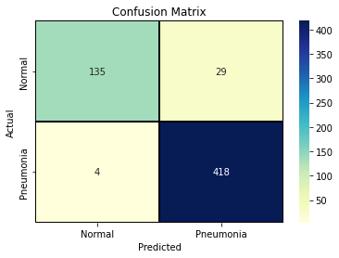
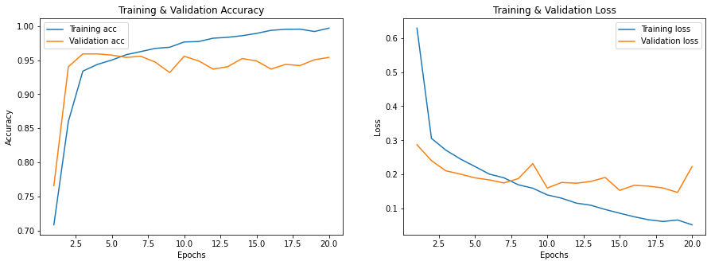
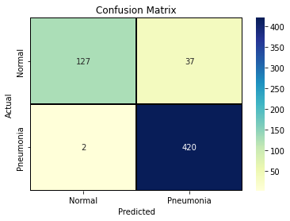
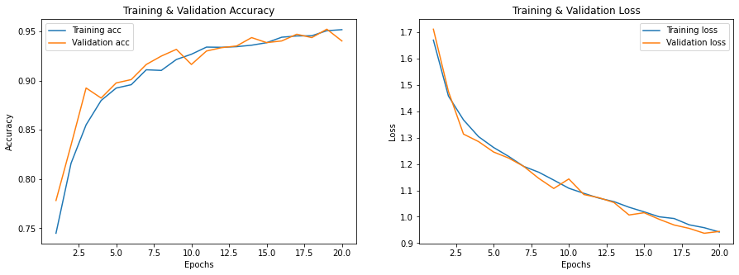
RESULTs: Confusion Matrices and learning curves
Baseline
Model 7

Slide 8
Recommendations
Use model more for triage and rapid assessment
Highlights cases requiring closer examination
Shortens
Always have trained medical staff review cases

Slide 9
Thank you!
Mirjam Nilsson
Questions? Comments?
Matthew Noonan
Email: mcn9284@gmail.com.com
www.contoso.com

