Slide 1
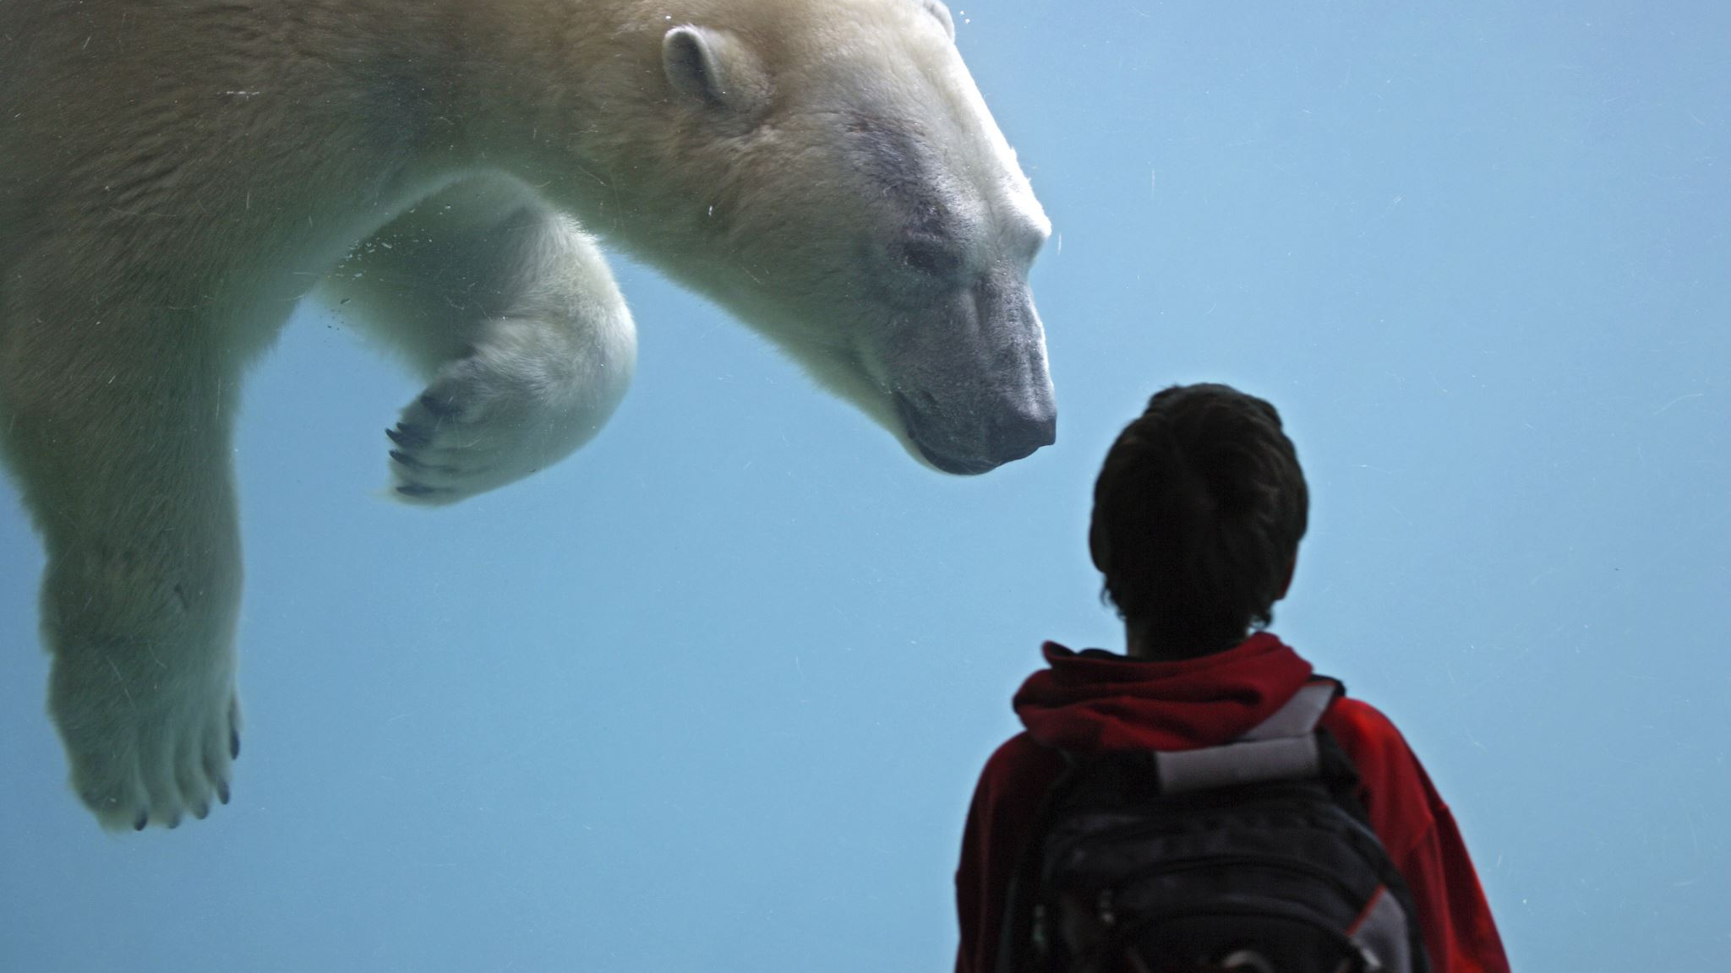
Analysis of Bear Incident Factors in North America
Data Exploration and Analysis
Matthew McNabb
11/14/2024

Slide 2
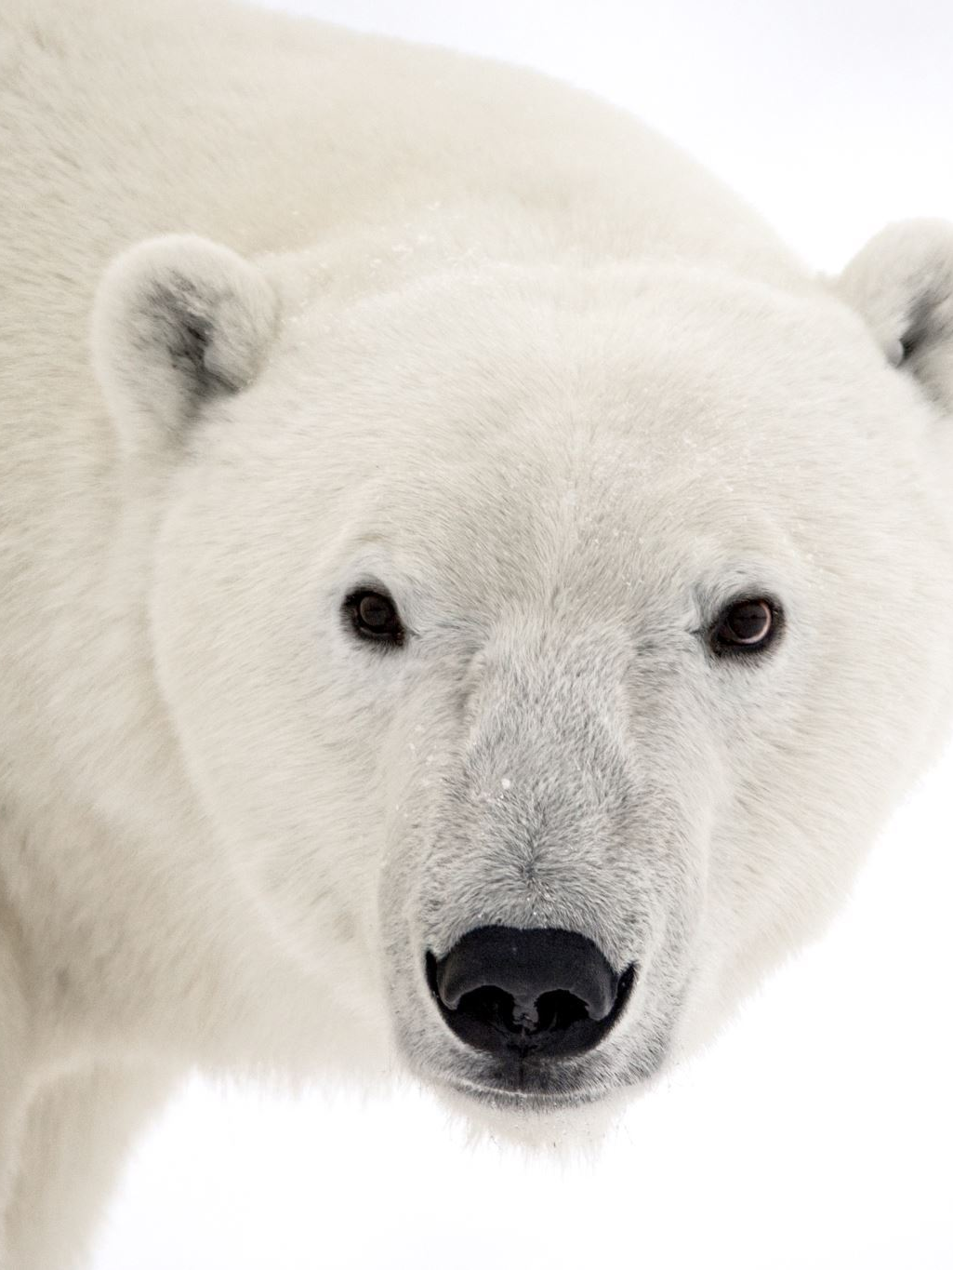
Introduction and Hypothesis
Hypothesis: The age of individuals involved in bear incidents differs based on whether the bear was wild or captive.
Project Goal: To analyze demographic and temporal patterns in bear incidents and determine if characteristics differ between wild and captive environments.

Slide 3
Dataset Overview
Source: The dataset includes information on incidents involving bear attacks, such as the age of the victim, type of bear involved, incident setting (wild or captive), year, and incident outcomes.
Variables Used:
Age: Age of the individual involved.
Year: Year of the incident.
Type: Wild or Captive bear incident.
Type of Bear: Species involved in the incident.
Only one killed: Indicator of whether only one person was killed.
Purpose of Selection: “These variables were chosen to address the hypothesis and explore differences in incident characteristics.”

Slide 4
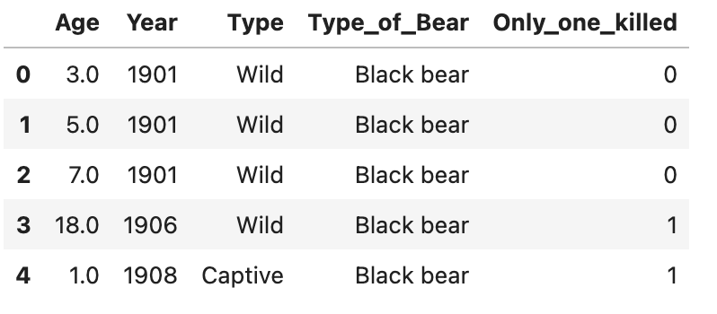
Data Cleaning and Preparation
Key Steps:
Renamed columns for consistency.
Selected relevant variables.
Handled missing values and converted data types for accuracy.
Challenges:
Addressing missing values in some variables.
Reformatting certain variables (e.g., Year) to ensure accurate analysis

Slide 5
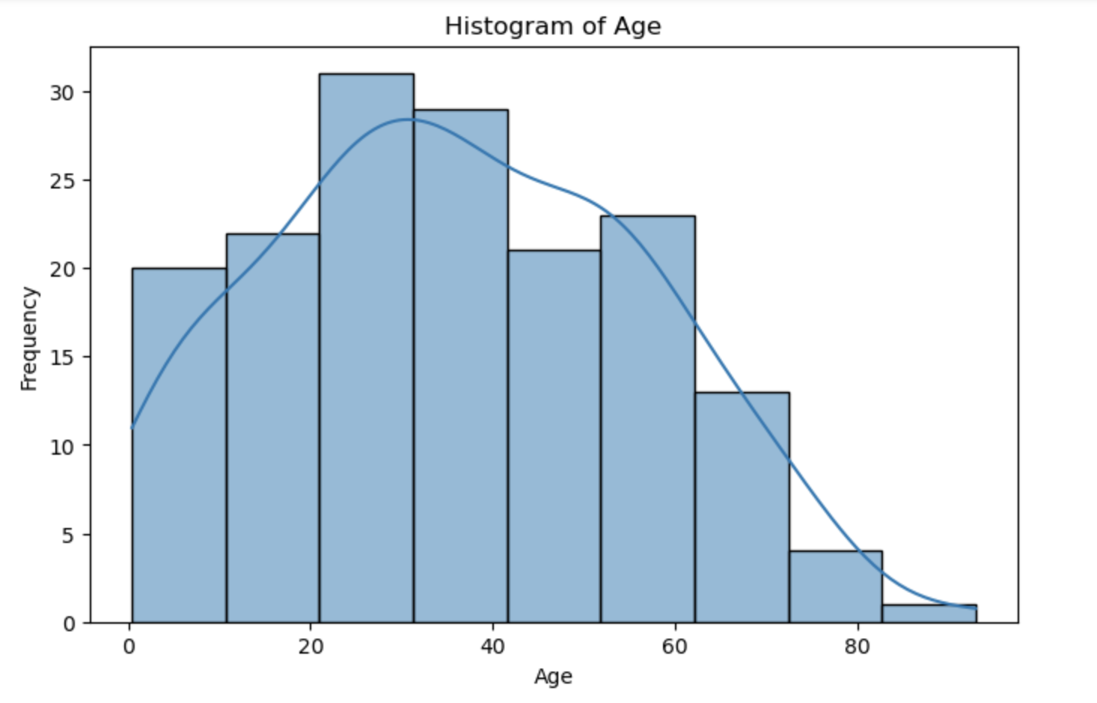
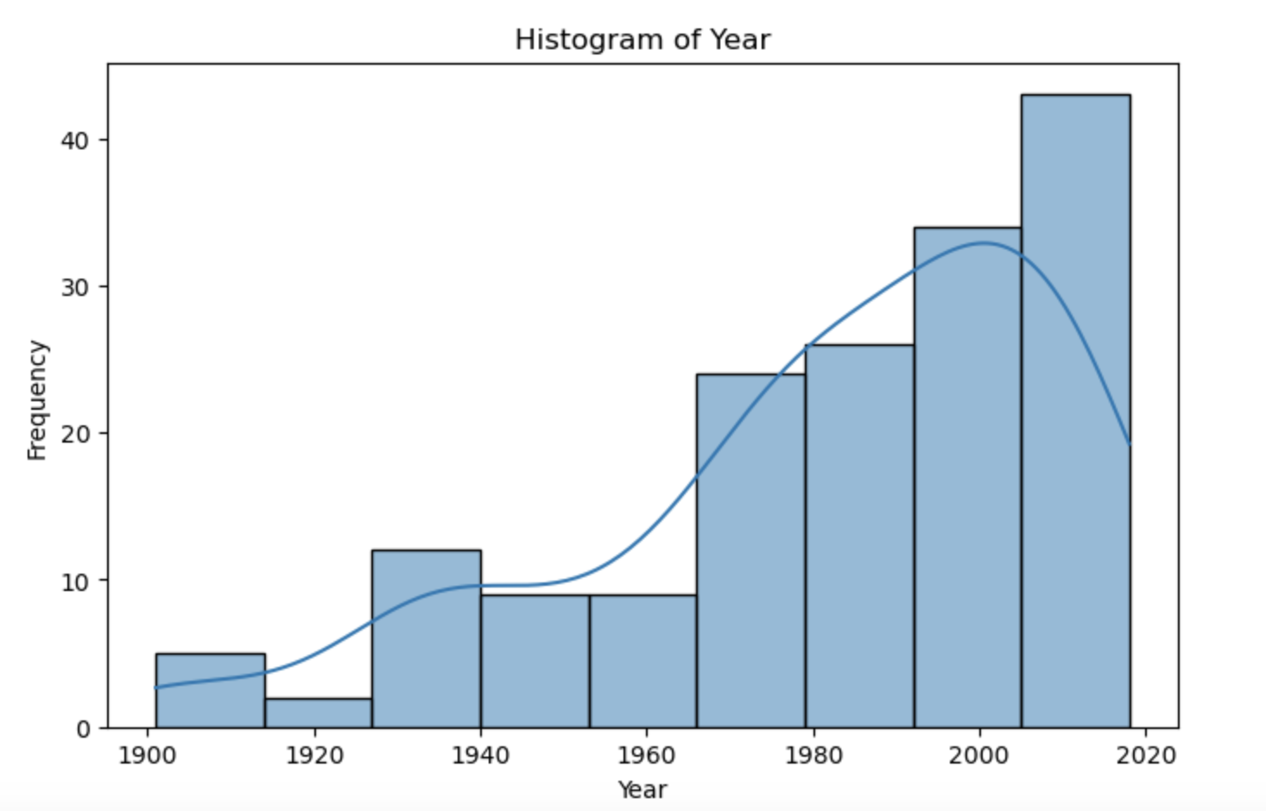
Descriptive Statistics and Histograms
Overview:
Descriptive statistics revealed that adults were the primary victims in bear incidents.
Histograms:
Age: Shows the age distribution of individuals involved in incidents.
Year: Displays the frequency of incidents over time.
Outliers:
Notable outliers in the Age variable (e.g., older individuals).
Variations in Year, suggesting patterns or anomalies over time

Slide 6
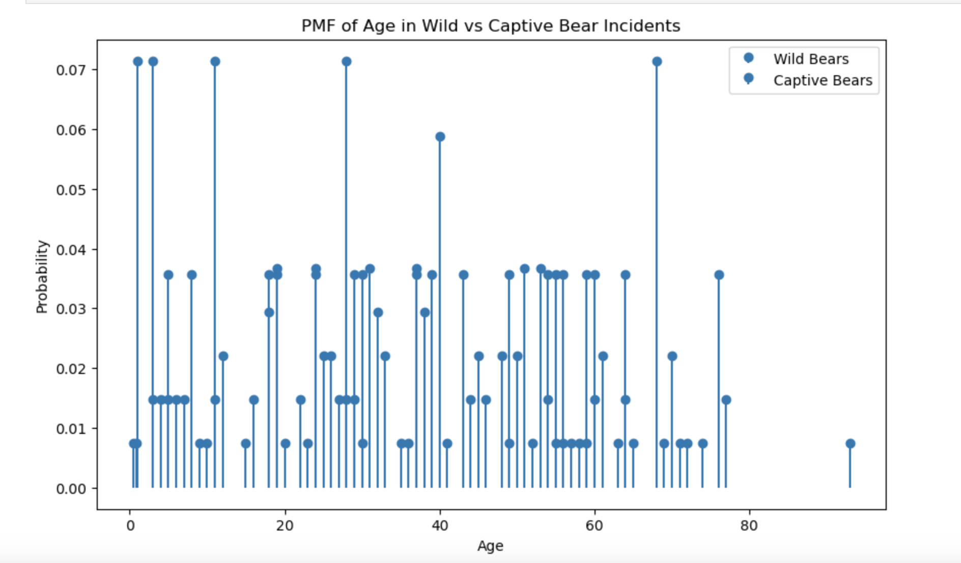
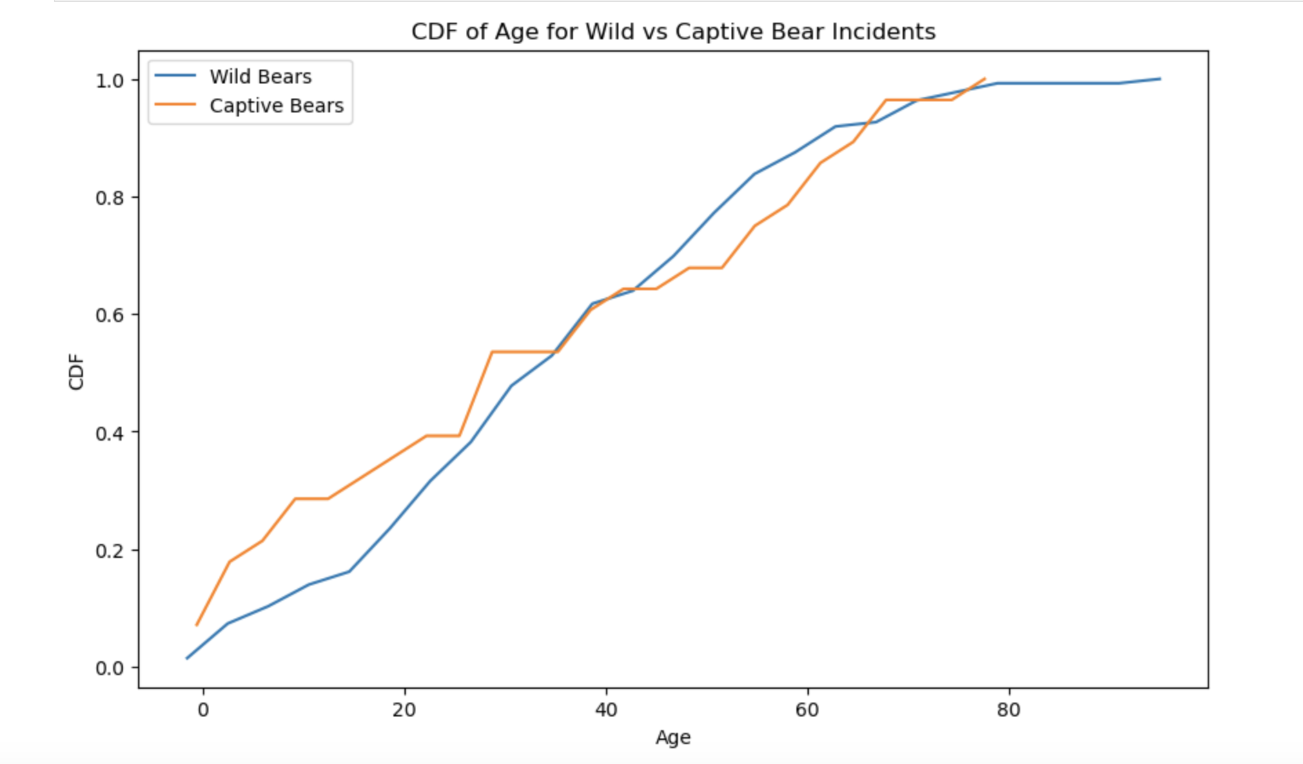
PMF and CDF Analysis
PMF Analysis:
Compared Age distributions for wild vs. captive incidents.
Observed that wild incidents had a broader age range, affecting a wide spectrum of ages.
CDF Analysis:
CDF confirmed cumulative differences in age distribution between wild and captive incidents.
Wild incidents show a more evenly distributed age range, whereas captive incidents are concentrated in specific age groups.

Slide 7
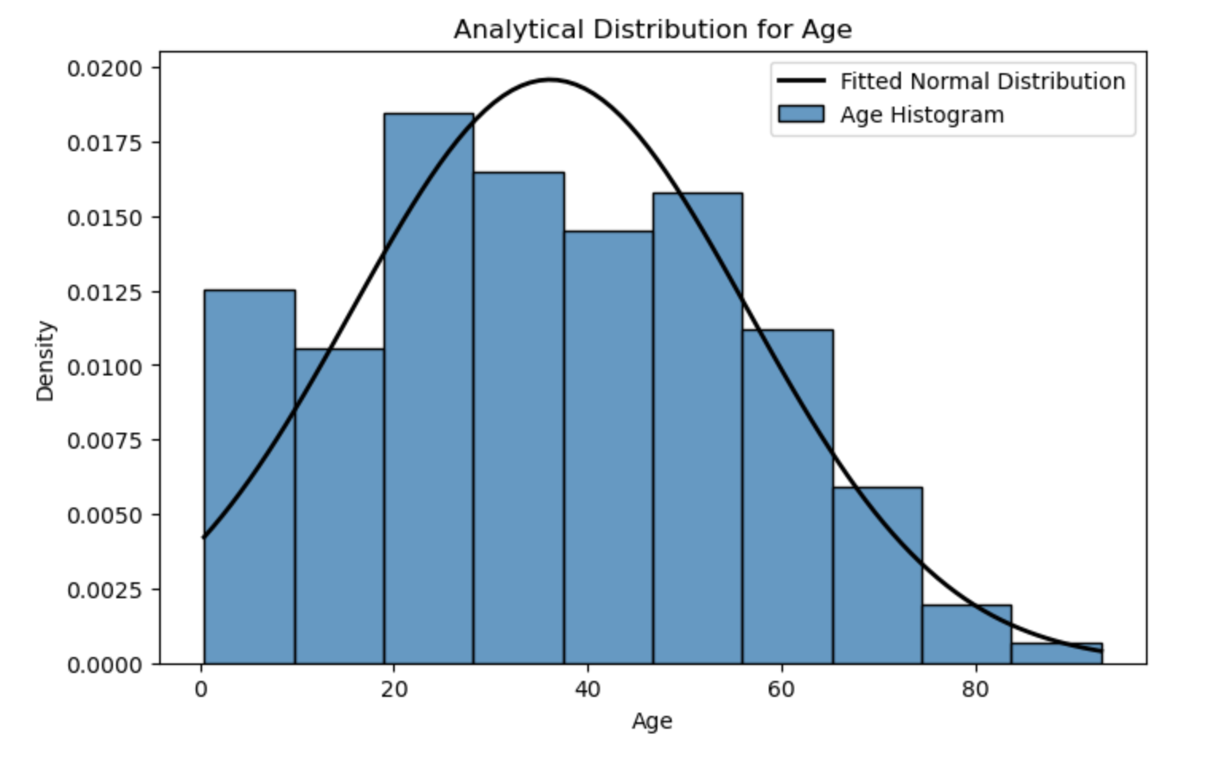
Analytical Distribution Fit
Normal Distribution Fit for Age:
We overlaid a normal distribution curve on the Age data to see if it approximates a bell curve.
Interpretation:
Age data roughly followed a normal distribution, with most incidents involving middle-aged individuals.
Deviations at the tails suggested rare cases involving either very young or very old individuals.

Slide 8
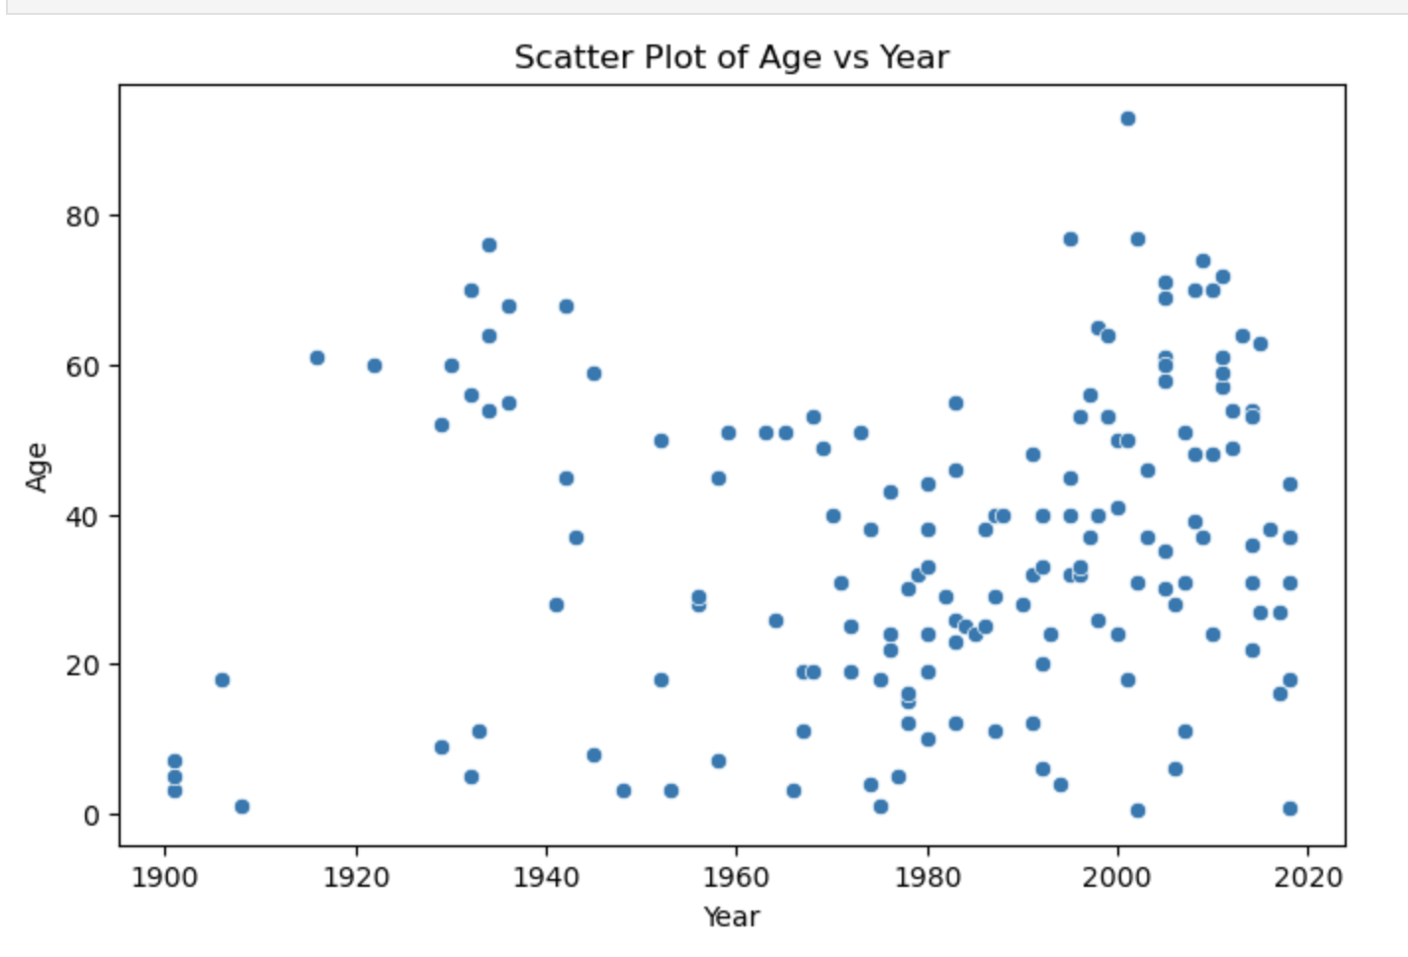
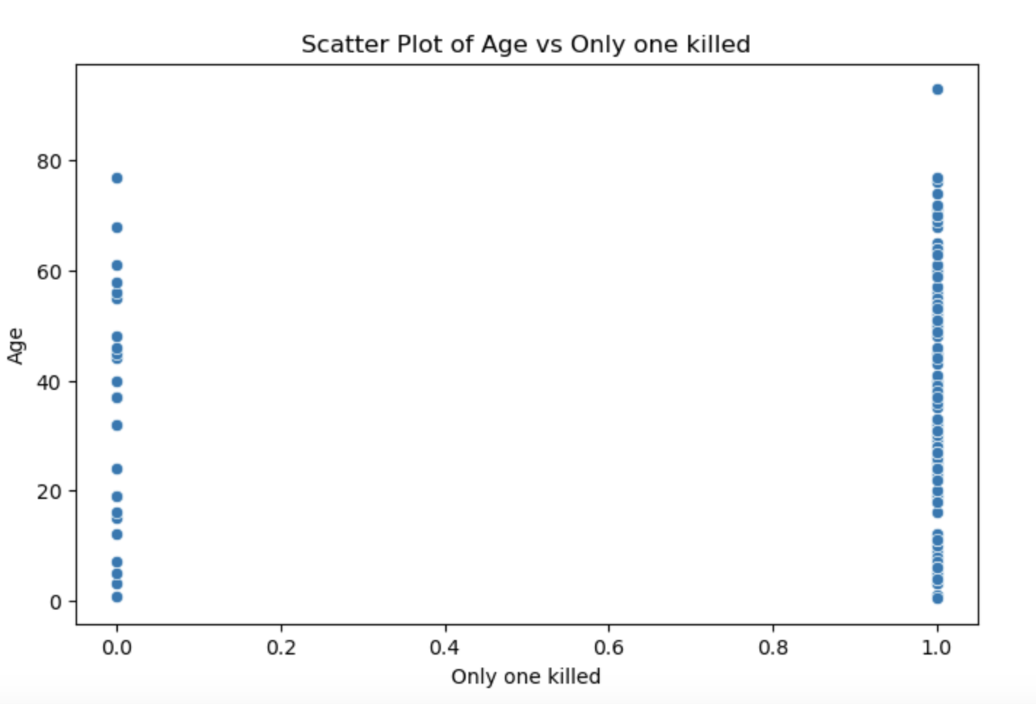
Scatter Plots and Correlation Analysis
Scatter Plots:
Age vs Year: Examined potential trends over time, with a weak positive correlation suggesting a slight increase in the ages involved in incidents in recent years.
Age vs Only one killed: No significant relationship was found, indicating that age may not directly impact incident severity.
Correlation Insights:
Weak positive correlation between Age and Year.
Lack of strong correlation suggests that other factors may be needed for predictive insights.

Slide 9
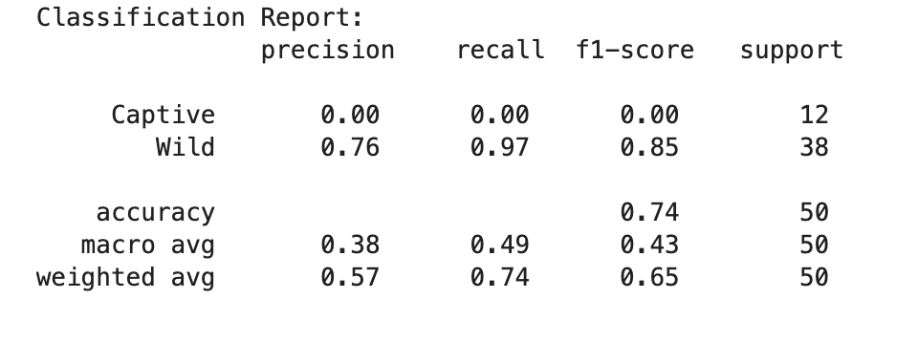
Logistic Regression Results
Content:
Objective: To test if Age and Year can predict the type of incident (wild vs. captive).
Results Summary:
The model achieved moderate prediction accuracy.
Age was a stronger predictor than Year, suggesting that age differences have some impact on incident type.
Interpretation:
While age shows some predictive power, additional variables would likely improve accuracy, such as behavioral or environmental factors.

Slide 10
Conclusion and Future Directions
Key Findings:
Wild incidents involve a broader age range, suggesting they affect a wider demographic.
Captive incidents are more age-specific, likely due to the controlled environments where they occur.
Limitations:
The dataset’s size and the lack of certain variables, such as location and bear behavior, limit the depth of analysis.
Assumptions were made about data accuracy, especially for historical incidents.
Future Research:
Expanding the dataset to include more incidents and additional variables, such as location, specific bear behaviors, and visitor activities, would provide a more comprehensive understanding.
Including these additional factors could improve prediction accuracy and yield more nuanced insights into factors influencing bear incidents.

