Slide 1

Airbnb Price Prediction
Modelling nightly prices using Inside Airbnb data
August 7, 2025

Slide 2
Problem & Motivation
Airbnb operates in over 80,000 cities worldwide and has transformed the short‑term lodging market.
It acts as a broker between hosts and guests, allowing owners to rent entire homes or spare rooms to visitors.
Understanding what drives listing price helps hosts optimise revenue, helps guests find fair value, and informs regulators about equity.
[1][2]

Slide 3
Data & Methods
Dataset summary
36,322 NYC listings (June 2025)
79 variables: host metadata, property details, amenities, reviews, price
Licensed under CC BY 4.0 (Inside Airbnb)
Modelling pipeline
Feature engineering: price conversion, amenities count, superhost, bedrooms/bathrooms, listing age
Preprocessing: one‑hot encode categorical variables, standardise numeric variables
Models: Linear, Ridge, Lasso, Random Forest, XGBoost; evaluated with 5‑fold cross‑validation
[3]

Slide 4
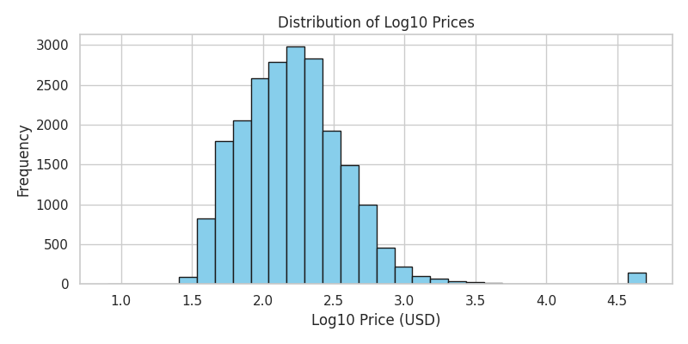
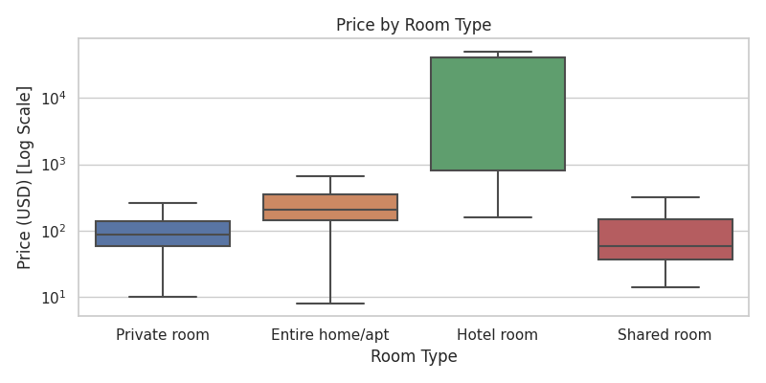
Exploratory Analysis: Price & Room Type
Price distribution
Price by room type

Slide 5
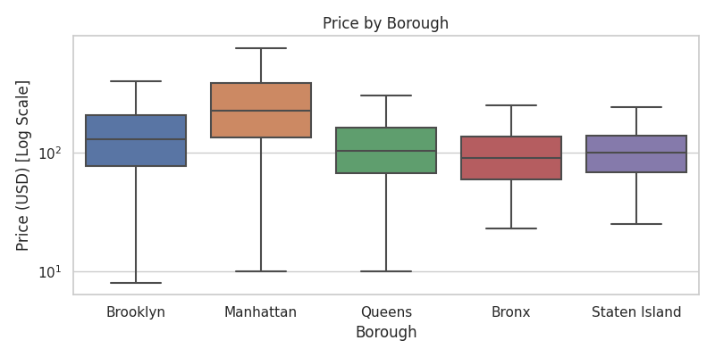
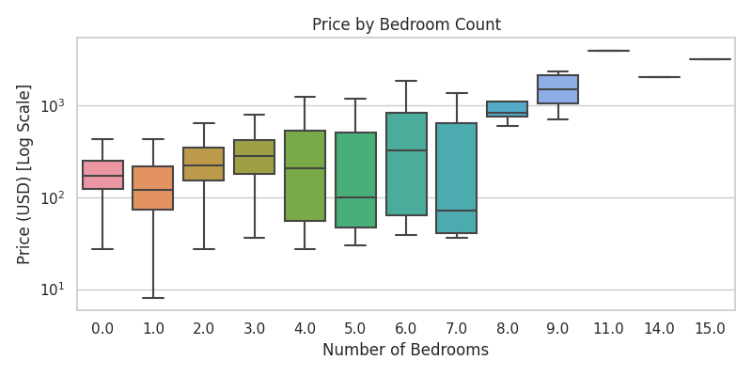
Exploratory Analysis: Location & Bedrooms
Price by borough
Price by bedrooms

Slide 6
Model Results & Feature Importance
Model | RMSE (log) | R²
Ridge | 0.50 | 0.54
Lasso | 0.52 | 0.50
Random Forest | 0.45 | 0.63
XGBoost | 0.44 | 0.64
Tree‑based models outperform linear models (XGBoost best).
Room and property types dominate importance, followed by capacity and borough.
Model explains ≈64 % of the variance in log‑price.

Slide 7
Fairness & Ethics
Fairness across boroughs
RMSE Bronx: 0.34
RMSE Brooklyn: 0.37
RMSE Manhattan: 0.38
RMSE Queens: 0.35
RMSE Staten Island: 0.26
Ethical considerations
Data scraped from public sources; avoid revealing specific addresses
Bias: listings cluster in affluent, transit‑served areas, so model may perpetuate inequities
Transparency: predictions based on historical patterns; communicate uncertainty and limitations
[4]

Slide 8
Conclusions & Recommendations
Tree‑based models predict Airbnb prices with high accuracy (R²≈0.64).
Room and property types, capacity, and borough drive price differences.
Hosts: prioritise property type upgrades, add bathrooms/amenities, and offer entire units when possible.
Guests: search beyond Manhattan and consider private rooms for better value.
Future work: incorporate data from other cities, merge demographic and tourist‑attraction data, and evaluate fairness with demographic parity metrics.

