Slide 1
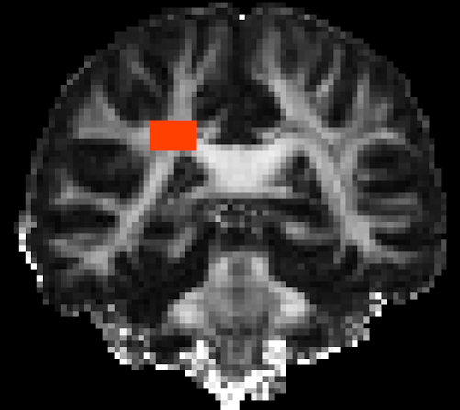

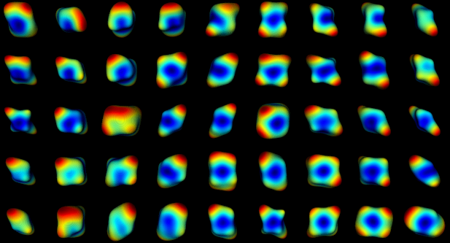
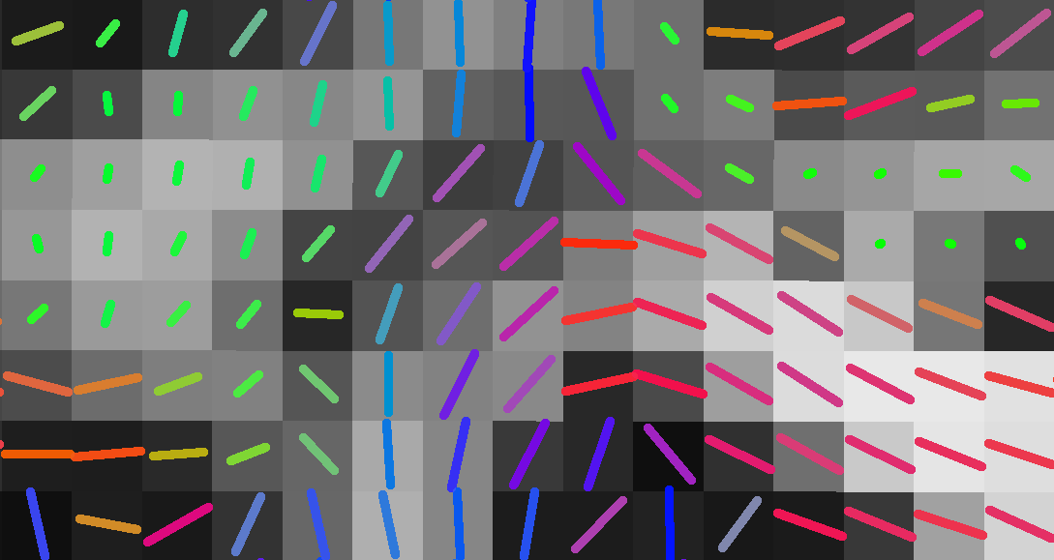
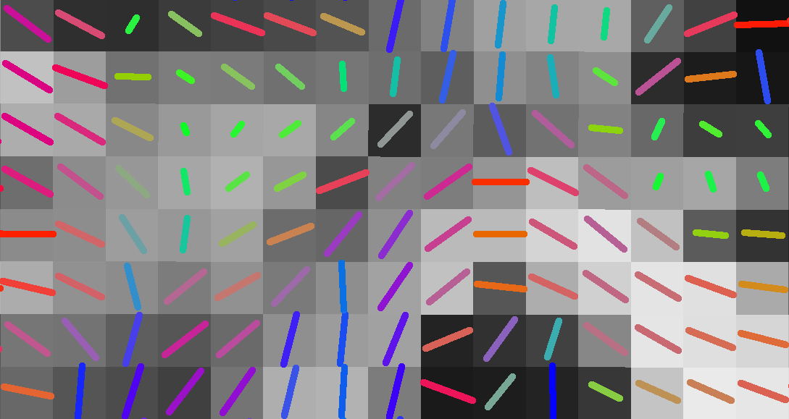
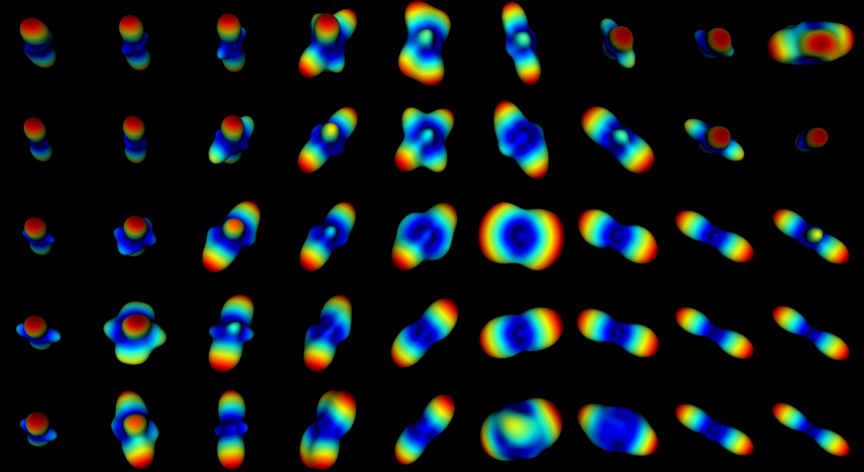
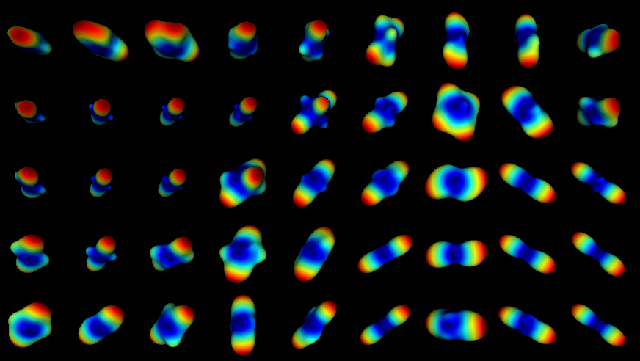
CR
CC
a
b
SLF
CR
CR
SLF
SLF
CC
CC
c
d
(e) DSI-11 Ex Vivo
(f) DSI-11-b10k In Vivo (G_{max}=225mT/m)
(g) DSI-11-b7k In Vivo (G_{max}=40mT/m)

