Slide 1
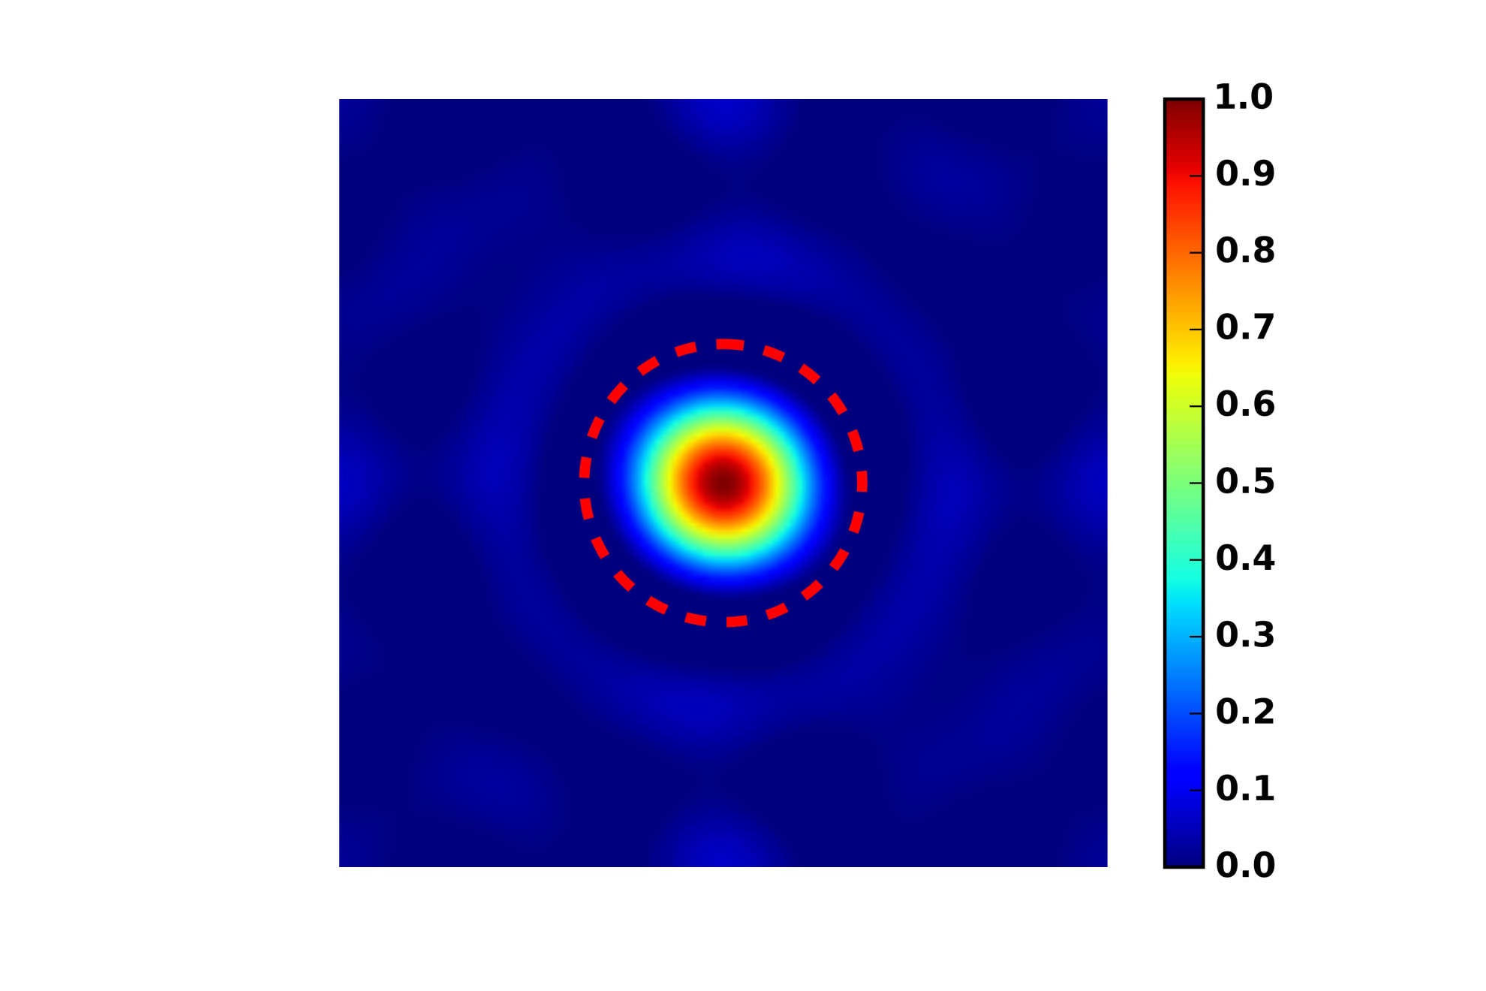
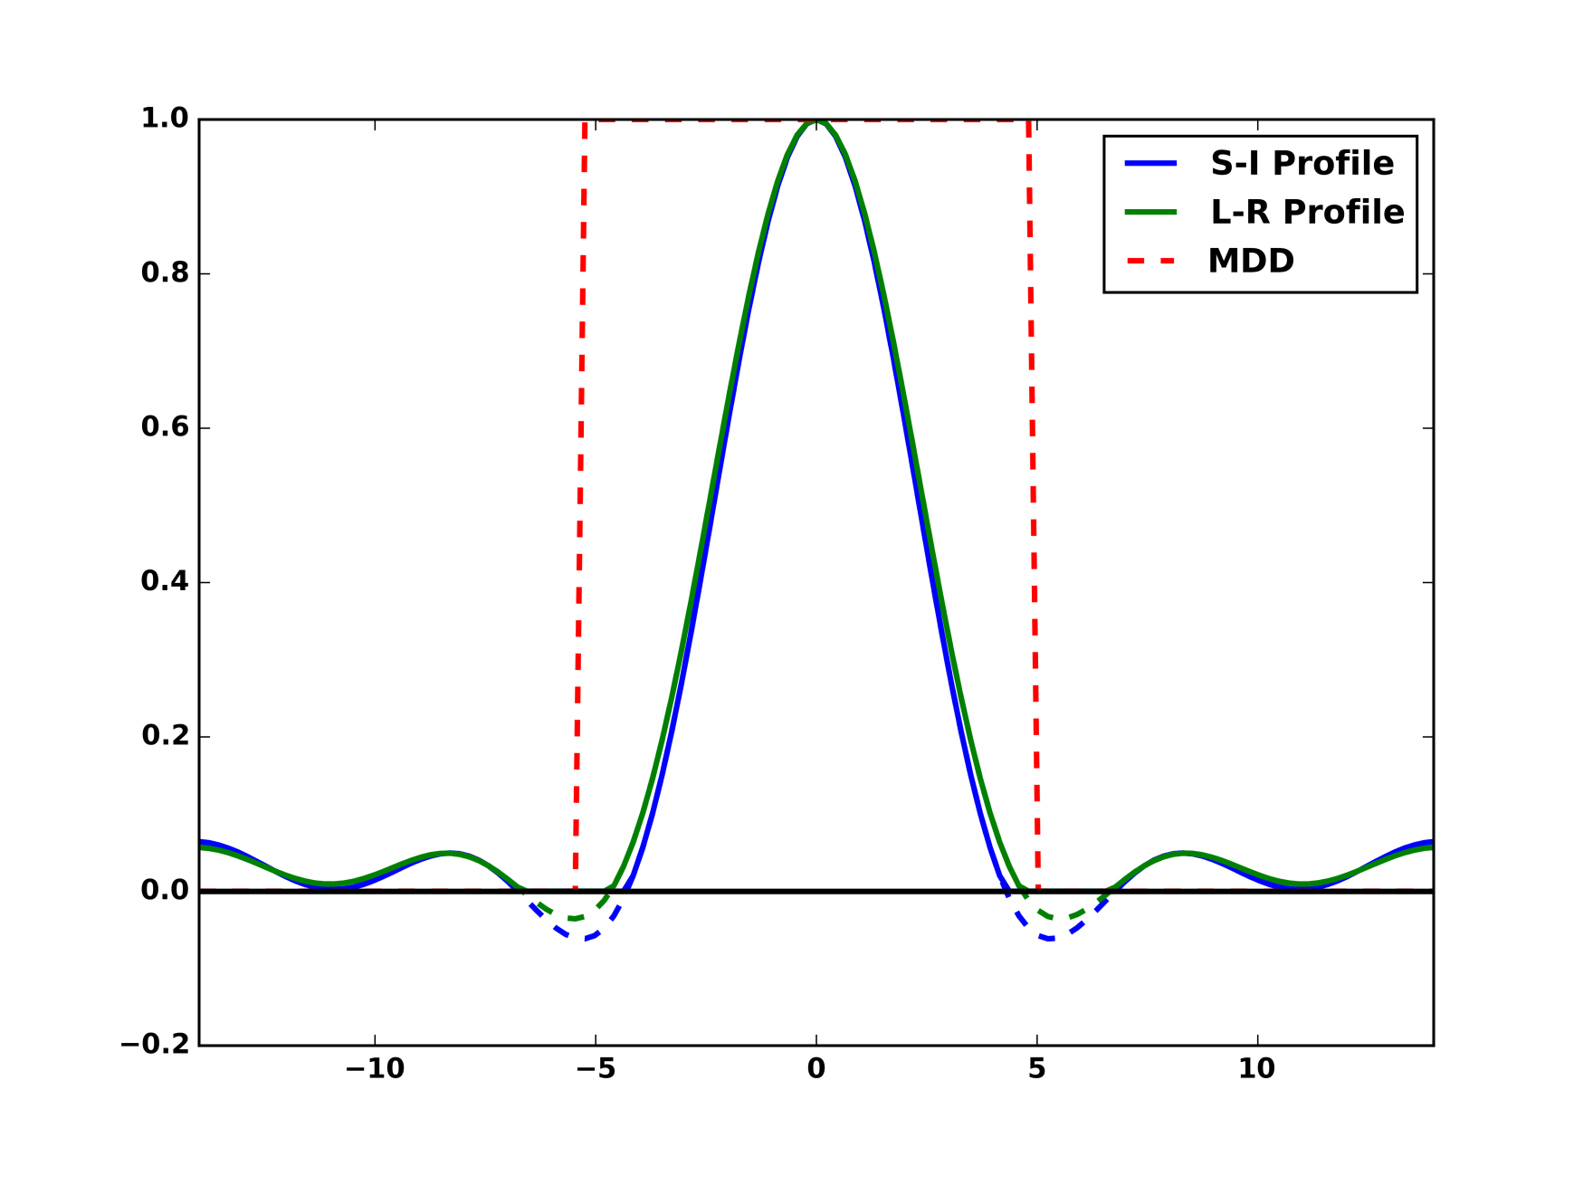
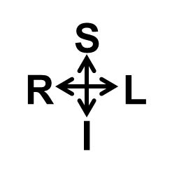
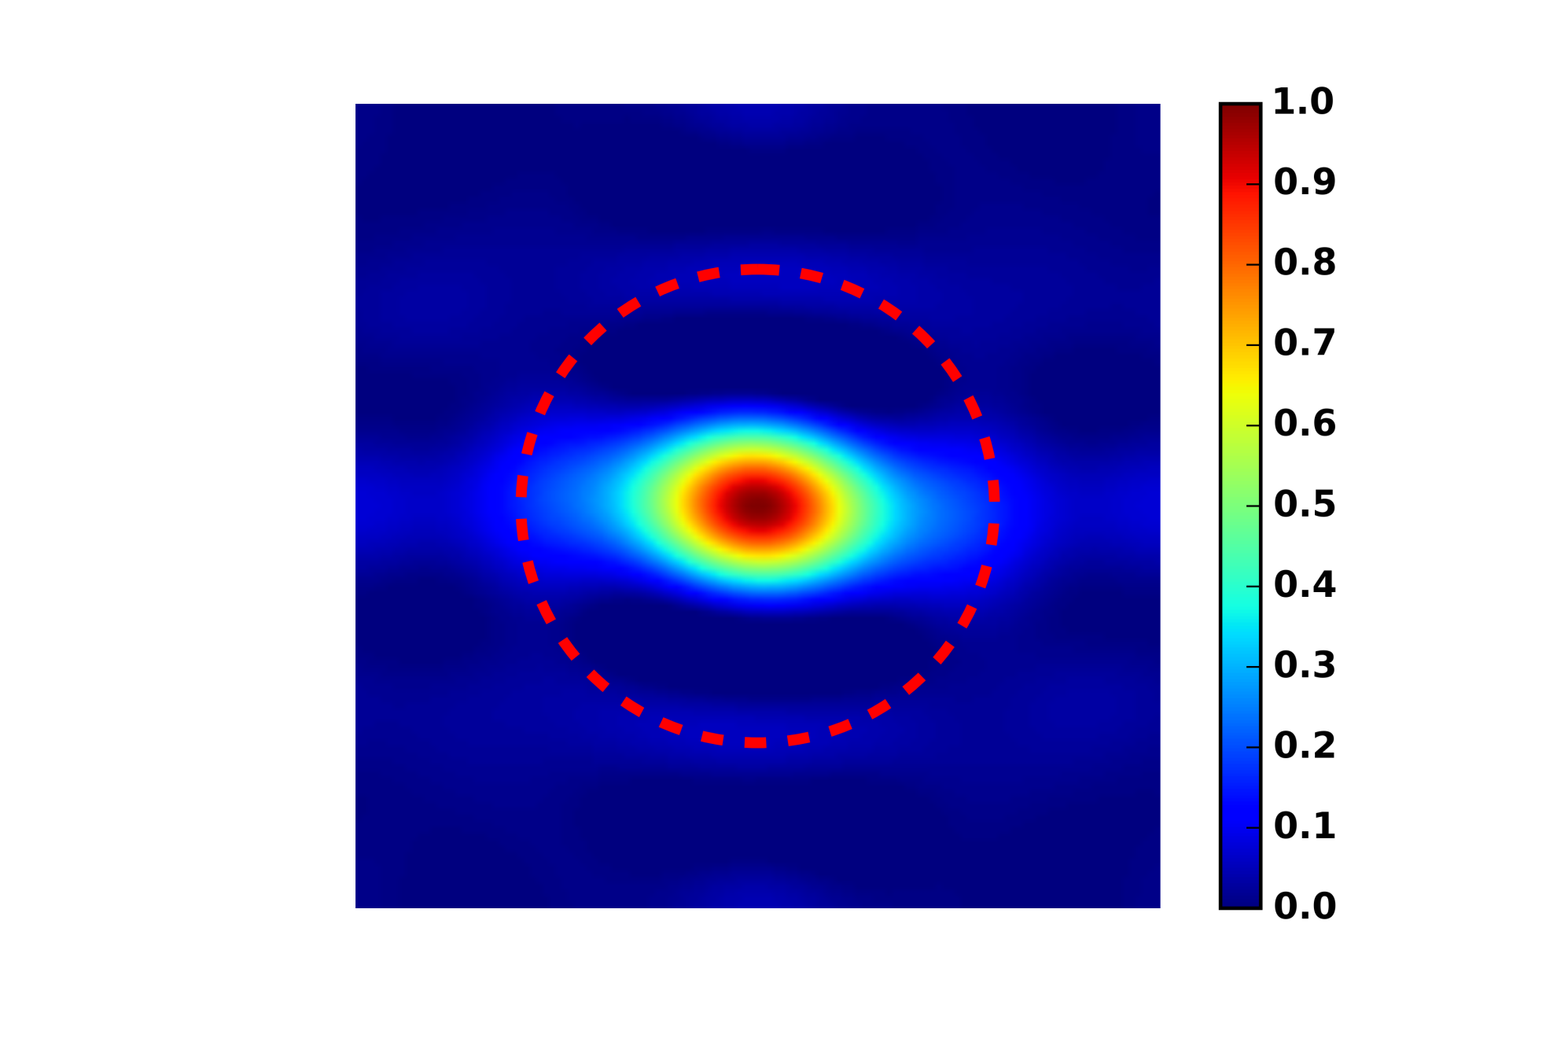
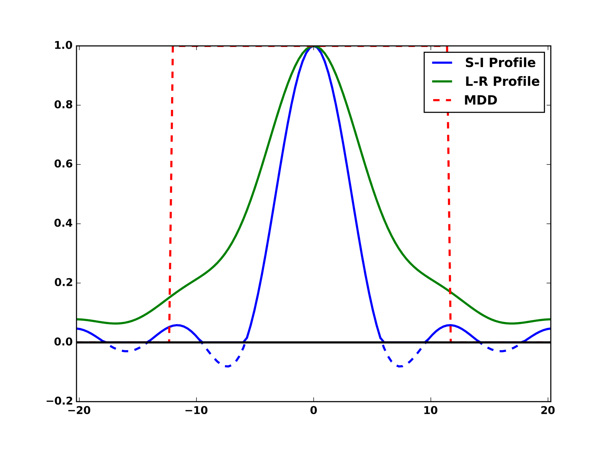
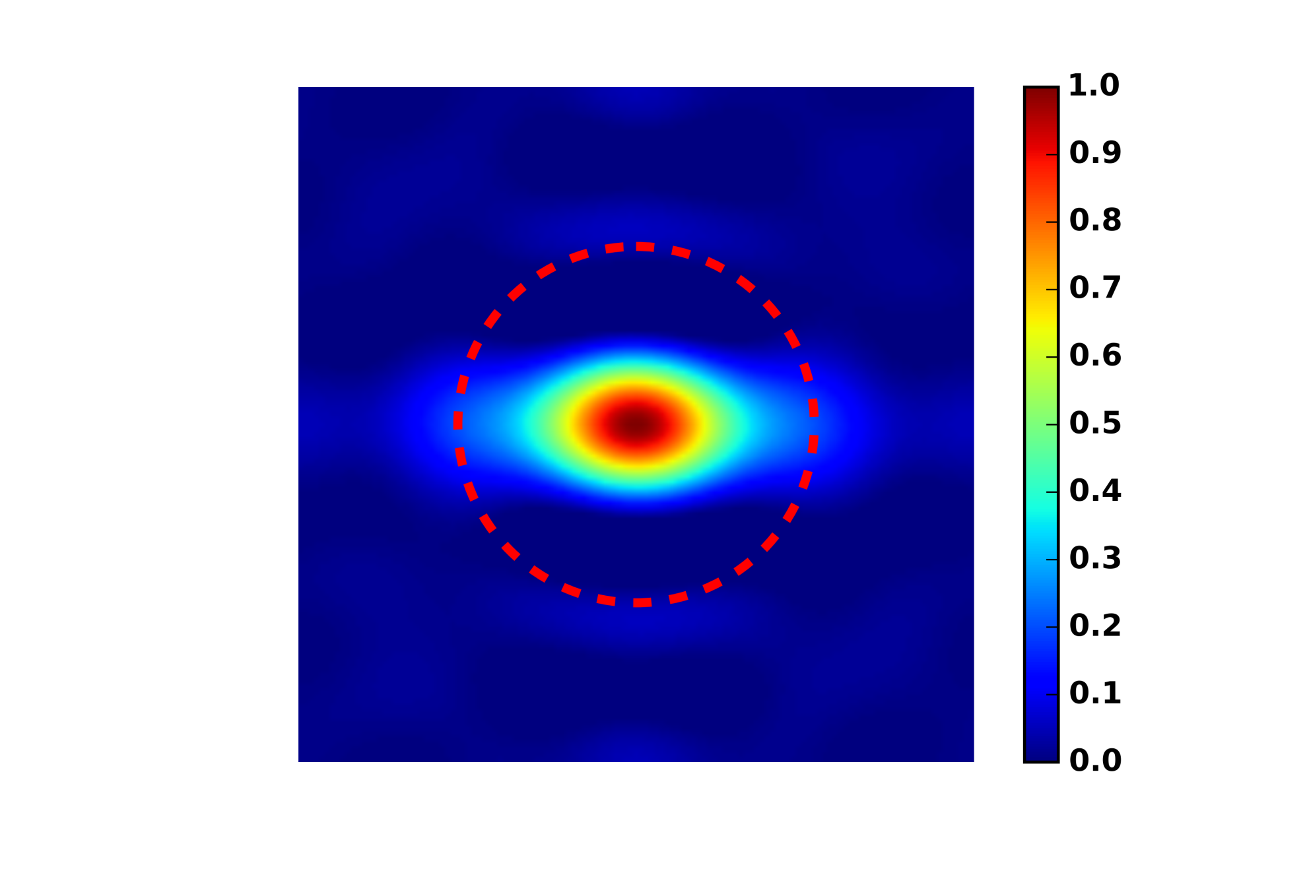
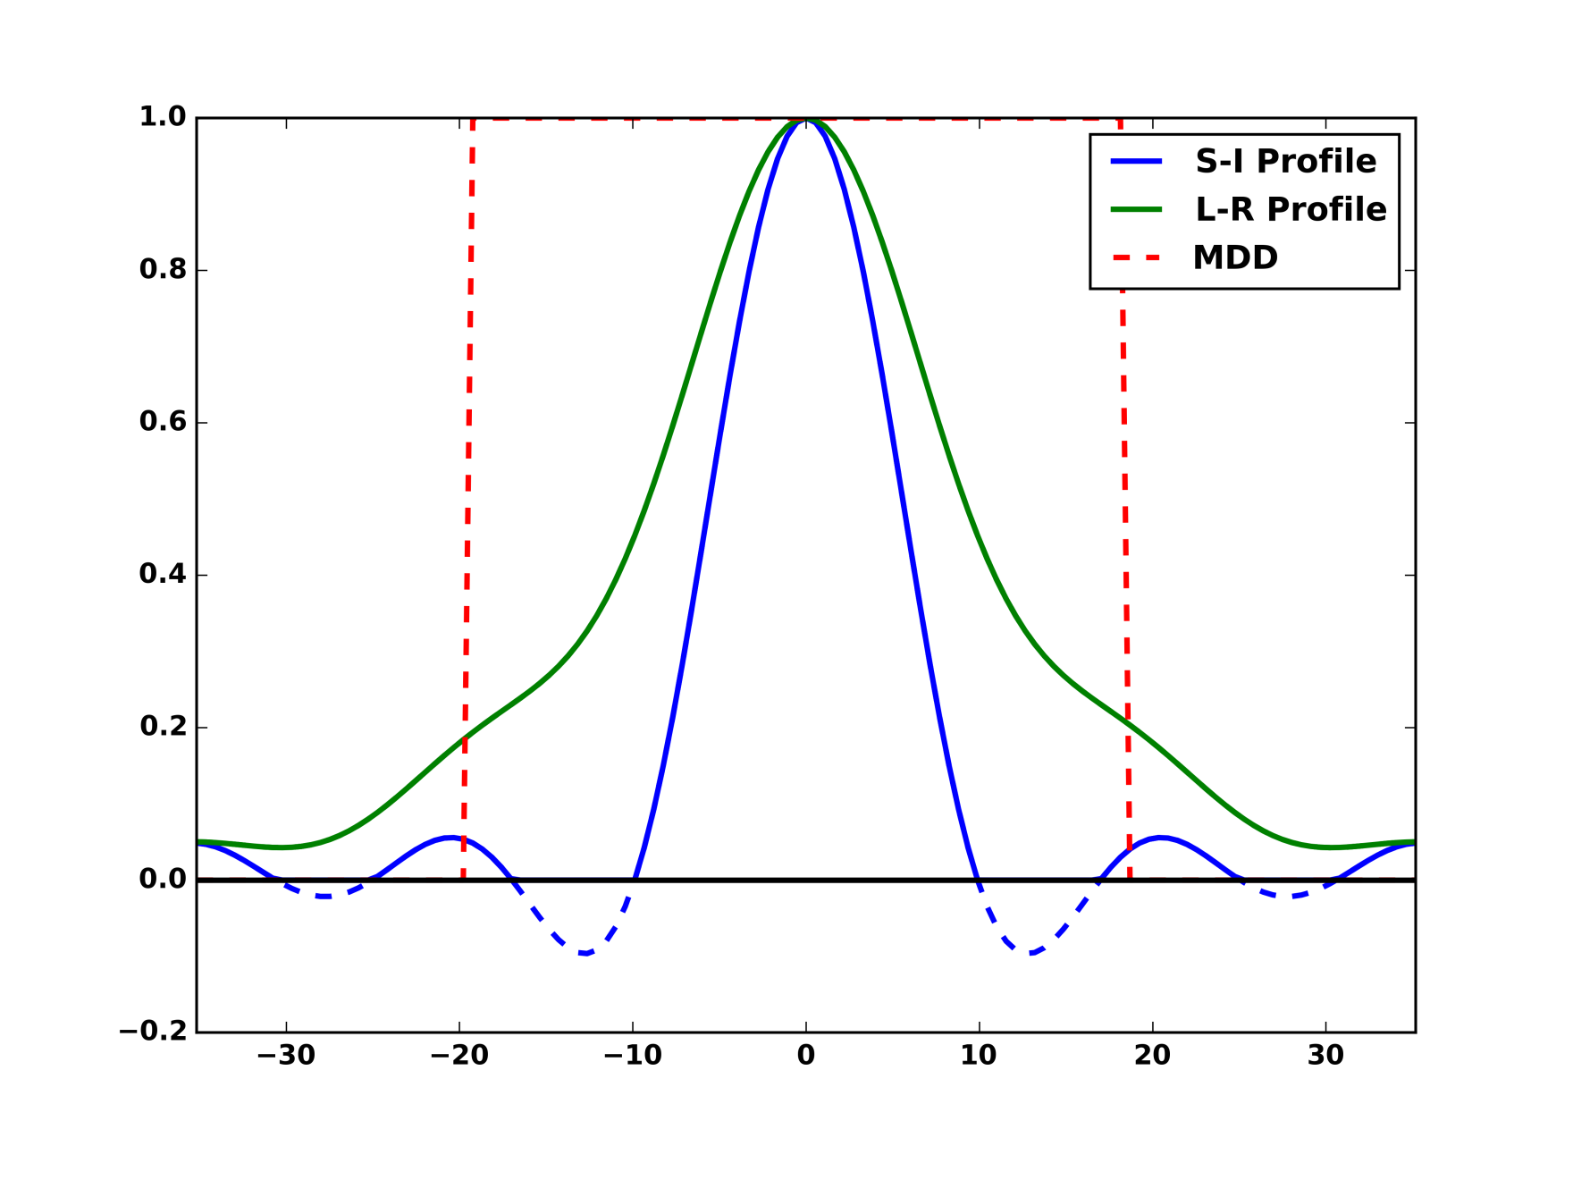
MDD=5.1 μm
probability density
FOV=28.0 μm
(a) DSI-11 Ex Vivo
displacement (μm)
MDD=11.9 μm
probability density
FOV=40.5 μm
(b) DSI-11-Gmax225 In Vivo
displacement (μm)
MDD=18.6 μm
probability density
FOV=70.3 μm
(c) DSI-11-Gmax40 In Vivo
displacement (μm)

