Slide 1
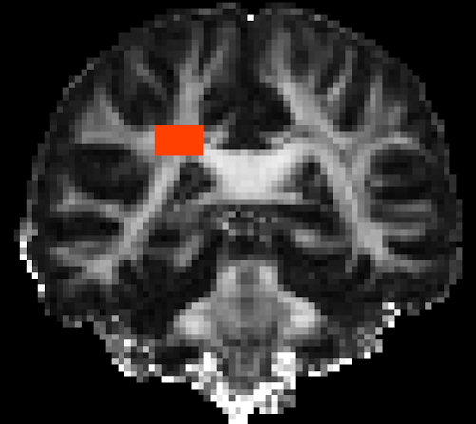




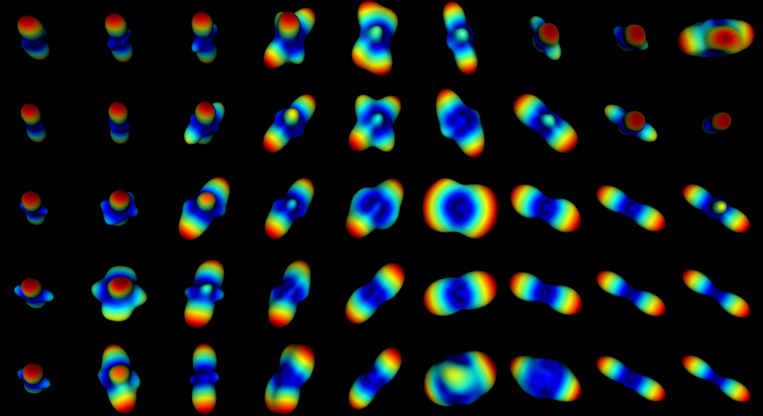
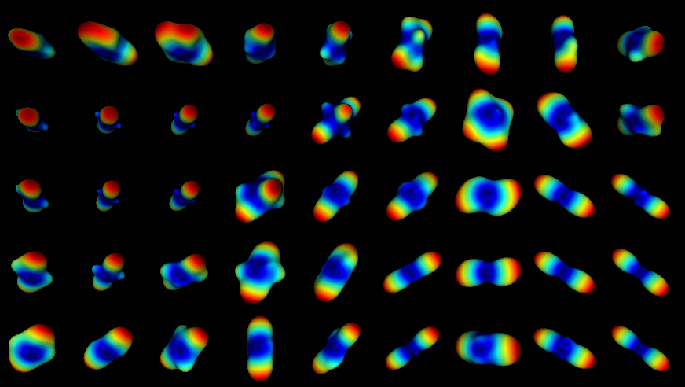
CR
CC
a
b
SLF
CR
CR
SLF
SLF
CC
CC
c
d
(e) DSI-11 Ex Vivo
(f) DSI-11-Gmax225 In Vivo
(g) DSI-11-Gmax40 In Vivo

