Slide 1



Web Application Security
for Junior Developers
By Sirani McNeill

Slide 2
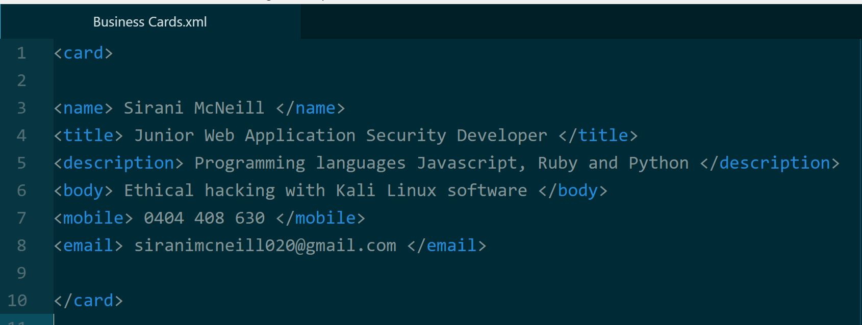
About Me
REMINDER: I have a severe sensi-neural hearing loss so if you have any questions for me at the end of the presentation, Samara/Gavin will converse this for me.. However, happy to chat with you at the end of the presentation if want to in private.
Notes:
Just to let you know Kali Linux is only a Linux distro with useful tools for web application security penetration testing but they are quite difficult to learn - so do your research!

Slide 3
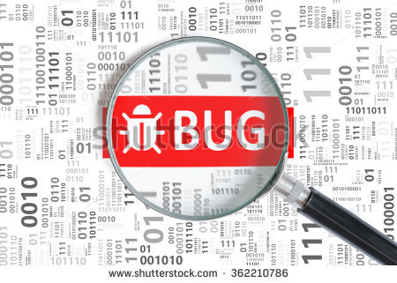
Is web application security about hunting bugs in the binary code like Sherlock Holmes?

Slide 4
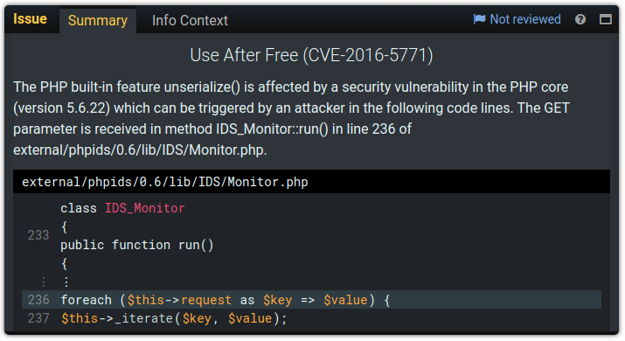
NO! Web Application security is about debugging your code for less security flaws like this below…..
Notes:
Basically, debugging is analyzing the web application codes to ensure that all errors in code are identified and corrected.
The analysis of codes makes sure of two facets in code:
Soundness
Correctness
All the two facets are meant to ascertain quality and security of codes and the application in general. A sound web application is the one with no bugs

Slide 5


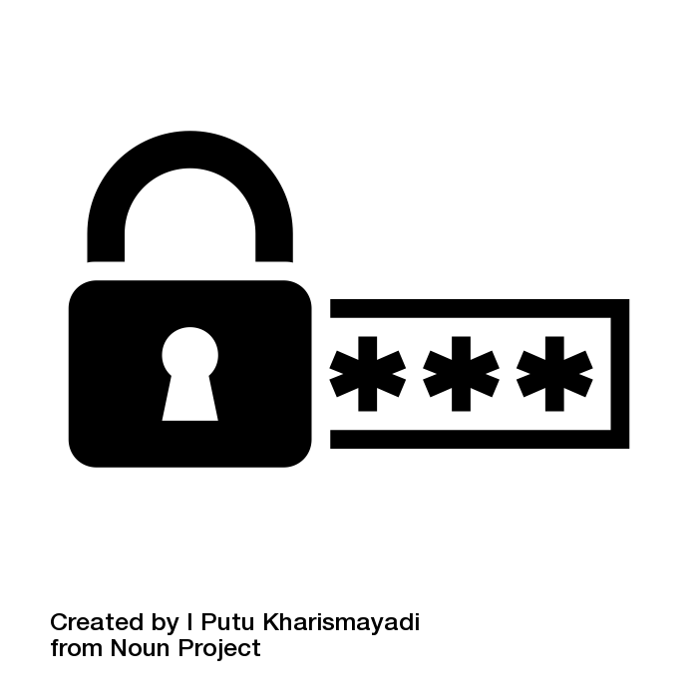
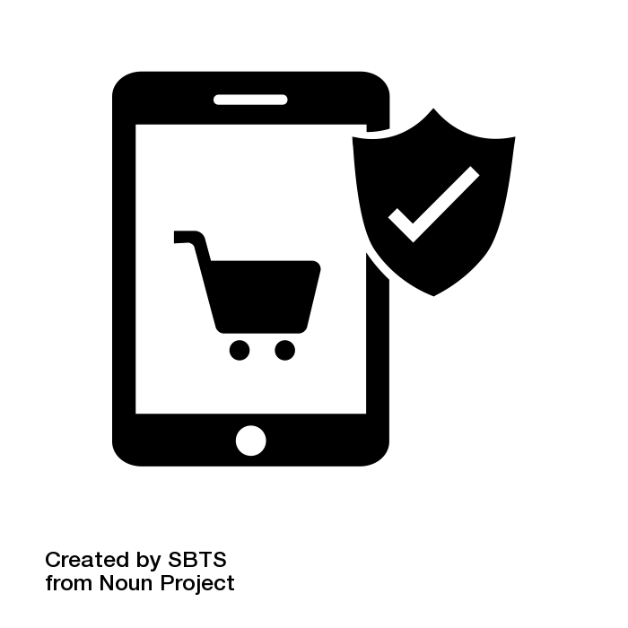
So what can you do to protect your company from being attacked by hackers?
Ethical hacking does the following:
1. Prevents confidential data breaches
2. Password security
3. Prevent encapsulation flaws
4 & 5. Stop hackers from ruining your day by stealing your work via cross site scripting and Denial of Service (DOS)
Notes:
Protecting a company against attacks by hackers is one of the hardest tasks while important at the same time.
To protect a company from attacks, it is crucial that the preparedness of the company is tested through ethical hacking.
Ethical hackers will unearth the issues which are faced by the organization which allows them to be addressed accordingly.

Slide 6
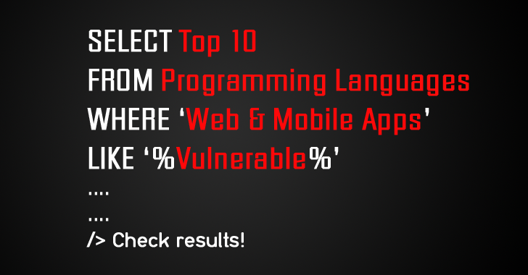
Web Application Security Testing
Pentesting VS Web Application Security
Notes:
SQL Injection shown above used in penetration-testing
What is Web Application Security Testing?
A security test is a method of evaluating the security of a computer system or network by methodically validating and verifying the effectiveness of application security controls. A web application security test focuses only on evaluating the security of a web application. The process involves an active analysis of the application for any weaknesses, technical flaws, or vulnerabilities. Any security issues that are found will be presented to the system owner, together with an assessment of the impact, a proposal for mitigation or a technical solution.

Slide 7
Five Phases of Penetration Testing
1. Reconnaissance
2. Scanning
5. Covering Access
3. Gaining Access
4. Maintaining Access
Notes:
Reconnaissance - is the act of gathering preliminary data or intelligence on your target . It can either be Active (done directly) or passive (done through an intermediary)
Scanning – Using technical tools like Kali Linux to gather further intel. For example scanning for vulnerabilities
Gaining Access – Using the gathered intel to gain access or take control of the network or application. You can also use the device to launch an attack.
Maintaining access – This involves using tactics to continue being in the system in order to gain as much information as possible. The attacker must be discrete in order not to be discovered.
Covering access – this involves covering their activities for the network admin not to discover any attack on their system.

Slide 8
How to find security threats in your code in OWASP
Open Web Application Security Project OWASP (OWASP) is a widely known framework for testing web apps.
To test web apps Web apps with OWASP, you need to carry out:
Information gathering
Configuration management
Testing password policy rules
Threat Agents
Attack Surface
Possible Attacks
Potential Technical Impacts
Important Business Impacts
While there are advanced automated scanners for web application code, it is crucial to find potential vulnerabilities manually in some instances.
Notes:
Code review is one of the crucial approaches of finding app vulnerabilities.
When used with manual and automated penetration testing tools, it has a potential of significantly increasing cost effectiveness.

Slide 9
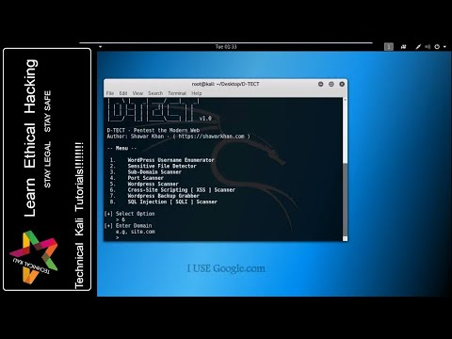
Kali Linux Video: Web Vulnerability Scanner
More Information: https://resources.infosecinstitute.com/14-popular-web-application-vulnerability-scanners/#gref

Slide 10
Kali Linux Demo
Notes:
Demo will be on taught using my computer

Slide 11
What skill-sets do you need to excel as a Penetration Tester?
CEH – Certified Ethical Hacker
Technical - OWASP Certification
Admin - Agile Project Management, Documentation
Creative - Human Centered Design Thinking
People skills - Consultancy
Computer Science/Programming
Where can I learn more information?
Attend Coder Academy cybersecurity bootcamp on either Sydney or Melbourne Campus https://coderacademy.edu.au/cyber-security-bootcamp
Only available in Melbourne
https://www.melbournepolytechnic.edu.au/courses/certificate-iv-in-cyber-security/

Slide 12
What are freelance bug bounties? How to get started in this career?
Bounty hunters are ethical hackers who gets paid to find vulnerabilities in software, code and websites.
To get paid as a web application bounty hunter, one needs to know some coding, have good knowledge on web applications and know more about aspects e.g. XSS and SQL injections among others.
To get started as a web application bounty hunter, you need to:
Carry out a research on the tools needed for web bounty hunting.
Practice what you are learning
Join ethical hacking communities
Read bounty bug methodologies
Always learn networking and get updated on the current web application trends
Go hacking.
Once you have enough knowledge and competent tools, you are ready to look for bugs and begin the work.
Companies who have done this have been Google, Twitter, Atlassian
Notes:
To become a good bounty hunter, start by reading books and articles such as:
The web application hackers handbook
OWASP Testing Guide

Slide 13
References
https://www.sumasoft.com/web-application-security-+5-reasons-why-you-must-take-it-seriously
https://lifehacker.com/how-to-earn-money-as-a-bug-bounty-hunter-1797946520
https://www.owasp.org/index.php/Web_Application_Security_Testing_Cheat_Sheet

Slide 14
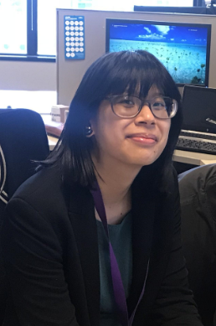
Connect with me on Twitter @mcne65
LinkedIn: Sirani McNeill
Any Questions?

