Slide 1

Quantum-Enhanced AI: Comparing Machine Learning Performance on Quantum and Classical Systems
Kimberly McNeil, Muhlenberg College ‘26
Advisor: Dr. Youngsun Jang, Muhlenberg College
Funded by: : The Ladley Endowed Student Research Fellowship Fund

Slide 2
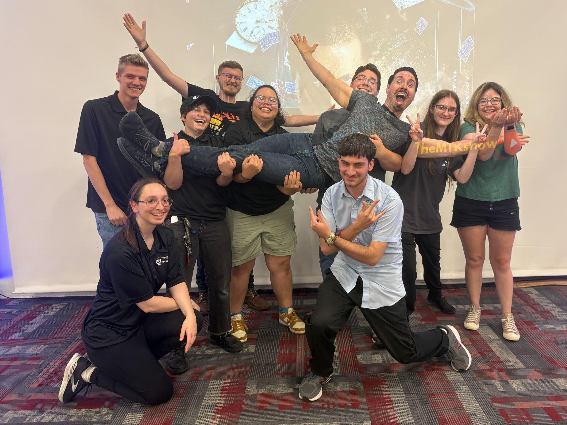

A Little About Me~~
Comp Sci Undergrad at Muhlenberg
Areas of Interest
  Machine Learning
  Data
Extra, non-STEM, Fun Passions
  Activities Council President
  Loves to Read
  Kirby Game Lore Fanatic

Slide 3
Research Question
Machine Learning (ML) uses a lot of complex math. Quantum Computing (QC) is quick at solving complex math. How can QC enhance ML? Let’s compare Classical to Quantum!

Slide 4
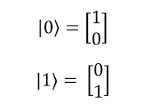
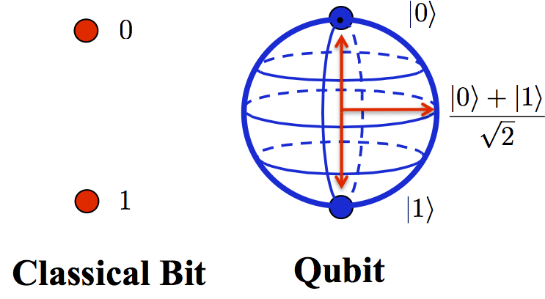
Quantum Computing Basics
Classical Computers use bits (0’s and 1’s).
Quantum Computers use qubits.
  Can be |0⟩, |1⟩, or both at once (superposition).
  Measures (collapses) as either 0 or 1 using
probability.
Each feature in our model will be
represented by a qubit!
Notes:
Horizontal states all have 50% chance of measuring 0 or 1, but have different relative states.
Helps encode input data.

Slide 5
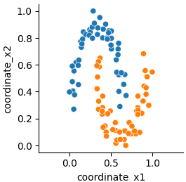
Our Dataset
Make_moons dataset from Scikit-learn.
Generates two types of "moons" (points) on a 2D plane.
100 samples with 0.1 noise.
Scaled and split into 80% train and 20% test

Slide 6
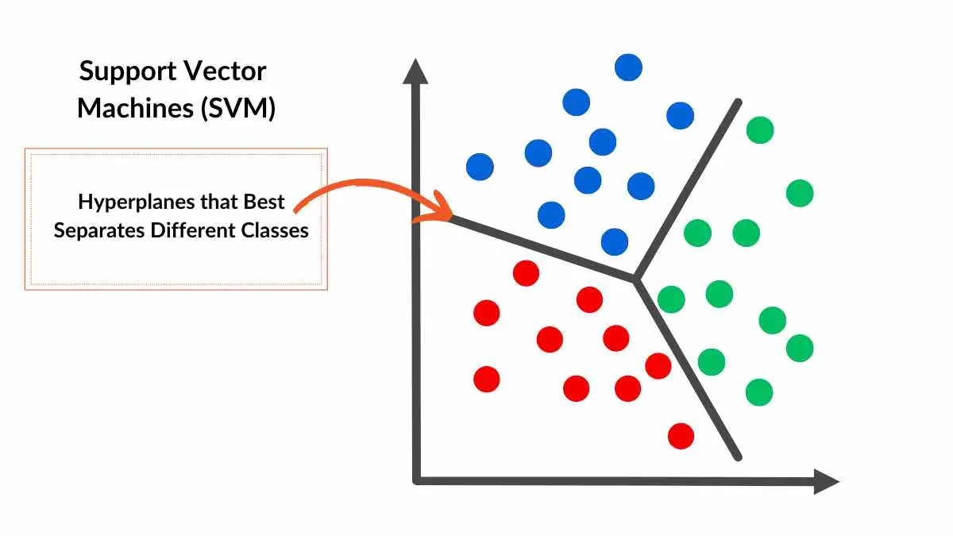
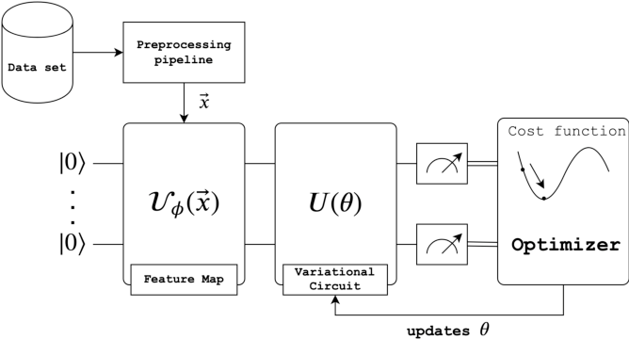
Our Models
Quantum-Classical Hybrid: Variational Quantum Classifier (VQC)
Classical: Support Vector Classifier (SVC)

Slide 7
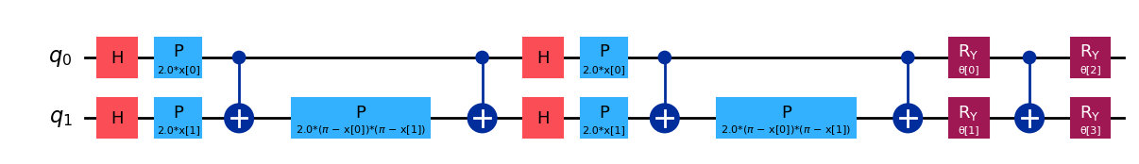
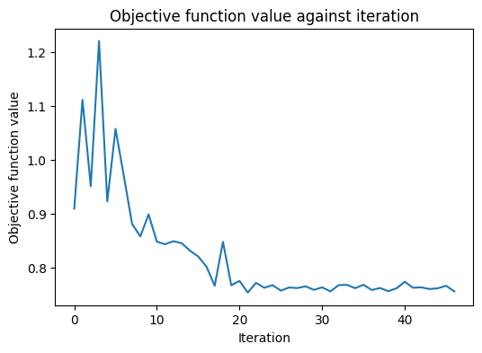
Variational Algorithm Design
1. Feature Map
2. Ansatz
3. Cost Function
&
4. Optimization Loop
Approaching Convergence, but there is more the optimizer is checking for that we can't really see!

Slide 8

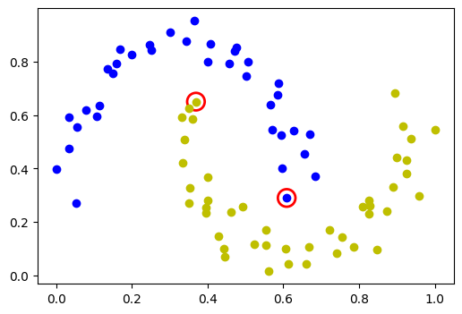
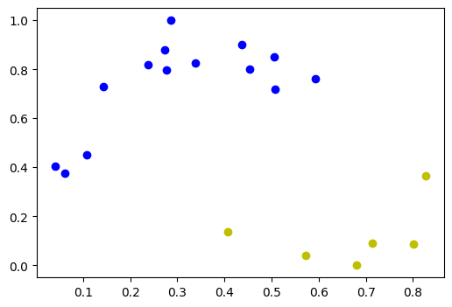
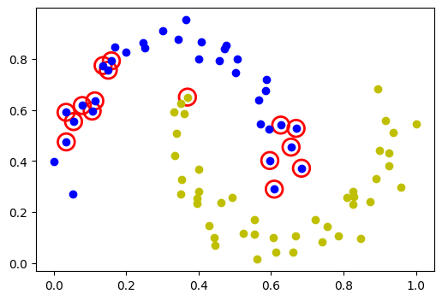
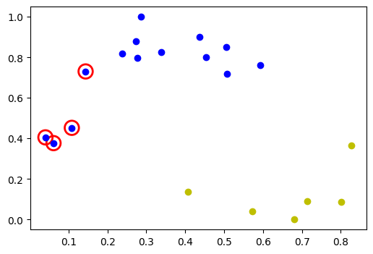
Results
SVC
Train / Test
VQC
Train / Test

Slide 9
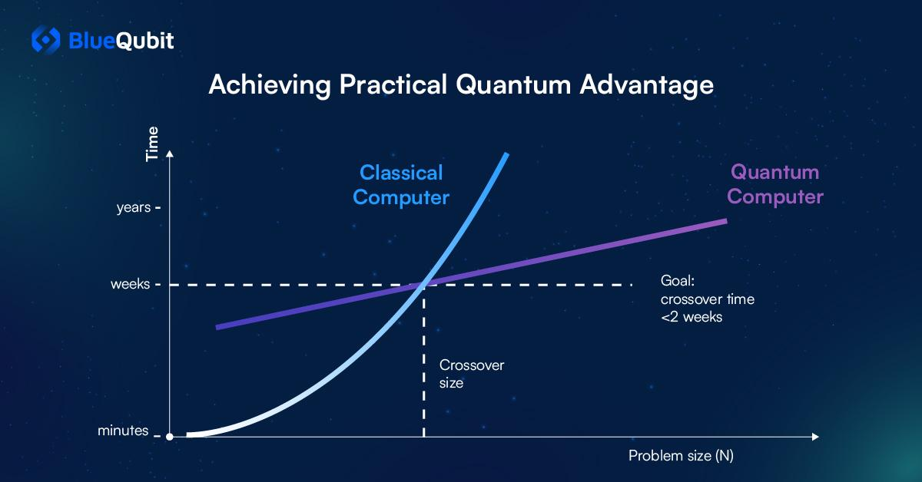
Quantum Advantage

Slide 10


Thank You for Listening!
Also, thank you, WISDOM, for this amazing opportunity!
Any Questions?
Connect with me on LinkedIn!
See My Full Work on Github!

