Slide 1
The Role of Bartle’s Gamer Types in Higher Education
William Seymour (CS)

Slide 2
Presentation Overview
What are Bartle’s gamer types?
What is gamification?
What does gamified HE entail?
What the report was investigating
Results and conclusion
Further work and Evaluation
Questions

Slide 3
Presentation Overview
What are Bartle’s gamer types?
What is gamification?
What does HE mean in this context?
What the report was investigating
Results and conclusion
Further work and Evaluation
Questions

Slide 4
Bartle’s Gamer Types
Gamers can be divided up into Killers, Socialisers, Explorers and Achievers
 | Acting | Interacting
Players | Killers | Socialisers
The World | Achievers | Explorers
Image from “Hearts, clubs, diamonds, spades” by Richard Bartle (1996)

Slide 5
Bartle’s Gamer Types
Players take a questionnaire about how they interact with multiplayer games
A way of psychologically profiling people based on the way in which they play
On a MUD, a new area opens up. Which do you look forward to more?
[E] Exploring the new area, and finding out its history
[A] Being the first to get the new equipment from the area

Slide 6
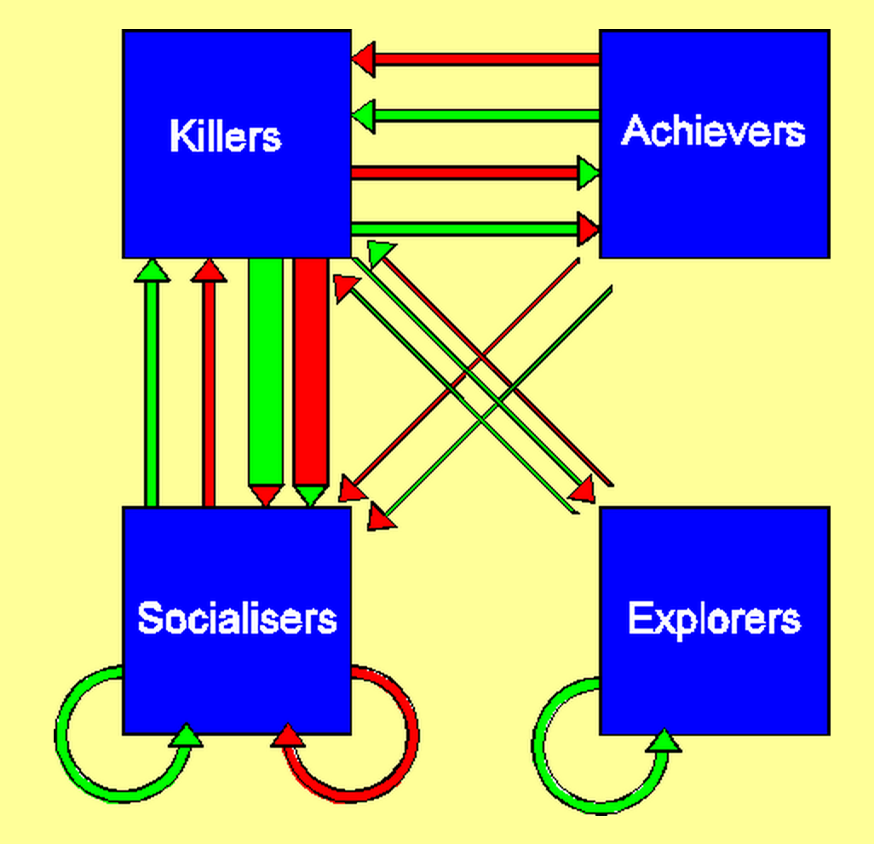
Bartle’s Gamer Types
A way to describe ecosystems of players in large online worlds
Image from “Hearts, clubs, diamonds, spades” by Richard Bartle (1996)

Slide 7
Presentation Overview
What are Bartle’s gamer types?
What is gamification?
What does HE mean in this context?
What the report was investigating
Results and conclusion
Further work and Evaluation
Questions

Slide 8
Gamification
“The use of game design elements
in non-game contexts”
Begin by isolating the elements that make games engaging
Transplant those elements to other forms of media to ‘gamify’ them
Aim to drive engagement
Definition from “From game design elements to gamefulness by Detarding et al. (2011)

Slide 9
Presentation Overview
What are Bartle’s gamer types?
What is gamification?
What does HE mean in this context?
What the report was investigating
Results and conclusion
Further work and Evaluation
Questions

