Slide 1
The Role of Bartle’s Gamer Types in Gamified Higher Education
William Seymour (CS)

Slide 2
Presentation Overview
What is gamification?
What are Bartle’s gamer types?
Research aims and methodology
Research results
Conclusion and further work
Evaluation
Questions

Slide 3
Gamification
“The use of game design elements
in non-game contexts”
Distinction between games and gamified activities
Transplant the mechanics that make games engaging to other media
Aims to drive engagement
Definition from “From game design elements to gamefulness by Detarding et al. (2011)

Slide 4
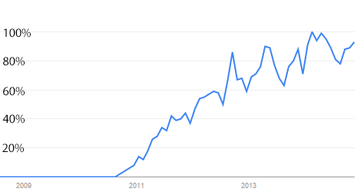
Gamification
Rapidly gained popularity from ~2010
Roots in operant conditioning and basic human needs
Rewards based on time rather than skill
Google Trends: proportion of gamification searches relative to the peak

Slide 5

What does gamified HE entail?
Using gamified systems to improve students’ experiences
Institutions are (slowly) getting on board with gamification

Slide 6
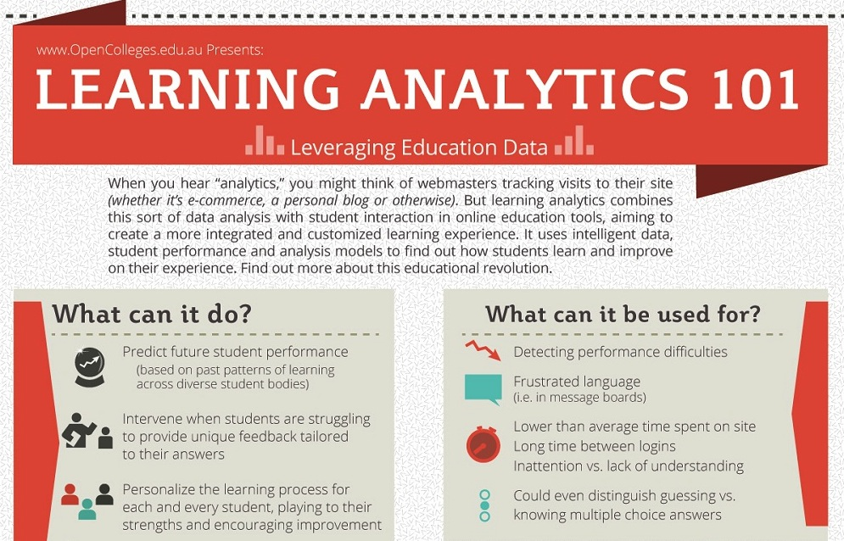
Learning analytics
Using data analysis to inform the education process
A more personalised experience for students
Part of an infographic by www.opencolleges.edu.au

Slide 7
Bartle’s Gamer Types
Gamers can be divided up into Killers, Socialisers, Explorers and Achievers
 | Acting | Interacting
Players | Killers | Socialisers
The World | Achievers | Explorers
Image from “Hearts, clubs, diamonds, spades” by Richard Bartle (1996)

Slide 8
Bartle’s Gamer Types
Players take a questionnaire about how they interact with multiplayer games
A way of psychologically profiling people based on the way in which they play
On a MUD, a new area opens up. Which do you look forward to more?
[E] Exploring the new area, and finding out its history
[A] Being the first to get the new equipment from the area

Slide 9
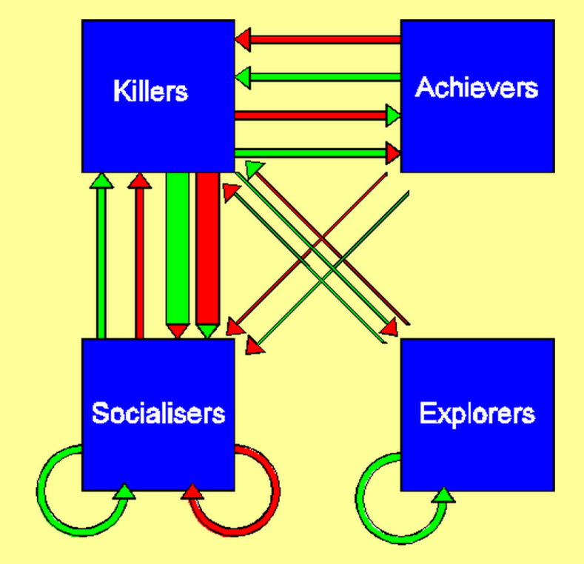
Bartle’s Gamer Types
Describe ecosystems of players
Widely used in gamification
Image from “Hearts, clubs, diamonds, spades” by Richard Bartle (1996)

Slide 10
Summary
We covered Gamification and Bartles gamer types
Do Bartle’s gamer types have a place in the future of gamified HE?

Slide 11
Research Undertaken
Modeling the player, learner and personality: Independency of the models of bartle, kolb and neo-ffi (big5) and the implications for game based learning.
No interesting correlation between types
Little explanation offered as to why
Johannes Konert, Stefan Gobel, and Ralf Steinmetz. Modeling the player, learner and personality: Independency of the models of bartle, kolb and neo-ffi (big5) and the implications for game based learning. 7th European Conference on Games Based Learning, 2013.

Slide 12
Research Undertaken
Is there a link between the way in which students learn and the way in which they play?
Comparison of Keirsey Temperament and Bartle Type
23 students from Warwick and other HE institutions

