Slide 1
The Role of Bartle’s Gamer Types in Gamified Higher Education
William Seymour (CS)

Slide 2
Presentation Overview
What are Bartle’s gamer types?
What is gamification?
What does gamified HE entail?
What the report was investigating
Results and conclusion
Further work and Evaluation
Questions

Slide 3
Presentation Overview
What are Bartle’s gamer types?
What is gamification?
What does gamified HE entail?
What the report was investigating
Results and conclusion
Further work and Evaluation
Questions

Slide 4
Bartle’s Gamer Types
Gamers can be divided up into Killers, Socialisers, Explorers and Achievers
 | Acting | Interacting
Players | Killers | Socialisers
The World | Achievers | Explorers
Image from “Hearts, clubs, diamonds, spades” by Richard Bartle (1996)

Slide 5
Bartle’s Gamer Types
Players take a questionnaire about how they interact with multiplayer games
A way of psychologically profiling people based on the way in which they play
On a MUD, a new area opens up. Which do you look forward to more?
[E] Exploring the new area, and finding out its history
[A] Being the first to get the new equipment from the area

Slide 6
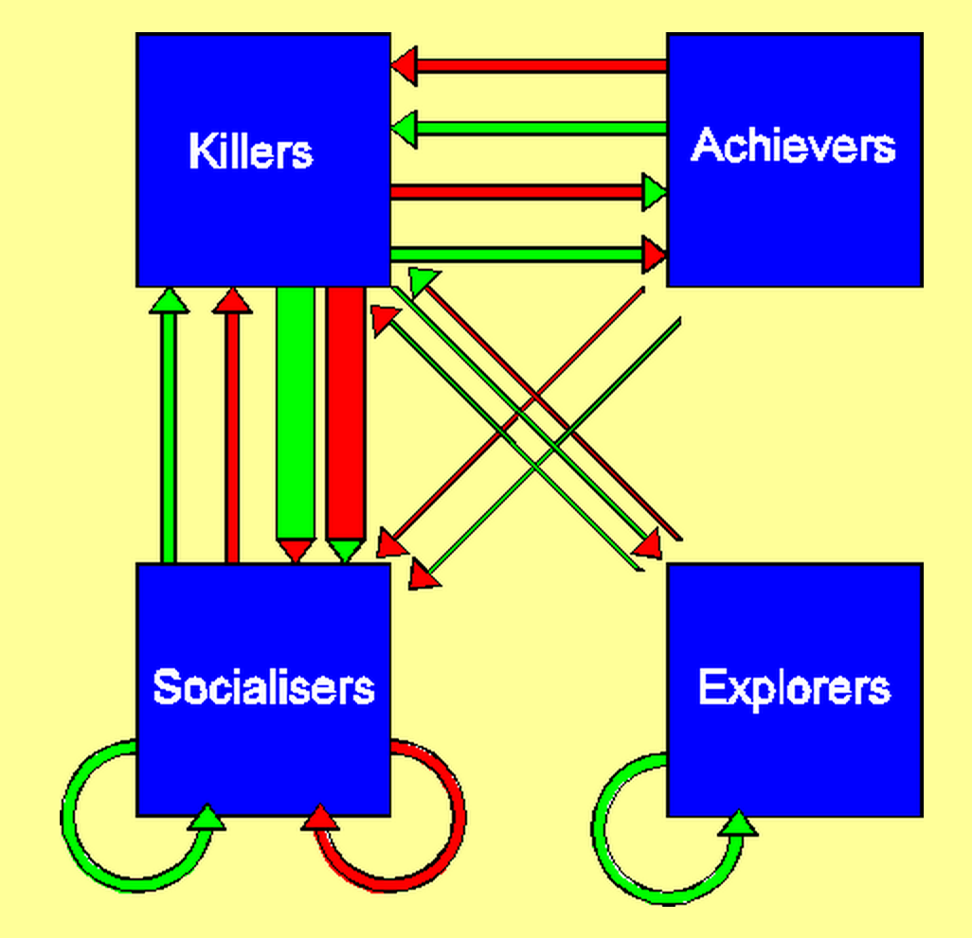
Bartle’s Gamer Types
A way to describe ecosystems of players in large online worlds
Image from “Hearts, clubs, diamonds, spades” by Richard Bartle (1996)

Slide 7
Presentation Overview
What are Bartle’s gamer types?
What is gamification?
What does gamified HE entail?
What the report was investigating
Results and conclusion
Further work and Evaluation
Questions

Slide 8
Gamification
“The use of game design elements
in non-game contexts”
Begin by isolating the elements that make games engaging
Transplant those elements to other forms of media to ‘gamify’ them
Aim to drive engagement
Definition from “From game design elements to gamefulness by Detarding et al. (2011)

Slide 9
Presentation Overview
What are Bartle’s gamer types?
What is gamification?
What does gamified HE entail?
What the report was investigating
Results and conclusion
Further work and Evaluation
Questions

Slide 10

What does gamified HE entail?
Using gamified systems to improve students’ experiences
Institutions are (slowly) getting on board with gamification

Slide 11
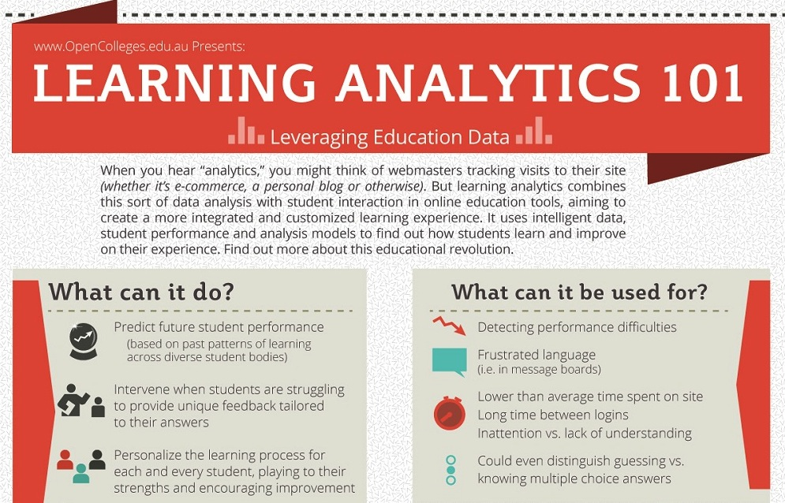
Learning analytics
Using gamified systems to improve students’ experiences
Institutions are (slowly) getting on board with gamification
Part of an infographic by www.opencolleges.edu.au

Slide 12
Presentation Overview
What are Bartle’s gamer types?
What is gamification?
What does gamified HE entail?
What the report was investigating
Results and conclusion
Further work and Evaluation
Questions

Slide 13
Modeling [sic] the player, learner and personality. Konnert et al., 2013
Compares Bartle types to Kolb Learning Style Index and Big 5
No interesting correlation between types
Little explanation offered as to why
Johannes Konert, Stefan Gobel, and Ralf Steinmetz. Modeling the player, learner and personality: Independency of the models of bartle, kolb and neo-ffi (big5) and the implications for game based learning. 7th European Conference on Games Based Learning, 2013.

