Slide 1

Papers, please!

Slide 2
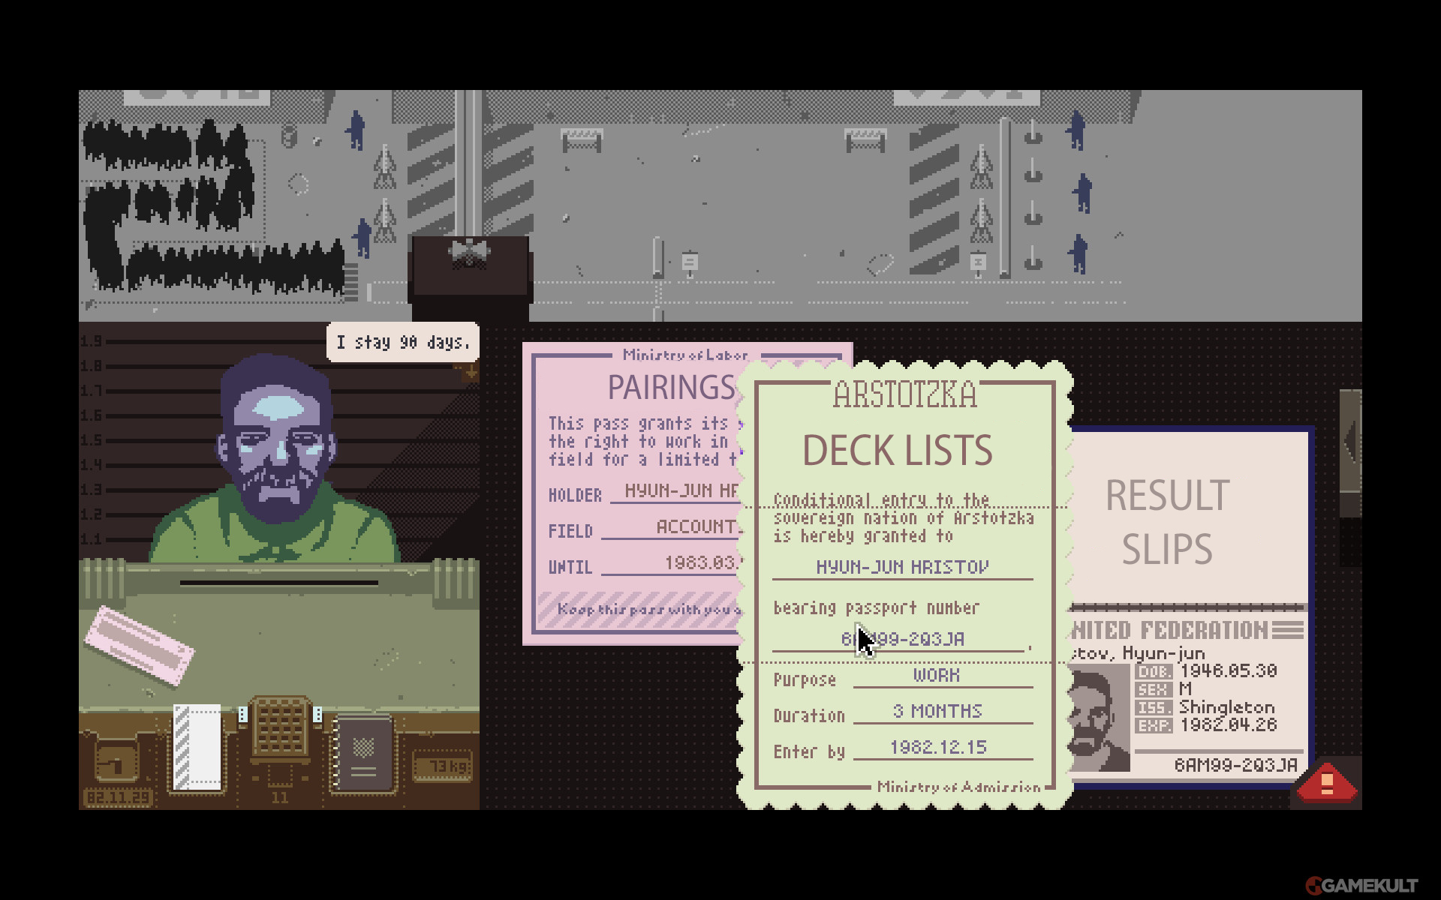

Slide 3
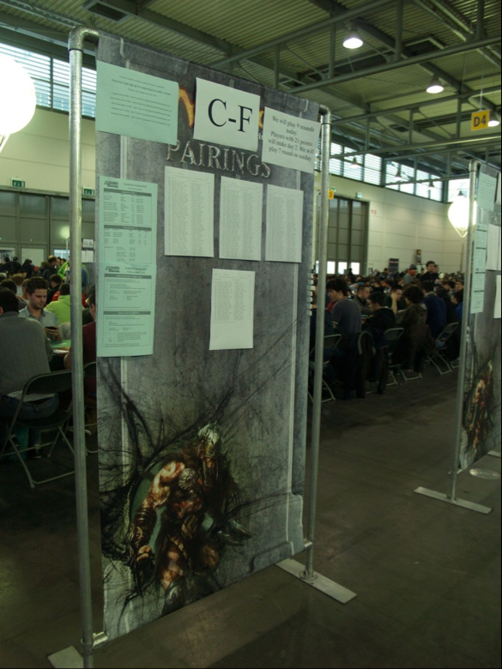
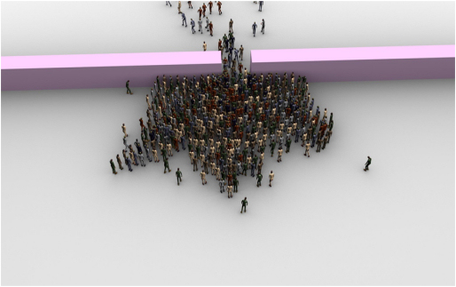
08:00 – Setting Up
Pairing boards placed far enough apart
Boards out of the way of bottlenecks
Pieces of tape stuck to boards

Slide 4
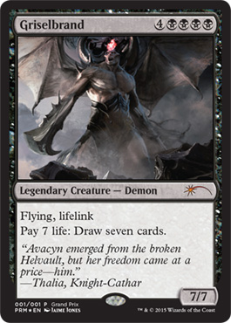
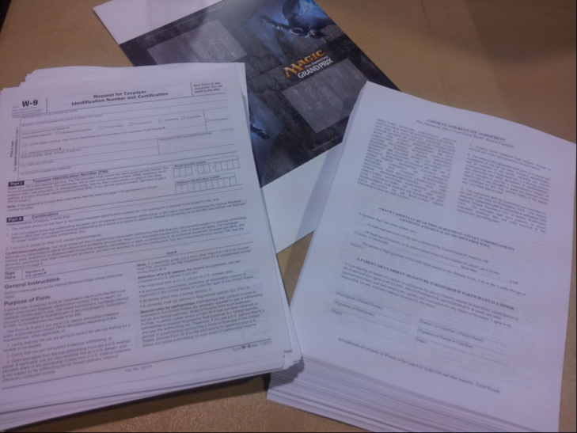
08:00 – Setting Up
Decklists, product, [foils], [waivers] ready
Piled by table size and location in the venue
Tasks delegated in advance!

Slide 5


Slide 6
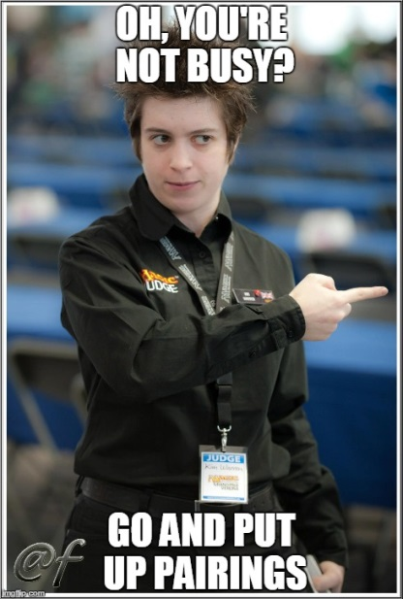
09:00 – Tournament Begins
Get a seat all for papers & deck checks!
Distribute sheets between team members
Try and have papers collected in order
Give pairings out to team members as soon as they are ready

Slide 7
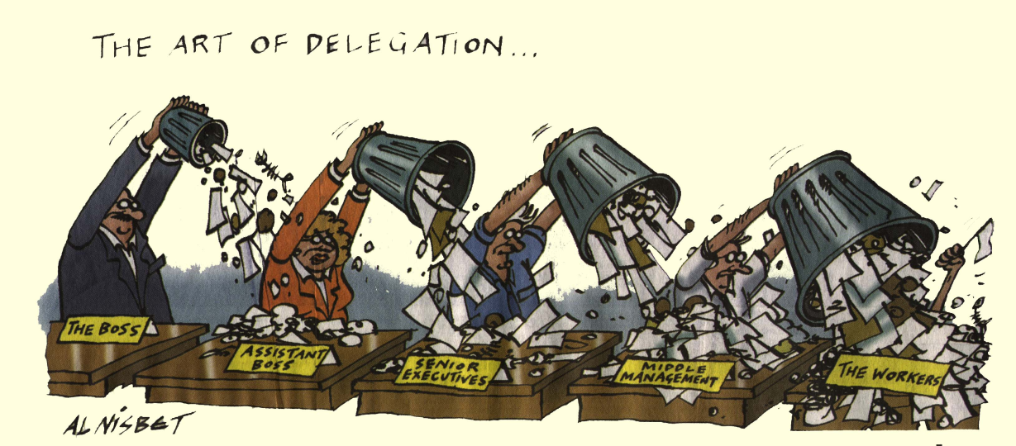
09:30 – Mid round 1
Get results slips printed
If you’re printing them yourself, use the cutting machine feature in WER
Get slips cut and distributed – ask other judges for help with this!

Slide 8
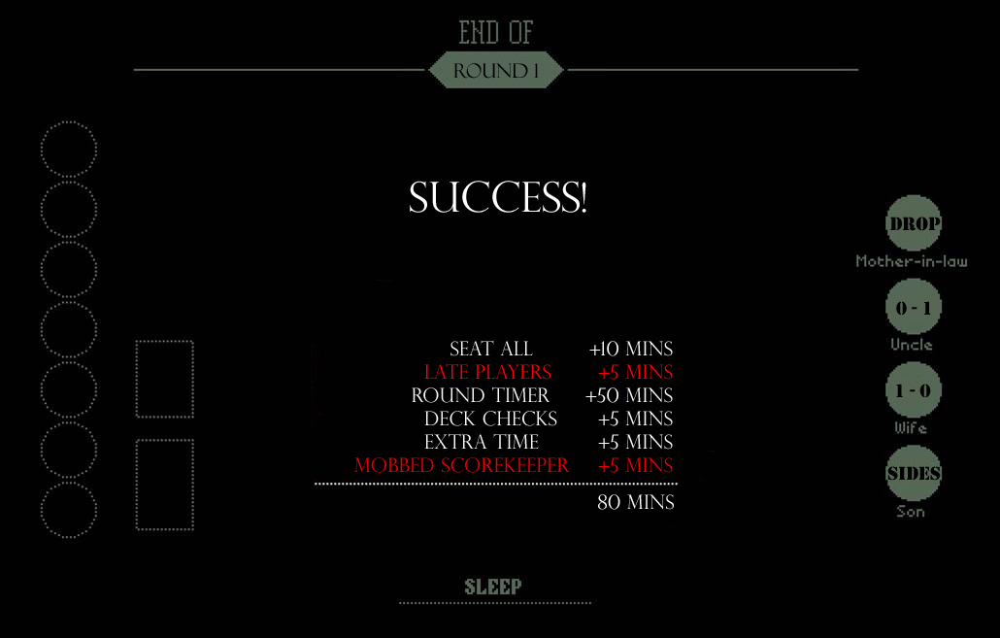

Slide 9
10:00 – End of round 1
Talk to the scorekeeper about how they want result slips (e.g. ordered)
Other judges should be watching tables by now – make sure they haven’t started hoarding result slips
Keep track of outstanding tables, and note down who you sent to each table
Track down missing results using the PA

