Slide 1
Mentorship
William Seymour | UK, Ireland & South Africa Judge Conference 2014

Slide 2
What is a mentor?
“an experienced and trusted adviser“
“an experienced person in a company or educational institution who trains and counsels new employees or students“

Slide 3
Should I mentor others?
Yes!
What if I can’t certify them?
Still yes!

Slide 4
Where can I mentor others?
At your local store
At events
OK, you get the idea…

Slide 5
Typical Learning Styles
Visual
Aural
Practical
Bookish?

Slide 6
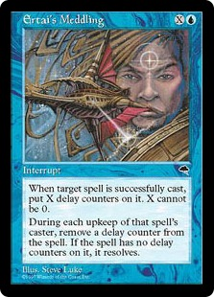
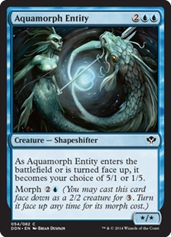
Picture the scene…

Slide 7
Oh s**t, a question
Find out what they’ve done to look for an answer
Tell them where they can find the answer
Don’t tell them the answer!

Slide 8
Example
What happens if Ertai’s Meddling is cast on a morph spell?
Well, a copy of the morph spell is placed onto the stack. As in, a 2/2 nameless colourless creature with no text. It doesn’t have a reverse face, because it’s a copy.
Which sections of the CR might be able to help you? Copying Objects seems like a good place to start.

Slide 9
“Spoon feeding in the long run teaches us nothing but the shape of the spoon.” ― E.M. Forster

Slide 10
At the event
Find out who the new kids on the block are
Find out what they’re interested in
Engage with them!

Slide 11
“Tell me and I forget, teach me and I may remember, involve me and I learn.”
― Benjamin Franklin

Slide 12
Recap
You should definitely be thinking about mentoring
Mentoring judge candidates
Mentoring other judges at events

Slide 13
mentorship.wseymour.co.uk
blogs.magicjudges.org/articles/2013/09/03/l3-qualities-mentorship/
blogs.magicjudges.org/articles/2014/09/23/the-feedback-process/

