Slide 1
01 / 29
THE HELP EXISTS. GETTING TO IT IS THE PROBLEM.
Paper Walls
Social determinants of health, document burden, navigation burden and resource access
PRESENTER
DATE
Matt Cochran · ZipShift Navigator
November 2026
ZIPSHIFT NAVIGATOR
Notes:
Thesis: For 175 years the evidence has said that where and how people live drives health more than clinical care. Today the help often exists on paper, but paperwork (administrative and document burden) and finding and reaching help (navigation burden) decide who actually gets it. Navigation tools and people close that gap. All figures in this deck are drawn from the project research files (research/01–04 and data CSVs).

Slide 2
PAPER WALLS
02 / 29
The law existed, the civil servants were there—and the people died in their thousands from starvation and disease. The law did not help, as it was only paper with writing…
RUDOLF VIRCHOW · REPORT ON THE TYPHUS EPIDEMIC IN UPPER SILESIA · 1848
Notes:
Context: about 10% of the Pless district died in one year. In Rybnik the typhus attack rate was 14.3% and case fatality 20.46%. Virchow concluded that 'medicine is a social science.' Source: Virchow (1848/2006), Report on the typhus epidemic prevailing in Upper Silesia, reprinted in American Journal of Public Health, 96(12).

Slide 3
PAPER WALLS
03 / 29
00 · Where health comes from
Living conditions drive health more than the clinic does
175 years of evidence point the same way.
Notes:
Section overview: models of what drives health, the historical record, and today's gaps in life expectancy, poverty and basic needs. Sources: see following slides; research/01-history.md and 04-data.md.

Slide 4
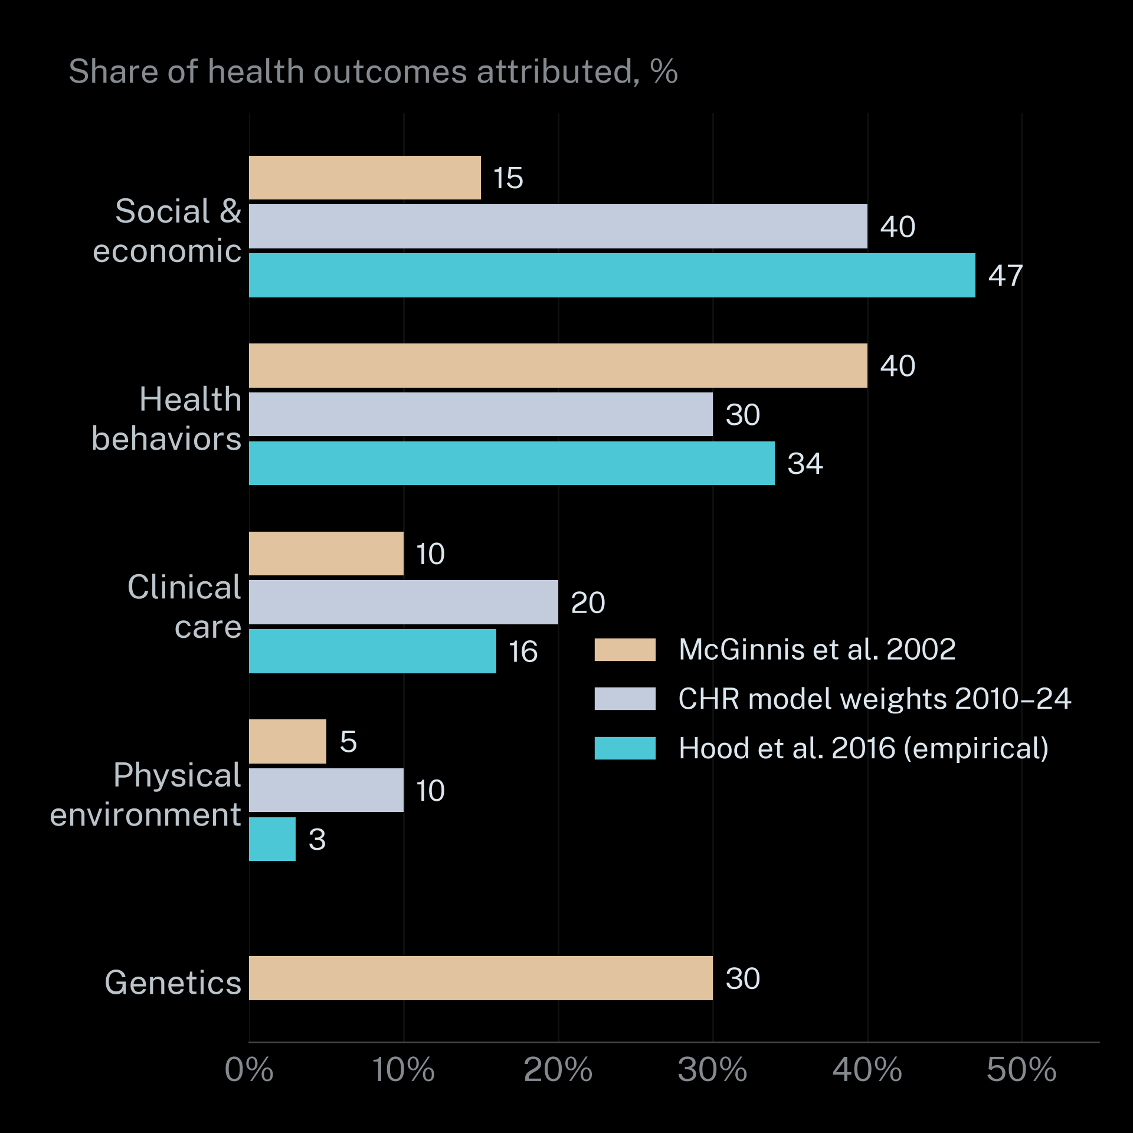
PAPER WALLS
04 / 29
Clinical care explains about one in six of the differences in health
Three models agree: social and economic conditions outweigh the clinic. The empirical estimate puts them at 47% against 16% for care.
Notes:
McGinnis et al. (2002): share of premature death — social circumstances 15, behaviors 40, clinical 10, environment 5, genetics 30. County Health Rankings weights 2010–2024 (Booske et al., 2010) — social & economic 40, behaviors 30, clinical 20, environment 10. Hood et al. (2016), empirical from county data — 47 / 34 / 16 / 3. Caveat (say aloud): 40/30/20/10 was a modeling choice, not a measurement; County Health Rankings retired it in 2025. The new model weights social & economic 50%, health infrastructure 25%, physical environment 25%. Sources: McGinnis, Williams-Russo & Knickman (2002); Booske et al. (2010); Hood et al. (2016).

Slide 5
PAPER WALLS
05 / 29
Science named the social causes of disease more than 175 years ago
1845
1848
1906
1930s
1980
Engels: Liverpool labourers die at 15 on average. The gentry at 35. He calls it 'social murder'.
Virchow: 'Medicine is a social science.'
Du Bois: mortality gaps are 'not a racial disease but a social disease'.
HOLC redlining maps grade neighborhoods by race and risk.
Black Report: class V infants die at 2× the rate of class I. 74,000 avoidable deaths.
Notes:
Also in this era: 1899 Du Bois, The Philadelphia Negro — house-to-house survey of 10,000+ residents; 1974 Lalonde Report — health field concept; 1978 Alma-Ata — inequality 'politically, socially and economically unacceptable'. Sources: Engels (1845); Virchow (1848/2006); Du Bois (1899; 1906); Nardone et al. (2020); Lalonde (1974); WHO (1978); Black et al. (1980).

Slide 6
PAPER WALLS
06 / 29
Policy caught up slowly and then turned to paperwork
1984
1995
2008
2022
2025
Whitehall I: the lowest civil-service grade has ~3× the mortality of the highest.
Link & Phelan: money, knowledge, power and connections are fundamental causes.
WHO Commission: 'Social injustice is killing people on a grand scale.'
CalAIM launches ECM and Community Supports. Medi-Cal adds CHW and peer support benefits.
H.R. 1 adds Medicaid work requirements and six-month renewals.
Notes:
Also: 1986 Ottawa Charter — prerequisites for health: peace, shelter, education, food, income; 1991 Dahlgren–Whitehead rainbow model; 2005 Patient Navigator Act (Pub. L. 109-18); 2010 Marmot Review, Healthy People 2020, County Health Rankings launch; 2016 Chetty et al. — 14.6-year (men) and 10.1-year (women) life expectancy gap between richest and poorest 1%; 2023–24 Medicaid unwinding — 25.2M disenrolled nationally, 69% procedural; 2025 County Health Rankings new model. Sources: Marmot et al. (1984); Link & Phelan (1995); CSDH (2008); DHCS (2026); CBO (2025); KFF (2024).

Slide 7
PAPER WALLS
07 / 29
The social gradient in health has never gone away
STUDY
PLACE AND TIME
GAP
Engels
Liverpool 1840
Age at death 35 vs 22 vs 15 by class
Du Bois
Philadelphia 1896–1905
Deaths per 1,000: 18.72 all vs 22.02 Black residents
Whitehall I
UK civil service (n = 17,530)
≈3× mortality in lowest vs highest grade
Chetty et al.
United States 2016
Top vs bottom 1%: 14.6 yrs men · 10.1 yrs women
Notes:
Sources: Engels (1845); Du Bois (1899); Marmot et al. (1984); Chetty et al. (2016), JAMA. Note: Du Bois's source prints the gap as 3.80; the two rates (18.72 vs 22.02) are shown as printed rather than the printed difference.

Slide 8
PAPER WALLS
08 / 29
Redlined neighborhoods in California still send more children to the ER for asthma
63.5
26.5
1.39
0.36
Asthma ED visits · D-grade
Asthma ED visits · A-grade
Adjusted rate ratio
Greenspace · D-grade
Per 10,000 per year in redlined tracts across 8 California cities incl. Fresno and Stockton.
The same measure in 'best' graded tracts: a 2.4× gap.
Redlined vs A-grade tracts after adjustment.
Mean NDVI across 102 U.S. cities vs 0.47 in A-grade areas.
Notes:
Nardone et al. (2020), Lancet Planetary Health: 8 California cities (Fresno, Los Angeles, Oakland, Sacramento, San Diego, San Jose, San Francisco, Stockton); asthma ED visits A 26.5 vs D 63.5 per 10,000/yr; adjusted RR 1.39. Nardone et al. (2021), Environmental Health Perspectives: NDVI A 0.47, B 0.43, C 0.39, D 0.36.

Slide 9
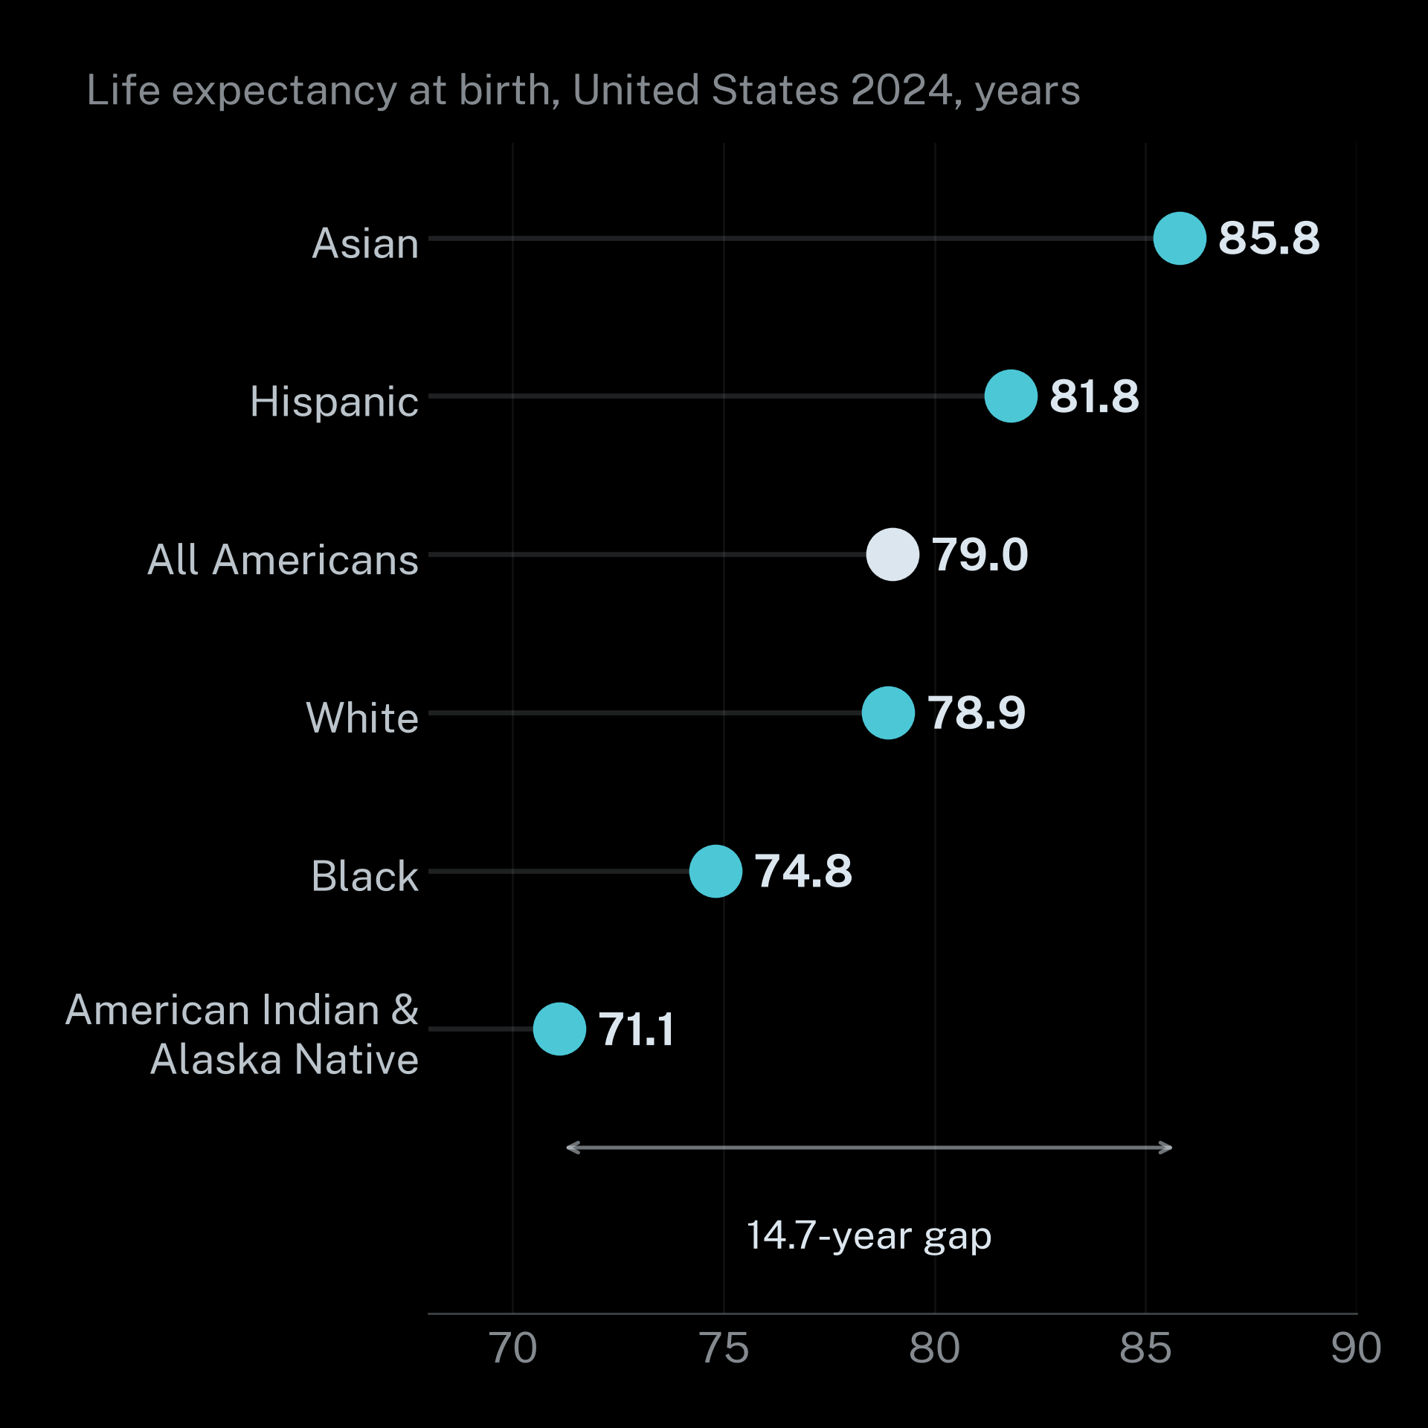
PAPER WALLS
09 / 29
A child born today faces a 14.7-year life expectancy gap by race
Asian Americans live to 85.8 on average. American Indian and Alaska Native people live to 71.1.
Notes:
Life expectancy at birth, 2024: Asian 85.8, Hispanic 81.8, all origins 79.0, White 78.9, Black 74.8, American Indian and Alaska Native 71.1. Source: Arias, Xu & Tejada-Vera (2026), United States life tables, 2024, NVSR 75(5), NCHS.

Slide 10
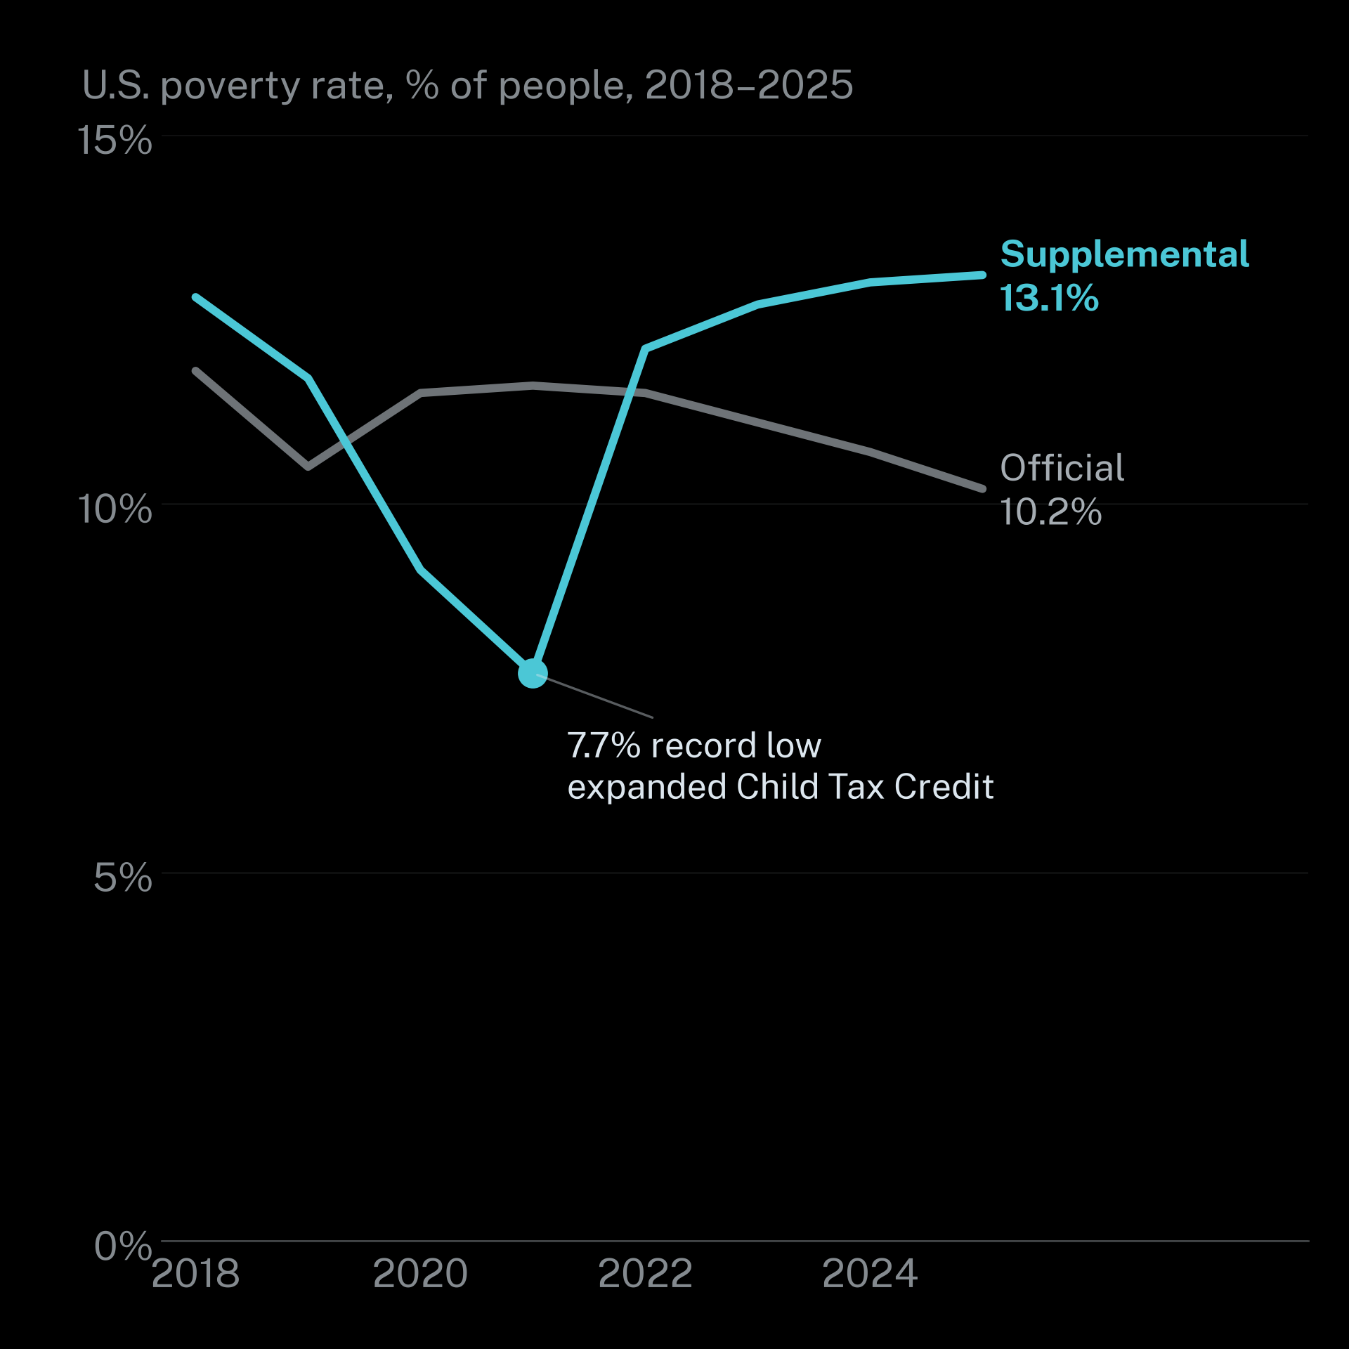
PAPER WALLS
10 / 29
The official poverty rate hides millions who cannot cover real costs
California's supplemental rate is 17.8% (2023–25), second highest of any state, against 10.7% official.
Notes:
Official vs Supplemental Poverty Measure (SPM), U.S.: 2018 11.8/12.8; 2019 10.5/11.7; 2020 11.5/9.1; 2021 11.6/7.7 (expanded Child Tax Credit, record low); 2022 11.5/12.1; 2023 11.1/12.7; 2024 10.7/13.0 (revised); 2025 10.2/13.1. Policy works: child SPM poverty fell to 5.1% in 2021. California SPM 17.8% (2023–25 average), 2nd highest state. Sources: Bijou & Shrider (2026), Poverty in the United States: 2025 (P60-290), Tables 3, 8, 17; Shrider & Bijou (2025).

Slide 11
PAPER WALLS
11 / 29
Unmet housing and food needs are common rather than rare
49%
13.7%
745,652
37%
Renters cost-burdened
Patients with an unmet need
22.7M U.S. renter households in 2024, a record. Under $30k: $210 a month left.
Of 1.1M+ screened in CMS AHC. Food 63% and housing 47% of those.
Households food insecure
People homeless
2025 point-in-time count. California holds 181,934 of them, about 24%.
2024 in USDA's final report. The series ended in September 2025.
Notes:
Sources: Joint Center for Housing Studies of Harvard University (2026), America's Rental Housing; USDA ERS (2026), Household food security in the United States in 2024; HUD (2025), Annual Homelessness Assessment Report (AHAR) Part 1; RTI International (2026a), CMS Accountable Health Communities final evaluation; RTI International (2023) for need breakdown.

Slide 12
PAPER WALLS
12 / 29
01 · Paper walls
Paperwork is policy and it decides who gets help
Burden = learning costs + compliance costs + psychological costs + redemption costs.
Notes:
'Paperwork is policy' (OIRA, 2023, p. 16). Herd & Moynihan (2018) define administrative burden as learning, compliance and psychological costs; OIRA (2023) adds redemption costs — the work of using a benefit once you have it. Scarcity taxes bandwidth: financial worry lowered cognitive performance about as much as a 13-point IQ drop (Mani, Mullainathan, Shafir & Zhao, 2013; Mullainathan & Shafir, 2013). Lowrey (2021) calls it a 'time tax': 'a levy of paperwork, aggravation, and mental effort imposed on citizens in exchange for benefits that putatively exist to help them.' A disability beneficiary on recertification: 'More frightening than having cancer—twice.' (Lowrey, 2021).

Slide 13
PAPER WALLS
13 / 29
More than $140 billion in benefits goes unclaimed every year
$140B+
81%
77.4%
53.5%
CalFresh take-up
California FY2022 against 88% for SNAP nationally.
Unclaimed each year
EITC take-up
WIC coverage
California tax year 2022 against 80.8% nationally.
U.S. 2022. Only 25.4% of eligible 4-year-olds and 19% in nonmetro areas.
Federal benefits people qualify for but never receive.
Notes:
Sources: OIRA (2023), Strategies for reducing administrative burden in public benefit and service programs; USDA FNS SNAP participation rates FY2022; IRS EITC Central participation rates (2026 page); Kessler, Bryant, Munkacsy & Gray (2024), WIC eligibility and program reach in 2022.

Slide 14
PAPER WALLS
14 / 29
Nearly half of applicants report difficulty enrolling in safety-net programs
Share of applicants who reported difficulty enrolling, by program.
Unemployment insurance
46%
Cash assistance
43%
SNAP
41%
Rental assistance
32%
SSDI
29%
Medicaid / CHIP and SSI (each)
28%
Notes:
Source: Urban Institute (December 2021) survey, as reported in OIRA (2023).

Slide 15
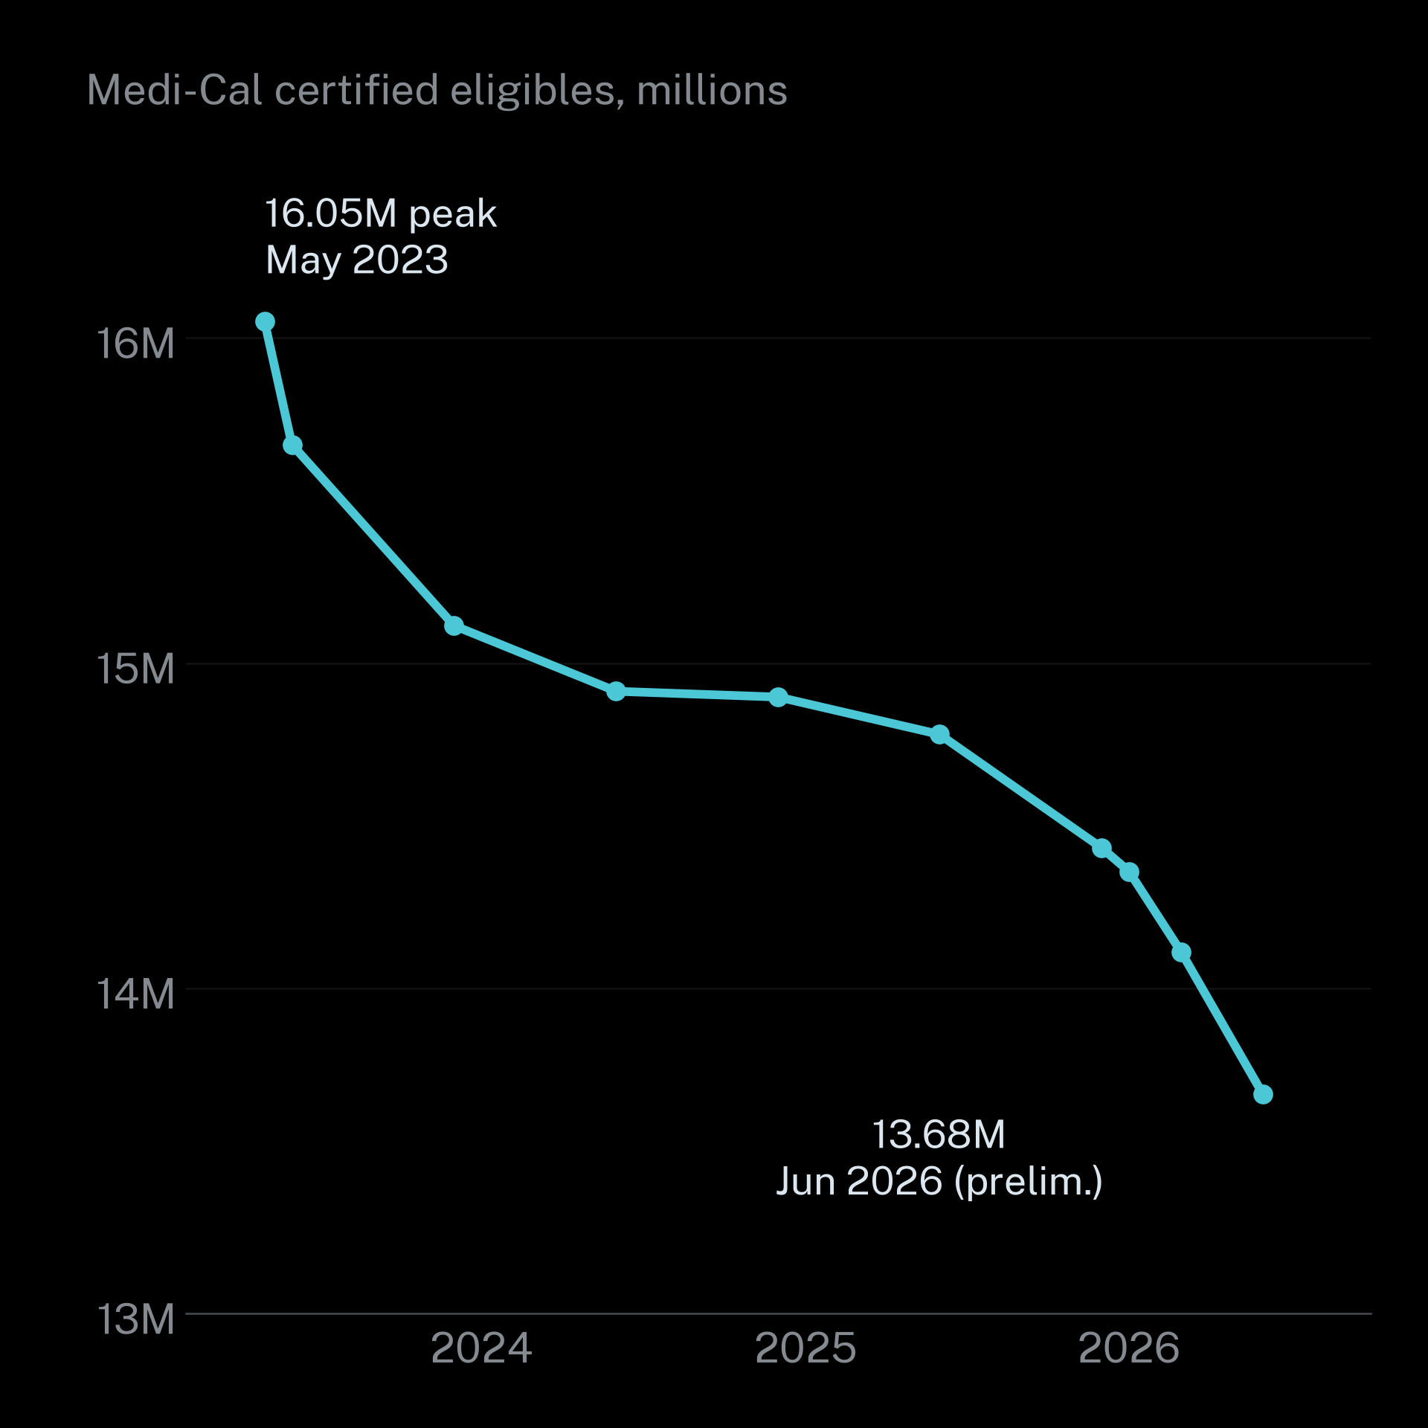
PAPER WALLS
15 / 29
Medi-Cal has shed 2.4 million members since the 2023 peak
90% of first disenrollments in the unwinding were procedural: paperwork rather than ineligibility.
Notes:
Medi-Cal certified eligibles: May 2023 16.05M (peak); Jun 2023 15.67M; Dec 2023 15.12M; Jun 2024 14.91M; Dec 2024 14.90M; Jun 2025 14.78M; Dec 2025 14.43M; Mar 2026 14.11M; Jun 2026 13.68M (preliminary). 1,998,710 Californians lost Medi-Cal in the unwinding; 90% of initial disenrollments were procedural, 66% after 90-day updates; non-MAGI (seniors and people with disabilities) 83%. Nationally 25.2M disenrolled, 69% procedural. Auto (ex parte) renewals rose from 31% to 63%. Sources: DHCS (2026), Medi-Cal Fast Facts (Sept 2026 edition; May 2023 peak from May 2026 edition); CHCF (2024); Tolbert & Corallo (2024), KFF.

Slide 16
PAPER WALLS
16 / 29
Nearly half of people who lost Medi-Cal never received a renewal form
Survey of 8,481 people who lost Medi-Cal. Not weighted or representative.
Never received a renewal form
46%
Want coverage back but don't know how
36%
Callers got no answer or a long hold
31%
Didn't know coverage would end
30%
Couldn't complete the form
23%
Notes:
Gaps were larger for Hispanic respondents (28% couldn't complete the form vs 18% White) and Spanish-only households (46% don't know how to restart vs 30% White). Caveat: survey not weighted or representative. Source: DHCS/CHCF (2024) Medi-Cal disenrollment survey.

Slide 17
PAPER WALLS
17 / 29
CalFresh families are six times more likely to leave in a paperwork month.
55–75% of leavers are still income-eligible. About 500,000 eligible households exit each year.
Notes:
Source: Unrath (2021), California Policy Lab, Understanding CalFresh churn.

Slide 18
PAPER WALLS
18 / 29
Low-income adults are the least likely to hold the ID that unlocks help
U.S. adult citizens without an unexpired driver's license, 2023. 20.76M in total (9%).
Income under $30k
23%
People with a disability
20%
Black
18%
Hispanic
15%
Asian / Pacific Islander
13%
White
5%
Notes:
2.6M adult citizens have no government photo ID at all. Homeless clients without ID denied services in a month: shelter 54.1%, food stamps 53.1%, SSI 51.1%, Medicaid 45.1% (2004 provider survey, NLCHP). SSA initial disability decisions took 217.5 / 231.1 / 226.2 days in FY2023–25. Note: the license figures are national, not California-specific. Sources: CDCE/UMD et al. (2024); NLCHP (2004); SSA (2026).

Slide 19
PAPER WALLS
19 / 29
Work requirements are the next wall and Arkansas shows where it leads
Arkansas 2018
H.R. 1 (2025)
California dates
18,000 lost coverage. Uninsured ages 30–49 rose 10.5% → 14.5%. No employment gain.
Adds 10.0M uninsured by 2034. Work requirements alone: 5.3M.
Work rules Jan 1 2027 (delay requested). Six-month renewals Mar 1 2027.
Notes:
Arkansas: >95% of those subject already met the requirement or should have been exempt; among those who lost coverage, 50% reported medical debt, 56% delayed care, 64% delayed medications (Sommers et al., 2019; 2020). H.R. 1: CBO (2025-10-28) and CRS (2025). California: DHCS has asked CMS for a 6-month delay of work requirements; immigrant-eligibility changes took effect Oct 1, 2026 (DHCS, 2026).

Slide 20
PAPER WALLS
20 / 29
02 · Navigation burden
Referrals rarely become help without someone to navigate
Help exists but people must find it, qualify, get there and keep up.
Notes:
Framing from research/03-navigation.md. Every step — find, qualify, get there, keep it — is a place to drop out.

Slide 21
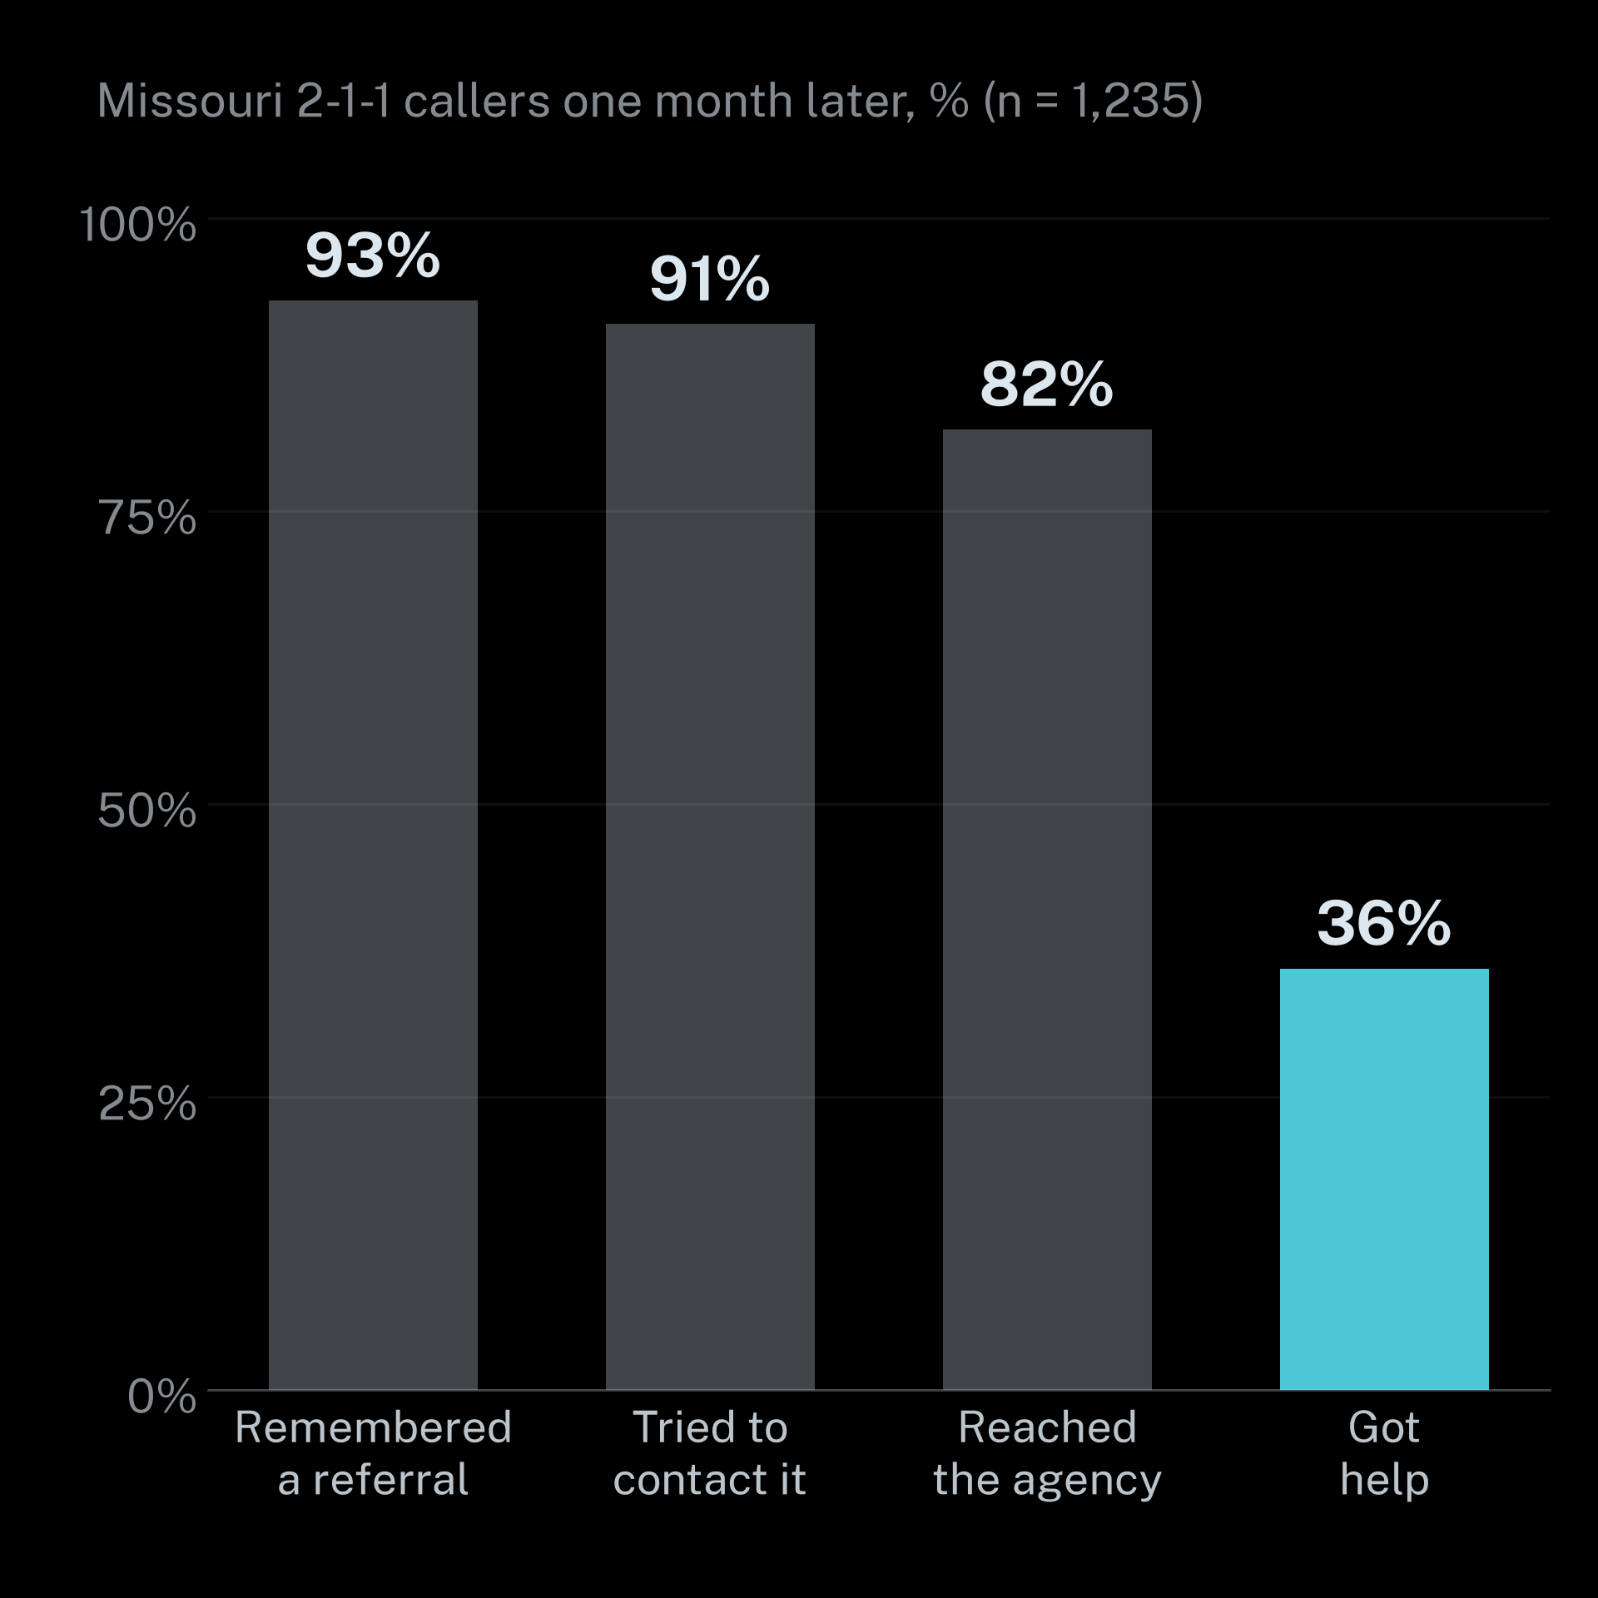
PAPER WALLS
21 / 29
Only 36% of 2-1-1 callers actually got the help they were referred to
82% reached an agency. Help ranged from 17% for housing to 67% for food.
Notes:
Missouri 2-1-1 callers, one month later (n = 1,235): 93% remembered a referral, 91% tried to contact it, 82% reached one, 36% received help (17% housing to 67% food). Source: Boyum et al. (2016).

Slide 22
PAPER WALLS
22 / 29
A closed referral is not the same as a connected person
65% → 38%
3.6M
36%
54% vs 94%
Miss care for lack of a ride
Basic or below
Share of U.S. adults with basic or below basic health literacy.
Americans each year who do not obtain medical care.
Actually connected
Home broadband
Duke / NCCARE360 while the platform marked 99% then 93% 'closed'.
Under $30k vs $100k+. 34% of low-income adults are smartphone-only.
Notes:
In the CMS AHC model more than half of navigated beneficiaries had no needs resolved, and navigators could not track which organizations had capacity. Sources: Johnson et al. (2024), NCCARE360/Unite Us at Duke; Wallace et al. (2005) for transportation; Kutner et al. (2006) for health literacy; McClain & Bishop (2026), Pew Research Center, for broadband; RTI International (2026a) for AHC.

Slide 23
PAPER WALLS
23 / 29
03 · What works
Navigation and simpler systems close the gap
People and plain processes turn eligibility into help.
Notes:
Section overview: evidence that navigation, community health workers, simpler forms and automatic renewals improve outcomes; then the local picture in Stanislaus and Merced. Sources on following slides.

Slide 24
PAPER WALLS
24 / 29
Navigators and community health workers improve outcomes and save money
INTERVENTION
RESULT
SOURCE
Harlem patient navigation
Early-stage diagnosis 6% → 41%. 5-yr survival 39% → 70%
Freeman & Rodriguez 2011
CHW IMPaCT trial
$2.47 returned per Medicaid dollar
Kangovi et al. 2020
CMS AHC navigation
>$200M net savings. Costs −3% Medicaid and −4% Medicare
RTI International 2026
Notes:
Harlem 1990 results are before/after (free screening plus navigation), not randomized: stage I 6% before vs 41% early stage (0–I) after; 5-year survival 39% → 70%. IMPaCT: $2.47 returned per $1 to a Medicaid payer within one fiscal year (sensitivity $1.84–$3.09). AHC: >$200M net savings. Sources: Freeman & Rodriguez (2011), Cancer; Kangovi et al. (2020), Health Affairs; RTI International (2026b).

Slide 25
PAPER WALLS
25 / 29
Simpler forms and automatic renewals keep eligible people enrolled
72% → 94%
40 → 16
31% → 63%
10 of 12
Minutes to finish
Medi-Cal auto-renewals
Community Supports
The same Michigan redesign cut completion time by more than half.
Michigan form completion
Ex parte renewals that need no paperwork from the member.
CalAIM services studied that showed net cost reductions.
After a plain-language redesign of the benefits application.
Notes:
Michigan Project Re:form (Civilla) as reported by Lowrey (2021). Medi-Cal ex parte renewal rate: CHCF (2024). CalAIM Community Supports cost-effectiveness, e.g., housing deposits −15.2%, medically tailored meals −10.5%: DHCS (2026b) ILOS report.

Slide 26
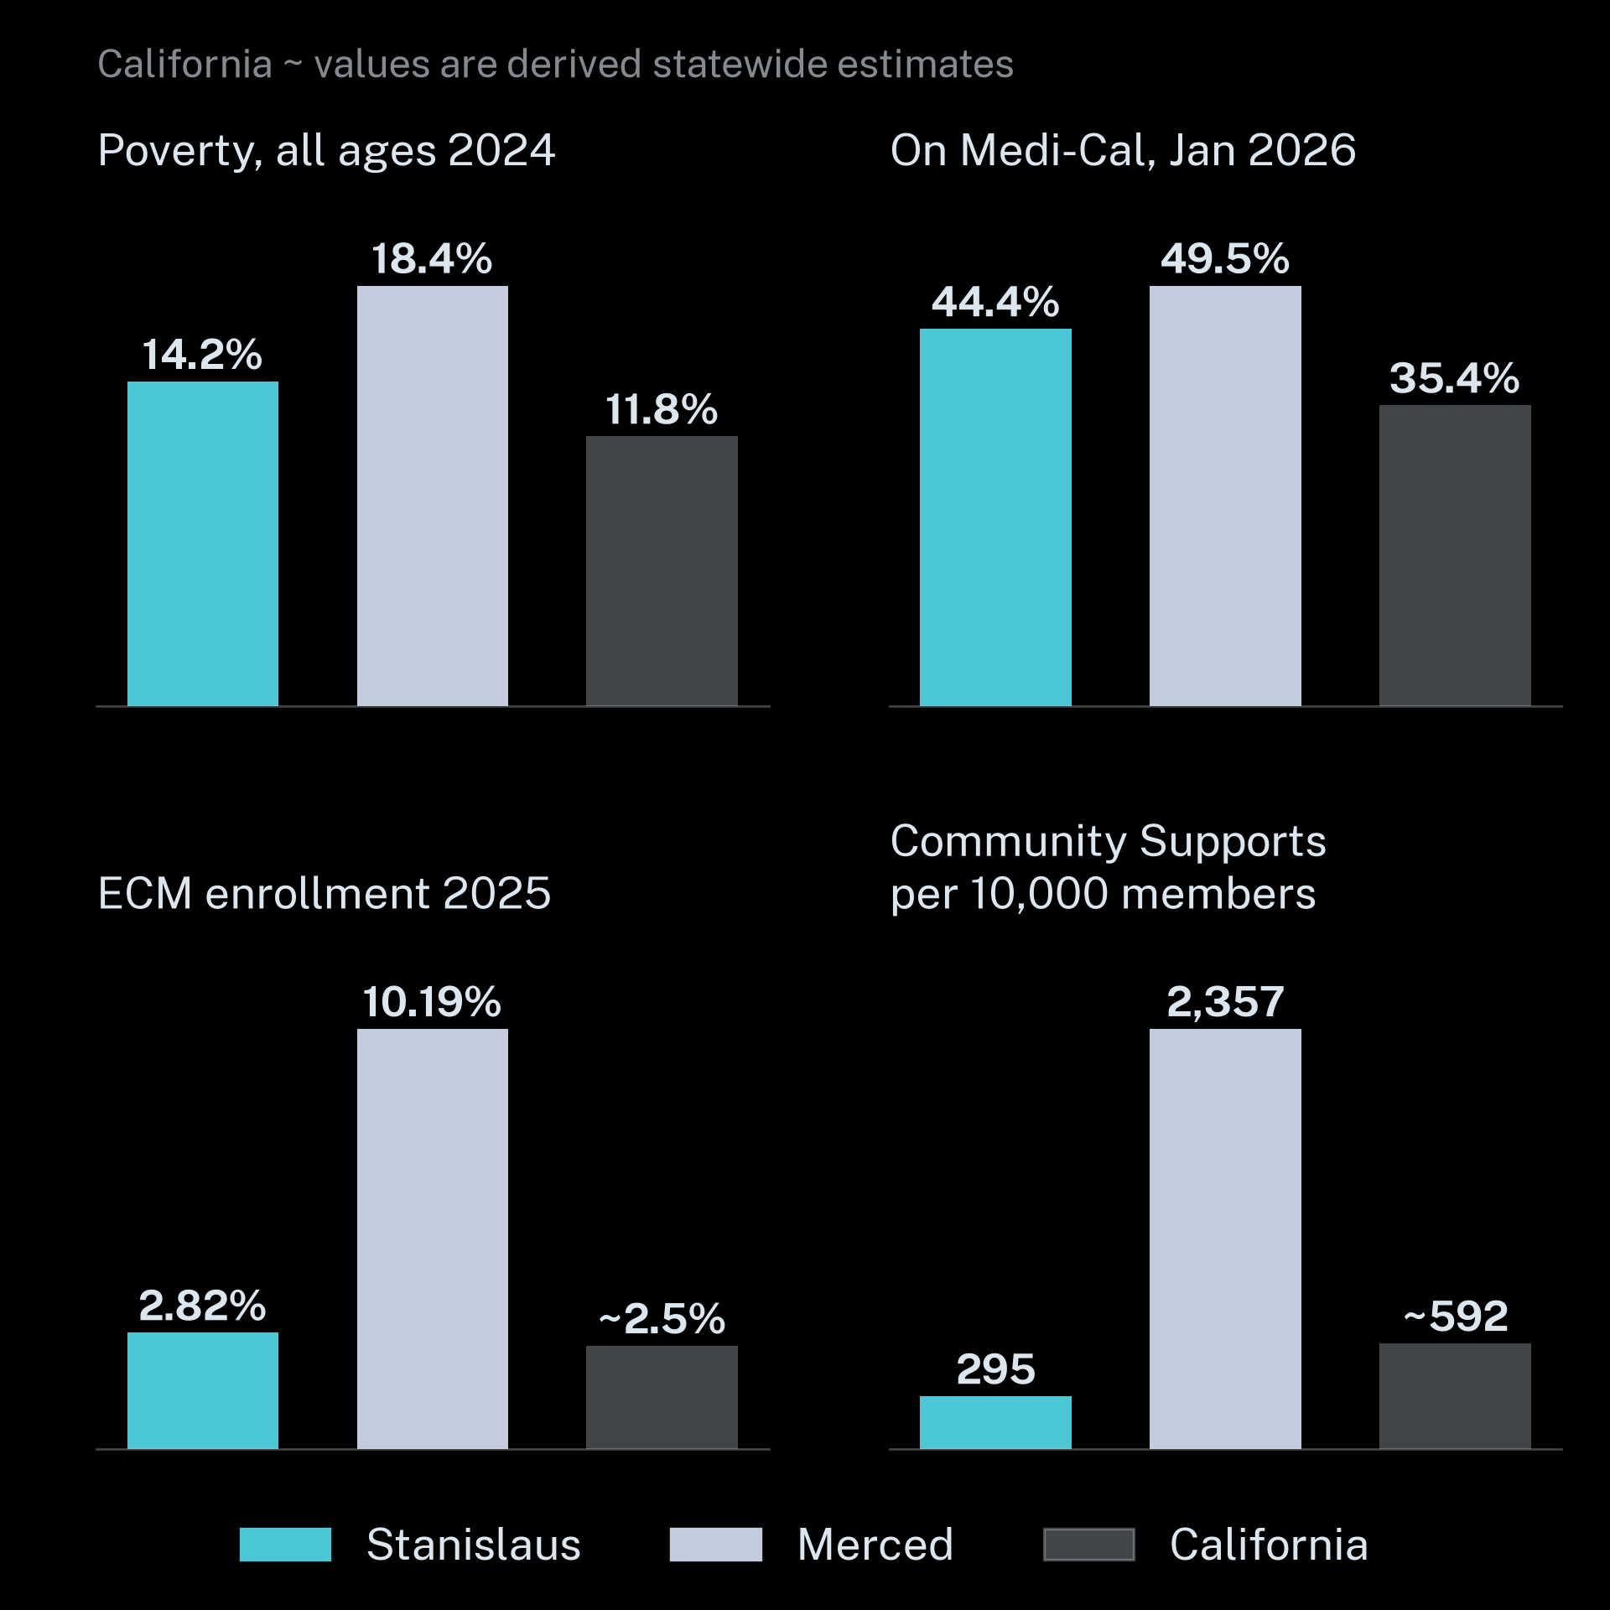
PAPER WALLS
26 / 29
Merced is poorer than Stanislaus yet reaches 3.6× more members with care management
Navigation capacity rather than need explains the gap. ECM ranks: Merced 1st and Stanislaus 23rd of 58.
Notes:
Stanislaus / Merced / California: poverty 2024 14.2 / 18.4 / 11.8%; life expectancy 2021–23 75.9 / 76.8 / 79.7 (US 77.6); food insecurity 2023 14.2 / 17.7 / 13.7%; on Medi-Cal Jan 2026 44.4 / 49.5 / 35.4%; children on Medi-Cal 59 / 69 / 50.9%; ECM enrollment 2025 2.82% (rank 23/58) vs 10.19% (rank 1/58), CA ~2.5% (derived); Community Supports services per 10,000 members 295 (rank 49) vs 2,357 (rank 3), CA ~592 (derived). Sources: U.S. Census Bureau SAIPE 2024; County Health Rankings & Roadmaps (2026); DHCS (2026a) Medi-Cal eligibles by county Jan 2026; DHCS (2026a) ECM and Community Supports quarterly implementation report.

Slide 27
PAPER WALLS
27 / 29
Navigation tools should carry the paper so people do not have to
FIND
QUALIFY
GET THERE
KEEP IT
One place in plain language at a 5th-grade reading level and in many languages.
Pre-screen eligibility and list the documents needed up front.
Transit, hours, phone and text. Offline-friendly on smartphones.
Renewal reminders and warm handoffs. Measure successful connection rather than 'closed'.
Notes:
Design principles drawn from the evidence above: smartphone-only access among low-income adults (McClain & Bishop, 2026), health literacy (Kutner et al., 2006), procedural disenrollment (CHCF, 2024), closed vs connected referrals (Johnson et al., 2024).

Slide 28
PAPER WALLS
28 / 29
ZIPSHIFT NAVIGATOR
Build for the person holding the paper
Open source community resource and referral app for Stanislaus County and beyond.
PROJECT
CONTACT
github.com/mcochranca-code/zipshift-navigator
Matt Cochran
Notes:
Call to action: fund and staff navigation, simplify renewals, and measure successful connection. ZipShift Navigator link: github.com/mcochranca-code/zipshift-navigator.

Slide 29
PAPER WALLS
29 / 29
References are listed in full in the accompanying bibliography.
APA 7 · Every figure is cited in that slide's speaker notes.
Notes:
Full APA 7 reference list: deliverables/bibliography.md (compiled from research/01-history.md, 02-admin-burden.md, 03-navigation.md, 04-data.md).

